Slide 1



CliniConnect: Connecting Patients with Clinics

Slide 2

Team members:
Mohamed Hesham Mohamed Ghonem
Youssef Mohamed Mahmoud
Ali Ayman Ali
Abdallah Tarek Abdallah

Slide 3
Problem Statement
Despite rising demand for healthcare services in Egypt, clinic utilization remains low due to inefficient scheduling, fragmented communication between clinics and doctors, and high patient no-show rates. Existing platforms focus mainly on patient-facing booking or pharmacy delivery, leaving a gap in B2B solutions that optimize clinic–doctor workflows. This inefficiency results in lost revenue for clinics, underutilized medical capacity, and reduced patient access to timely care.

Slide 4
Introduction to CliniConnect
CONNECTING PATIENTS
CliniConnect is designed to seamlessly connect patients with local clinics, enhancing access to essential medications through an intuitive interface.
KEY FEATURES
Users can easily locate nearby clinics, and book consultations, ensuring a comprehensive healthcare experience at their fingertips.

Slide 5
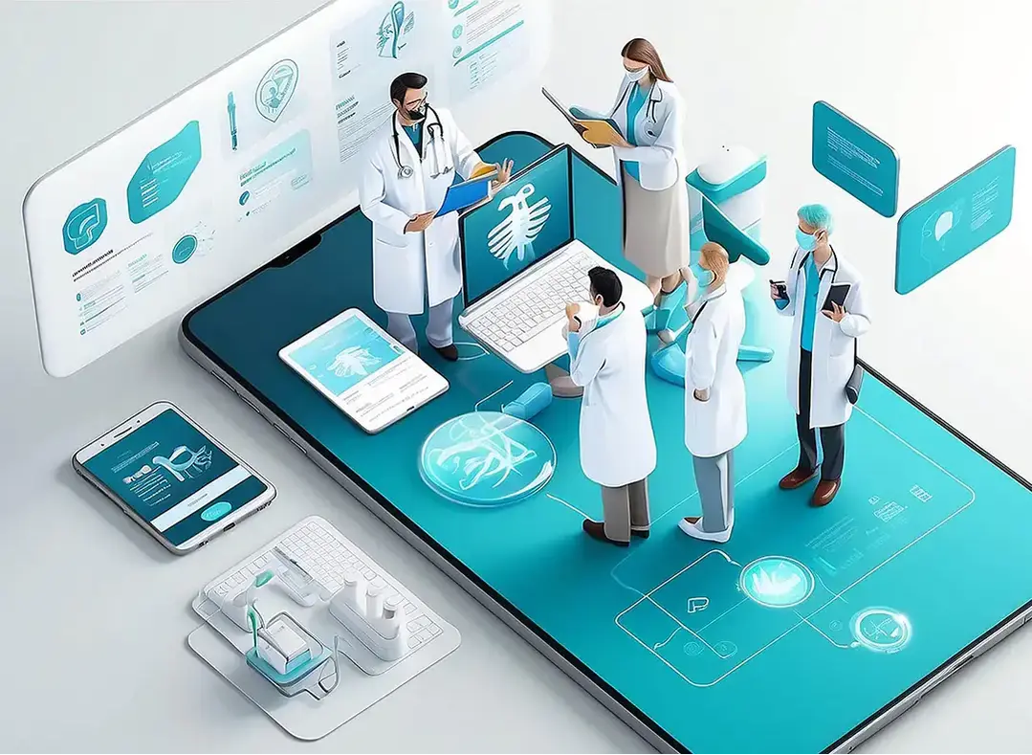
Market Context
HEALTHCARE LANDSCAPE IN EGYPT
Egypt's healthcare system is evolving, with increasing demand for digital solutions that enhance patient access to pharmacies and streamline medication procurement.
The Egypt digital health platforms market is
valued at more than 100 million USD by 2024.

Slide 6

Competitors
Competitor | Focus Area | Founded in
Vezeeta | Doctor booking, teleconsultation, practice management | 2012
Yodawy | Digital pharmacy, prescription delivery, insurance integration | 2018
Chefaa | Online pharmacy & chronic medication delivery | 2017
7keema | Home healthcare services (nurses/doctors on-demand) | 2017
Estshara | Teleconsultation platform | 2018

Slide 7
Why We Decided to make CliniConnect?
Targeting a vital sector: healthcare, with continuous non-seasonal demand
Significant opportunities for digital transformation in Egypt, especially in booking and time management
Low clinic utilization rates confirm a problem worth solving

Slide 8

Why Is it suitable as a business?
The idea is easily scalable as a digital platform connecting two parties: patient and clinic
Clear revenue streams: booking commissions, clinic subscriptions, and extra services like reminders or tele-consultation
The platform improves clinic operational efficiency, creating real value for both sides, not just users

Slide 9
What is the data role?
Data is a core element, not just reporting
Descriptive analysis revealed demand size, top specialties, and peak times
Key insights like clinic utilization exposed a major gap, enabling data-driven solutions such as better appointment distribution and reduced no-shows

Slide 10
STRENGTHS
SWOT Analysis of CliniConnect
CliniConnect leverages local market knowledge to create a user-friendly platform that simplifies patients’ interactions in Egypt's healthcare landscape. Also, it will get revenue from all the clinics contracted with it as of marketing and the process.
WEAKNESSES
As a new entrant, CliniConnect faces technology adoption barriers among users and must ensure strong cooperation from clinics to succeed.

Slide 11
Opportunities and Threats
Opportunities
The increasing demand for digital health solutions presents significant opportunities for CliniConnect to enhance patient access and convenience in Egypt.
Threats
Regulatory changes and competition from established players pose challenges, potentially impacting CliniConnect’s market entry and growth strategies in the healthcare landscape.

Slide 12
Project Steps:
Data Exploration
Data Cleaning
Data Modeling
Insights Extraction
Dashboard Creation

Slide 13
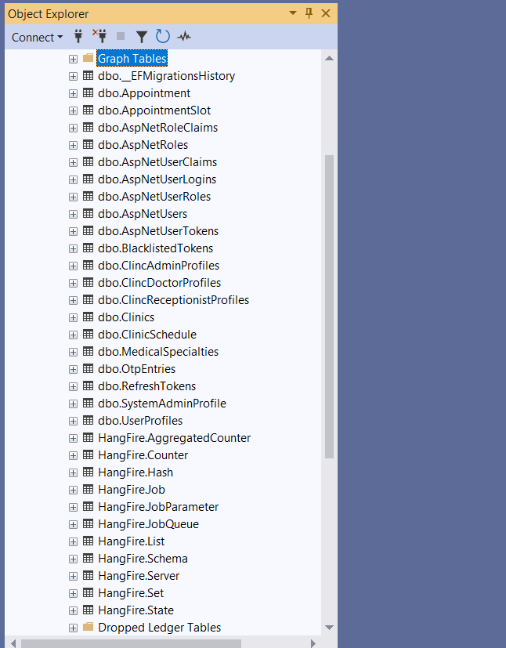
The data was received from the backend team as a backup file, so we explored it through Sql Server Management Studio and found 32 tables each had its own attributes, while lots of them was for related to the backend code, we extracted the needed information from 7 tables
Data Exploration

Slide 14
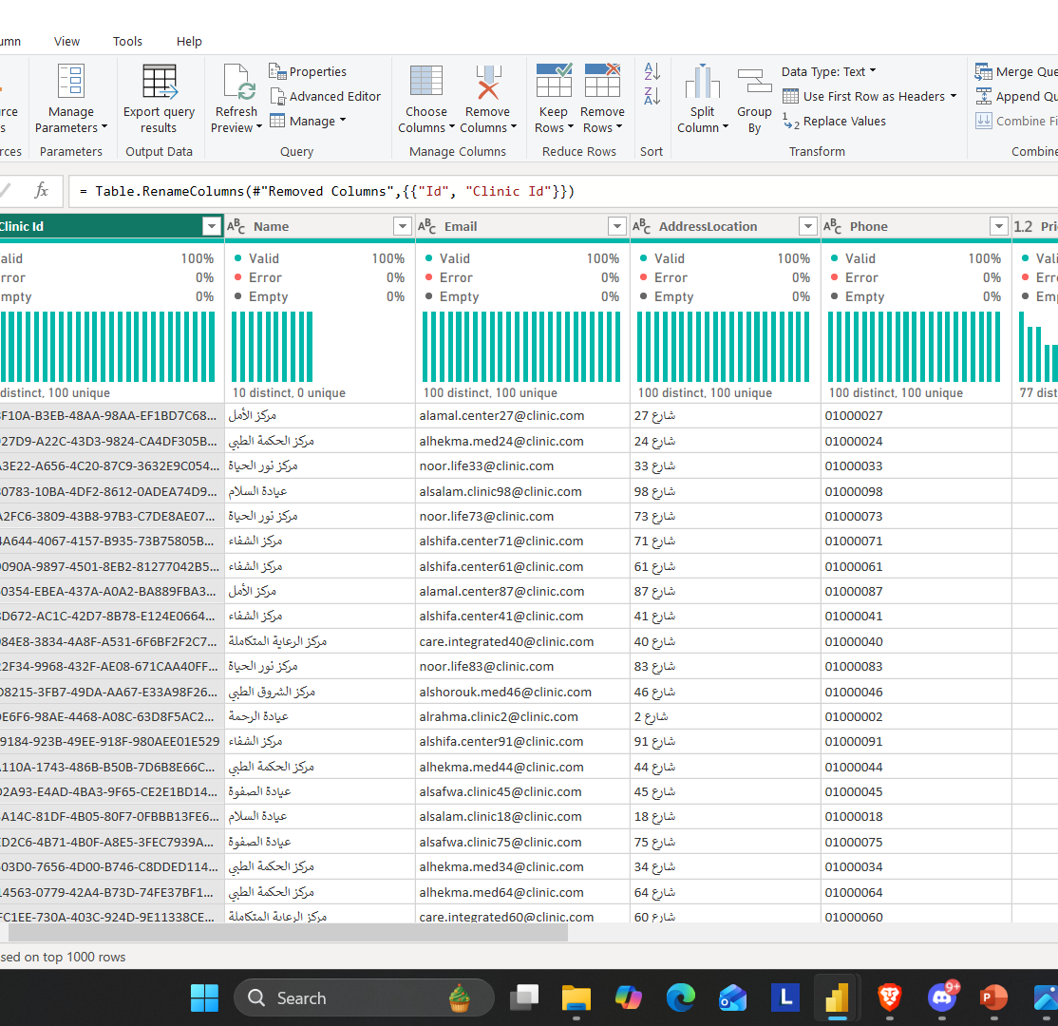
Data Cleaning
The dataset was reviewed and cleaned to improve quality and usability. All null (empty) tables and columns containing no meaningful data were identified and removed. This process ensured that the remaining data is relevant, complete, and consistent, making it suitable for accurate analysis and reporting.

Slide 15
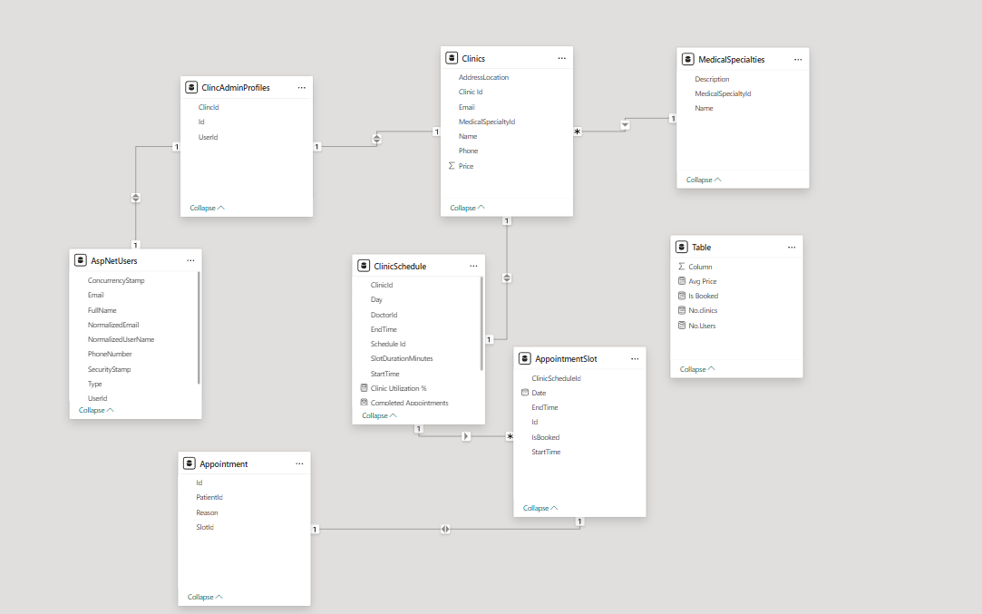
Data Modeling

Slide 16
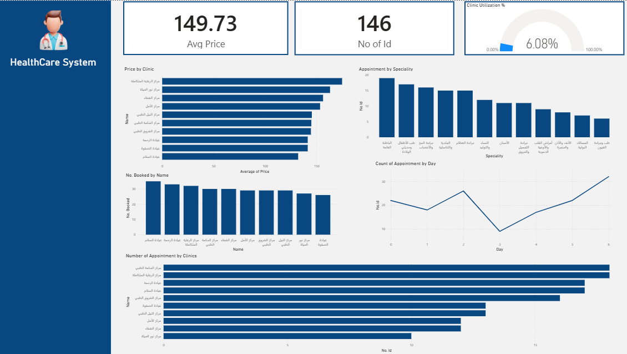
Dashboard

Slide 17
Connecting Egypt to Better Medical Access
Thanks!!

