Slide 1
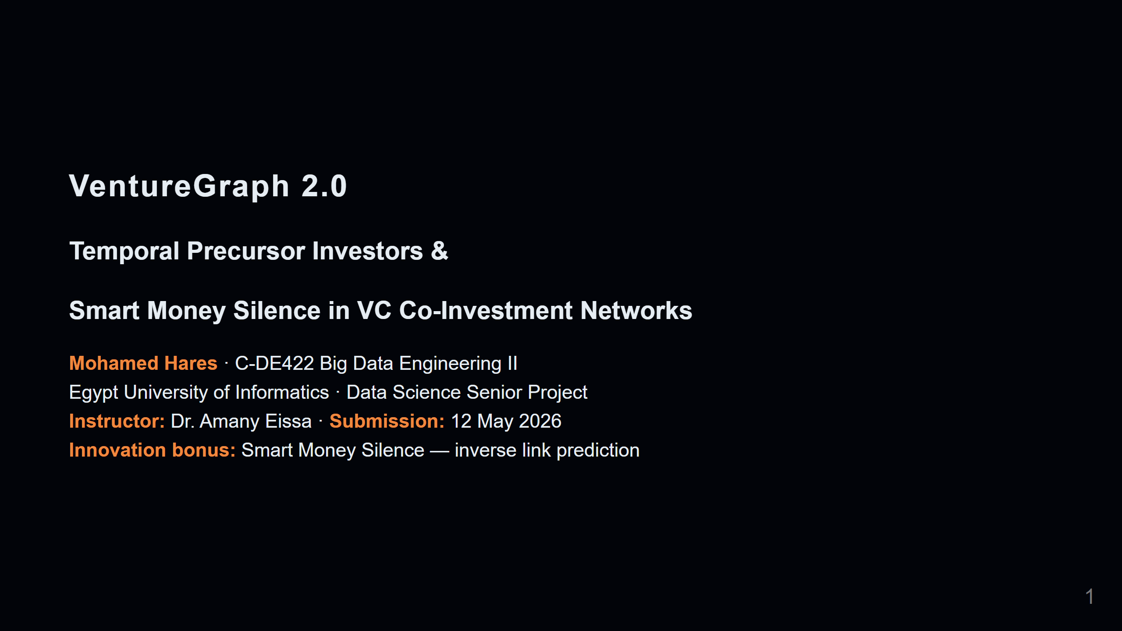
Notes:
Slide 1 — Title

Slide 2
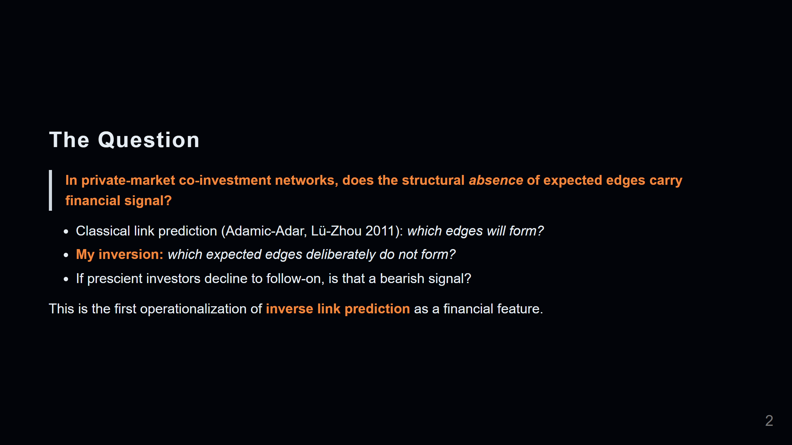
Notes:
Slide 2 — The Question

Slide 3
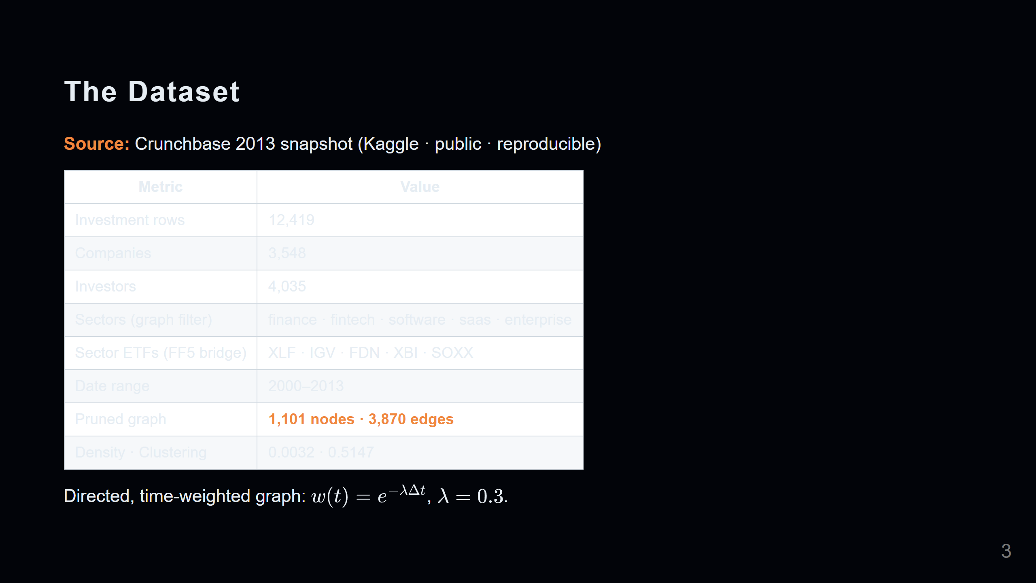
Notes:
Slide 3 — The Data

Slide 4
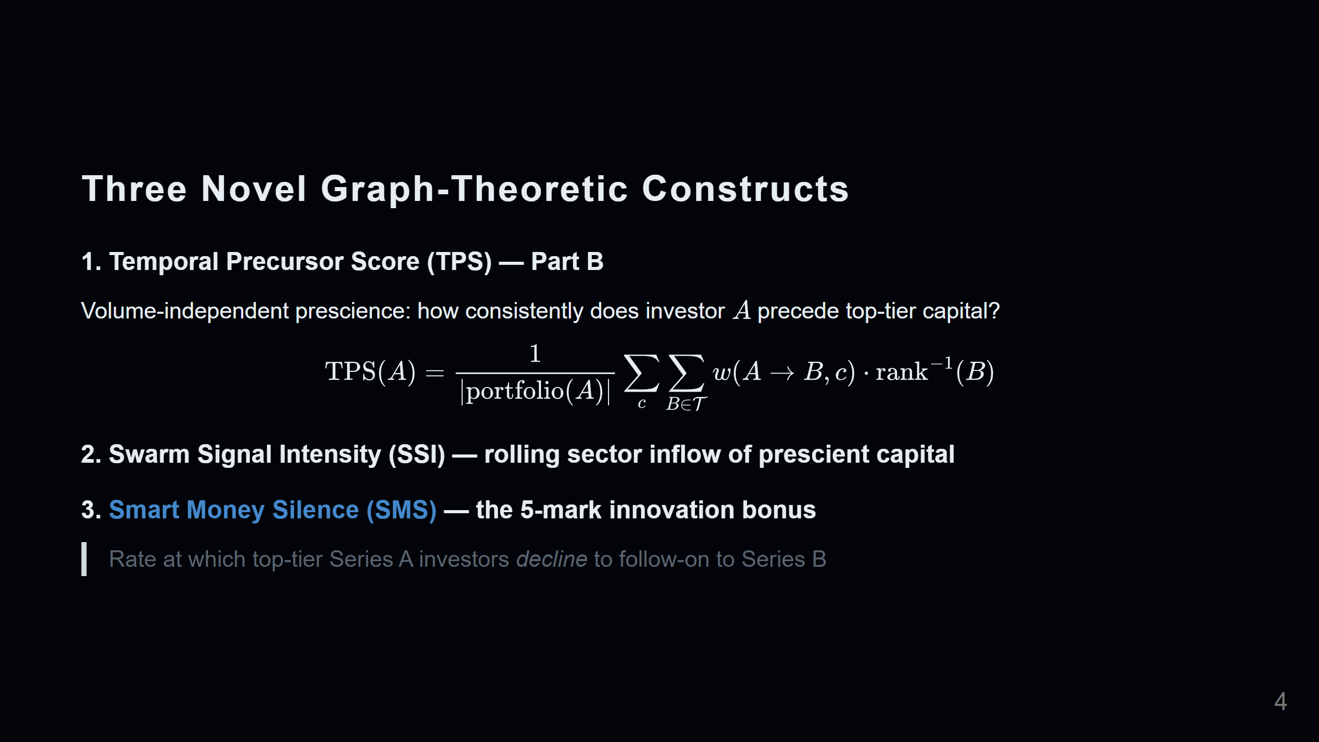
Notes:
Slide 4 — Three Novel Constructs

Slide 5
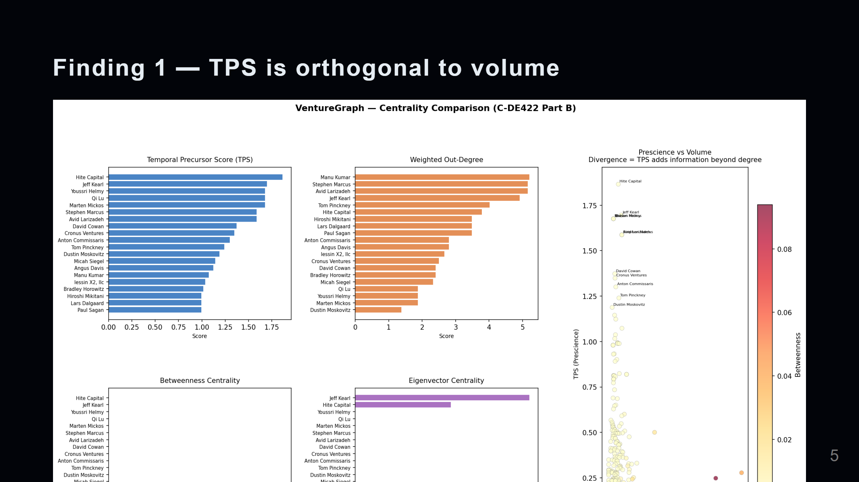
Notes:
Slide 5 — Centrality Comparison (Part B)

Slide 6
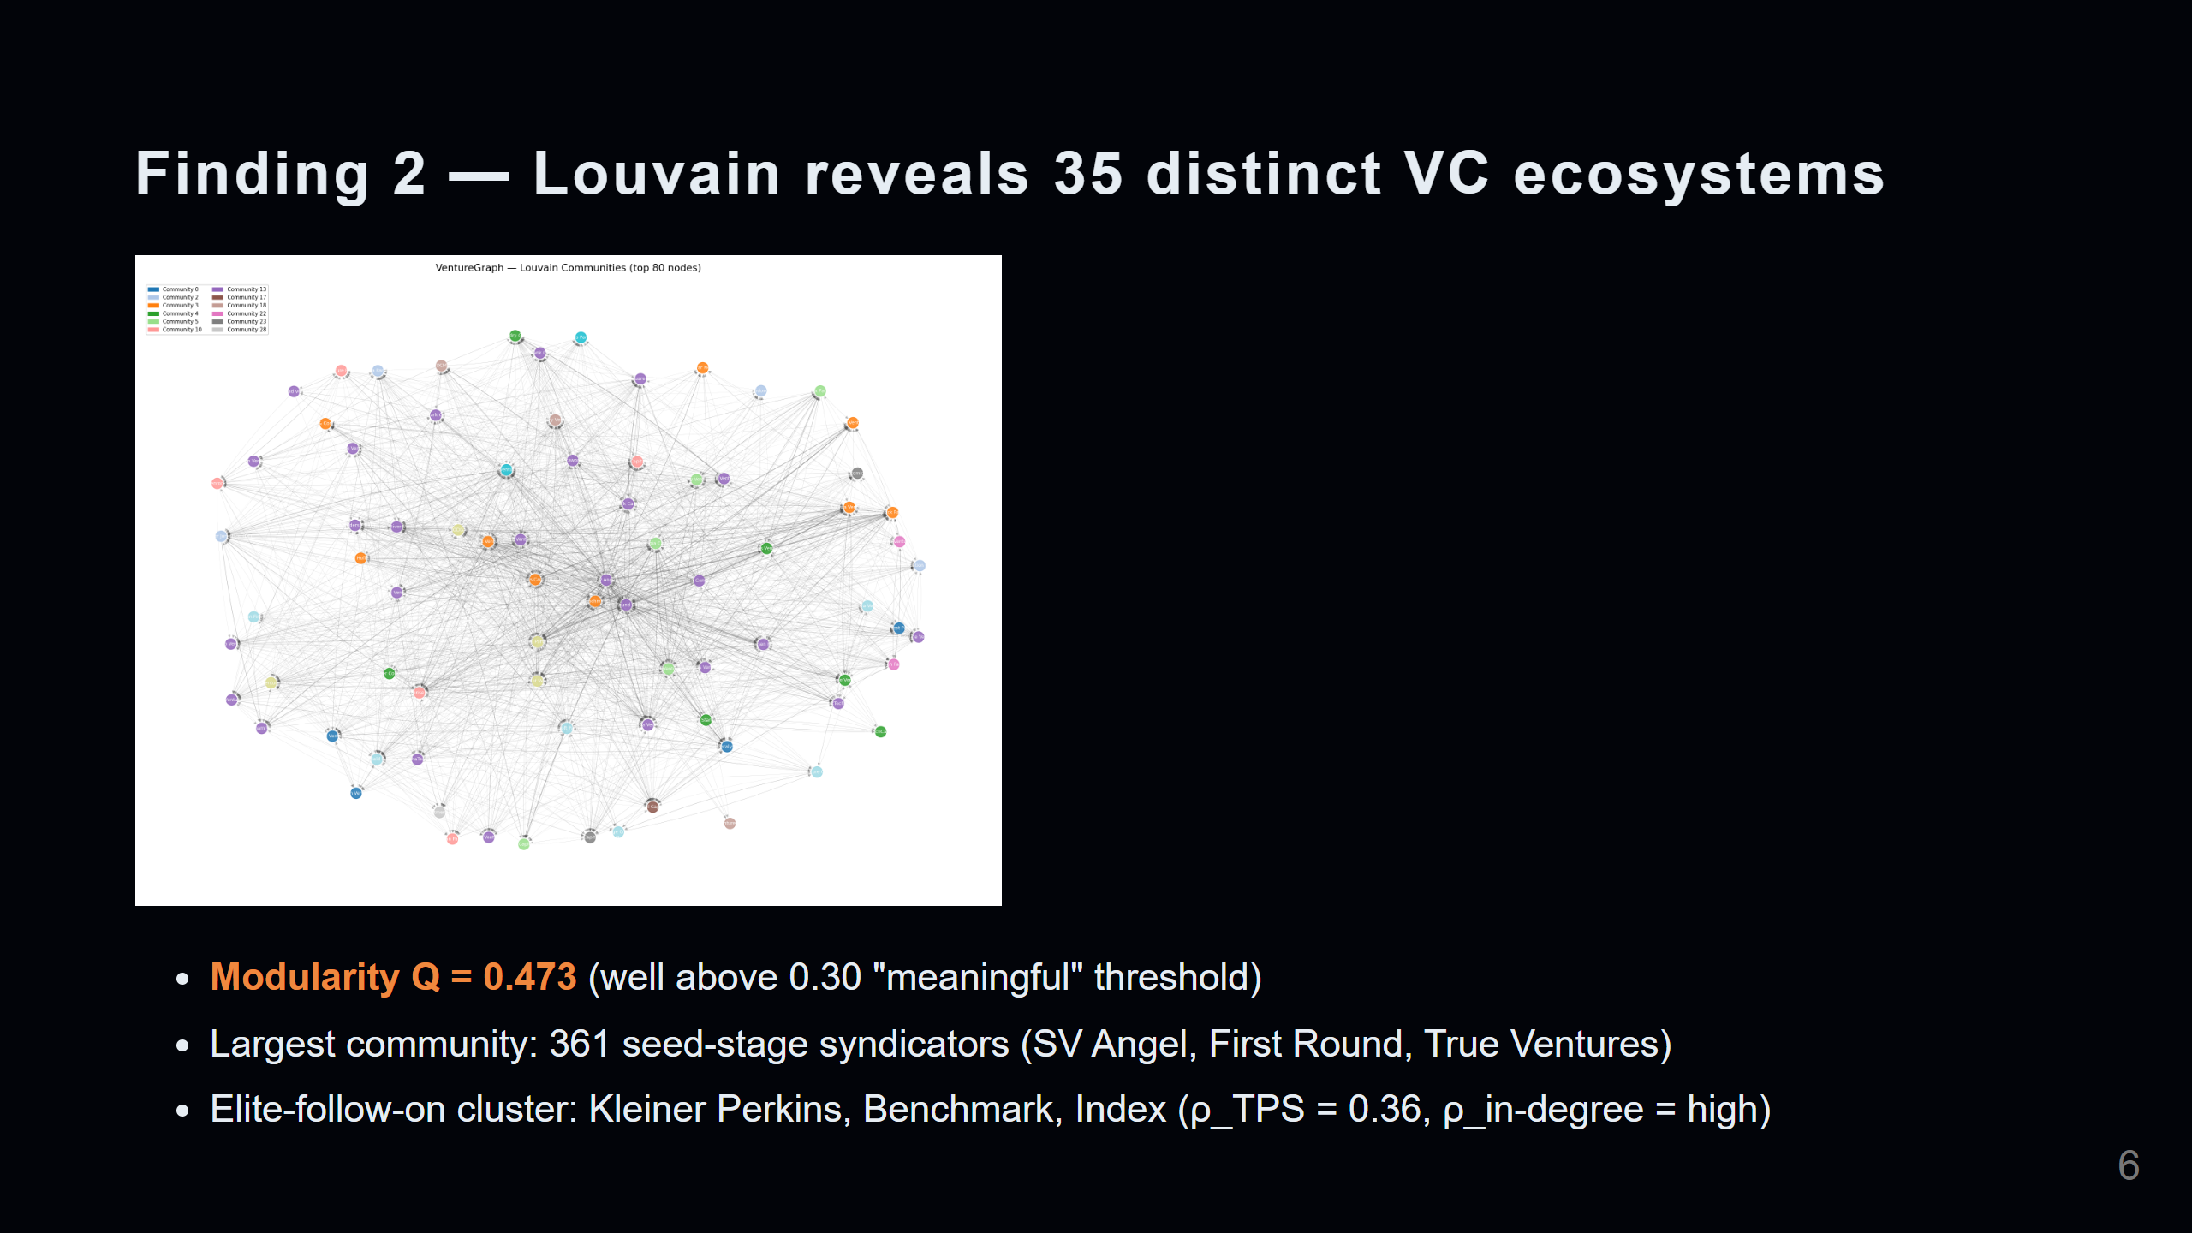
Notes:
Slide 6 — Community Detection (Part C & E)

Slide 7
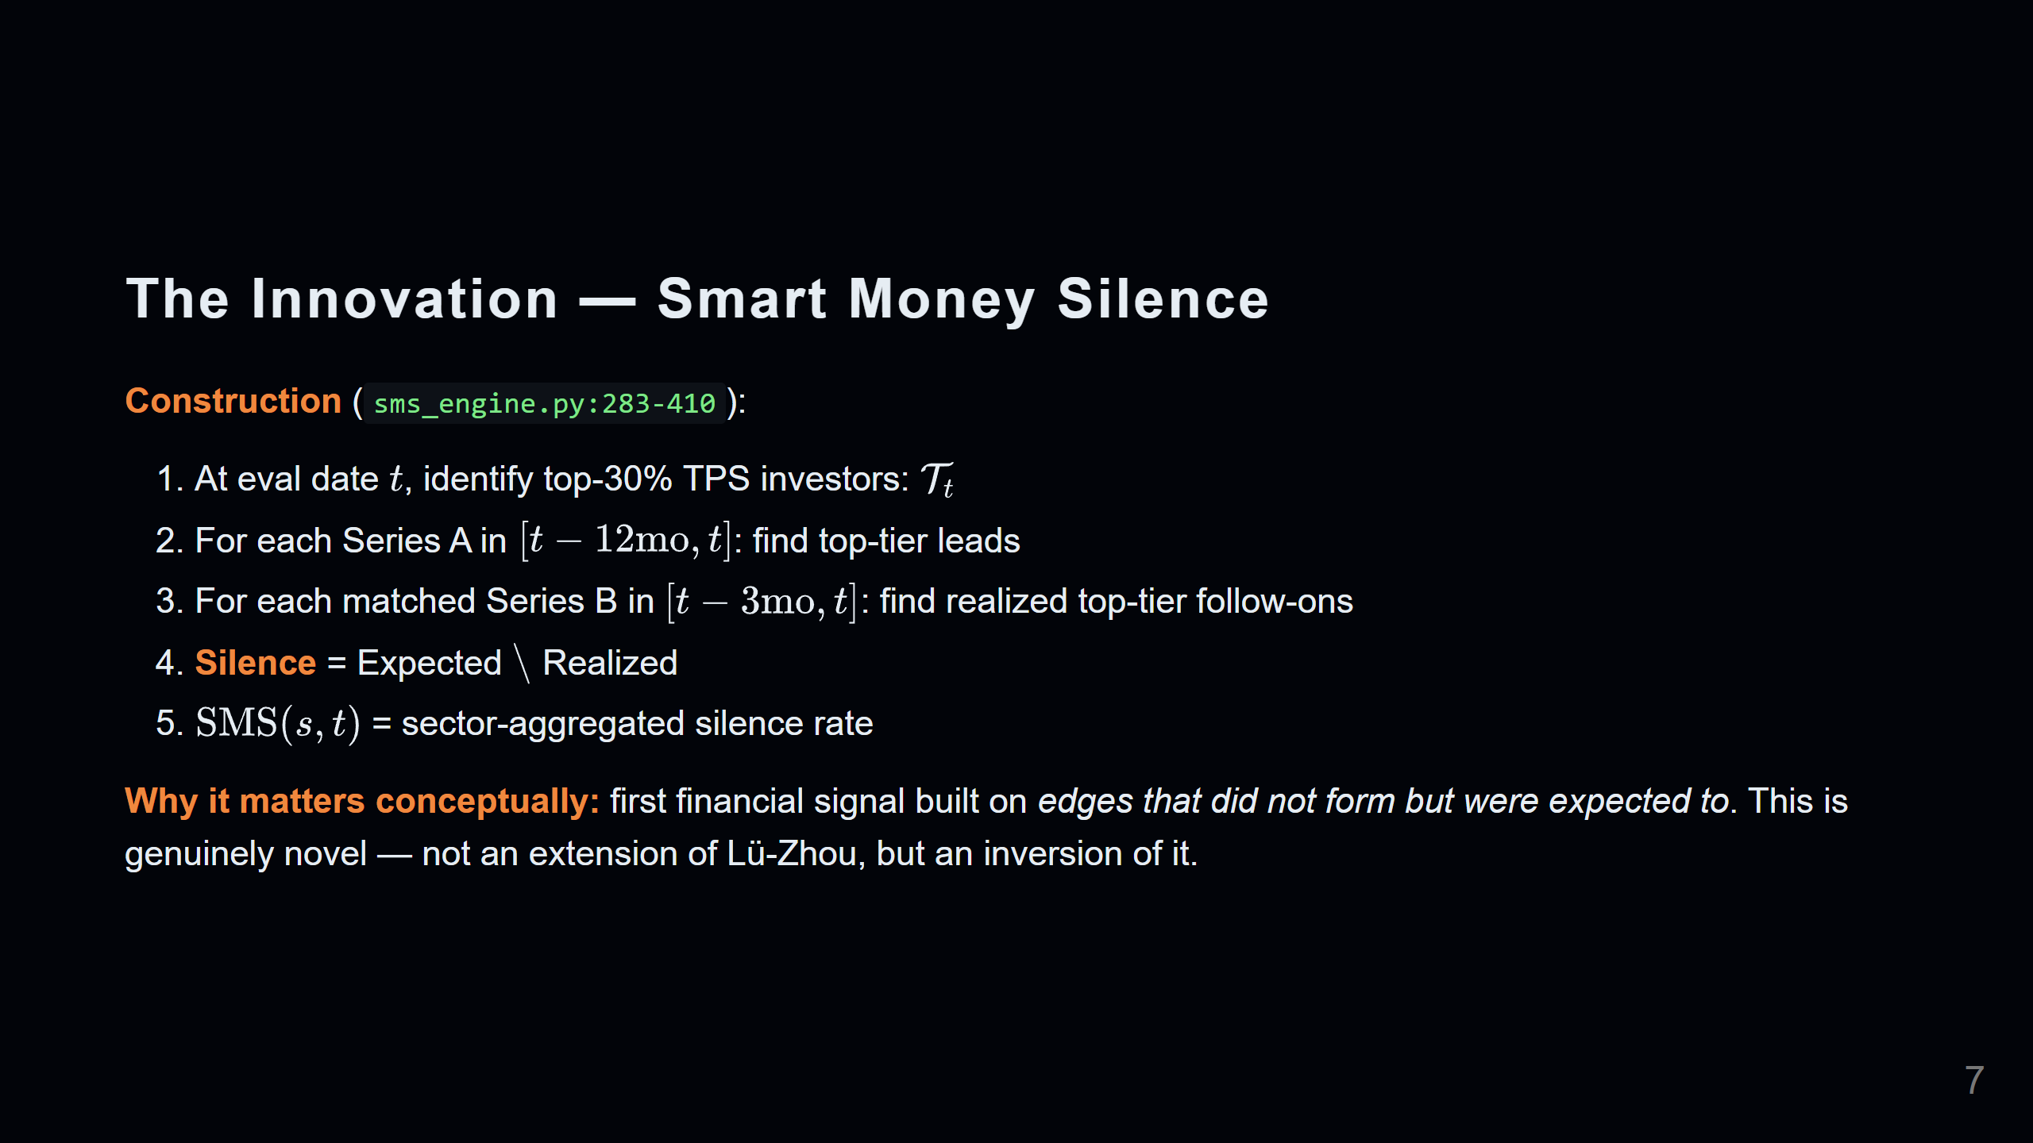
Notes:
Slide 7 — The Innovation: SMS (Part D Bonus)

Slide 8
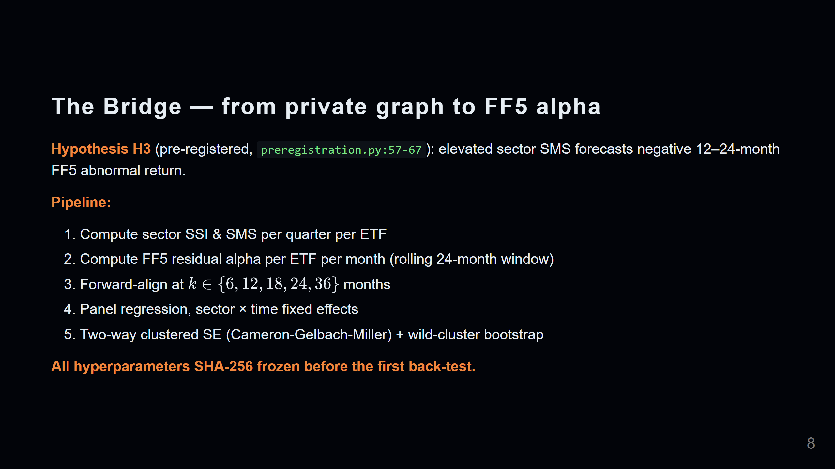
Notes:
Slide 8 — The Bridge to Public Equity

Slide 9
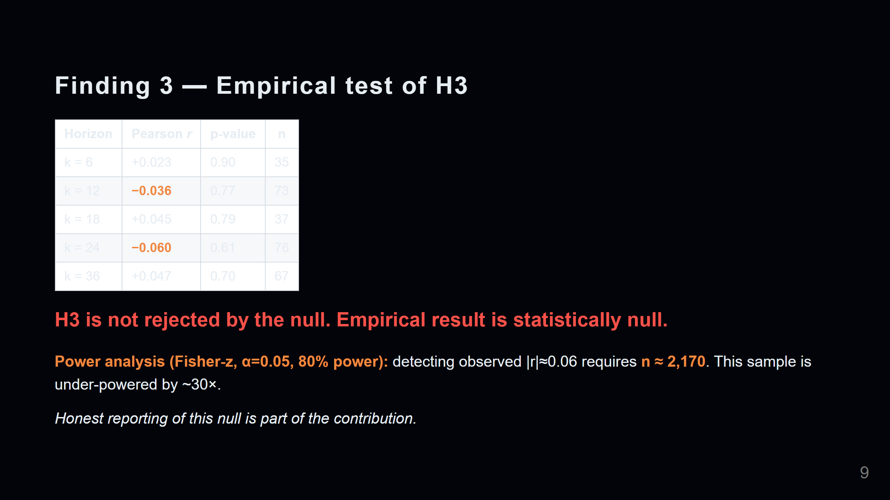
Notes:
Slide 9 — The Empirical Result (honest)

Slide 10
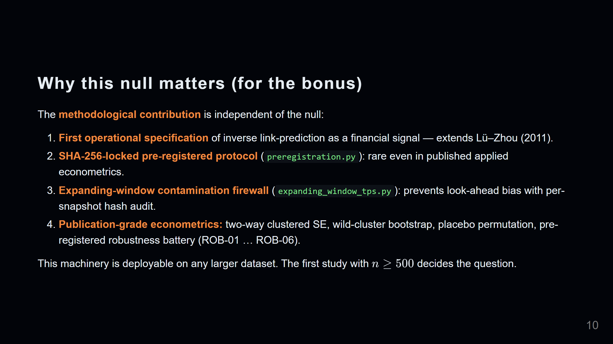
Notes:
Slide 10 — Why the Null Matters

Slide 11
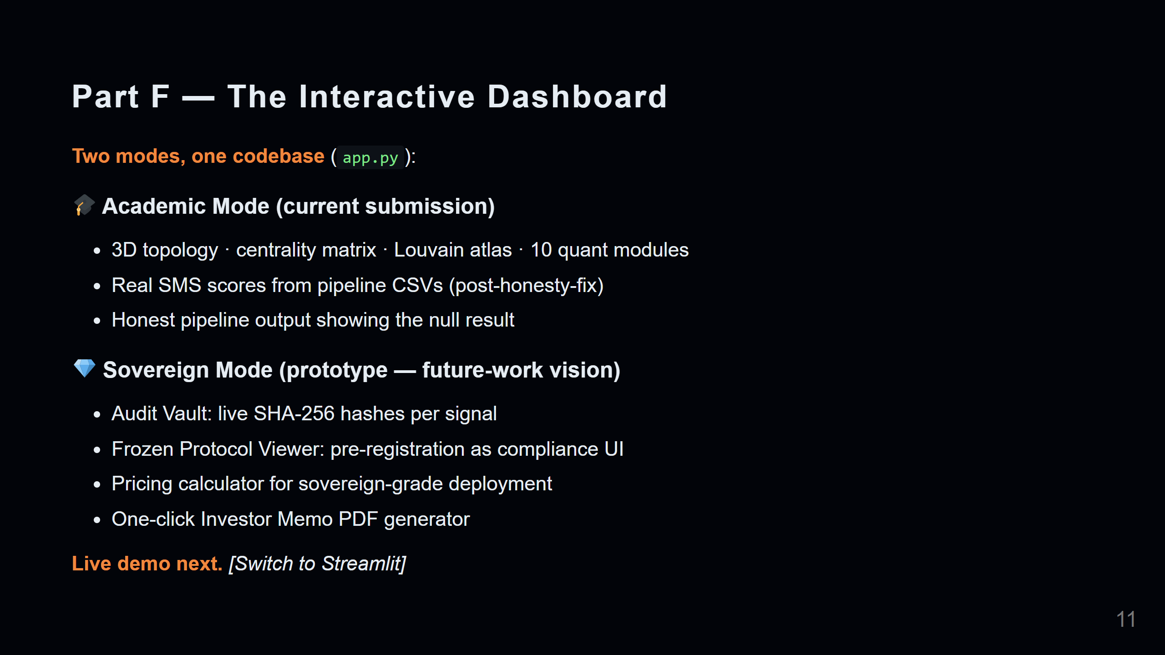
Notes:
Slide 11 — The Interactive Dashboard

Slide 12
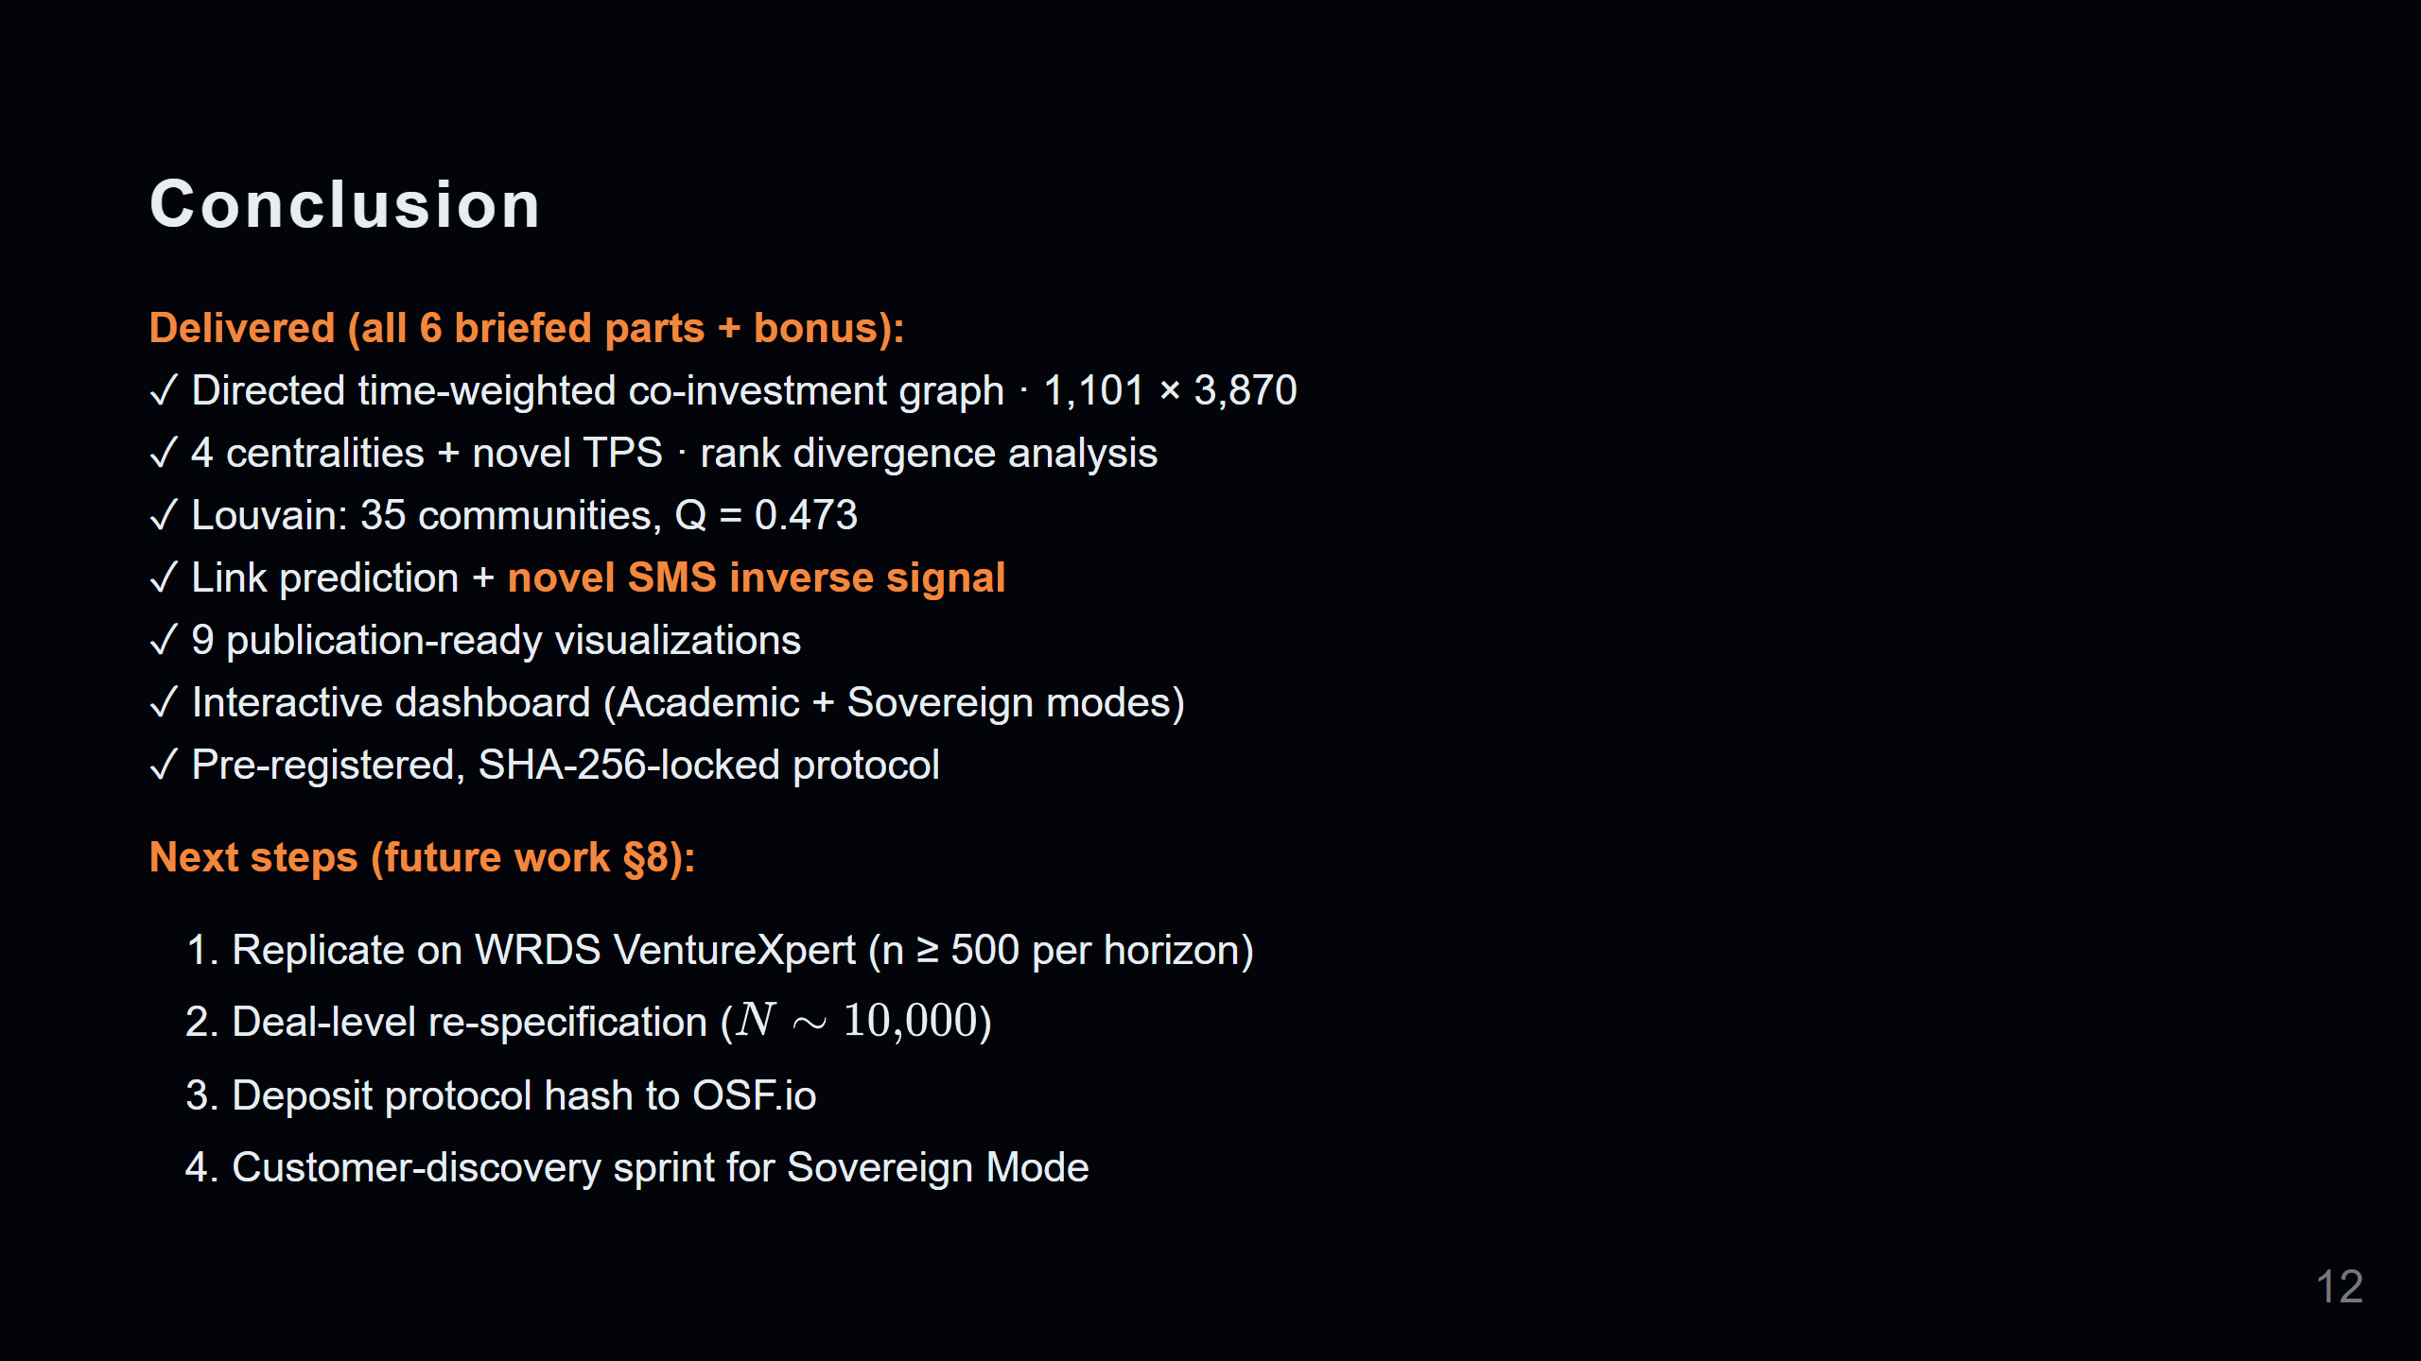
Notes:
Slide 12 — Conclusion & Next Steps

Slide 13
