Slide 1
university DBMS case study
ENG:Mohamed hossam

Slide 2
Agenda
ER-Diagram
Mapping
SQL Implementation
PL/SQL Implementation
Bash Scripts

Slide 3
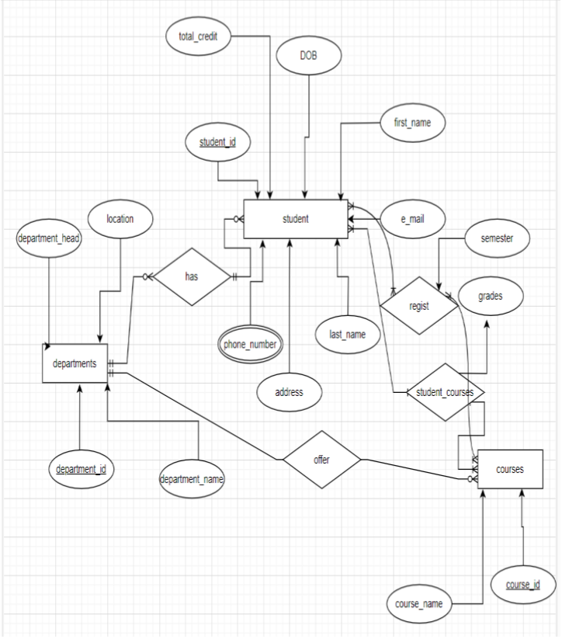
ER-Diagram

Slide 4
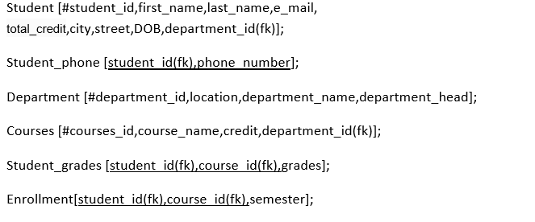
Mapping

Slide 5
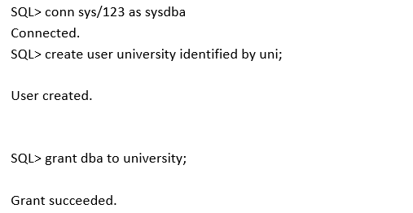
SQL Implementation
Creating a new user and give the privileges

Slide 6
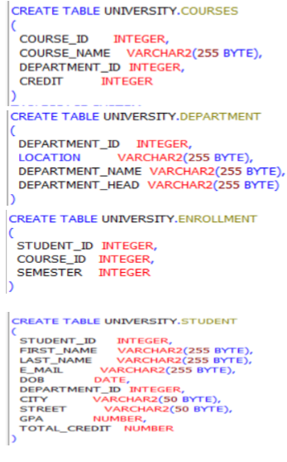
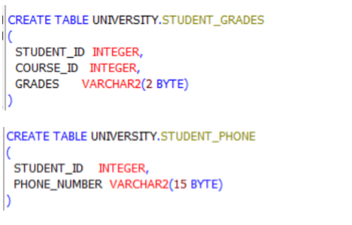
SQL Implementation
Creating tables

Slide 7
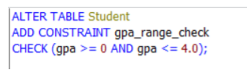
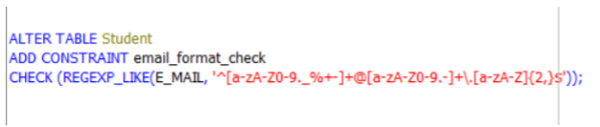
SQL Implementation
check constraint

Slide 8
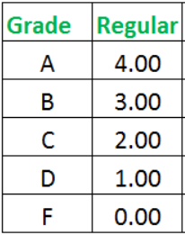
PL/SQL implementation
Calculate GPA

Slide 9
PL/SQL implementation
Update grade

Slide 10
PL/SQL implementation
Trigger
The trigger is designed to automatically calculate the GPA for students whenever new grades are inserted or updated in the STUDENT_GRADES table.

Slide 11
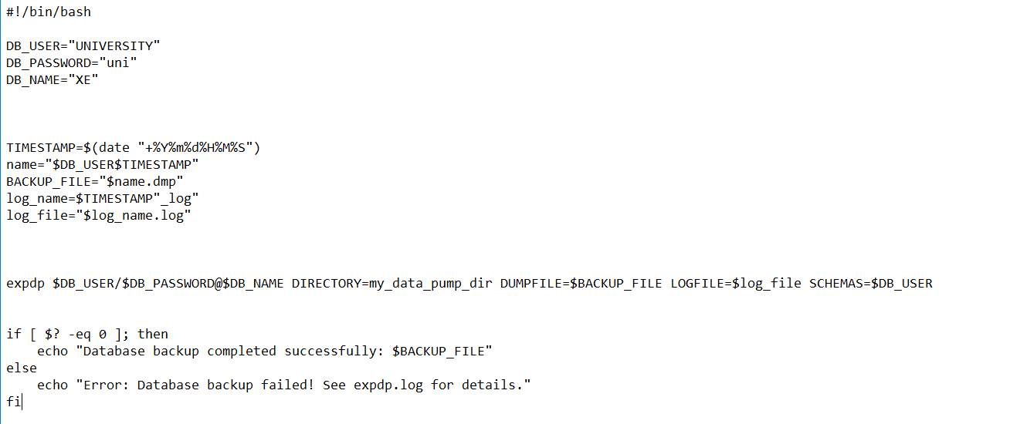
bash scripting
Back-up script

Slide 12
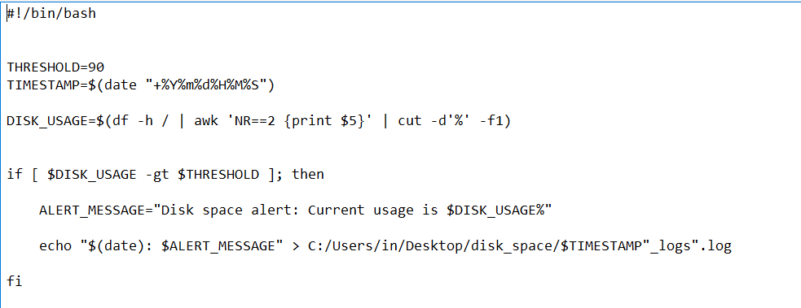
bash scripting
Check the current use of the dick

Slide 13
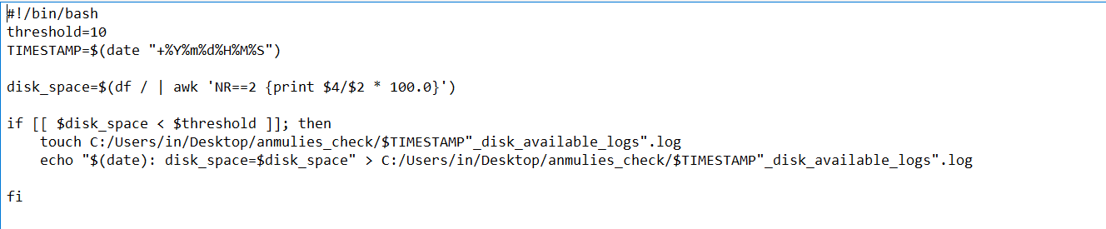
bash scripting
Monitor the available space in the dick

Slide 14
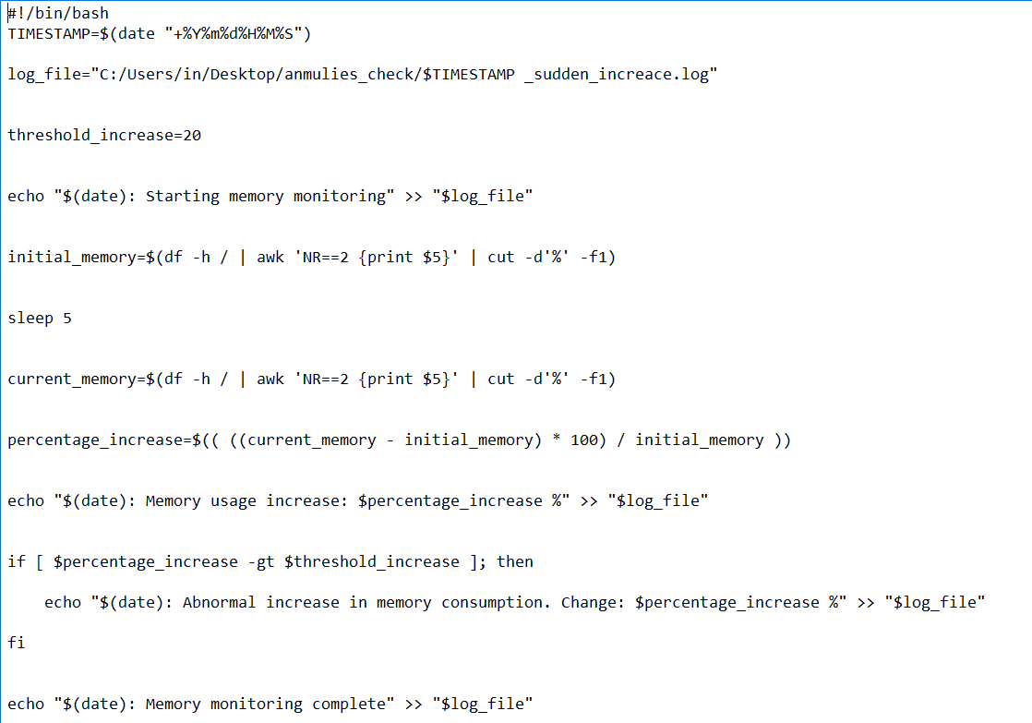
bash scripting
Check sudden increase in database

Slide 15
Any question?
Thank you for your listening

