Slide 1
Project review
Mohamed Irfan m
Ra2232241020068
Ii mca b sec
pca20p03l

Slide 2
abstract
Topic- Hemo hub- A life flow management
HEMOHUB- A life flow management is a web-based application. The entire project was developed with distributed client server computing technology in mind. Through this application anyone interested in donating blood can register through this website. Moreover, any general patients can request blood through this site. Admin is the main authority who can do addition, deletion and modification if required. The project has been planned to be having the view of distributed architecture with centralized storage of the database. This website has been developed using the HTML, CSS, JavaScript for the Front End and for backend python programming language.
Hemo hub management system is a critical component of healthcare infrastructure, providing a centralized platform for the efficient management of blood donation, testing, storage, and distribution processes. This system encompasses various modules such as donor registration, blood collection scheduling, inventory management, blood typing and managing.

Slide 3
introduction
Hemo -hub management is a browser-based system that is designed to store, process, retrieve and analyze blood related information. This project aims at maintaining all the information pertaining to blood donors, different blood group available in this blood bank and help them to manage in a better way. This website provides the user or the donors a secured environment by accepting the log in ID’s and password from the user. This application allows the user to store the donor details as soon as the donor is registered. The admin will check the donor registered details if only he/ she is capable for donating the blood then only the donor can donate the blood at their registered centers. Before that the admin will send message or notification to donor registered mobile number or email.

Slide 4
Existing system
The method faces challenges due to intrinsic characteristics of making the detection of blood complex process.
Fake information may occurrence.
Non-Transparent way of process.
Transaction of blood are low accuracy may lead to malfunction.
Application interface is not a friendly at end user process.
Less security

Slide 5
Proposed system
Early alert system are notified through email or message.
The proposed method for analysis focuses on the detection of through a single step approach.
It leverages template-based edge enhancement to accurate both receiver and donor data.
It consists of real time database as followed.
Transparent process is held throughout entire steps.
High level security system implemented.

Slide 6
System requirements
HARDWARE REQUIREMENT:
Operating system: windows 11
Processor: Intel Core i5 (12th Gen) Processor
Hard Drive: 1TB.
Memory (RAM): 8 GB
SOFTWARE REQUIREMENT:
Python
Windows OS
Minimum :4 GB RAM
Framework: Django

Slide 7
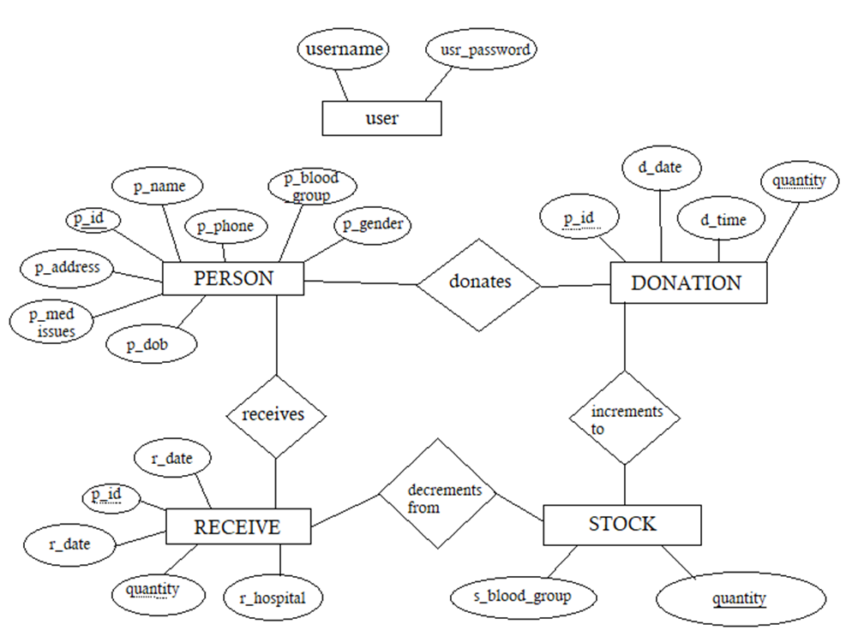
Architecture diagram

Slide 8
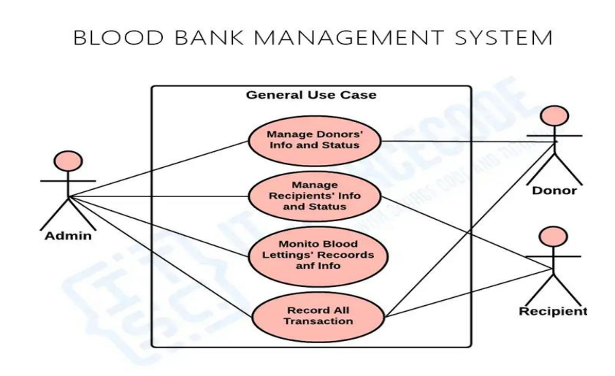
Use case diagram

Slide 9
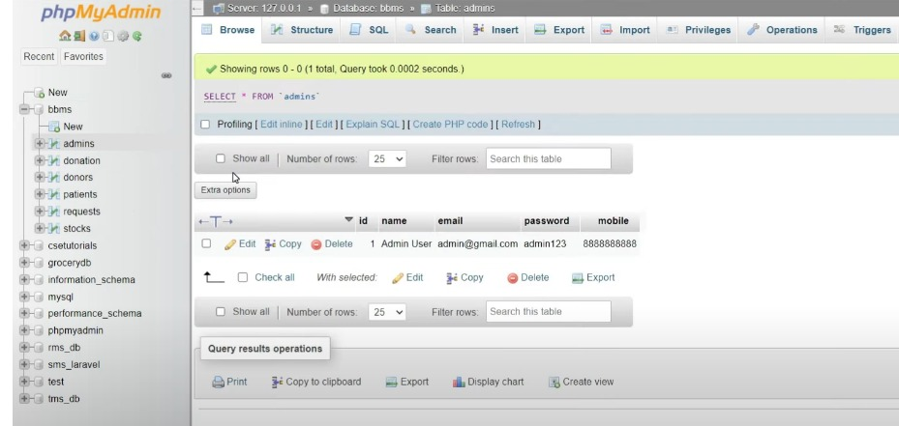
Database design

Slide 10
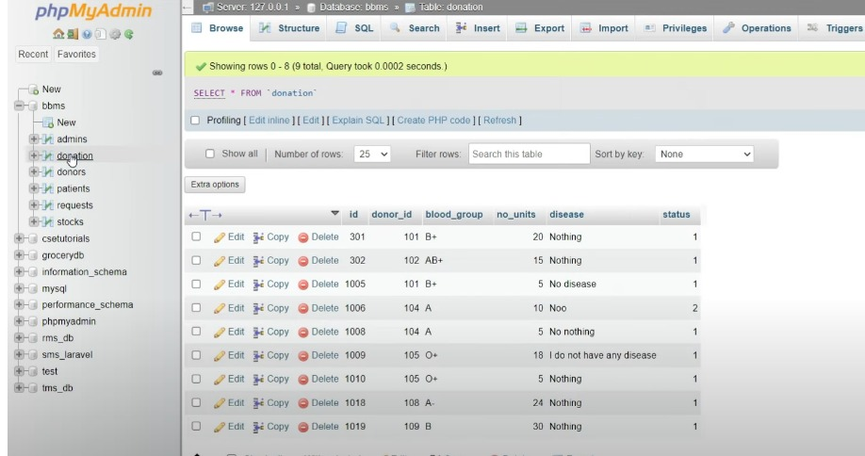
Donor database

Slide 11
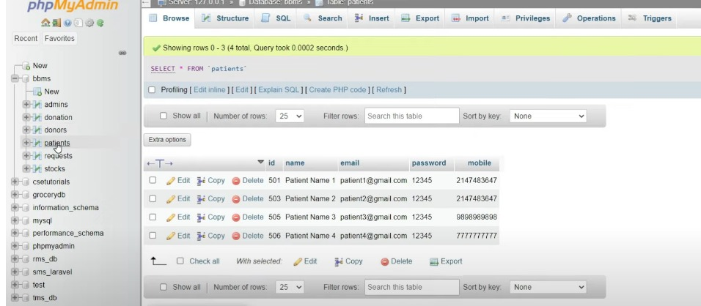
Patient database

Slide 12
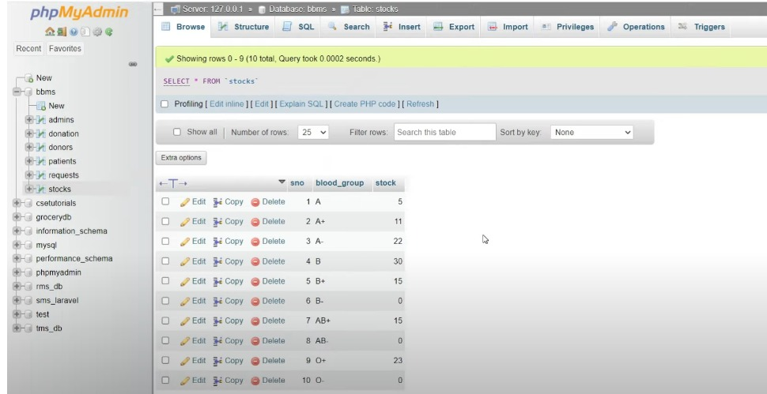
Stock database

Slide 13
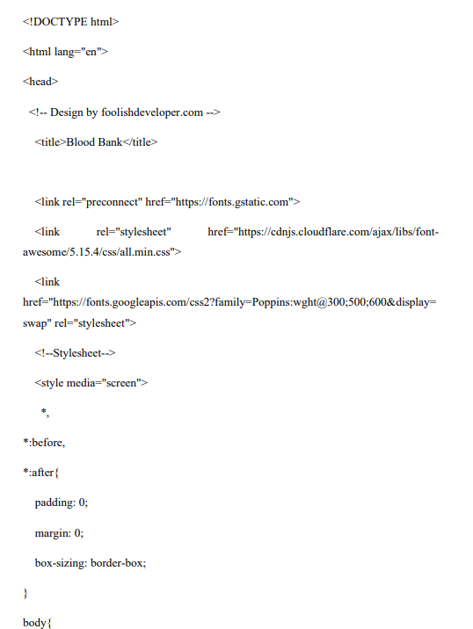
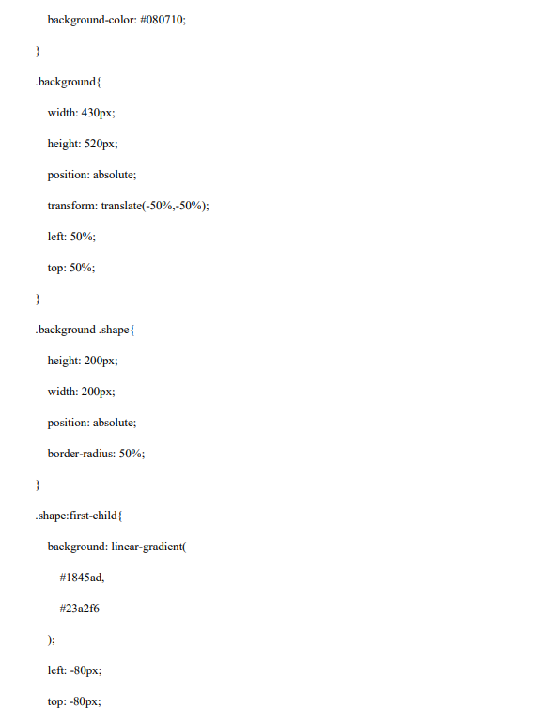
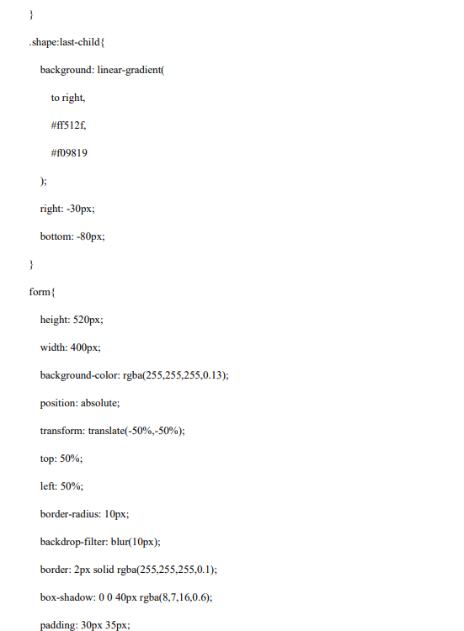
Sample coding

Slide 14
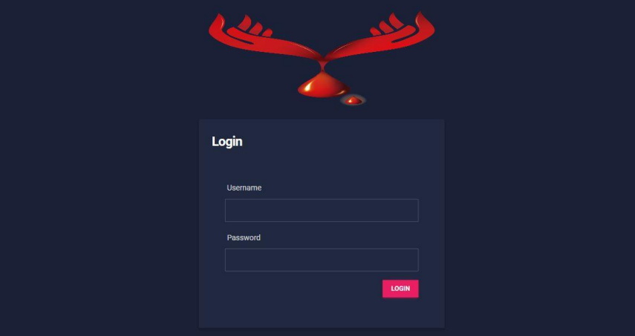
Screenshots - login

Slide 15
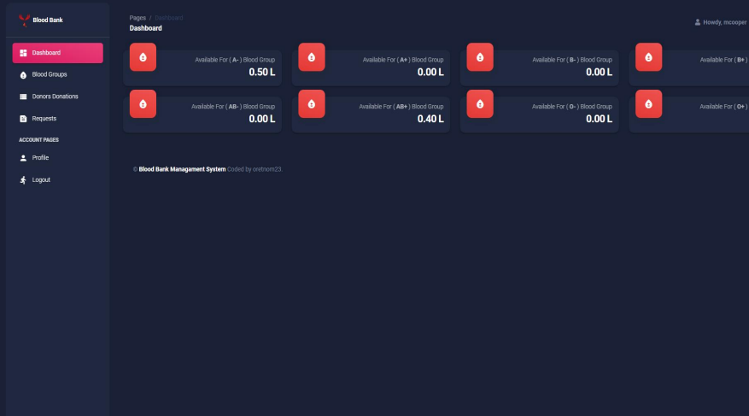
dashboard

Slide 16
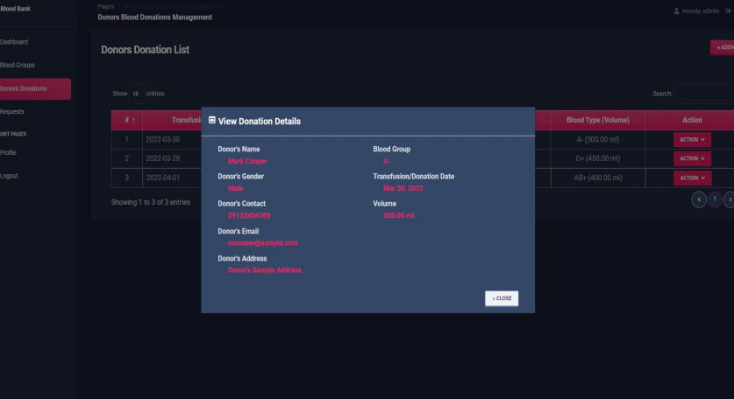
Donor details

Slide 17
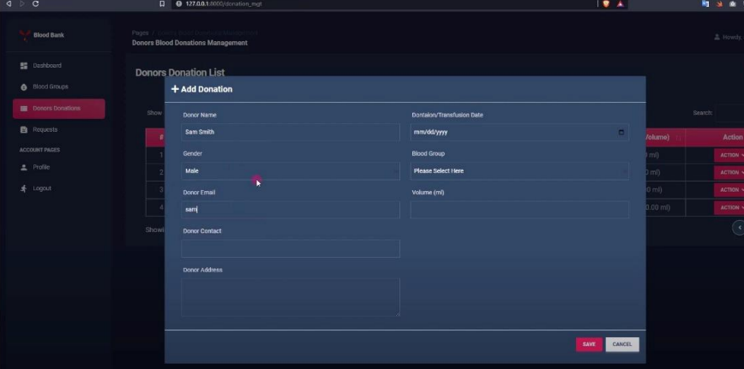
Blood donation

Slide 18
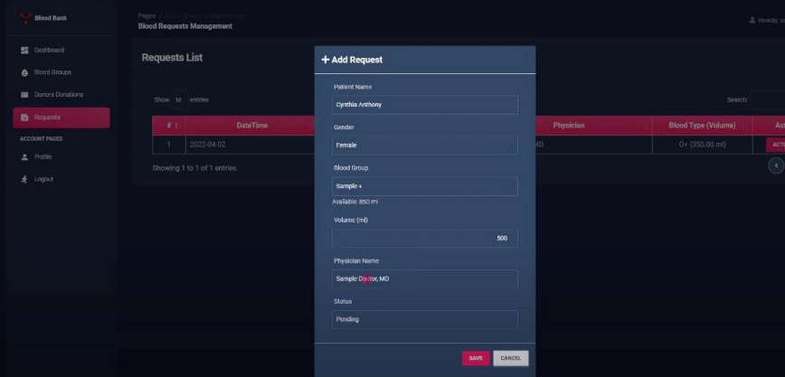
Request blood

Slide 19
Future enhancement
Easy to transaction blood through this web application.
Early alert to all end user.
Remote Blood Collection Units: Establishing remote blood collection units in underserved areas or mobile units that can travel to community events can increase accessibility to blood donation services and widen the donor pool
All the hub includes health care, blood bank staff are fit for educational programs to train and test.

Slide 20
Thanks for you precious time!!!!!

