Slide 1
We have developed a Web Application and provided you with our code in the submission files in the directory “web app”, Feel free to run it and be fascinated ☺
Unfortunately, the nova server connection made it challenging for us to deploy the program, hence we provided screen shots from the application.

Slide 2
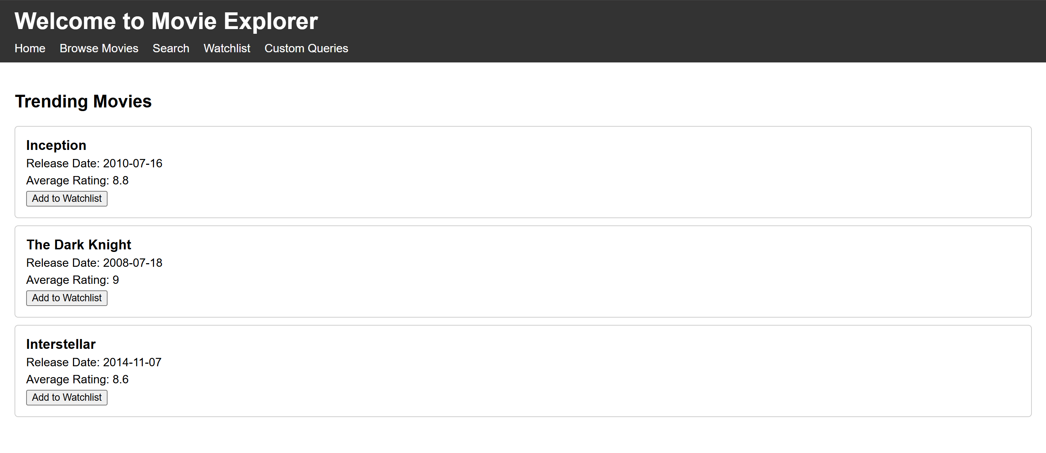
Home page displaying all movies in the database

Slide 3
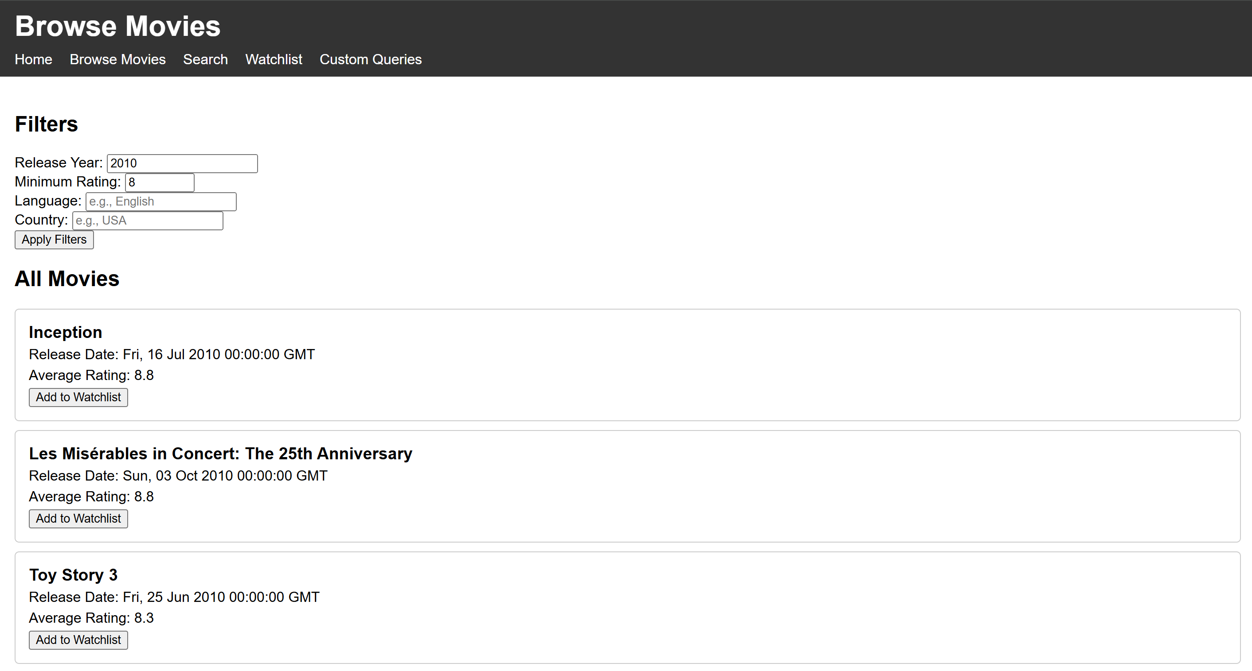
Filtering mechanism

Slide 4
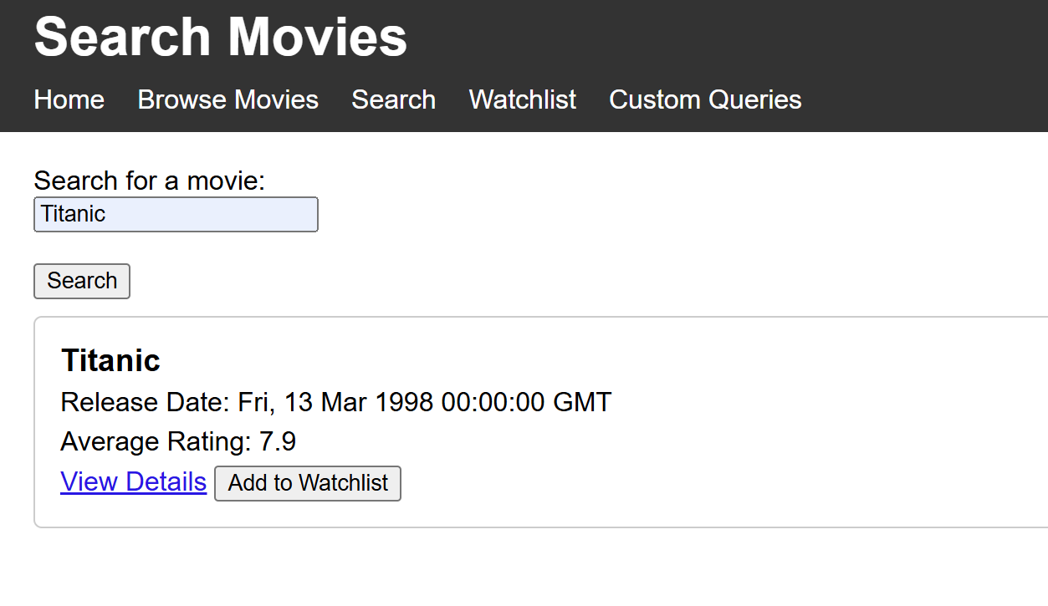
Search by title

Slide 5
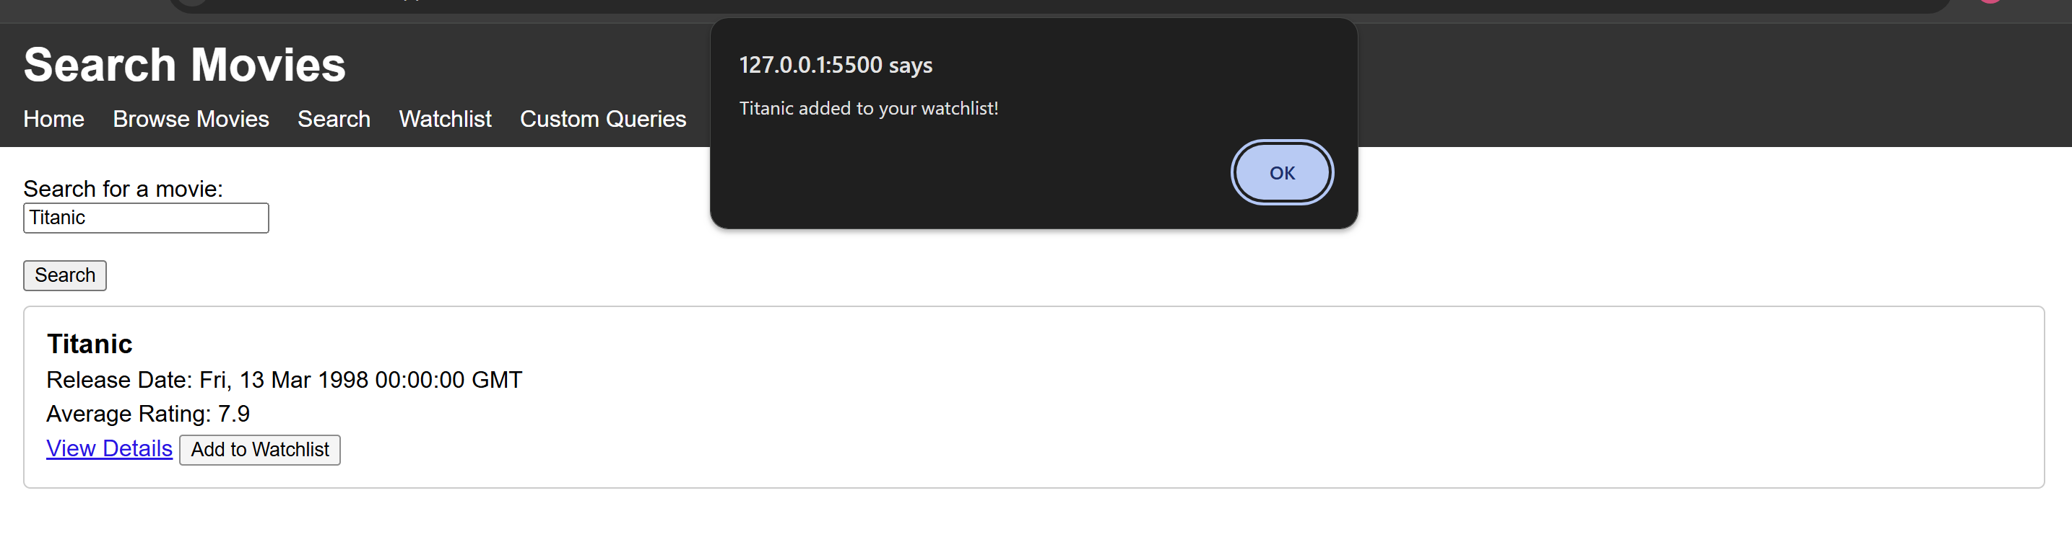
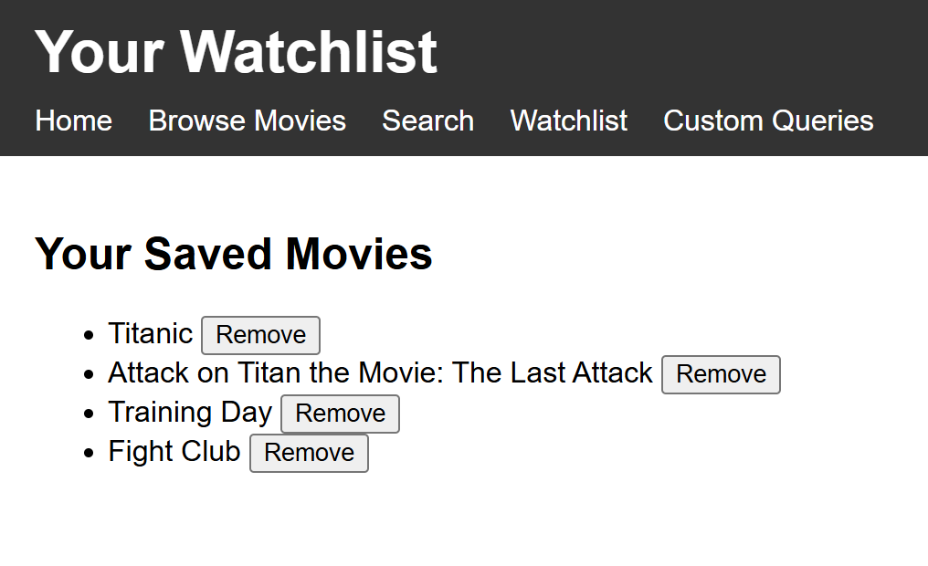

Watchlist Feature

Slide 6
All of this was implemented by basically two queries that are interactive with the user. Please note that these were not the queries we have submitted as requirements of the assignment, in the last section we will see the execution of the required queries

Slide 7
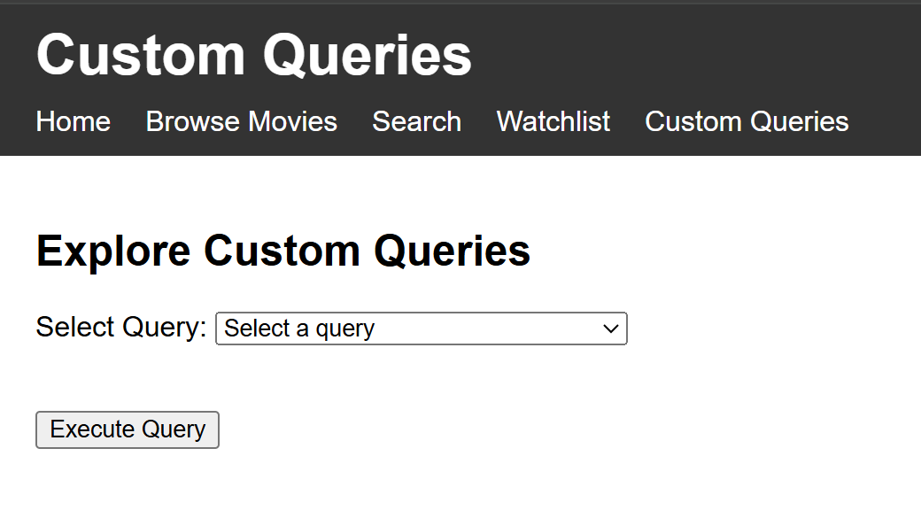
Here the user can pick one of the five queries we have submitted and execute them

Slide 8
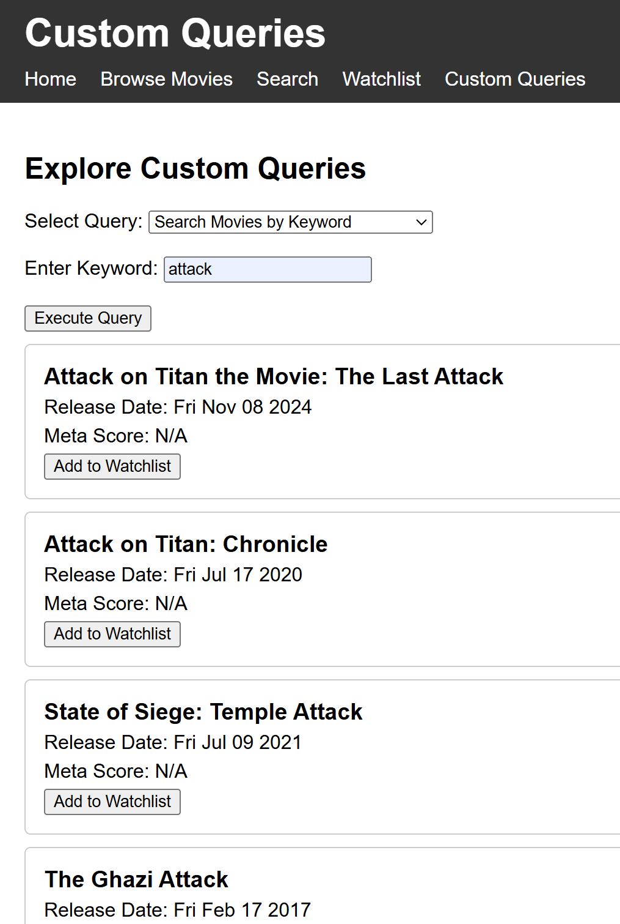
Query 1
The user inserts a keyword, this keyword is transferred as an input to the custom_query function in the backend which then executes the query and return its result to the front end code (the other queries are executed similarly).

Slide 9
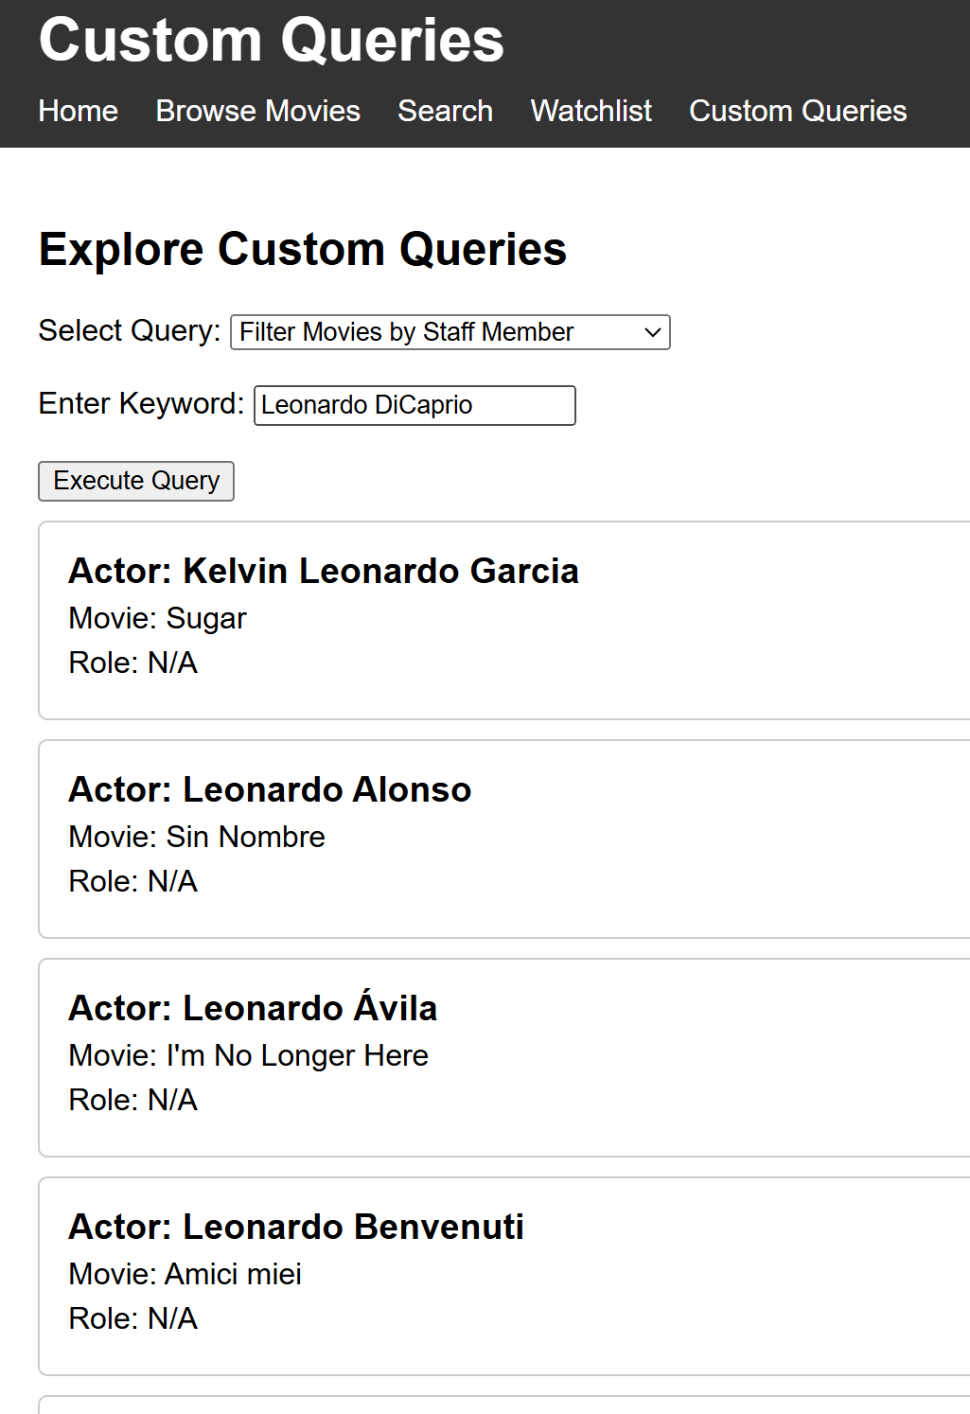
Query 2

Slide 10
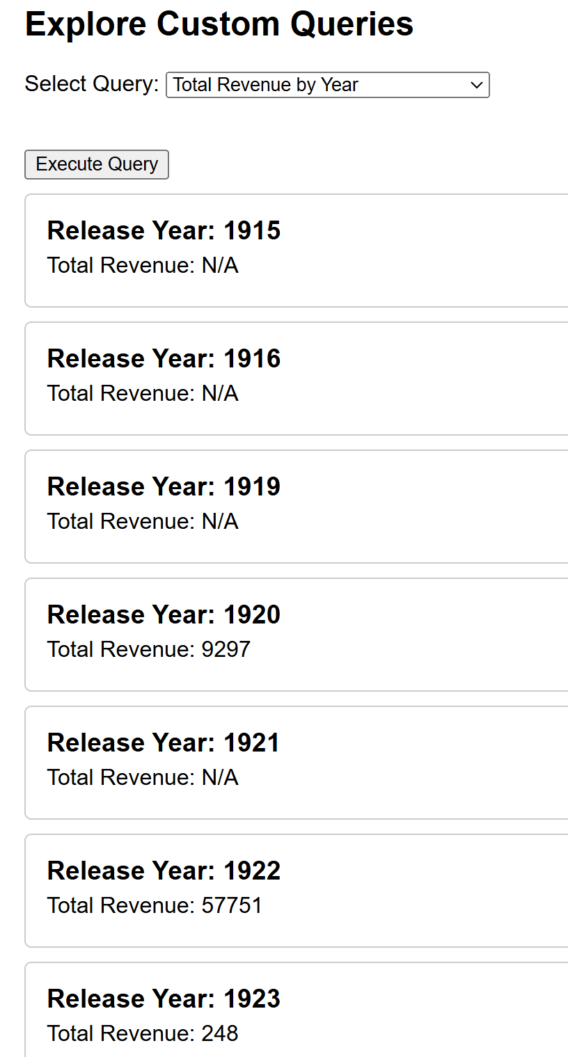
Query 3

Slide 11
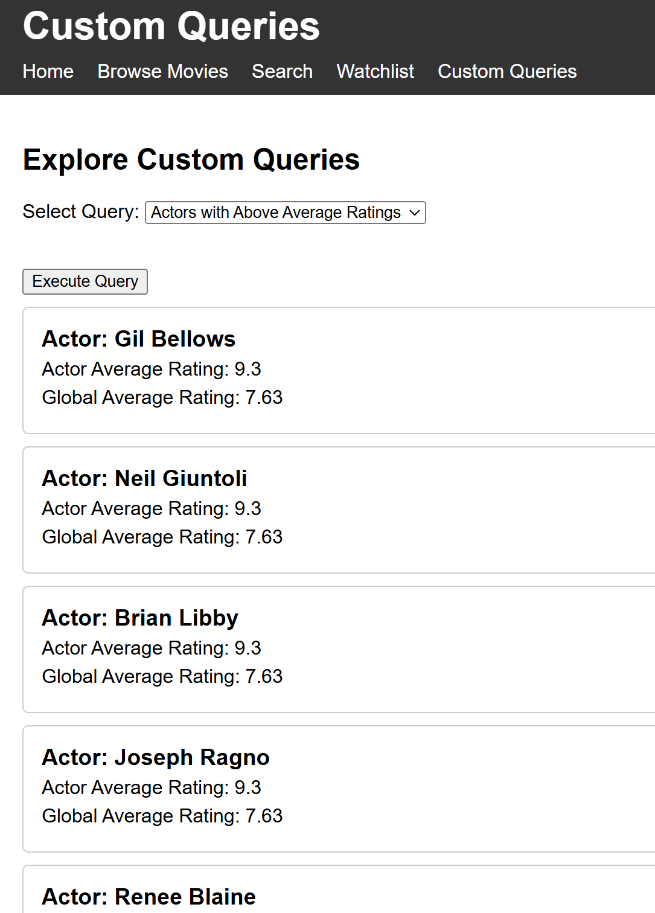
Query 4

Slide 12
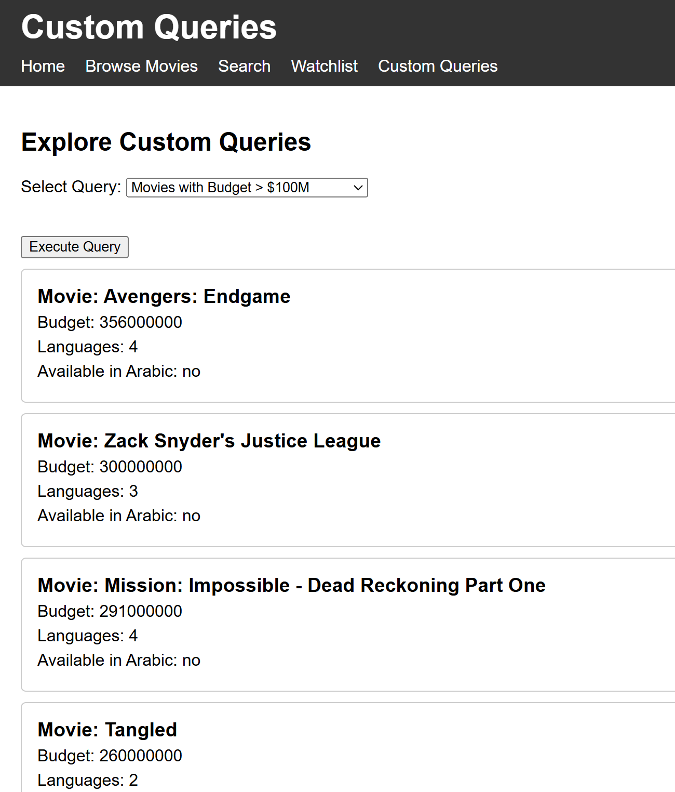
Query 5

Slide 13
You can execute these queries directly in python using the query_execution.py as explained in the documentation file.

