Slide 1
ARMA Model

Slide 2
introduction to ARMA
ARMA stands for Auto Regressive Moving Average.
An ARMA model is a class of statistical models used to describe weakly stationary time series.
We use ACF & PACF plots to check parameters and see if there’s a need to use differencing.
An ARMA model can be created using the statsmodels library as follows:
Define the model by calling ARMA() and passing in the p, d, and q parameters.
The model is prepared on the training data by calling the fit() function.
Predictions can be made by calling the predict() function and specifying the index of the time or times to be predicted
The parameters of the ARMA model are defined as follows:
p: The number of lag observations included in the model, also called the autoregressive order.
d: The number of times that the raw observations are differenced, also called the degree of differencing.
q: The size of the moving average window, also called the order of moving average.

Slide 3
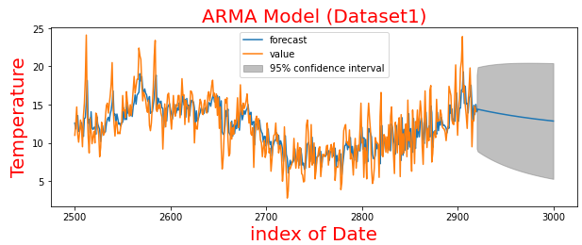
Result “Mean Square Error:3.987

Slide 4
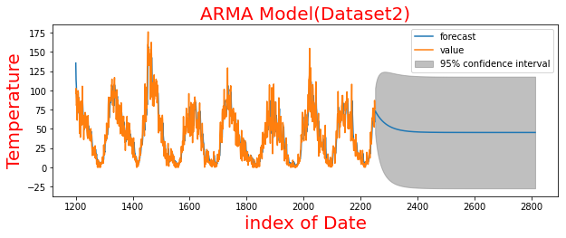
Result “Mean Square Error:62.247

