Slide 1
GRU

Slide 2
What is GRU
How it works
Result

Slide 3
What is GRU
Gated recurrent units (GRUs) are a gating mechanism in recurrent neural networks
The GRU is like (LSTM) with a forget gate, but has fewer parameters than LSTM, as it lacks an output gate.
GRUs are improved version of standard recurrent neural network to solve the vanishing gradient problem of a standard RNN

Slide 4
How it works
GRU uses update gate and reset gate. Basically, these are two vectors which decide what information should be passed to the output.
they can be trained to keep information from long ago, without washing it through time or remove information which is irrelevant to the prediction.
The update gate helps the model to determine how much of the past information (from previous time steps) needs to be passed along to the future.
The reset gate is used from the model to decide how much of the past information to forget.

Slide 5
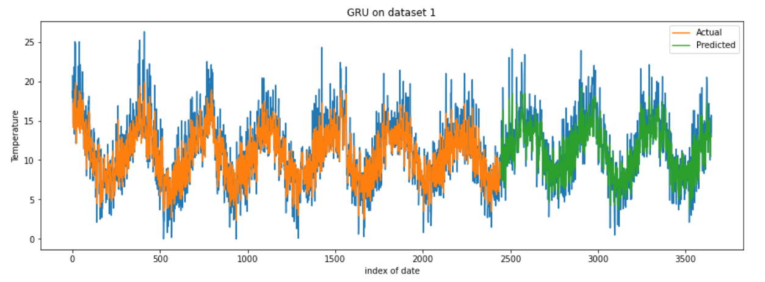
result

Slide 6
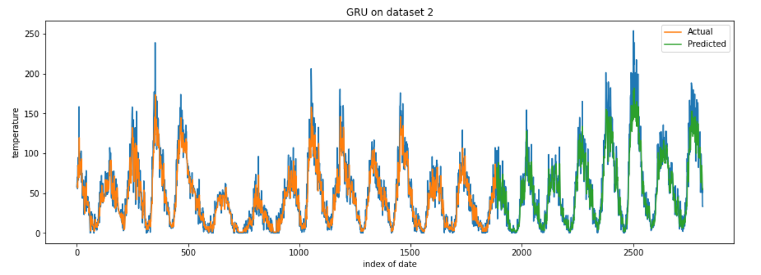
Cont.

