Slide 1


PWM-DRAWER
AMIT_Poject
ENG: Mohamed Mosaad

Slide 2

INTRODUCTION
Pulse Width Modulation, a technique for controlling the average power delivered by an electrical signal.
PWM is used to generate analog signals from
digital devices, such as microcontrollers.
PWM works by switching the supply between on and off at a fast rate.

Slide 3

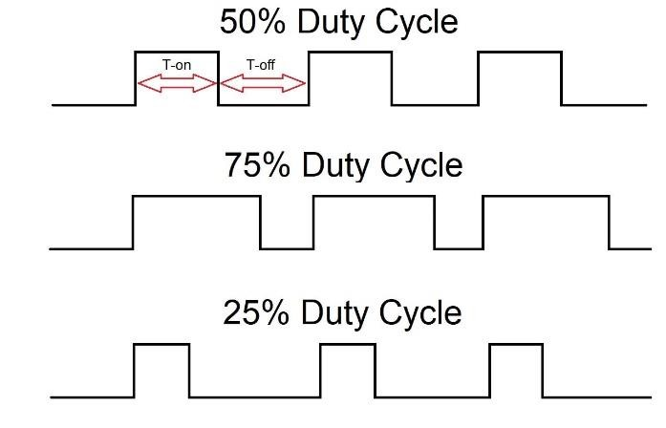
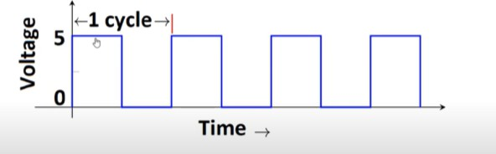
PWM signal elements
Frequency
Duty cycle
Is represented through the total number of cycle per second.
Is defined with respect to percentage or as a number between 0 & 1.

Slide 4
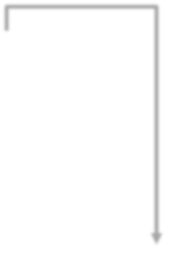
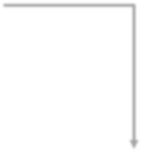

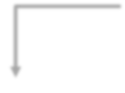

Layered Architecture
Application Layer
PWM_Drawer
Hardware Abstraction Layer
GLCD
Micro-Controller Abstraction Layer
DIO
GPT
PWM
ICU

Slide 5



Flowchart
Initialization PWM_Init(); ICU_Init(); GLCD_Init();
Measure_Signal
ICU_GetDutyCycle();
Draw_Signal GLCD_DisplayString(); GLCD_DisplayFloatingPoint(); GLCD_DisplayInteger(); GLCD_DisplaySpecialPattern();

Slide 6
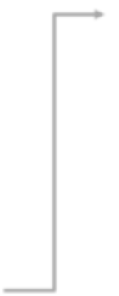





Flowchart
Measure_Signal
ICU_GetDutyCycle();
Clear Input Capture Flag
Set Trigger Edge: RISING_EDGE
Clear Input Capture Flag and Timer Counter Set Trigger Edge: RSING_EDGE
Wait for Input Capture → i.e. Start of Cycle
Wait for Input Capture → i.e. Low Count
𝐻𝑖𝑔h 𝑇𝑖𝑚𝑒
𝐷𝑢𝑡𝑦 𝐶𝑦𝑐𝑙𝑒 % = x100
𝑃𝑒𝑟𝑖𝑜𝑑 𝑇𝑖𝑚𝑒
Clear Input Capture Flag and Timer Counter
Set Trigger Edge: FALLING_EDGE
3
_{𝐻𝑖𝑔ℎ 𝑇𝑖𝑚𝑒 𝑚s =}𝐻𝑖𝑔ℎ 𝐶𝑜𝑢𝑛𝑡 ∗𝑃𝑟𝑒𝑠𝑐𝑎𝑙𝑒𝑟∗10
𝐹𝑐𝑝𝑢
period 𝑇𝑖𝑚𝑒 𝑚s
Wait for Input Capture → i.e. High Count
3
₌(𝐻𝑖𝑔ℎ 𝐶𝑜𝑢𝑛𝑡+𝐿𝑜𝑤 𝐶𝑜𝑢𝑛𝑡) ∗𝑃𝑟𝑒𝑠𝑐𝑎𝑙𝑒𝑟∗10
𝐹𝑐𝑝𝑢

Slide 7
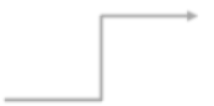
Flowchart
Draw_Signal GLCD_DisplayString(); GLCD_DisplayFloatingPoint(); GLCD_DisplayInteger(); GLCD_DisplaySpecialPattern()
;
GLCD Line 0: Display Frequency Value in kHz.
Choose a scale (milliseconds
_{to pixel) as} 𝑝𝑒𝑟𝑖𝑜𝑑 𝑡𝑖𝑚𝑒
GLCD Line 1: Display Duty Cycle Value in %
5
GLCD Line 4: Display Period Time Value in milliseconds.
GLCD Line 5: Display Arrow on First Cycle Period Time.
GLCD Line 6: Display the PWM signal shape.

Slide 8

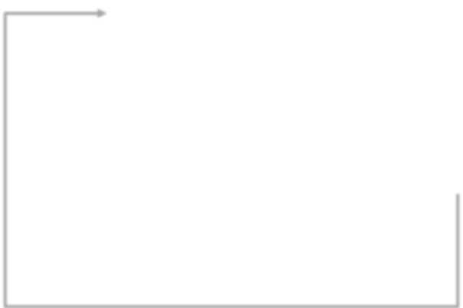


Flowchart
Draw_Signal GLCD_DisplayString(); GLCD_DisplayFloatingPoint(); GLCD_DisplayInteger(); GLCD_DisplaySpecialPattern()
;
GLCD Line 6: Display the PWM signal shape.
Repeat till max. pixel width (128)
Display Falling Edge Pattern
Repeat for
𝐿𝑜𝑤 𝑡𝑖𝑚𝑒
Display Rising Edge Pattern
𝑆𝑐𝑎𝑙𝑒
Repeat for
𝑝𝑒𝑟𝑖𝑜𝑑 𝑡𝑖𝑚𝑒
Display High Line Pattern
5
Display High Line Pattern

Slide 9
THANKS!

