Slide 1
Intelligent Predictive Maintenance System
Machine Learning?Based Failure Prediction and Decision Support
AI4I 2020 Predictive Maintenance Dataset
Project Presentation

Slide 2
Problem statement
Operational challenge
Maintenance gap
Project solution
Unexpected equipment failures can cause downtime, repair expense, production loss, and safety concerns.
Reactive or time-based maintenance can either miss developing failures or cause unnecessary maintenance.
Use machine sensor readings to predict failure risk early and convert the result into an actionable maintenance decision.
Intelligent Predictive Maintenance System | AI4I 2020 Dataset

Slide 3
Objectives
Predict machine failure from machine type and sensor readings.
Provide failure probability, risk score, and risk level.
Estimate a likely failure type using the AI4I failure-mode indicators.
Explain each prediction using actual local SHAP values.
Recommend maintenance action and compare expected failure loss with preventive maintenance cost.
Deliver the system through a simple Streamlit dashboard.
Intelligent Predictive Maintenance System | AI4I 2020 Dataset

Slide 4
Dataset: AI4I 2020 predictive maintenance
Verified dataset profile
Production inputs
Failure-mode indicators
? 10,000 rows ? 14 columns ? Main target: Machine failure ? Stored in Dataset/ai4i2020.csv
? Type ? Air temperature [K] ? Process temperature [K] ? Rotational speed [rpm] ? Torque [Nm] ? Tool wear [min]
TWF, HDF, PWF, OSF, and RNF are used to construct the separate likely-failure-type model.
Intelligent Predictive Maintenance System | AI4I 2020 Dataset

Slide 5
Data cleaning and validation
The reusable loader validates that required features, target, and failure-indicator columns are available.
Cleaning removes duplicate rows and missing values.
Machine failure is explicitly stored as an integer target.
The training pipeline writes the cleaned dataset to Output/cleaned_data.csv.
This keeps training reproducible and avoids depending on notebook-only processing.
Intelligent Predictive Maintenance System | AI4I 2020 Dataset

Slide 6
Exploratory data analysis (EDA)
Analysis performed
Submission evidence
Notebooks/03_EDA.ipynb contains multiple visual outputs. The notebook stage was used to understand sensor distributions and relationships before production pipeline development.
The repository includes a valid production confusion-matrix image. Other image placeholders are empty, so this presentation does not add or claim unavailable EDA charts.
Intelligent Predictive Maintenance System | AI4I 2020 Dataset

Slide 7
Machine learning models compared
Model | Imbalance handling
Logistic Regression | class_weight = balanced
Decision Tree | class_weight = balanced
Random Forest | class_weight = balanced
XGBoost | scale_pos_weight from training imbalance
Selection emphasizes recall-focused F2, then recall and precision ? not accuracy alone ? because missed failures are costly.
Intelligent Predictive Maintenance System | AI4I 2020 Dataset

Slide 8
Model evaluation
Model | Recall | F2 | ROC-AUC | Threshold
XGBoost | 0.847 | 0.774 | 0.972 | 0.55
Random Forest | 0.800 | 0.738 | 0.970 | 0.45
Decision Tree | 0.706 | 0.673 | 0.846 | 0.90
Logistic Regression | 0.694 | 0.501 | 0.884 | 0.70
Metrics are taken from the current Output/evaluation_results.csv.
Intelligent Predictive Maintenance System | AI4I 2020 Dataset

Slide 9
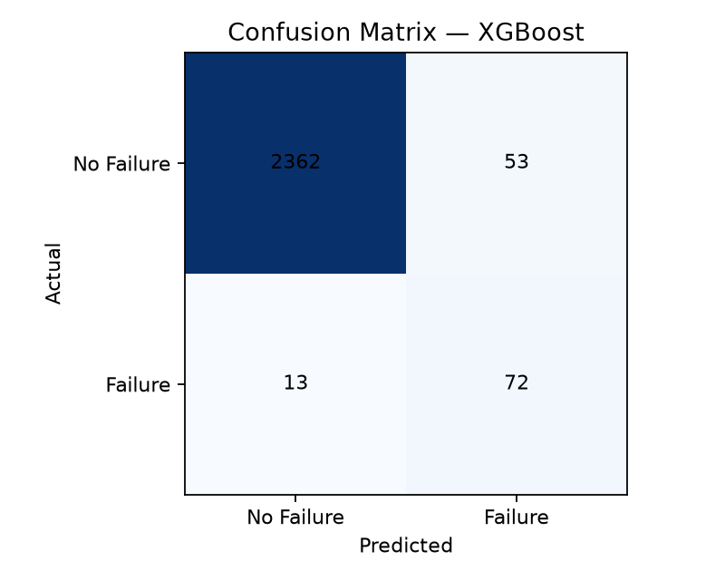
Why XGBoost was selected
Verified production results
Recall: 84.7% F2 score: 0.774 ROC-AUC: 0.972 XGBoost achieved the highest F2 score among the compared models.
Real output: production confusion matrix generated by current training code
Intelligent Predictive Maintenance System | AI4I 2020 Dataset

Slide 10
Decision threshold: 0.55
Predicted failure when probability ? 0.55
How it was selected
Why it matters
The training process evaluated candidate thresholds from 0.05 to 0.95 in 0.05 steps and selected the best recall-focused F2 score.
The threshold turns probability into a practical failure warning. It is stored with the deployed model metadata and is not changed by the dashboard.
Intelligent Predictive Maintenance System | AI4I 2020 Dataset

Slide 11
SHAP explainability
Input
Actual SHAP values
Safe explanation
User-entered machine type and sensor readings are processed by the same saved preprocessing pipeline.
For the selected tree-based model, local SHAP values identify features that increased or reduced predicted failure risk.
If local SHAP output is unavailable, the dashboard shows no explanation rather than generating a fake one.
Intelligent Predictive Maintenance System | AI4I 2020 Dataset

Slide 12
Risk scoring and maintenance decision
Risk score | Risk level | Current action
Below 25 | LOW | Continue Monitoring
25 to below 50 | MEDIUM | Schedule Maintenance
50 to below 75 | HIGH | Prepare Maintenance
75 to 100 | CRITICAL | Immediate Maintenance
Immediate Maintenance is also recommended when predicted failure probability reaches the current model threshold (0.55).
Intelligent Predictive Maintenance System | AI4I 2020 Dataset

Slide 13
Streamlit dashboard
User enters
System displays
Business output
Machine Type Air Temperature Process Temperature Rotational Speed Torque Tool Wear
Failure class and probability Risk score and level Likely failure type Local SHAP factors Maintenance recommendation
Model threshold Potential failure cost Expected failure loss Preventive maintenance cost Business decision
No dashboard screenshot is embedded because no valid dashboard screenshot file is currently available in Images/.
Intelligent Predictive Maintenance System | AI4I 2020 Dataset

Slide 14
Final results
Recall
F2 score
ROC-AUC
84.7% Identifies a high proportion of actual failures in the current evaluation.
0.774 Recall-focused selection metric used for production choice.
0.972 Strong discrimination in the current held-out evaluation.
The project connects failure prediction with failure type, actual SHAP explanations, risk scoring, maintenance recommendations, and cost-aware decision support.
Intelligent Predictive Maintenance System | AI4I 2020 Dataset

Slide 15
Conclusion and future enhancements
Conclusion
Future enhancements
A complete college/internship-level predictive maintenance workflow is implemented: validated data loading, shared preprocessing, imbalance-aware model comparison, saved production models, explainable prediction, risk scoring, business decisions, and a Streamlit dashboard.
? Validate with additional industrial data ? Add sensor-history trends and alerts ? Use organization-specific cost values ? Add model monitoring and prediction logging ? Include real dashboard screenshots and remaining EDA exports in the final submission package
Intelligent Predictive Maintenance System | AI4I 2020 Dataset

