Slide 1

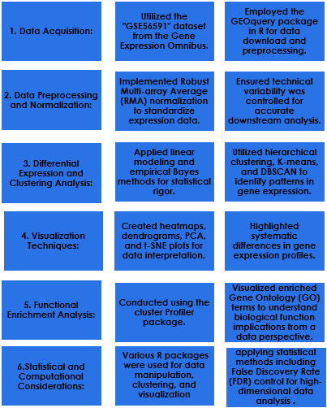
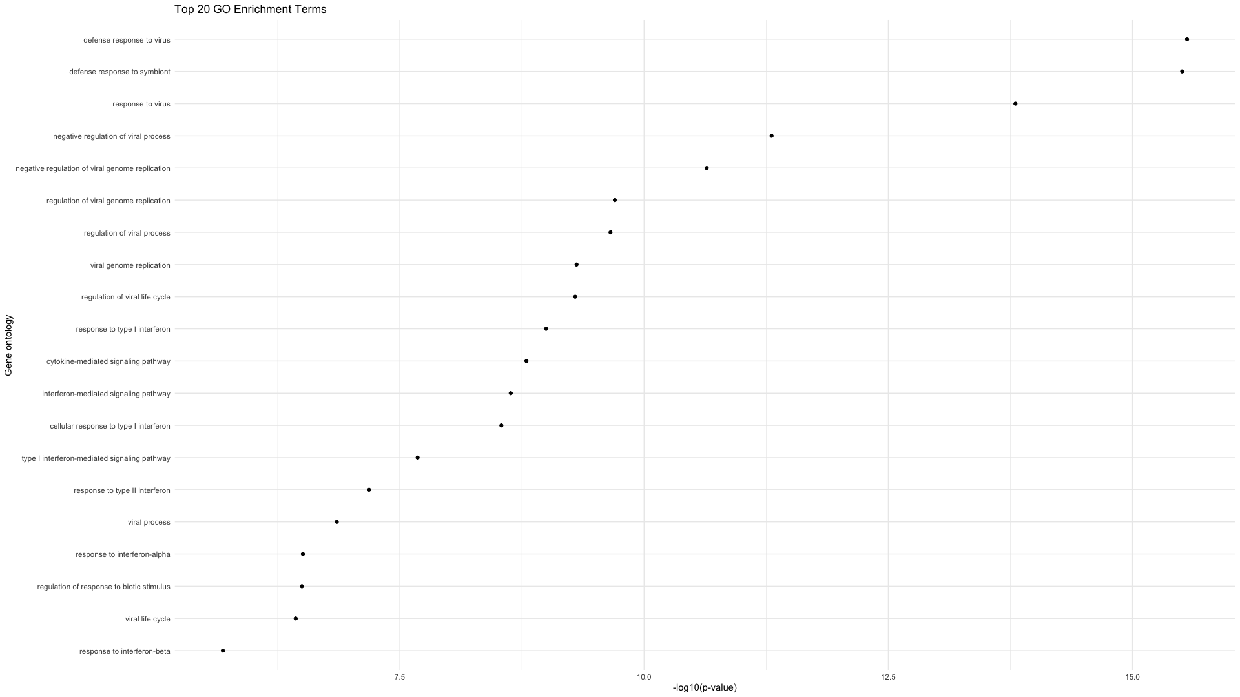
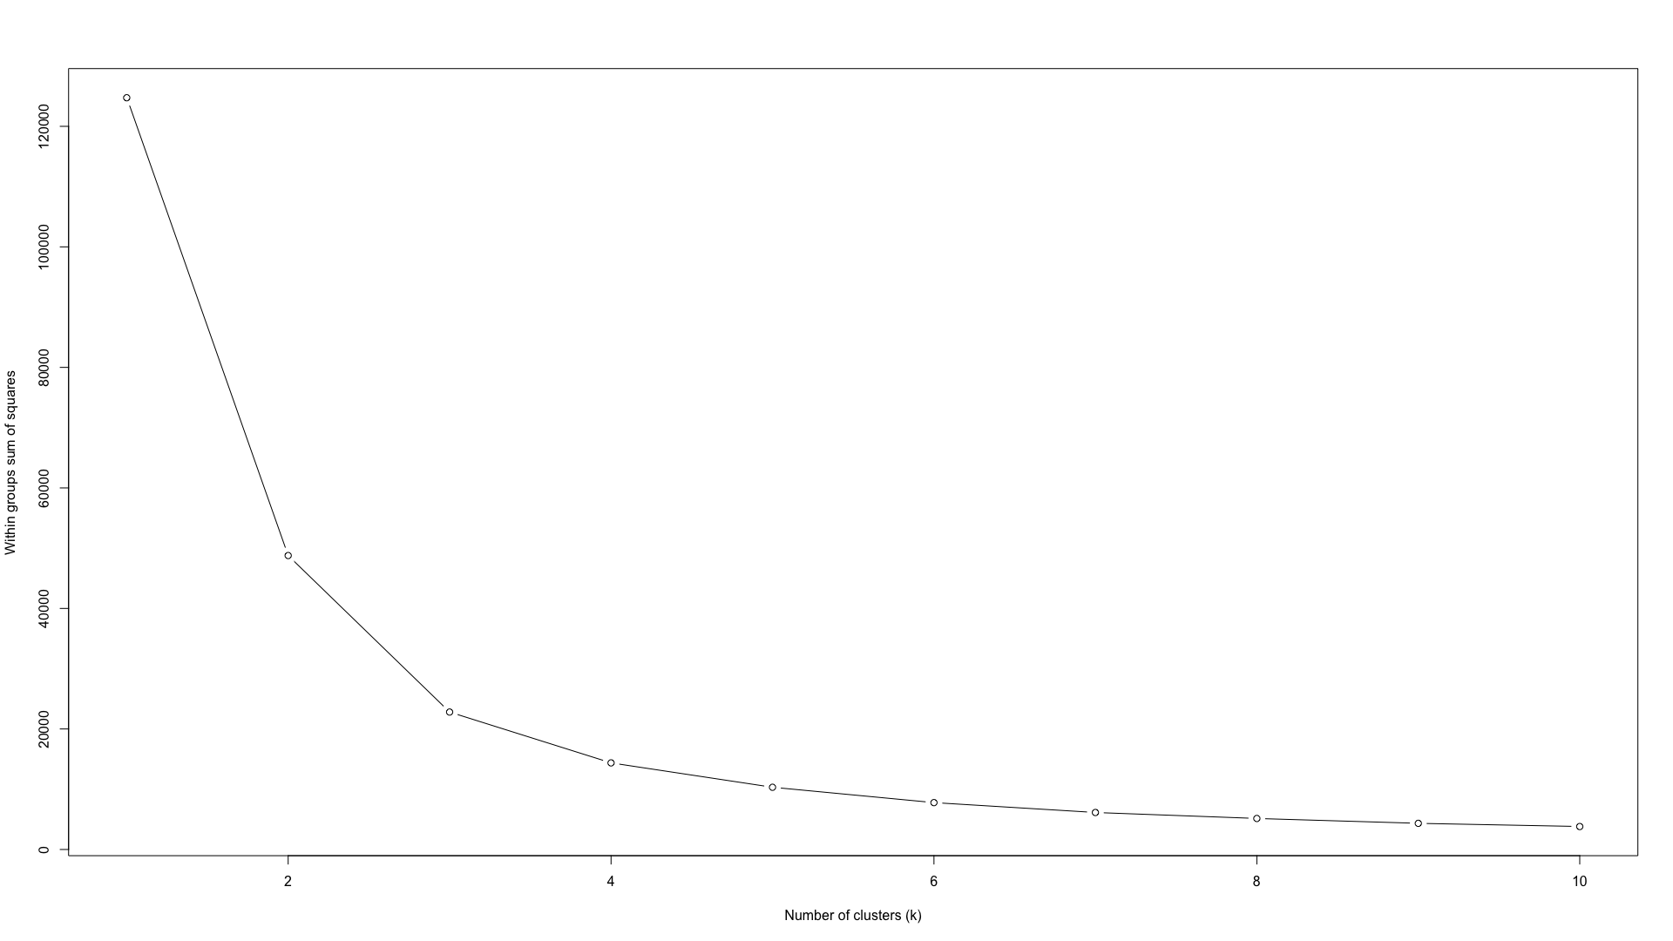
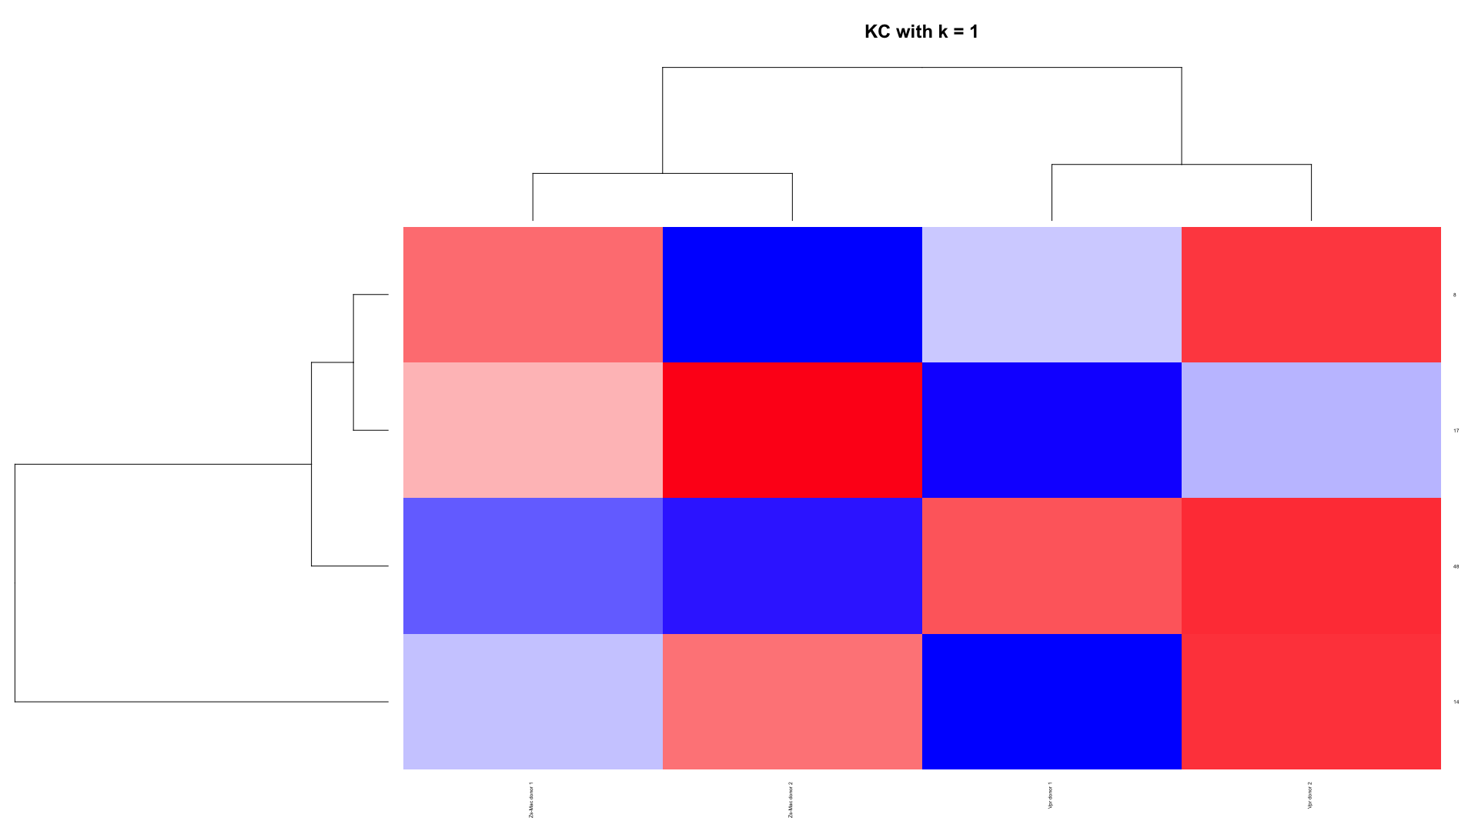
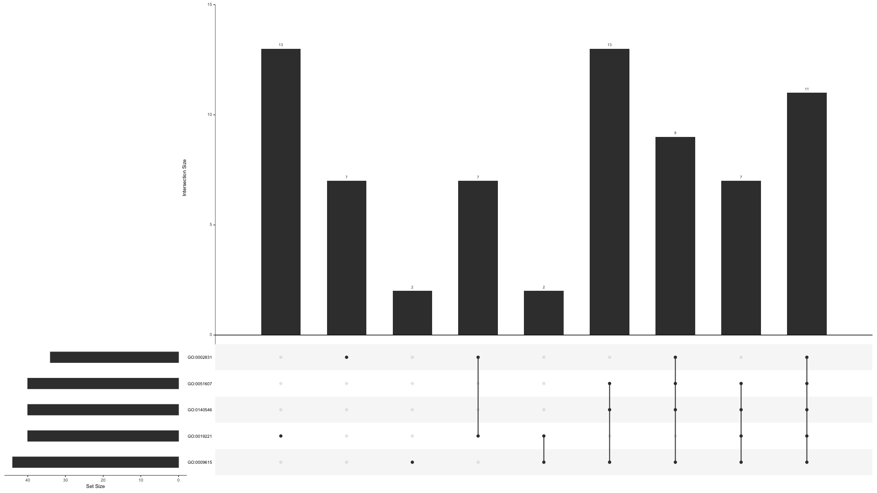
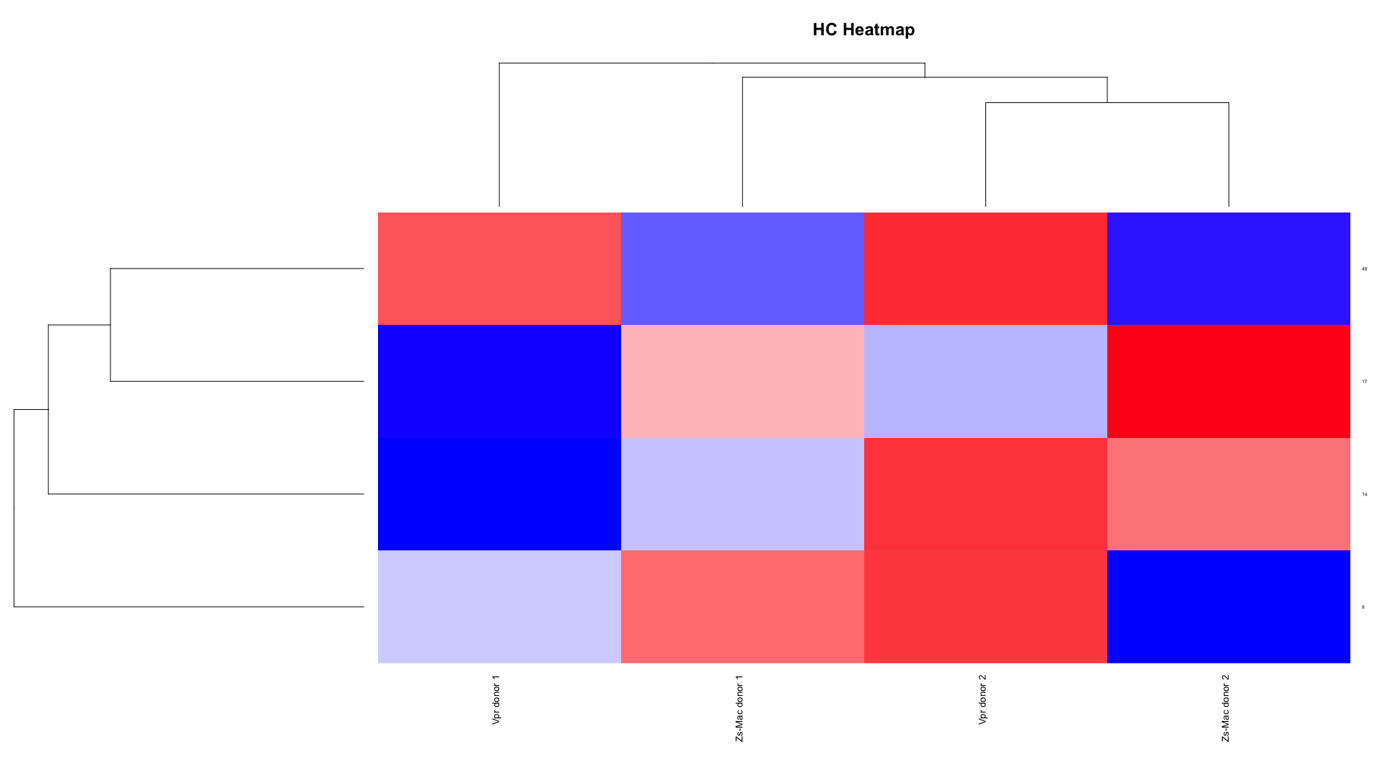
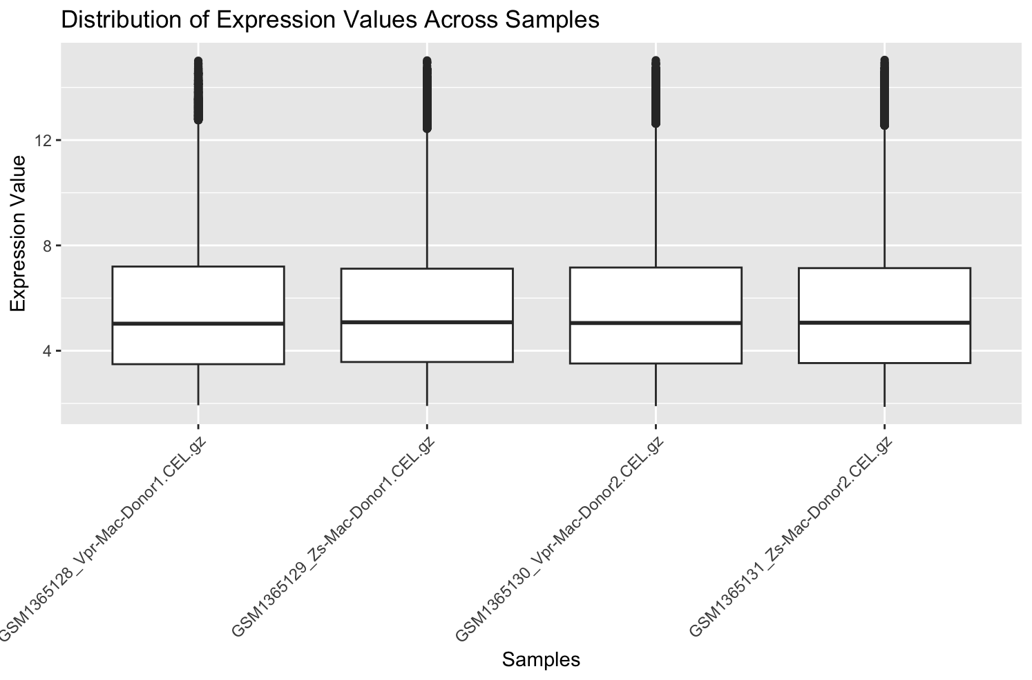
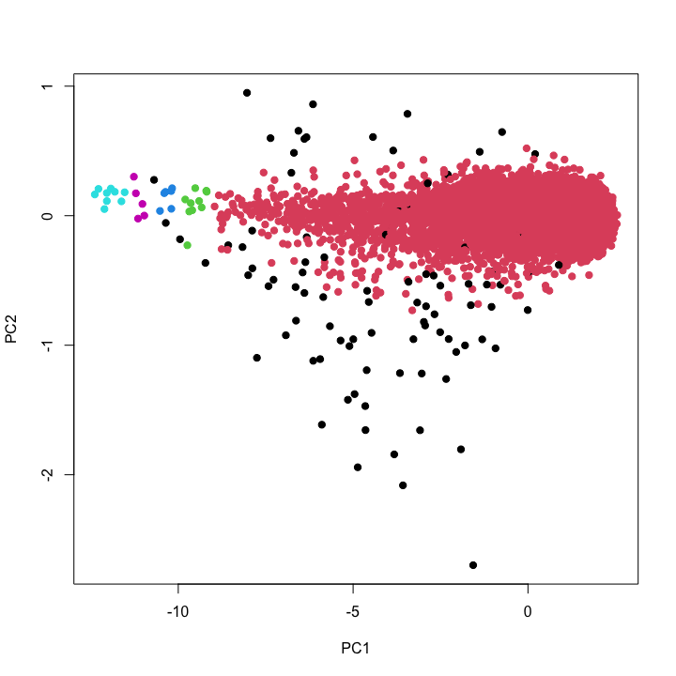
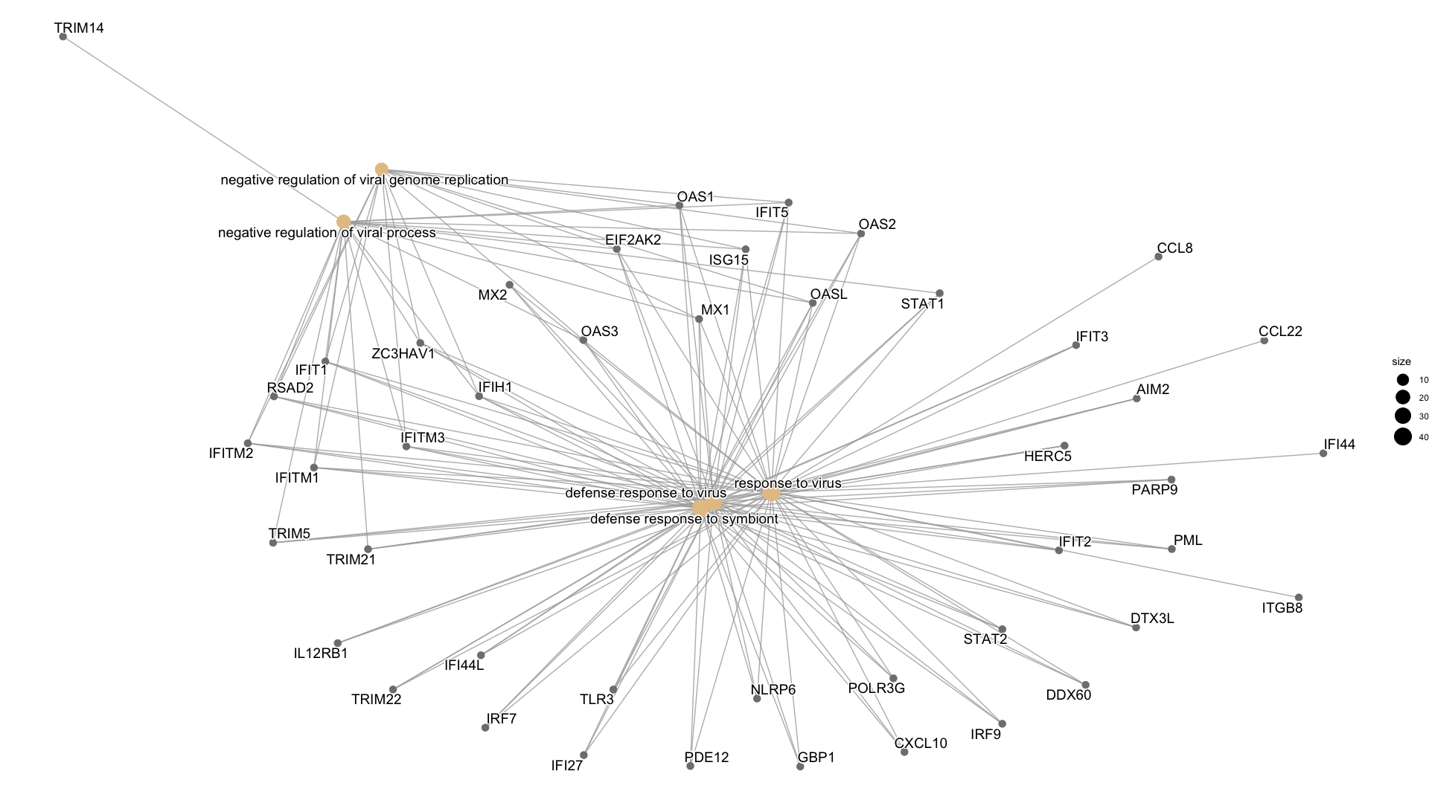
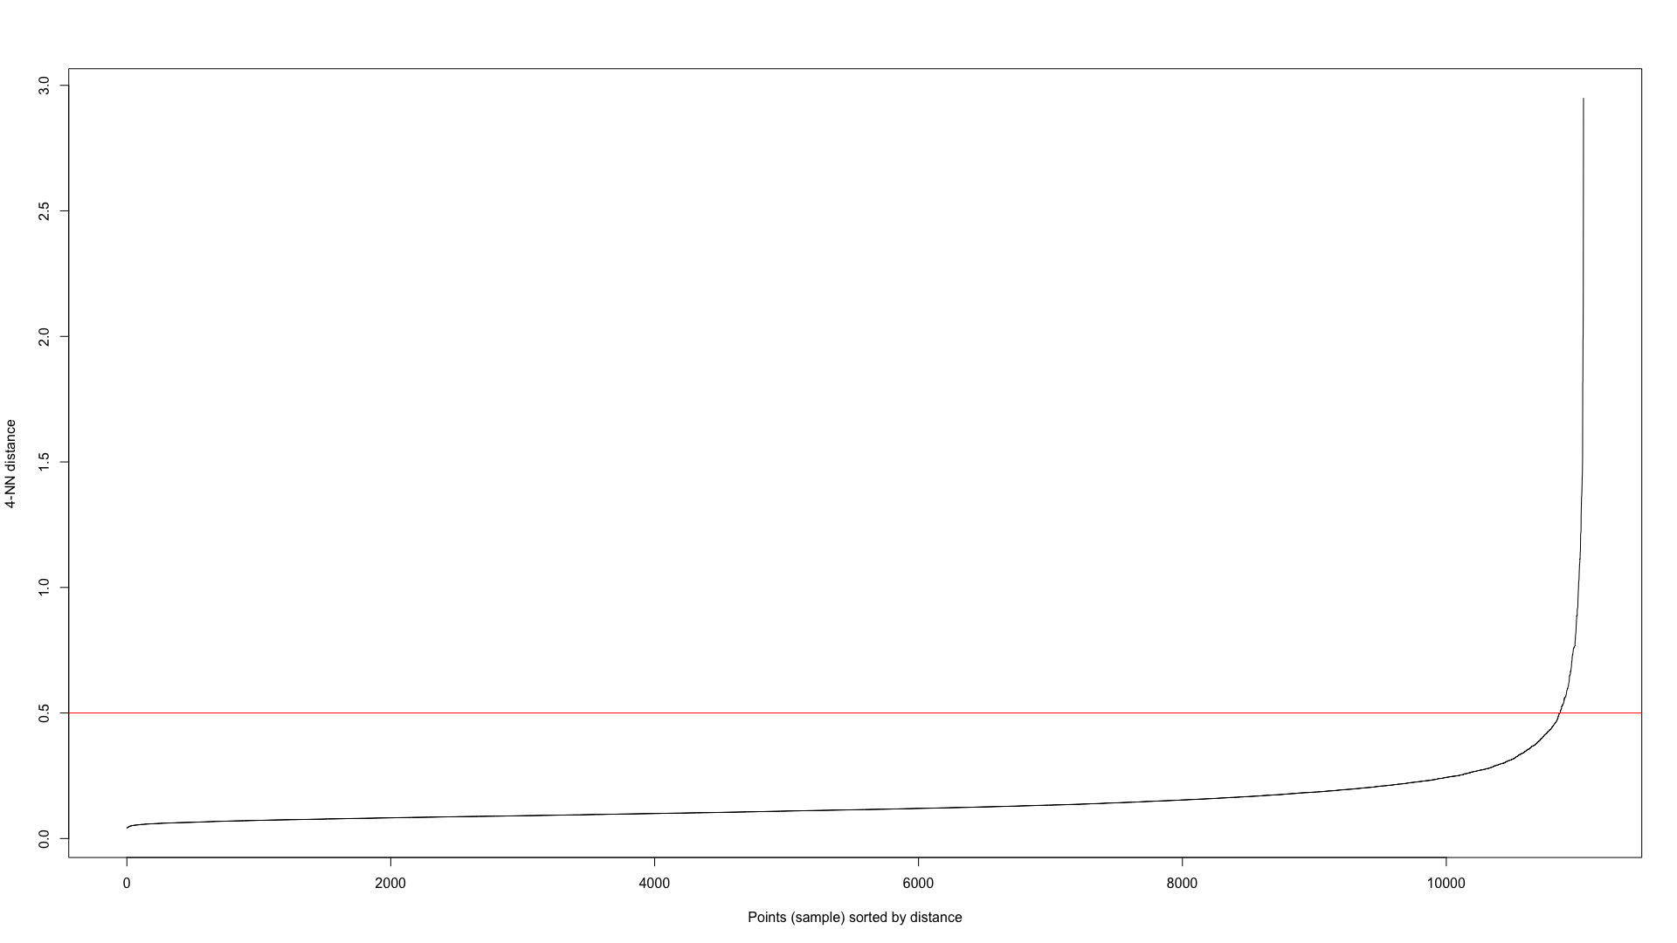
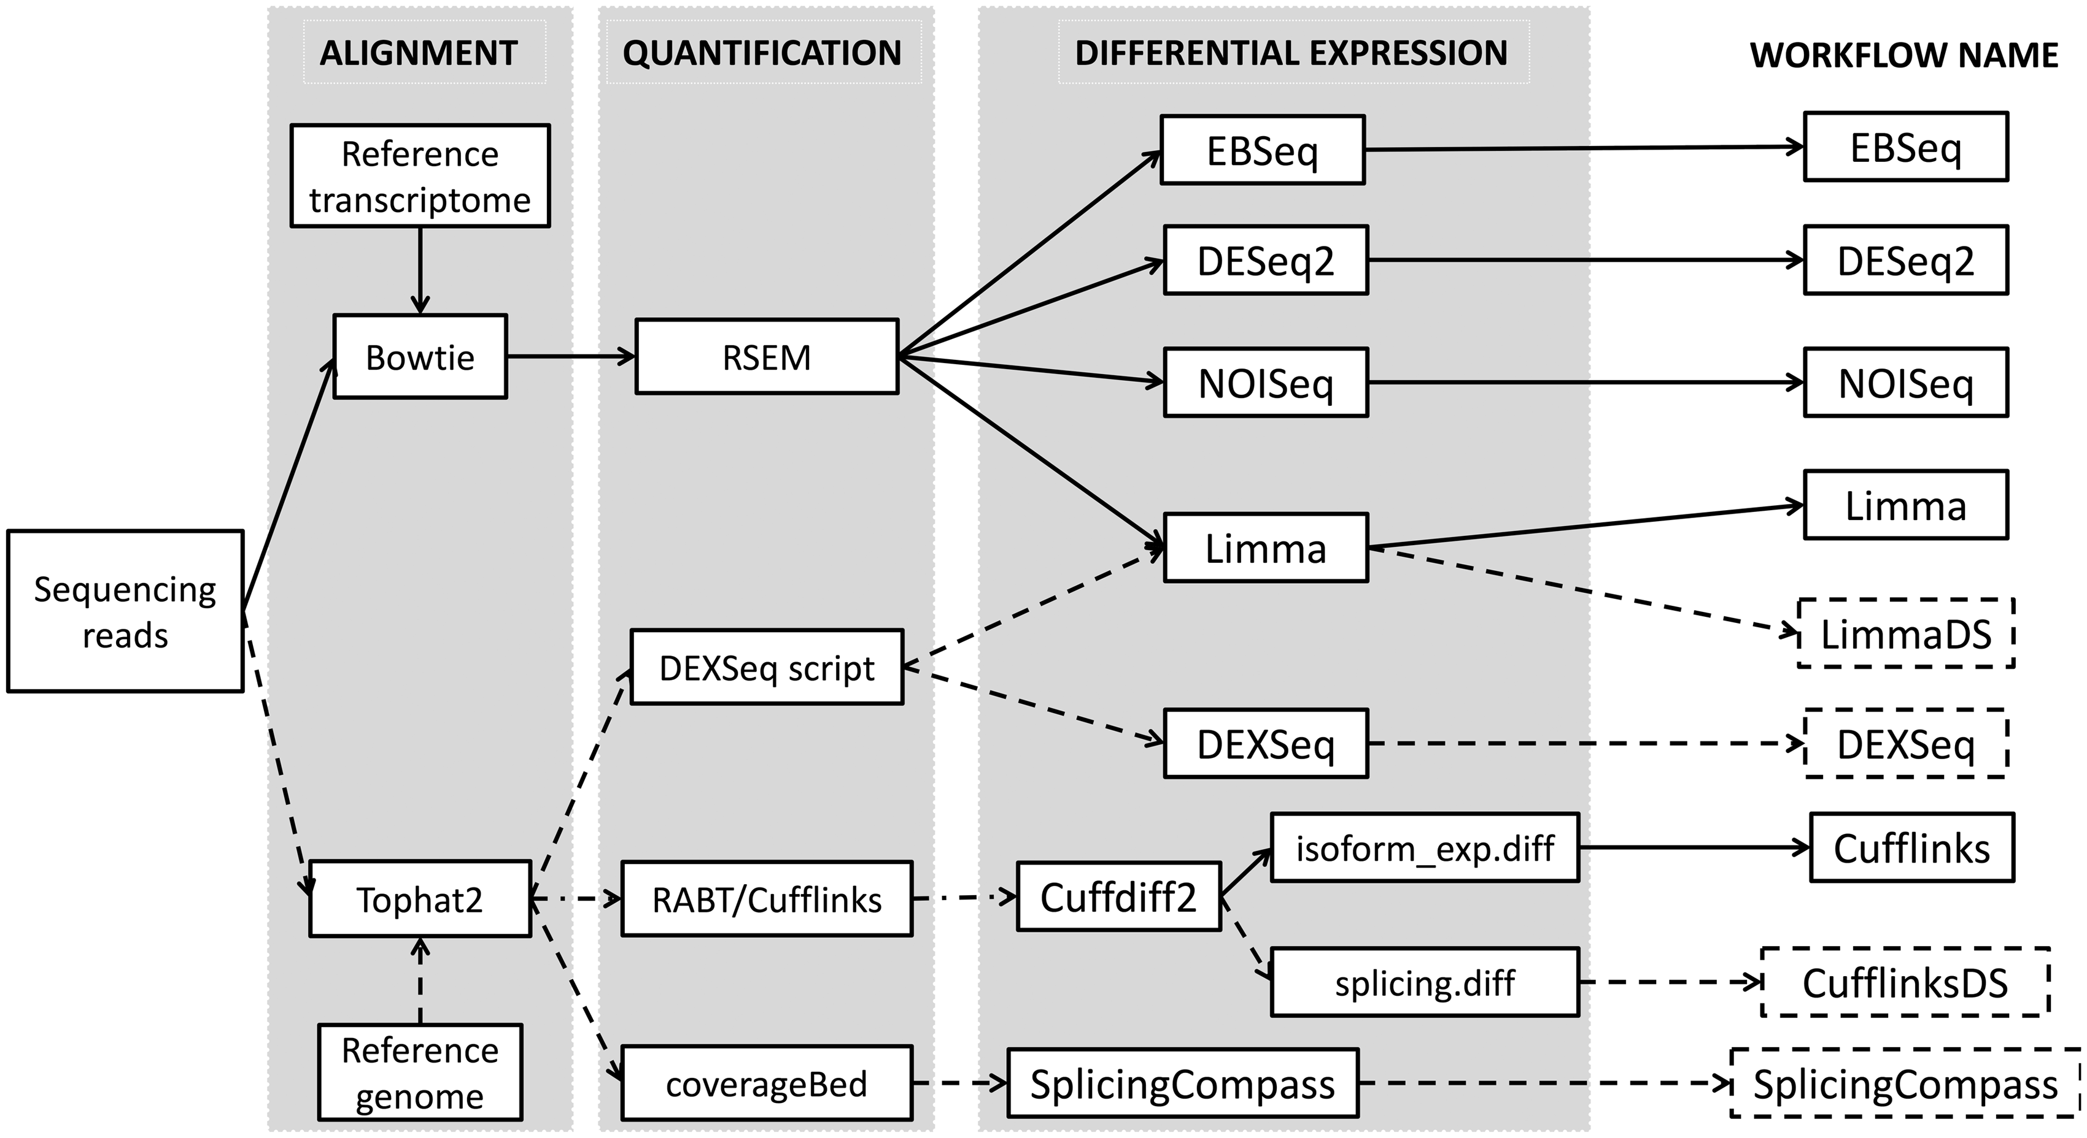
Impact of HIV1-Vpr on Cell Replication
Authors: Bilal Kachir, Eyimofe Oladipo, Mohamed Saeed
University of Detroit Mercy – College of Engineering & Science
ABSTRACT
MATERIALS & METHODS
RESULTS
CONCLUSION
The HIV-1 accessory protein, Viral Protein R (Vpr), is instrumental in the pathogenesis of HIV, significantly influencing cell replication processes critical to understanding HIV/AIDS progression. This study delves into the impact of Vpr on cell cycle dynamics, DNA repair activities, and interactions with the immune system, which are key to devising effective HIV/AIDS treatments.[1]
We employed gene expression data from the ”GSE56591” dataset in the Gene Expression Omnibus, implementing Robust Multi-array Average (RMA) normalization to standardize this data. Our analysis included differential expression assessment using linear models and empirical Bayes methods, providing a robust statistical framework. We used clustering methods like hierarchical clustering, K-means, and DBSCAN to discern patterns in significant gene symbols, enhancing our under- standing of Vpr’s role at the molecular level. Visualization techniques, including heatmaps, dendrograms, PCA, and t-SNE, were integral for interpreting these complex data patterns.[2] The study also encompassed functional enrichment analysis using the clusterProfiler package, which identified and visualized enriched Gene Ontology (GO) terms, offering insights into the biological functions and pathways implicated by Vpr’s activity.
Our findings indicate that Vpr induces G2/M cell-cycle arrest in host cells, a mechanism likely contributing to the depletion of CD4+ T cells, a cornerstone of HIV/AIDS progression. Addi- tionally, we observed Vpr’s role in activating the DNA damage response in host cells, underlining its critical function in the virus’s life cycle and its ability to evade the immune system. These results pave the way for novel therapeutic strategies targeting Vpr-related pathways. The potential development of Vpr-specific inhibitors, combined with existing antiretroviral therapies, could significantly enhance HIV/AIDS treatment efficacy. This research not only broadens our comprehension of HIV-1’s interaction with cellular mechanisms but also heralds new avenues in HIV/AIDS therapeutic research and development
1. Data Quality Confirmation: Post-normalization, uniform median expression levels confirmed controlled technical variability.
2. Clustering Analysis: PCA and hierarchical clustering revealed distinct gene expression patterns with clear clusters.
3. Differential Expression and Enrichment Analysis: Identified genes showed significant changes in expression linked to biological processes like the response to virus and defense response to the virus, highlighting a strong immunological gene expression signature.
4. Integration of Multi-Omic Data and Network Analysis: Network analysis provided insights into common pathways and processes, highlighting key genes and their multifunctional roles in enriched biological processes.
The study highlights the significant role of HIV-1 Vpr protein in modulating the transcriptional profile of monocyte-derived macrophages (MDMs), particularly influencing innate immunity and interferon responses. The research reveals the complex interaction between Vpr and host cellular mechanisms, suggesting novel therapeutic strategies targeting Vpr-related pathways for more effective HIV/AIDS management .
REFERENCES
[1] M. Emerman. (1996). “HIV-1, Vpr and the cell cycle.” Current biology: CB [Online]. vol. 6, issue 9, 1096–1103. https://doi.org/10.1016/s0960-9822(02)00676-0.
[2] Zahoor, M.A., Xue, G., Sato, H., Murakami, T., Takeshima, S.-n., et al. (2014). HIV-1 Vpr Induces Interferon-Stimulated Genes in Human Monocyte-Derived Macrophages. PLoS ONE, 9(8), e106418. https://doi.org/10.1371/journal.pone.0106418
OBJECTIVES
The objective of this study is to examine the impact of the HIV-1 accessory protein Viral Protein R (Vpr) on cell cycle dynamics, DNA repair activities, and interactions with the immune system. These aspects are crucial for understanding HIV/AIDS progression and devising effective treatments​​.

