Slide 1

Analog to Digital Converter
Mohamed Saied

Slide 2

Agenda
What are the Types of Signals?
What is meant by an Analog Signal?
Types of Sensors?
ADC Theory
SAR in detail
ADC Module in AVR
Polling and Interrupt for ADC

Slide 3
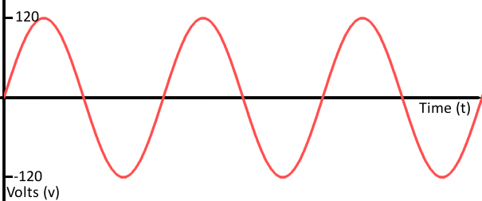
Analog Signal

Slide 4
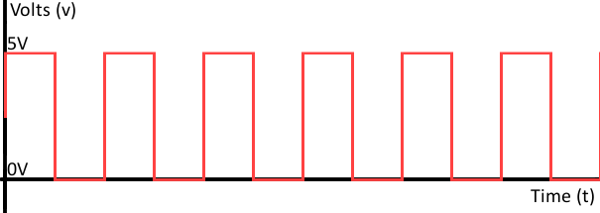
Digital Signal

Slide 5
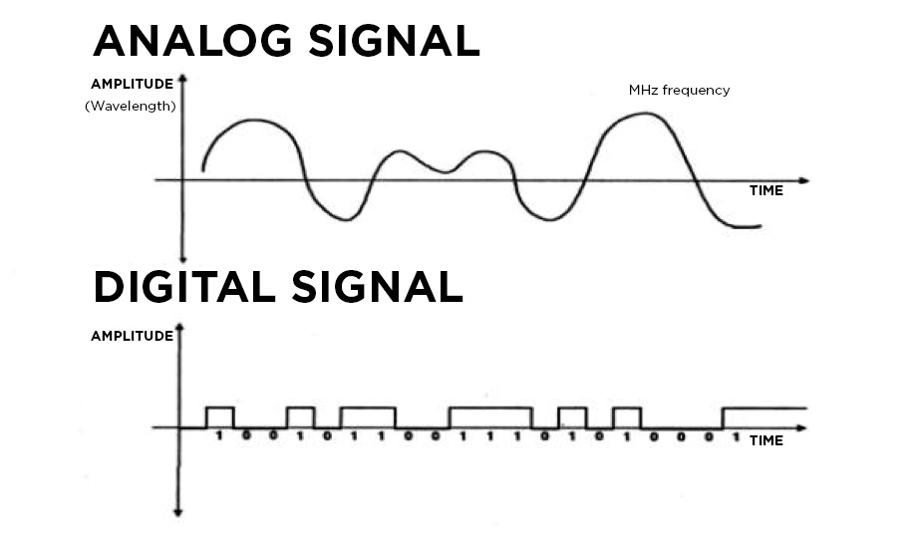
Signal Parameters
Amplitude is maximum displacement or distance moved by a point on a vibrating body or wave measured from its equilibrium position. It is equal to one-half the length of the vibration path.
frequency is the number of complete cycles per second
So F= 1/T

Slide 6
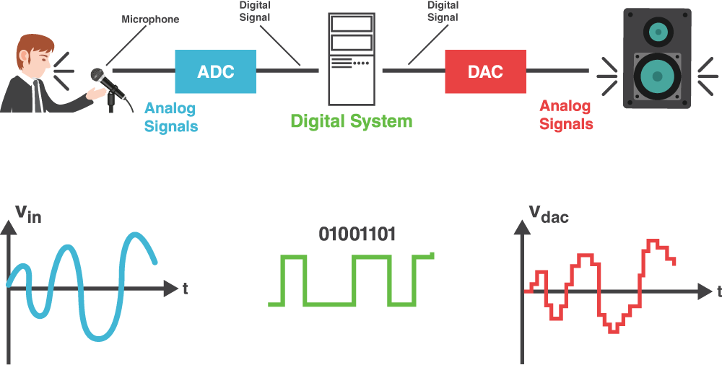
Examples of Analog to Digital

Slide 7
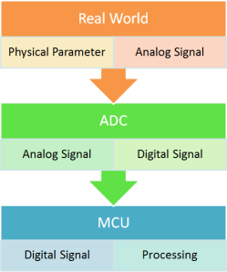
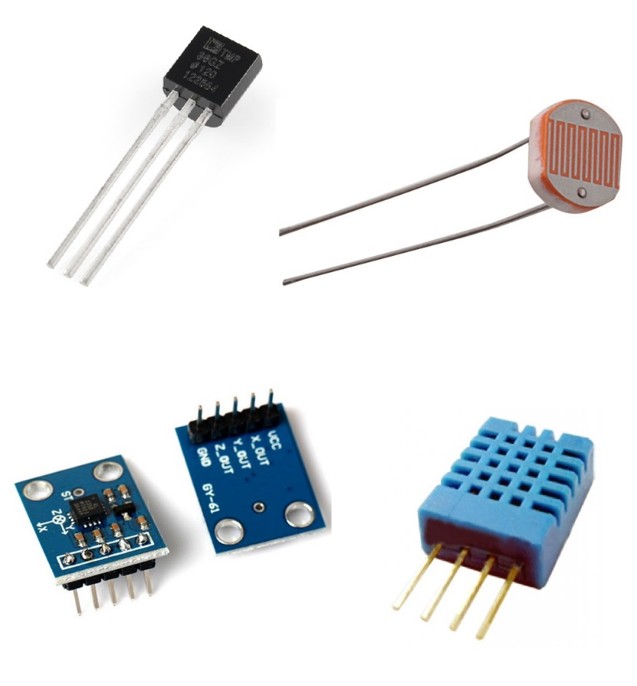
Dealing with Real world

Slide 8
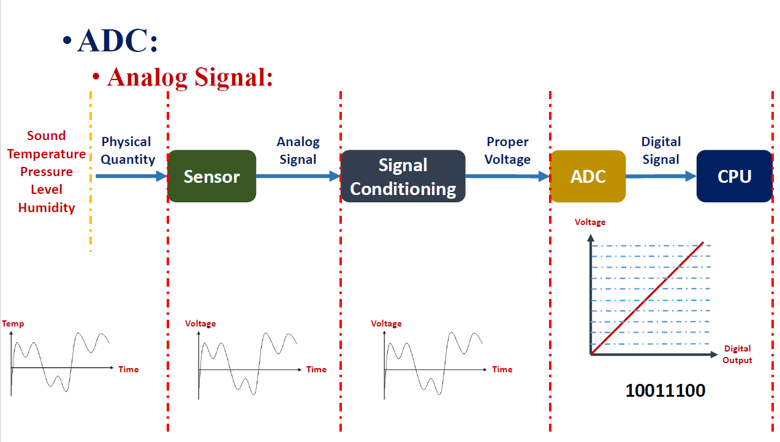

Slide 9
Procedure to Convert an Analog Signal
Two steps for Converting an analog Signal into Digital Signal:
1) Sampling 2) Quantization
Analog
Sampling
Sampled
Quantization
Digital
Step 1: Sampling converts a continuous time continuous amplitude (real valued) signal to discrete time continuous amplitude (still real valued) signal. Remember only time axis is discretized and not the amplitude axis.
Step 2: Quantization converts the discrete time continuous amplitude signal to discrete time and discrete valued (from a set of finite values, so that it can be represented by finite bits and can be stored on a computer).

Slide 10
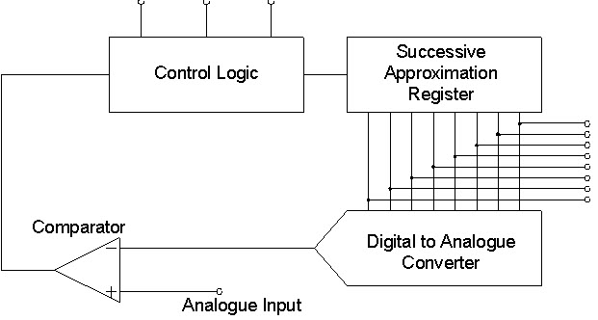
Types of Analog to Digital Converters
Some of the types of analog to digital converters include:
Dual Slope A/D Converter
Flash A/D Converter
Successive Approximation A/D Converter

Slide 11
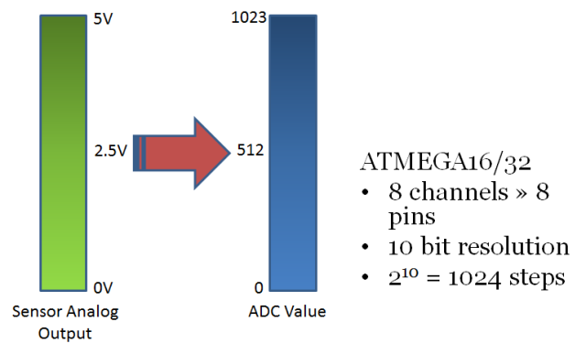



ADC Resolution

Slide 12
References
The Scientist and Engineer's Guide to Digital Signal Processing By Steven W. Smith, Ph.D. Online Version : https://www.dspguide.com/ch29.htm

