Slide 1

DIO Layered Arch.
Mohamed Saied

Slide 2
Contents
DIO Examples for Input and Output
DIO in AVR
Simple DIO Register access
DIO circuits with microcontroller
→ LEDS , Buttons , Buzzer and Relay

Slide 3
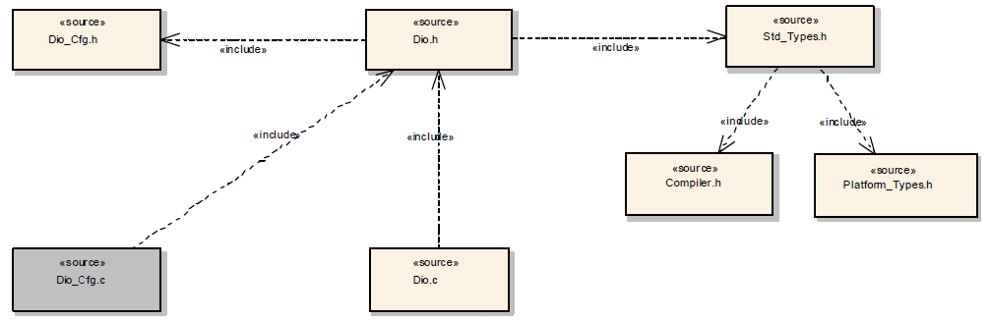
DIO Architecture

Slide 4
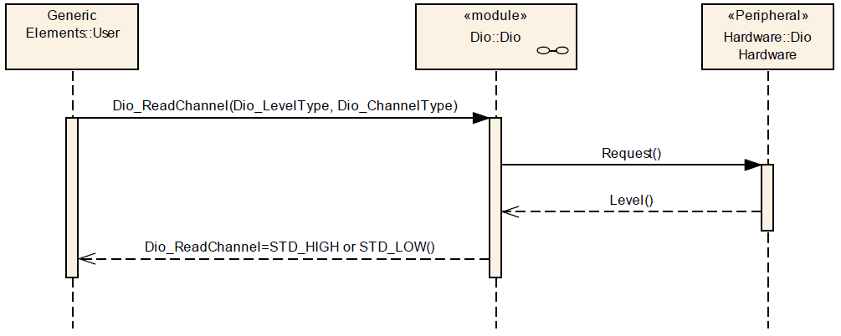
Read from DIO Channel

Slide 5
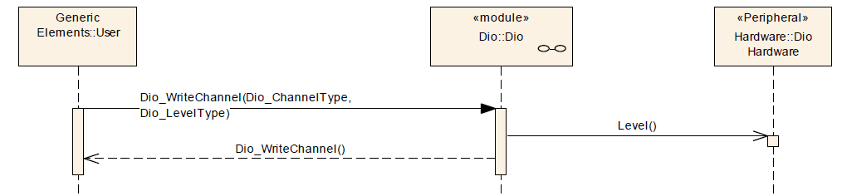
Write to DIO Channel
Sequence Diagram for Writing to a specific Channel

Slide 6
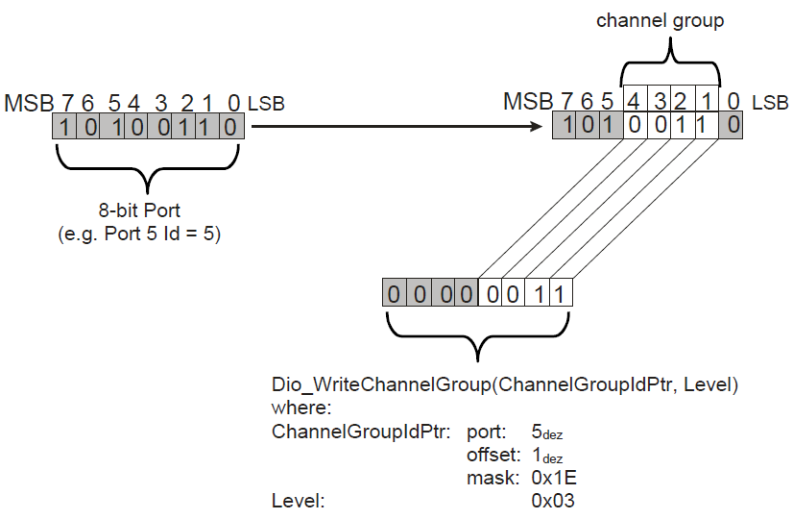
DIO Write Channel

Slide 7
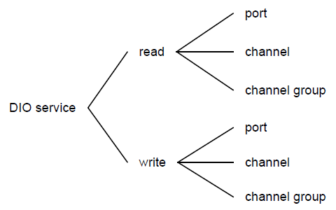
DIO Service

