Slide 1

Serial Peripheral Interface
Mohamed Saied

Slide 2
Synchronous Mode
Sender sends a clock signal along with data at every rising / falling edge of the clock, the data value is read by the receiver.
SENDER
0
1
0
1
SENDER CLOCK
RECIEVER
0 1 0 1

Slide 3
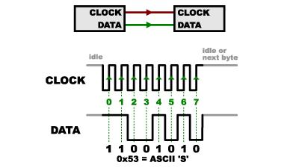
Why SPI?
To overcome the overhead problem of the UART[Asynchronous protocol] , the need of synchronous solution became essential.
Where the communication is over bus means multiple devices can communicate on the same lines
SPI is a single master multi-slave protocol
Slave follows the clock of the master

Slide 4
How SPI works?
The interconnection between Master and Slave CPUs with SPI is shown in Figure 66. The system
consists of two Shift Registers, and a Master clock generator. The SPI Master initiates the
communication cycle when pulling low the Slave Select SS pin of the desired Slave. Master and
Slave prepare the data to be sent in their respective Shift Registers, and the Master generates
the required clock pulses on the SCK line to interchange data. Data is always shifted from Master
to Slave on the Master Out – Slave In, MOSI, line, and from Slave to Master on the Master In
– Slave Out, MISO, line. After each data packet, the Master will synchronize the Slave by pulling
high the Slave Select, SS, line.
When configured as a Master, the SPI interface has no automatic control of the SS line. This
must be handled by user software before communication can start. When this is done

Slide 5
Why SPI? Cont’
We can use SPI when interfacing with sensors or modules which have specific or complex structure like it needs special initialization commands so we transfer data and wait for the module to response , for example we send one byte and the module might send two bytes in return , so we expect variable data length , this is where SPI can be useful.

Slide 6
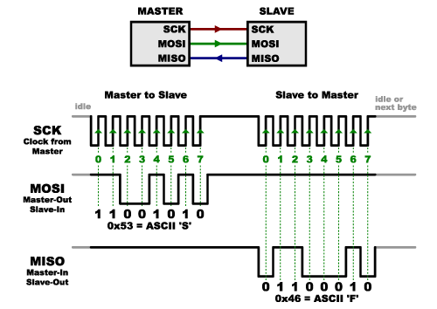
How Communication is done?
Clock has phase and polarity transfer is done at specific edge condition
SPI has 4 lines one for clock
And two for data , Master Out Slave in
Master In Slave Out

Slide 7
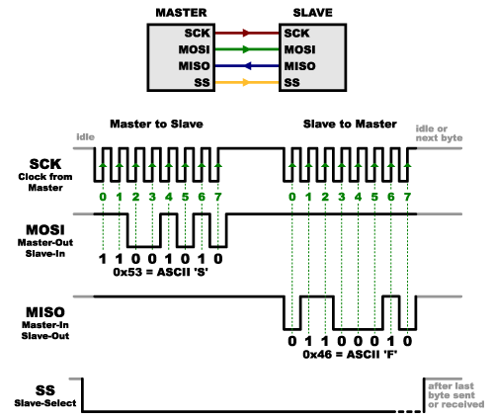
Slave select
SS pin is slave select is to make the master to select which device to communicate with
It’s an active low signal comes out from
The master to slave
In master the user has the control of
The SS pin
In slave the SPI has the control on SS pin

Slide 8
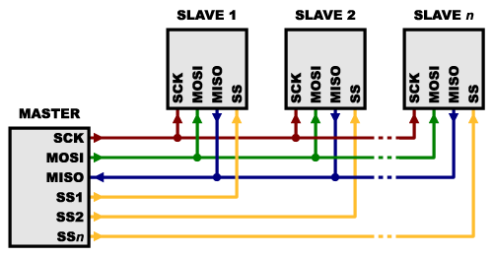
Single Master Multi-Slave
Multiple slaves option is guaranteed in SPI by using multiple SS pins each for every device

Slide 9
Data Transfer in SPI
MOSI
MISO
M1
M2
M3
M4
M5
M6
M7
S0
S1
S2
S3
S4
S5
S6
S7
M0
MASTER
SLAVE

Slide 10
Data Transfer in SPI
MOSI
MISO
M2
M3
M4
M5
M6
M7
S0
S1
S2
S3
S4
S5
S6
S7
M0
M1
MASTER
SLAVE

Slide 11
Data Transfer in SPI
MOSI
MISO
S0
S1
S2
S3
S4
S5
S6
S7
M0
M1
M2
M3
M4
M5
M6
M7
MASTER
SLAVE

Slide 12
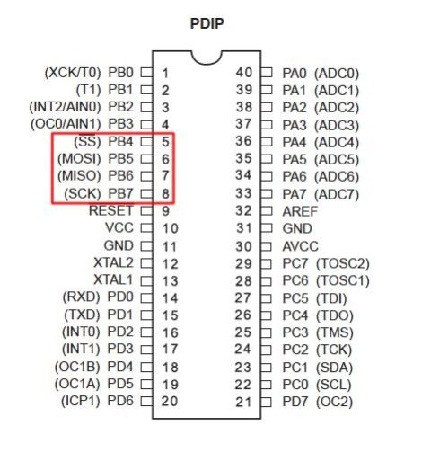
SPI in AVR
SPI pins in atmega32

Slide 13
SPI Registers
SPCR – SPI Control Register – This register is basically the master register i.e. it contains the bits to initialize SPI and control it.
SPSR – SPI Status Register – This is the status register. This register is used to read the status of the bus lines.
SPDR – SPI Data Register – The SPI Data Register is the read/write register where the actual data transfer takes place.

Slide 14

Control Register
enable SPI, set up clock speed ,its phase and polarity, configure master/slave, polling or interrupt and data order

Slide 15


Clock phase and polarity
Clock polarity
Clock phase

Slide 16
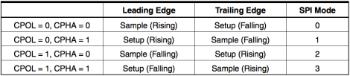
Data Modes

Slide 17
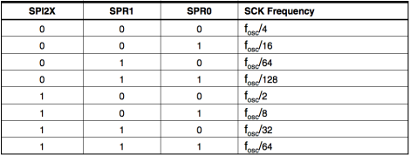
SPI Speed
Note that spI2X is placed in SPSR and its used when we need specific frequency or high speed communication.

Slide 18
Initialize SPI in Master Mode
Data Order
Select mstr to 1
Clock polarity and phase
Select Speed
Enable SPI
Interrupt or polling

Slide 19
LAB
Write two programs for two atmega32 to Communicate over SPI
Configure Speed to 1Mhz
The first is master and the second is slave
Where master sends ‘A’ and slaves checks if ‘A’ was received it gets led on

