Slide 1

Timers
Mohamed Saied

Slide 2
What is Timer?
A timer is a circuit that counts. This is said from an electronics point of view.
It is widely used and is a very important component of microprocessors and microcontrollers.

Slide 3
Timer Basics
Timers are classified based on their mode of operation into synchronous and asynchronous timers.
Synchronous timers count with respect to the clock while asynchronous timers depend upon the change in the input.
They are also classified according to the maximum number they can count. Eg. 8 bit timer,16 bit timers etc
Timers are easy to implement and are done using basic flip flop circuits .

Slide 4
Timers in AVR
There are 3 timers in the AVR of which 2 are 8 bit timers the other one is a 16 bit timer.
The timers found in the AVR or mostly in a microcontroller or processor is of synchronous type

Slide 5
8 bits timer vs 16bits timer
what do they mean? An 8 bit timer can count to 2 to the power of 8 and a 16 bit timer can count upto the 2 to the power of 16.
Basically timers in the controller are registers and an 8 bit timer is a 8bit register and 16 bit timer is 16bit register.
The 8 bit timer starts counting from zero and goes upto 255.(that’s 256 counts)
The 16 bit timer starts counting from zero and goes uptp 65535(65536 counts)
Once the timer reaches the maximum value it “overflows” i.e. it restarts.

Slide 6
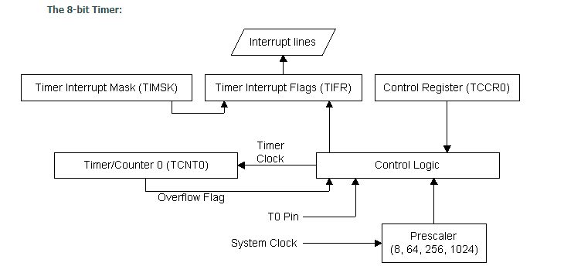
Timer Architecture

Slide 7

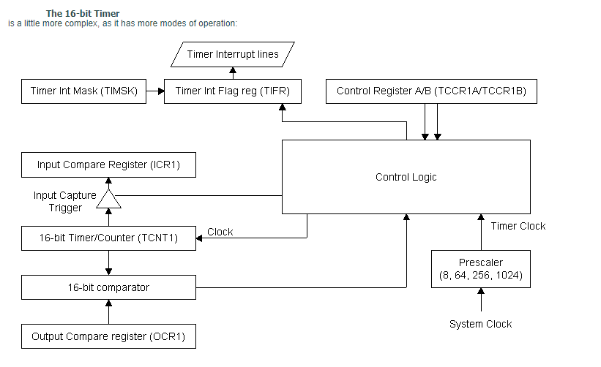
Timer Architecture cont’

Slide 8
Timer Prescalar
What will we do for cases like the 100ms delay?
The solution lies in reducing the frequency.
How do we do that? That’s where that prescaler comes into play.
Do understand that we don’t actually reduce the frequency of the clock but we make the timer to behave as if it is in a reduced frequency
Also note that there will be a trade-off between resolution and accuracy if you use a prescalar.
The prescalar is set by manipulating some bits.

Slide 9
Timer Modes of Operation
Normal Mode
Output Compare Mode
Clear Timer on Compare Match
Input Capture

Slide 10
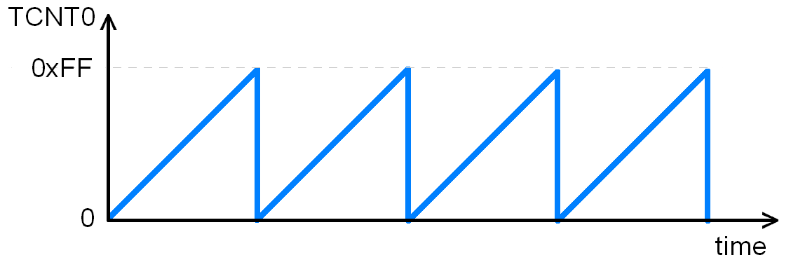
8 Bit Timer

Slide 11
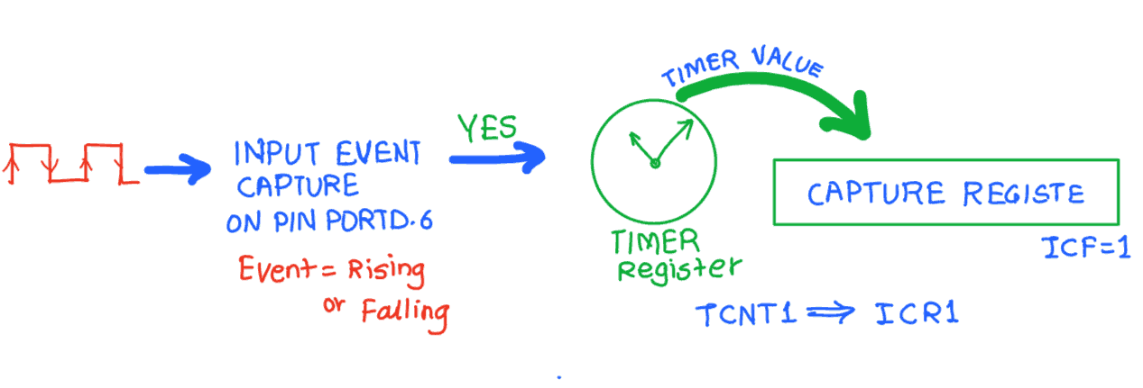
Input Capture Mode

Slide 12
Steps to Configure in Input Capture
Initialize the TCCR1A and TCCR1B for proper timer mode (any mode other than 8, 10, 12, 14), to select the edge (Positive or Negative).
Monitor the ICF1 flag in TIFR register to see if edge is arrived. Upon the arrival of the edge, the TCNT1 value is loaded in to ICR1 register automatically by controller.

Slide 13
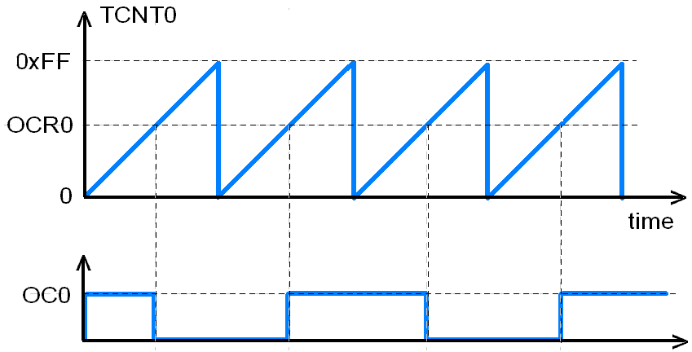
Wave Generation in Normal Mode

Slide 14
LAB01
Measure Pulse width using Input Capture Module
Display duty cycle on LCD

Slide 15
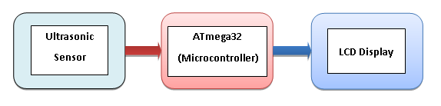
Interface with UltraSonic

Slide 16

PWM
Pulse Width Modulation (PWM) is a technique by which width of a pulse is varied while keeping the frequency constant.
Why we need to do this? Let’s take an example of controlling DC motor speed, more the Pulse width more the speed. Also there are application like, controlling light intensity by PWM.
A period of a pulse consists of an ON cycle (5V) and an OFF cycle (0V). The fraction for which the signal is ON over a period is known as duty cycle.
Duty Cycle (In %) =
E.g. Consider a pulse with a period of 10ms which remains ON (high) for 2ms.
The duty cycle of this pulse will be
D = 2ms / 10ms = 20%

Slide 17
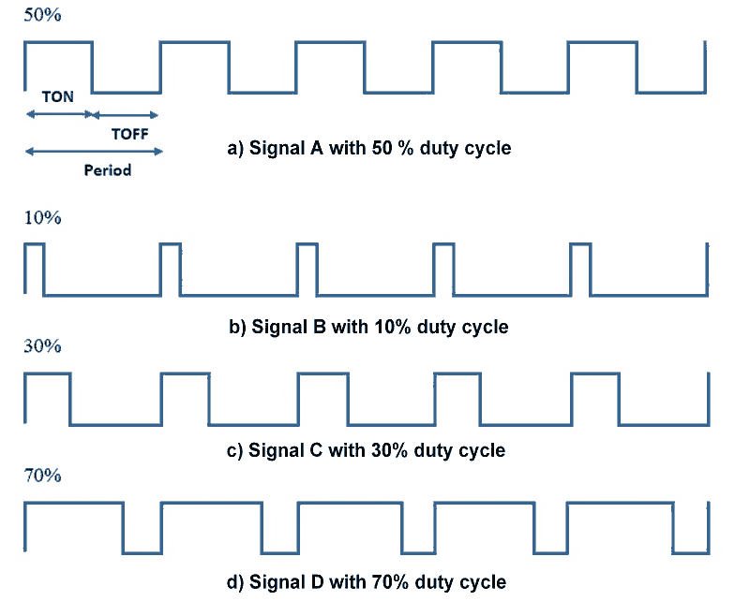
PWM

Slide 18
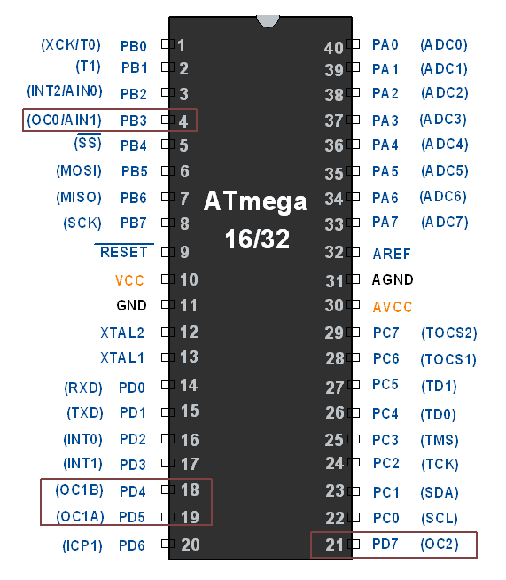
PWM pins in Atmega32
ATmega32 has inbuilt PWM unit. As we know, ATmega has 3 Timers T0, T1 and T2 which can be used for PWM generation. Mainly there are two modes in PWM.
Fast PWM
Phase correct PWM
We need to configure Timer Register for generating PWM. PWM output will be generated on corresponding Timer’s output compare pin (OCx).

Slide 19
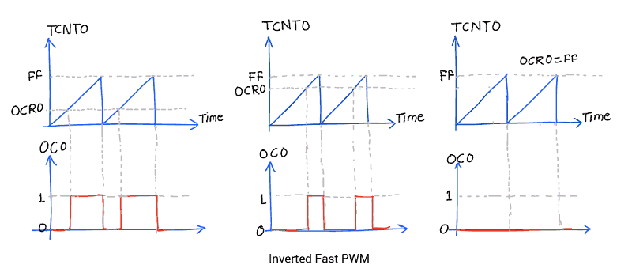
Inverted mode of Fast PWM
Setting Duty cycle: we have to load value in OCR0 register to set duty cycle.
255 value for 100% duty cycle and 0 for 0% duty cycle. Accordingly, if we load value 127 in OCR0, Duty cycle will be 50%.

Slide 20
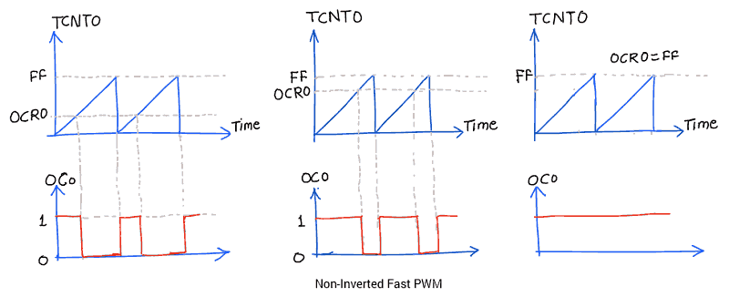
Non-inverted Fast PWM
Setting Duty cycle in non-inverted mode

Slide 21
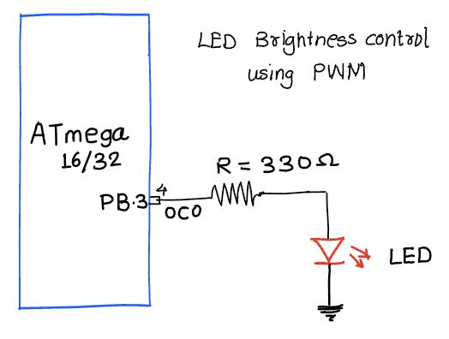
LAB PWM
Control LED brightness using Fast PWM.

Slide 22
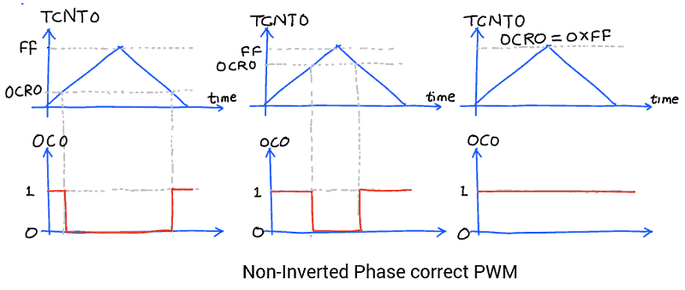
Phase Correct PWM mode

Slide 23
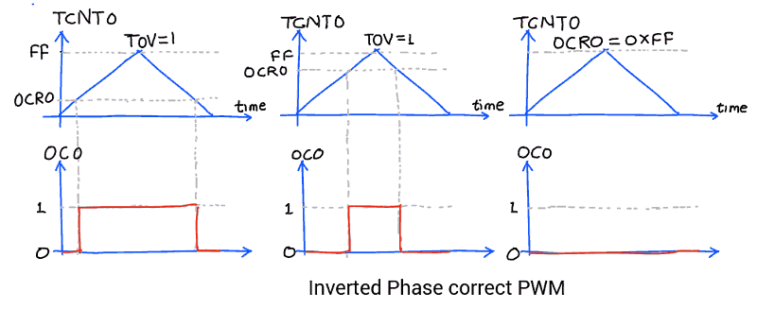
Phase Correct of inverted PWM

Slide 24
LAB Phase Correct PWM
Use Phase correct pwm

Slide 25
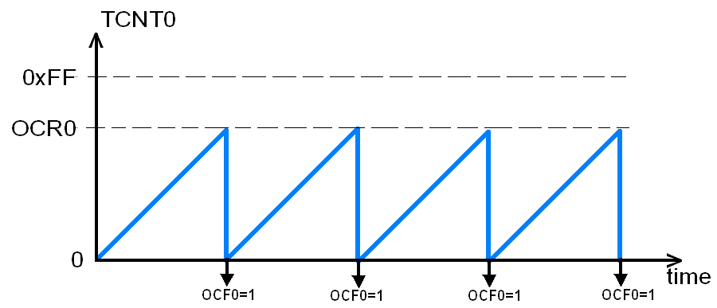
CTC(Clear Timer on Compare Match) Mode

Slide 26
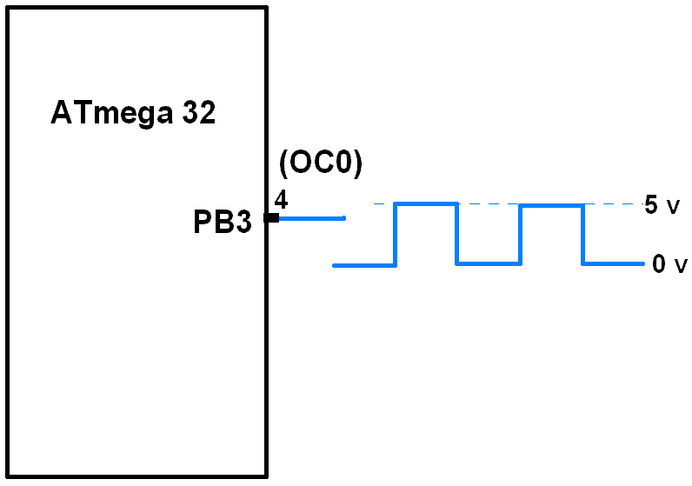
CTC for Wave Generation

Slide 27

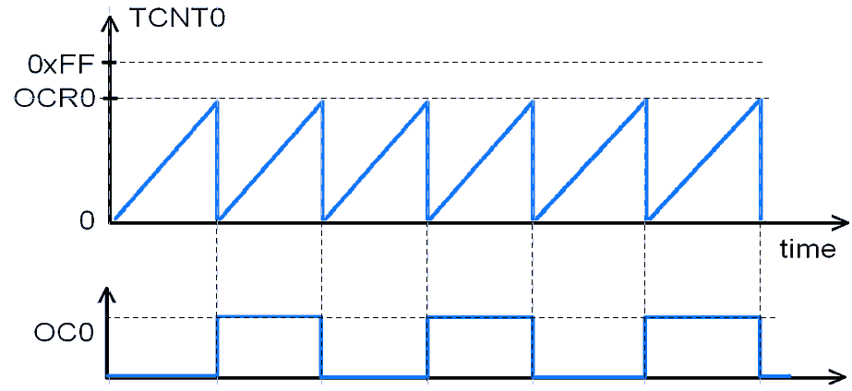
Wave Generation in CTC

Slide 28
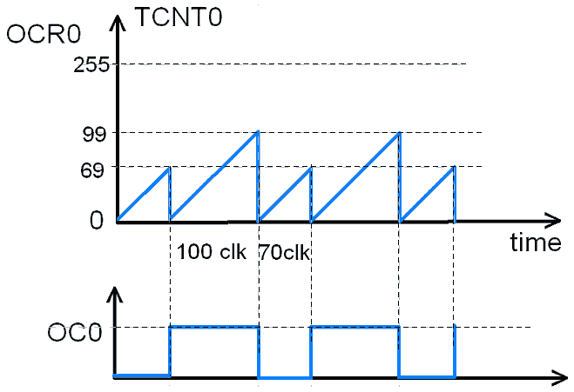
Square wave in CTC

Slide 29
Timer Formula
FPWM = FOSC / ( N * ( 1 + TOP ) )

Slide 30
References
http://www.avrbeginners.net/architecture/timers/timers.html

