Slide 1

Data sharing with Interrupt
Mohamed Saied

Slide 2

Shared-Data Problem
Interrupts should not change data that the another task is using
Main Task
Interrupt
R1 = 3 + 5;
R1 = R1 / 2;
print R1
R1 = R1 + 1
Saving and restoring registers helps
Cannot do the same for memory
- Hard to predict which locations to save

Slide 3

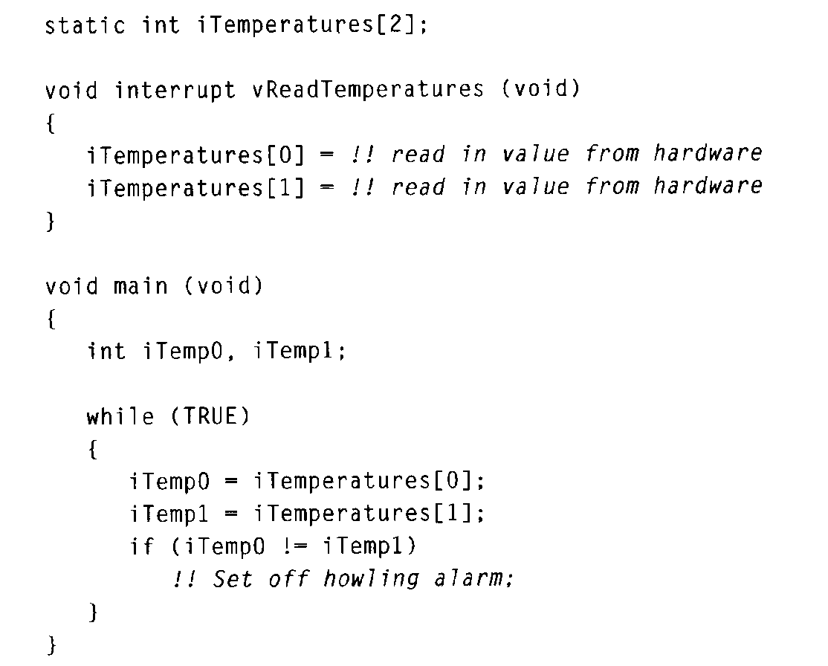
Shared-Data Example
Main task checks two temperatures to make sure they are equal
Interrupt reads the two temperatures periodically
Interrupt can make the temperatures seem out of sync
Bugs are intermittent

Slide 4
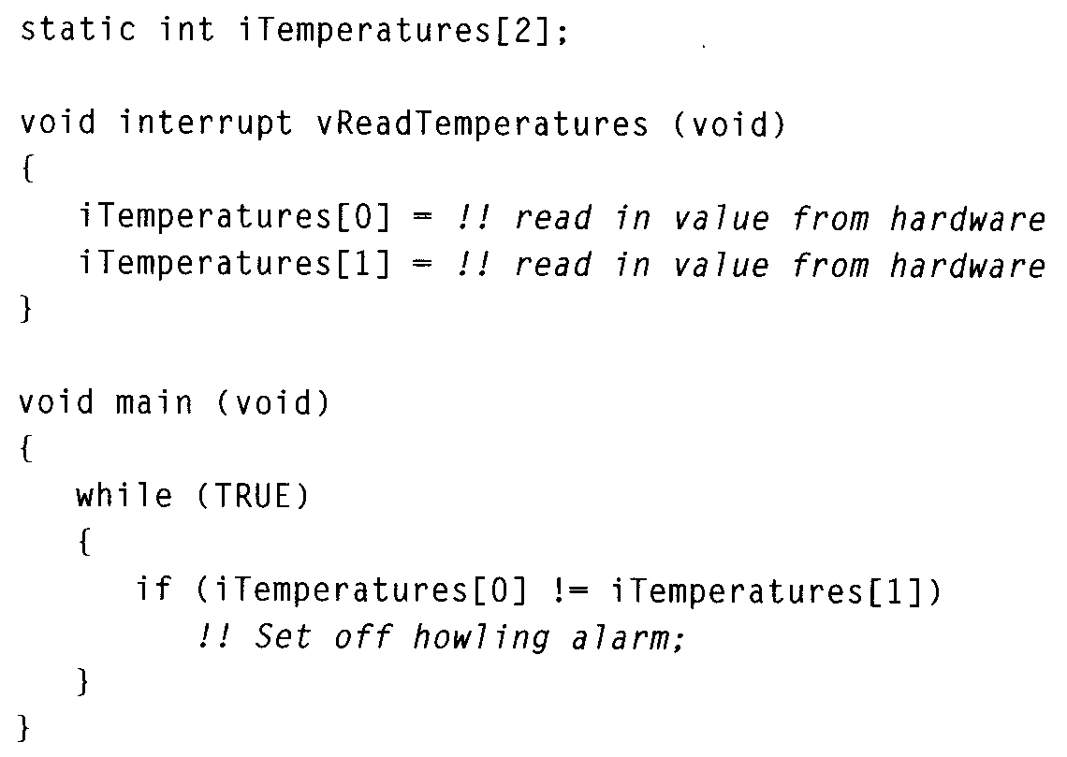
Shared-Data Fix?
Maybe problem can be fixed
Place read and compare on same line
No, assembly does not match C code

Slide 5
Shared-Data Solution
Identify each critical region where interrupts could be disruptive
Identify code regions that use memory written by an interrupt
Reading more than one address can lead to inconsistency
Disable interrupts before the region, enable interrupts after

Slide 6
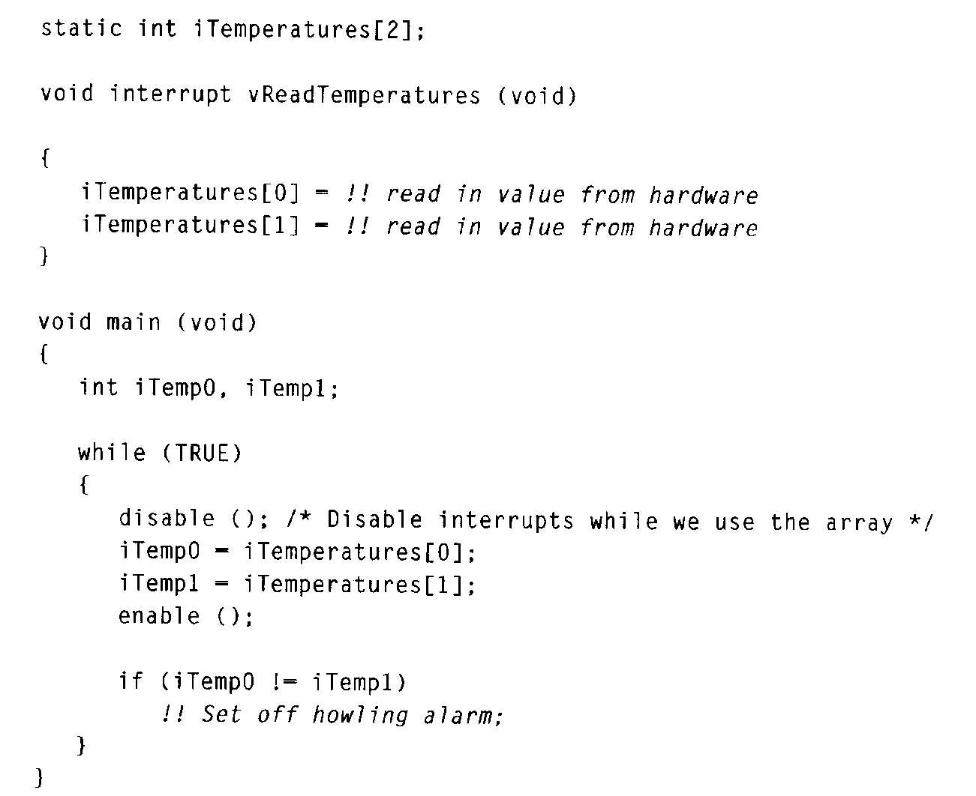
Shared-Data Solution Example
Critical region is where temps are both read by main task
Data reading is “atomic”

Slide 7
Nested Critical Regions
void functionA(void)
{
disableInterrupts( );
---
enableInterrupts( ); }
void functionB(void)
{
disableInterrupts( );
---
functionA( );
---
enableInterrupts( );
--- some code which may be interrupted
}
Critical regions inside function calls can conflict
functionA terminates the critical region of functionB early

Slide 8
Possible Nesting Solution
Code can check to see if interrupts are disabled before disabling and then enabling them.
void functionA(void)
{
if (InterruptsDisabled()) dis=0; else dis=1;
if (dis) disableInterrupts( );
--- some code which must not be interrupted
If (dis) enableInterrupts( );
}

Slide 9
Another Nesting Solution
int DisableCnt = 0;
void functionA(void)
{
MyDisable();
--- some code
MyEnable();
}
void MyDisable()
{
disableInterrupts();
DisableCnt++;
}
void MyEnable()
{
DisableCnt--;
If (DisableCnt == 0)
enableInterrupts();
}
Could use a counter in Enable/Disable routine keep track of “levels” of disabling.
Enabled only when all counts are zero.

Slide 10
Thanks

