Slide 1

Keypad Interfacing
Mohamed Saied

Slide 2
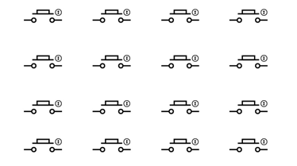
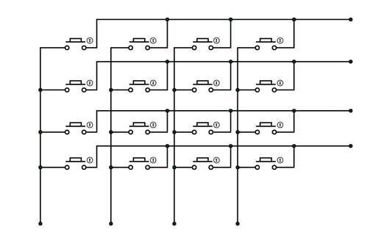
Keypad Interface with AVR
Keypads are parts of HMI or Human Machine Interface and play really important role in a small embedded system where human interaction or human input is needed. Matrix keypads are well known for their simple architecture and ease of interfacing. In this project, we will learn How to interface a 4X4 keypad with AVR ATmega32 microcontroller.
This Matrix has Rows and columns

Slide 3
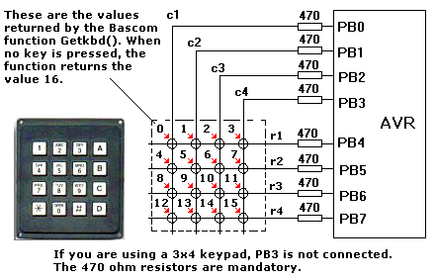
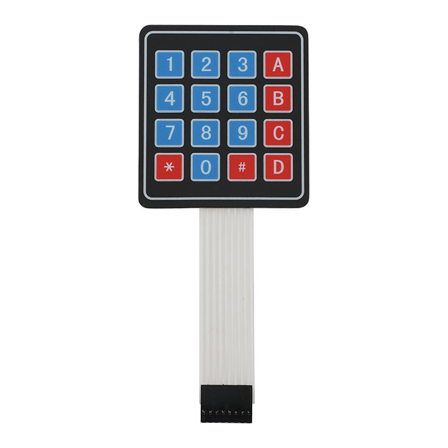
Keypad
Here we have connected 16 keys in a multiplexed form so to reduce the pin usage of controller.
When compared to the first case of connected 16 keys we needed 16pins on controller but now after multiplexing we need simply 8 pins of controller to connect 16 keys.

Slide 4
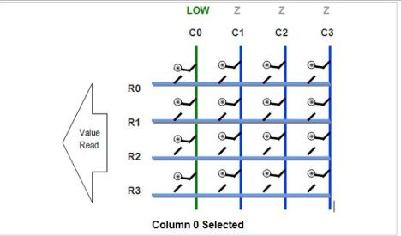
Keypad Operation
in the image as you can see C0 is made LOW while all other Columns are in HIGH Z State.
The Value of R0 to R3 is read to get their pressed status. Since the internal pull-ups have been enabled, if the keys are in the high state, the buttons are NOT PRESSED.
These pull-ups keep their value high when they are floating (that means NOT connected to anything).
But as soon as the key is pressed it gets attached to the LOW line from the column thus making it LOW.

Slide 5
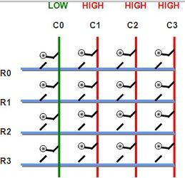
Keypad Operation
Let’s say we selected column number C0, so we make it LOW (i.e., GND or logic 0), in the same time we make all other columns high impedance (i.e. input).
If we don’t make other lines high impedance (tri-state or Input) they are in output mode. And in output mode they must be either LOW(GND or logic 0) or HIGH (5v or logic 1).
We can’t make other lines LOW as we can select only one line at a time and C0 is already low as per assumption. So the only other possible state is all other columns are HIGH.
This is shown in figure below. Red color on column indicates high state while green is for low state.

Slide 6
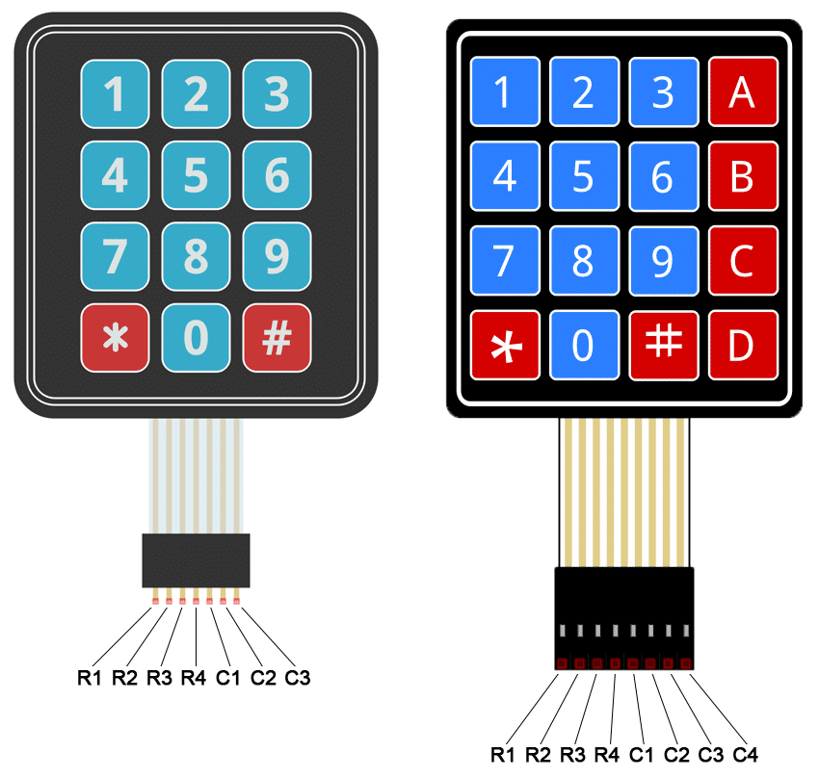
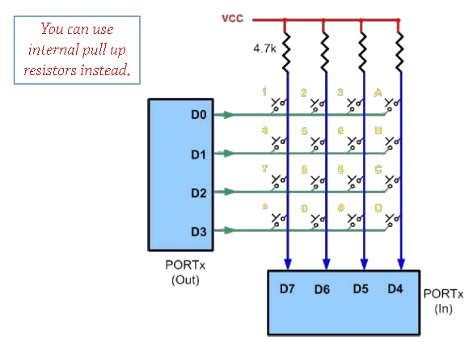
Hardware Connection

Slide 7
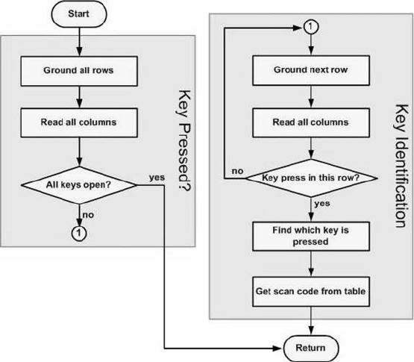

Flow Chart
Make Rows as Output and columns as Input
Ground all rows and read all columns to indicate a key pressed
Output HIGH on all rows then output LOW on each row by turn and scan columns
If a key is pressed a particular column will have a Low signal since its shorted with the row

Slide 8
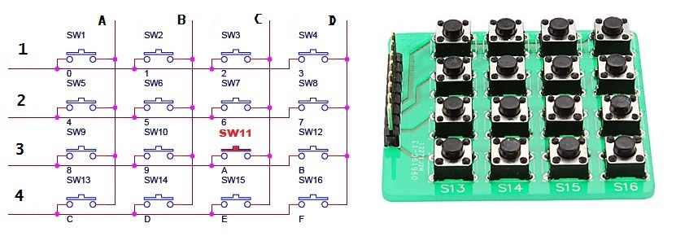
Key Pressed
What happens when a Key is pressed?
When a key is pressed and Row makes contact with a column (Short circuit between a row and a column) then become the same value for example if all columns were high and we ground each row then read all columns check if any of them is grounded in the picture
If keypad buttons are (1234ABCD) 1101 1101 is the value when button row num:3 column : C (third row and third column)

Slide 9
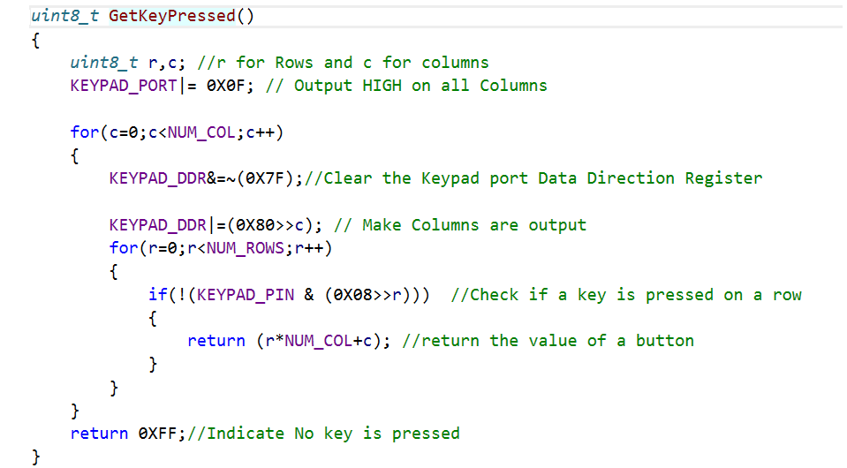
Bare Metal Keypad Interface

Slide 10
KEYPAD Layered Architecture
Keypad.h is included in keypad.c
Keypad_cfg.h included in keypad.h
Keypad.c
Keypad_config.h
keypad.h

Slide 11
LABS
LAB01 : Connect keypad to microcontroller and blink a led with the number of times of a key press value example: Key 2 is pressed then blink the led two times.
LAB02 : Connect Keypad and LCD to Microcontroller then Display on LCD the value of a key press

Slide 12
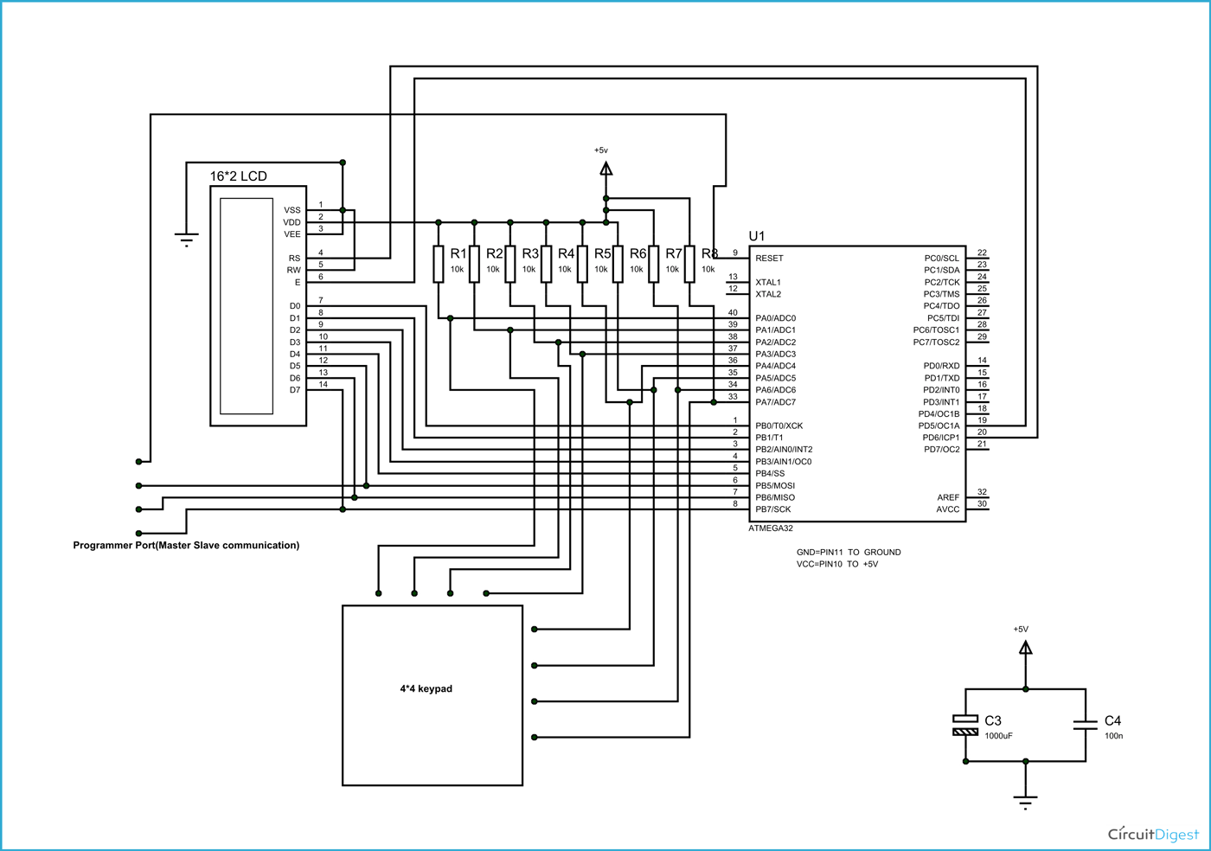
LCD and Keypad

Slide 13
Reference
https://embedds.com/interfacing-matrix-keyboard-with-avr/
https://github.com/peterokwara/Keypad-Lcd/blob/master/main.c
https://www.slideshare.net/mohamed_fab/06-interfacing-keypad-4x42016

