Slide 1

CNN
Mohamed Saied

Slide 2
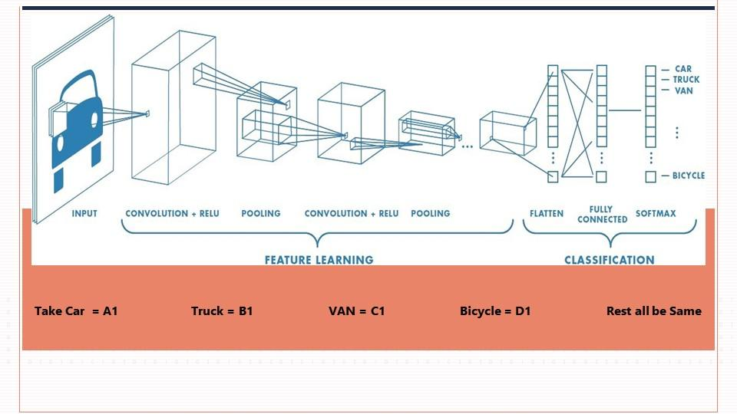

Slide 3
Layer Types
Convolution - filter
Pooling
Fully connected
Softmax

Slide 4
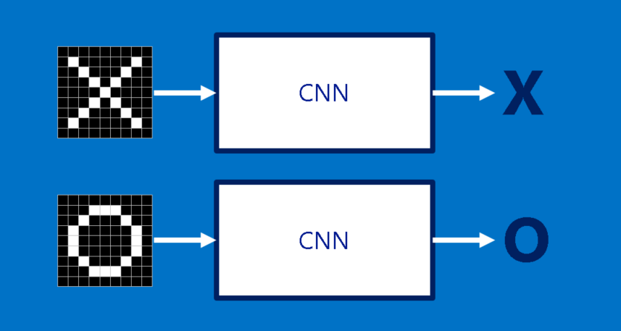
How it works
Finds the features by applying the filters
Finds the class by applying the fully connected layer and softmax

Slide 5
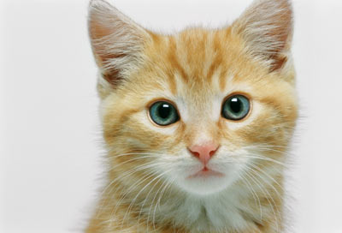
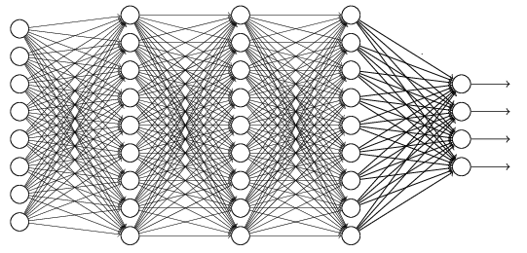
The whole CNN
cat dog ……
Convolution
Max Pooling
Can repeat many times
Fully Connected Feedforward network
Convolution
Max Pooling
Flattened

Slide 6
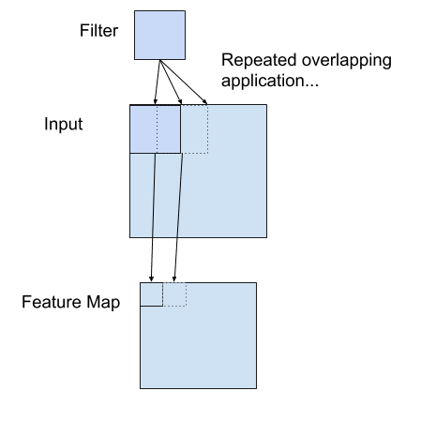
Convolution Layer

Slide 7
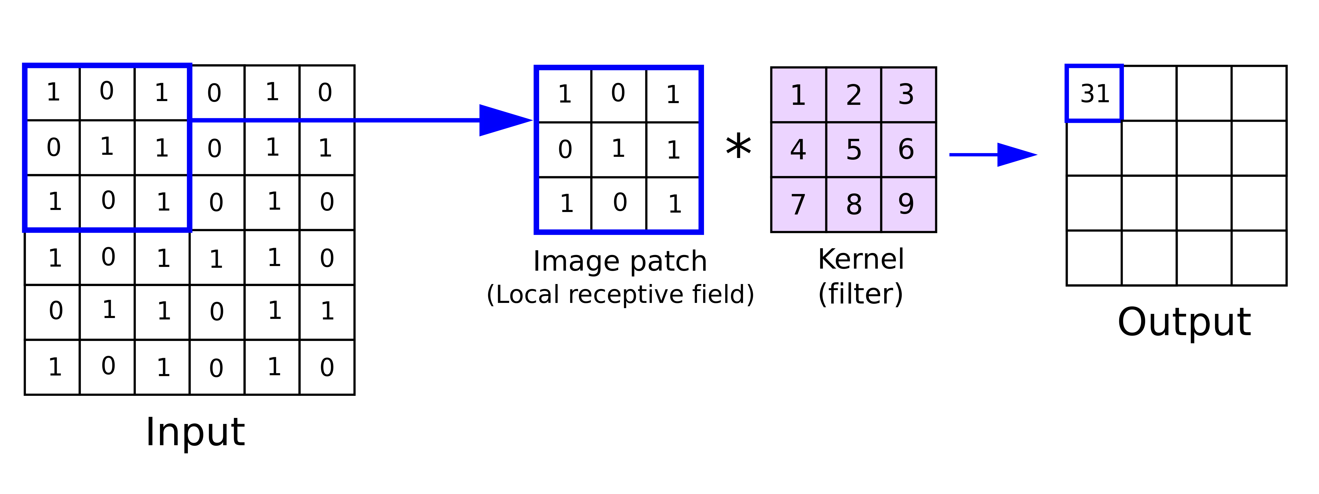
How Convolution Works

Slide 8
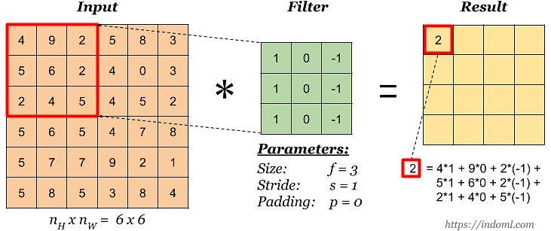

Slide 9
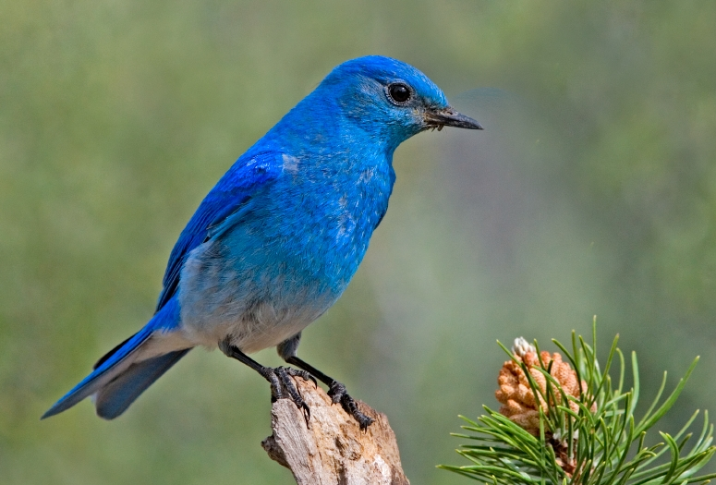

Why Pooling
Subsampling pixels will not change the object
bird
bird
Subsampling
We can subsample the pixels to make image smaller
fewer parameters to characterize the image

Slide 10
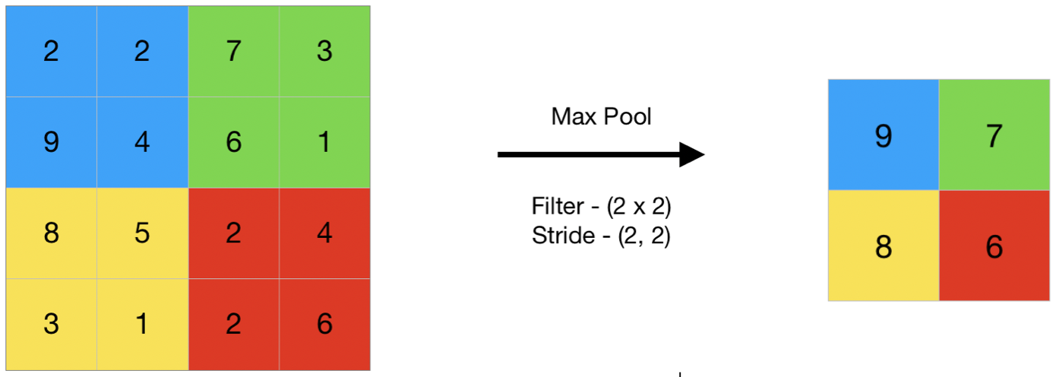
Pooling

Slide 11
Readings and watchings
Convolution vs cross-correlation
https://www.youtube.com/watch?v=tS-ib_mgGbU
How convolution works
https://towardsdatascience.com/convolution-vs-correlation-af868b6b4fb5
How CNN works in deep learning
https://machinelearningmastery.com/convolutional-layers-for-deep-learning-neural-networks/
CNN in arabic
https://www.youtube.com/watch?v=4RP8trOTK_o

