Slide 1
Embedded C++ Diploma
Object-Oriented
Design Patterns

Slide 2
Outline
Overview of Design Patterns
Four Design Patterns
  Iterator
  Decorator
  Strategy
  Observer

Slide 3
The Beginning of Patterns
Christopher Alexander, architect
  A Pattern Language--Towns, Buildings, Construction
  Timeless Way of Building (1979)
  “Each pattern describes a problem which occurs over and over again in our environment, and then describes the core of the solution to that problem, in such a way that you can use this solution a million times over, without ever doing it the same way twice.”
Other patterns: novels (tragic, romantic, crime), movies genres (drama, comedy, documentary)

Slide 4
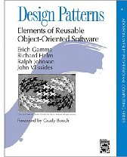
“Gang of Four” (GoF) Book
Design Patterns: Elements of Reusable Object-Oriented Software, Addison-Wesley Publishing Company, 1994
Written by this "gang of four"
  Dr. Erich Gamma, then Software Engineer, Taligent, Inc.
  Dr. Richard Helm, then Senior Technology Consultant, DMR Group
  Dr. Ralph Johnson, then and now at University of Illinois, Computer Science Department
  Dr. John Vlissides, then a researcher at IBM
    Thomas J. Watson Research Center
    See John's WikiWiki tribute page http://c2.com/cgi/wiki?JohnVlissides

Slide 5
Object-Oriented Design Patterns
This book defined 23 patterns in three categories
  Creational patterns deal with the process of object creation
  Structural patterns, deal primarily with the static composition and structure of classes and objects
  Behavioral patterns, which deal primarily with dynamic interaction among classes and objects

Slide 6
Documenting Discovered Patterns
Many other patterns have been introduced documented
  For example, the book Data Access Patterns by Clifton Nock introduces 4 decoupling patterns, 5 resource patterns, 5 I/O patterns, 7 cache patterns, and 4 concurrency patterns.
  Other pattern languages include telecommunications patterns, pedagogical patterns, analysis patterns
  Patterns are mined at places like Patterns Conferences

Slide 7
ChiliPLoP
Recent patterns books work shopped at ChiliPLoP, Wickenburg and Carefree Arizona
  Patterns of Enterprise Application Arhitecture Martin Fowler
  Patterns of Fault Tolerant Software, Bob Hamner
  Patterns in XML Fabio Arciniegas
  Patterns of Adopting Agile Development Practices Amr Elssamadisy
  2010: Patterns of Parallel Programming, Ralph Johnson
    16 patterns and one Pattern Language work shopped

Slide 8
GoF Patterns
  Creational Patterns
    Abstract Factory
    Builder
    Factory Method
    Prototype
    Singleton
  Structural Patterns
    Adapter
    Bridge
    Composite
    Decorator
    Façade
    Flyweight
    Proxy
  Behavioral Patterns
    Chain of Responsibility
    Command
    Interpreter
    Iterator
    Mediator
    Memento
    Observer
    State
    Strategy
    Template Method
    Visitor

Slide 9
Why Study Patterns?
Reuse tried, proven solutions
  Provides a head start
  Avoids gotchas later (unanticipated things)
  No need to reinvent the wheel
Establish common terminology
  Design patterns provide a common point of reference
  Easier to say, “We could use Strategy here.”
Provide a higher level prospective
  Frees us from dealing with the details too early

Slide 10
Other advantages
Most design patterns make software more modifiable, less brittle
  we are using time tested solutions
Using design patterns makes software systems easier to change—more maintainable
Helps increase the understanding of basic object-oriented design principles
  encapsulation, inheritance, interfaces, polymorphism

Slide 11
Style for Describing Patterns
We will use this structure:
  Pattern name
  Recurring problem: what problem the pattern addresses
  Solution: the general approach of the pattern
  UML for the pattern
    Participants: a description as a class diagram
  Use Example(s): examples of this pattern, in Java

Slide 12
A few OO Design Patterns
Coming up:
  Iterator
    access the elements of an aggregate object sequentially without exposing its underlying representation
  Strategy
    A means to define a family of algorithms, encapsulate each one as an object, and make them interchangeable
  Observer a preview
    One object stores a list of observers that are updated when the state of the object is changed

Slide 13
The Observer Design Pattern
Name: Observer
Problem: Need to notify a changing number of objects that something has changed
Solution: Define a one-to-many dependency between objects so that when one object changes state, all its dependents are notified and updated automatically

Slide 14
Examples
From Heads-First: Send a newspaper to all who subscribe
  People add and drop subscriptions, when a new version comes out, it goes to all currently described
Spreadsheet
  Demo: Draw two charts—two views--with some changing numbers--the model
16-<number>

Slide 15
Examples
File Explorer (or Finders) are registered observers (the view) of the file system (the model).
Demo: Open several finders to view file system and delete a file
Later in Java: We'll have two views of the same model that get an update message whenever the state of the model has changed
16-<number>

Slide 16
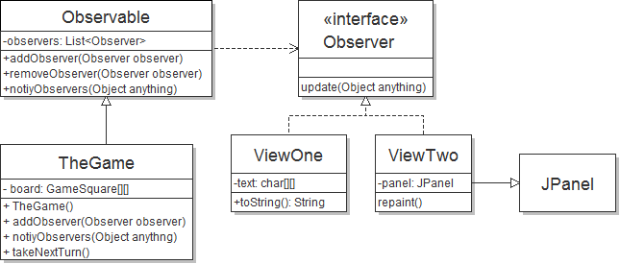
Observer Example

Slide 17
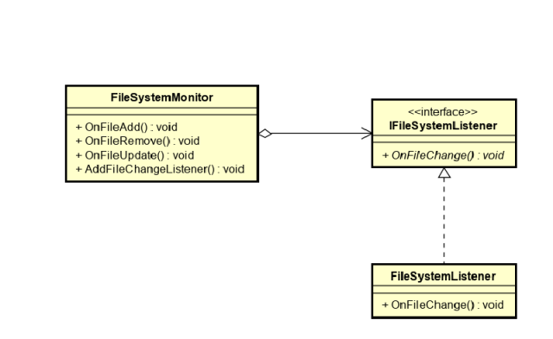

Assignment

Slide 18
Iterator

Slide 19
Pattern: Iterator
Name: Iterator (a.k.a Enumeration)
Recurring Problem: How can you loop over all objects in any collection. You don’t want to change client code when the collection changes. Want the same methods
Solution: 1) Have each class implement an interface, and 2) Have an interface that works with all collections
Consequences: Can change collection class details without changing code to traverse the collection

Slide 20
GoF Version of Iterator page 257
ListIterator
First()
Next()
IsDone()
CurrentItem()
// A C++ Implementation
ListIterator<Employee> itr = list.iterator();
for(itr.First(); !itr.IsDone(); itr.Next()) {
cout << itr.CurrentItem().toString();

Slide 21
Java version of Iterator
interface Iterator
boolean hasNext()
    Returns true if the iteration has more elements.
Object next()
    Returns the next element in the iteration and updates the iteration to refer to the next (or have hasNext() return false)
void remove()
    Removes the most recently visited element

Slide 22
Java’s Iterator interface
// The Client code
List<BankAccount> bank =
new ArrayList<BankAccount>();
bank.add(new BankAccount("One", 0.01) );
// ...
bank.add(new BankAccount("Nine thousand", 9000.00));
String ID = "Two";
Iterator<BankAccount> itr = bank.iterator();
while(itr.hasNext()) {
if(itr.next().getID().equals(searchAcct.getID()))
System.out.println("Found " + ref.getID());
}

Slide 23
UML Diagram of Java's
Iterator with a few Collections
<<interface>>
List
iterator(): Iterator
…
<<interface>>
Iterator
hasNext()
next()
Vector
iterator()
LinkedList
iterator()
ArrayList
iterator()
Iterator
hasNext()
next()
Client
http://download.oracle.com/javase/6/docs/api/java/util/List.html

Slide 24
Decorator Design Pattern
Rick Mercer
CSC 335: Object-Oriented
Programming and Design

Slide 25
The Decorator Pattern from GoF
Intent
  Attach additional responsibilities to an object dynamically. Decorators provide a flexible alternative to sub classing to extend flexibility
Also Known As Wrapper
Motivation
  Want to add properties to an existing object.
2 Examples
    Add borders or scrollbars to a GUI component
    Add stream functionality such as reading a line of input or compressing a file before sending it over the wire

Slide 26
Applicability
Use Decorator
  To add responsibilities to individual objects dynamically without affecting other objects
  When extending classes is impractical
    Sometimes a large number of independent extensions are possible and would produce an explosion of subclasses to support every combination (this inheritance approach is on the next few slides)

Slide 27
An Application
Suppose there is a TextView GUI component and you want to add different kinds of borders and/or scrollbars to it
You can add 3 types of borders
  Plain, 3D, Fancy
and 1 or 2 two scrollbars
  Horizontal and Vertical
An inheritance solution requires15 classes for one view

Slide 28
That’s a lot of classes!
    TextView_Plain
    TextView_Fancy
    TextView_3D
    TextView_Horizontal
    TextView_Vertical
    TextView_Horizontal_Vertical
    TextView_Plain_Horizontal
    TextView_Plain_Vertical
    TextView_Plain_Horizontal_Vertical
    TextView_3D_Horizontal
    TextView_3D_Vertical
    TextView_3D_Horizontal_Vertical
    TextView_Fancy_Horizontal
    TextView_Fancy_Vertical
    TextView_Fancy_Horizontal_Vertical

Slide 29
Disadvantages
Inheritance solution has an explosion of classes
If another view were added such as StreamedVideoView, double the number of Borders/Scrollbar classes
Solution to this explosion of classes?
  Use the Decorator Pattern instead

Slide 30
VisualComponent
draw()
resize()
1
TextView
draw()
resize()
SteamedVideoView
draw()
resize()
Decorator
draw()
resize()
1
Decorator contains a visual component
An imagined example
Border
draw()
resize()
ScrollBar
draw()
resize()
Plain
draw()
resize()
3D
draw()
resize()
Fancy
draw()
resize()
Horiz
draw()
resize()
Vert
draw()
resize()

Slide 31
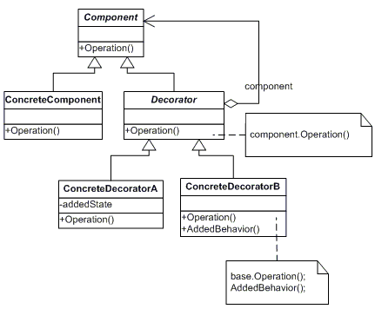
Decorator's General Form

Slide 32
JScrollPane
Any Component such as Container, JList, Panel can be decorated with a JScrollPane
The next slide shows how to decorate a JPanel with a JScrollPane

Slide 33
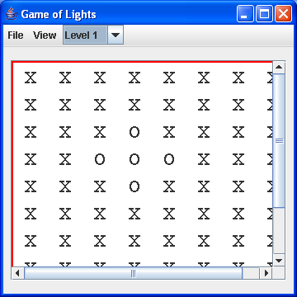
Decorate a JPanel
JScrollPane scrollPane = new JScrollPane(toStringView);
add(scrollPane); // Add to a JFrame or another panel

Slide 34
Motivation Continued
The more flexible containment approach encloses the component in another object that adds the border
The enclosing object is called the decorator
The decorator conforms to the interface of the component so its presence is transparent to clients
The decorator forwards requests to the component and may perform additional actions before or after any forwarding

Slide 35
Decorator Design: Java Streams
InputStreamReader(InputStream in) System.in is an InputStream object
  ... bridge from byte streams to character streams: It reads bytes and translates them into characters using the specified character encoding. JavaTMAPI
BufferedReader
  Read text from a character-input stream, buffering characters so as to provide for the efficient reading of characters, arrays, and lines. JavaTMAPI
What we had to do for console input before Java 1.5’s Scanner
  BufferedReader keyboard =
  new BufferedReader(new
  InputStreamReader(System.in));

Slide 36
Decorator pattern in the real world
BufferedReader decorates InputStreamReader
Still needed to parse integers, doubles, or words
BufferedReader
readLine() // add a useful method
InputStreamReader
read() // 1 byte at a time
close()

Slide 37
Java streams
With > 60 streams in Java, you can create a wide variety of input and output streams
  this provides flexibility good
    it also adds complexity
  Flexibility made possible with inheritance and classes that accept classes that extend the parameter type

Slide 38
Another Decorator Example
We decorated a FileInputStream with an ObjectInputStream to read objects that implement Serializable
  and we used FileOutputStream with ObjectOutputStream
  then we were able to use nice methods like these two read and write large complex objects on the file system:
  \
  outFile.writeObject(list);
// and later on …
list = (ArrayList<String>)inFile.readObject();

Slide 39
Another Decorator Example
Read a plain text file and compress it using the GZIP format ZIP.java
Read a compress file in the GZIP format and write it to a plain text file UNGZIP.java
Sample text iliad10.txt from Project Gutenberg
bytes
875,736 iliad10.txt bytes
305,152 iliad10.gz
875,736 TheIliadByHomer
(after code on next slide)

Slide 40
// Open the input file
String inFilename = "iliad10.txt";
FileInputStream input = new FileInputStream(inFilename);
// Open the output file
String outFilename = "iliad10.gz";
GZIPOutputStream out = new GZIPOutputStream(
new FileOutputStream(outFilename));
// Transfer bytes from output file to compressed file
byte[] buf = new byte[1024];
int len;
while ((len = input.read(buf)) > 0) {
out.write(buf, 0, len);
}
// Close the file and stream
input.close();
out.close();

Slide 41
// Open the gzip file
String inFilename = "iliad10.gz";
GZIPInputStream gzipInputStream =
new GZIPInputStream(new FileInputStream(inFilename));
// Open the output file
String outFilename = "TheIliadByHomer";
OutputStream out = new FileOutputStream(outFilename);
// Transfer bytes from compressed file to output file
byte[] buf = new byte[1024];
int len;
while ((len = gzipInputStream.read(buf)) > 0) {
out.write(buf, 0, len);
}
// Close the file and stream
gzipInputStream.close();
out.close();

Slide 42
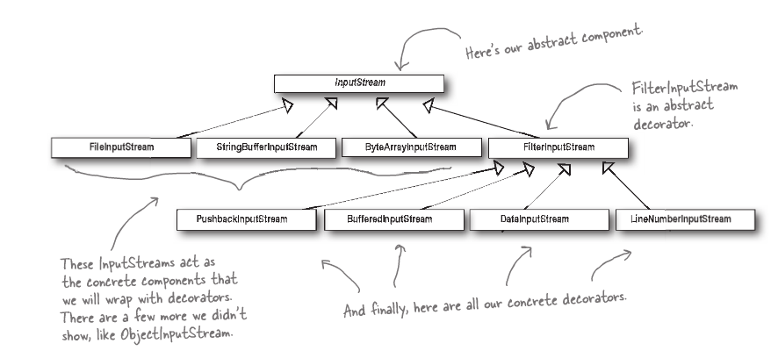
GZIPInputStream is a Decorator
GZIPInputStream

Slide 43
Summary
Decorators are very flexible alternative of inheritance
Decorators enhance (or in some cases restrict) the functionality of decorated objects
They work dynamically to extend class responsibilities, even inheritance does some but in a static fashion at compile time

Slide 44
Strategy Design Pattern
  Strategy

Slide 45
Pattern: Strategy
Name: Strategy (a.k.a Policy)
Problem: You want to encapsulate a family of algorithms and make them interchangeable. Strategy lets the algorithm vary independently from the clients that use it (GoF)
Solution: Create an abstract strategy class (or interface) and extend (or implement) it in numerous ways. Each subclass defines the same method names in different ways

Slide 46
Design Pattern: Strategy
Consequences:
  Allows families of algorithms
Known uses:
  Critters seen in section for Rick’s 127B / 227
  Layout managers in Java
  Different Poker Strategies in a 335 Project
  Different PacMan chase strategies in a 335 Project
  Different Jukebox policies that can be

Slide 47
Java Example of Strategy
  this.setLayout(new FlowLayout());
  this.setLayout(new GridLayout());
In Java, a container HAS-A layout manager
  There is a default
  You can change a container's layout manager with a setLayout message

Slide 48
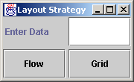
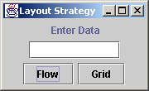
Change the stategy at runtime
Demonstrate LayoutControllerFrame.java
  private class FlowListener
  implements ActionListener {
// There is another ActionListener for GridLayout
public void actionPerformed(ActionEvent evt) {
// Change the layout strategy of the JPanel
// and tell it to lay itself out
centerPanel.setLayout(new FlowLayout());
centerPanel.validate();
}
}
12-<number>

Slide 49
interface LayoutManager
  Java has interface java.awt.LayoutManager
  Known Implementing Classes
    GridLayout, FlowLayout, ScrollPaneLayout
  Each class implements the following methods
  addLayoutComponent(String name, Component comp)
  layoutContainer(Container parent)
  minimumLayoutSize(Container parent)
  preferredLayoutSize(Container parent)
  removeLayoutComponent(Component comp)

Slide 50
UML Diagram of Strategy
General Form
Context
strategy: Strategy
setStrategy(Strategy)
…
<<interface>>
Strategy
AlgorithmInterface
implements
ConcreteClassA
AlgorithmInterface
ConcreteClassB AlgorithmInterface
ConcreteClassC
AlgorithmInterface

Slide 51
Specific UML Diagram of LayoutManager in Java
<<interface>>
LayoutManager
addLayoutComponent()
layoutContainer()
minimumLayoutSize()
JPanel
layoutMan: LayoutManager
size: Dimension
setLayout(lm: LayoutManager)
setPreferredSize(di:Dimension)
implements
GridLayout
addLayoutComponent()
layoutContainer()
minimumLayoutSize()
FlowLayout
addLayoutComponent()
layoutContainer()
minimumLayoutSize()
ScrollPaneLayout
addLayoutComponent()
layoutContainer()
minimumLayoutSize()

Slide 52
Another Example
Pac Man GhostChasesPacMan strategies in 2001
  Level 1: random
  Level 2: a bit smarter
  Level 3: use a shortest path algorithm http://www.martystepp.com/applets/pacman/
Could be interface ChaseStategy is in the Ghost class
interface ChaseStategy {
public Point nextPointToMoveTo();
}
and Ghost has setChaseStrategy(new ShortestPath())

