Slide 1
Design Patterns
Mohamed Saied

Slide 2
Proxy
A Proxy provides an interface that forwards function calls to another interface of the same form. A Proxy pattern is useful to modify the behavior of the RealSubject class while still preserving its interface. This is particularly useful if the RealSubject class is in third-party library and hence not easily modifiable directly.

Slide 3
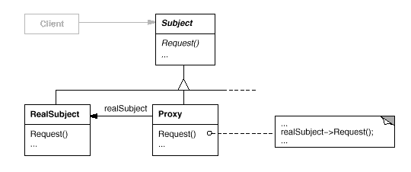
UML for Proxy Pattern

Slide 4
Use case 1
Implement lazy instantiation of the RealSubject object
In this case, the RealSubject object is not actually instantiated until a method call is invoked. This can be useful if instantiating the RealSubject object is a heavyweight operation that we wish to defer until absolutely necessary.

Slide 5
Use case 2
Implement access control to the RealSubject object
We may want to insert a permissions layer between the Proxy and the RealSubject objects to ensure that users can only call certain methods on the RealSubject object if they have appropriate permission.

Slide 6
Use case 3
Support debug or dry-run modes
This lets us insert debugging statement into the Proxy methods to log all call to the RealSubject object or we can stop the forwarding to certain RealSubject method with a flag to let us call the Proxy in a dry-run mode, such as to turn off writing the object's state to disk

Slide 7
Use Case 4
Make the RealSubject class to be thread safe
This can be done by adding mutex locking to the methods that are not thread safe. While this may not be the most efficient way to make the underlying class thread safe, it is a useful if we cannot modify the RealSubject.

Slide 8
Use case 5
Share resources
We could have multiple Proxy objects share the same underlying RealSubject class. This could be used to implement reference counting, for instance. This is, actually, another design pattern called the Flyweight pattern, where multiple objects share the same underlying data to minimize memory.

Slide 9
Use case 6
Protect against future changes in the RealSubject class
We anticipate that a dependent library will change in the future so we create a proxy wrapper around that API that directly mimics the current behavior. So, when the library changes later, we can preserve the old interface via our proxy object and simply change its underlying implementation to use the new library methods.

Slide 10
Singleton
The Singleton pattern ensures a class has only one instance, and provides a global point of access to it.
A Singleton is an elegant way of maintaining global state, but we should always question whether we need global state

Slide 11
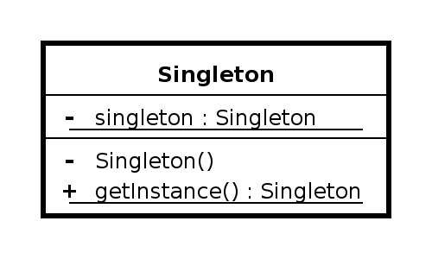

Class Diagram

Slide 12
Use case
Singleton pattern offers several advantages over global variables because it does the following:
Enforces that only one instance of the class can be instantiated.
Allows control over the allocation and destruction of the object.
Provides thread-safe access to the object's global state.
Prevents the global namespace from being polluting.

Slide 13
Singleton in Multi-threading
The revised version is not thread safe because there could be a race condition during the initialization of the static Singleton, Singleton& Singleton::getInstance().

Slide 14
Thread safe Singleton
Singleton& Singleton::getInstance()
{
Mutex mutex;
ScopedLock(&mutex;); // to unlock mutex on exit
static Singleton instance;
return instance;
}

Slide 15
Singleton : pattern vs Anti-pattern
In 2009, the authors of the original design patterns said the only pattern they would consider removing from the original list is Singleton. This is because it is essentially a way to store global data and tends to be an indicator of poor design.

Slide 16
Alternatives
There are several alternatives to the Singleton pattern:
dependency injection
Monostate pattern
session context

Slide 17
Adaptor
Convert the interface of a class into another interface clients expect. Adapter (or Wrapper) lets classes work together that couldn't otherwise because of incompatible interfaces. Adapter pattern's motivation is that we can reuse existing software if we can modify the interface.

Slide 18
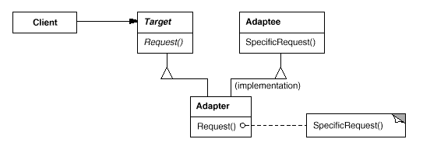
UML for Adaptor

Slide 19
How it works
Adapter pattern relies on object composition.
Client calls operation on Adapter object.
Adapter calls Adaptee to carry out the operation.
In STL, stack adapted from vector:
When stack executes push(), underlying vector does vector::push_back().

Slide 20
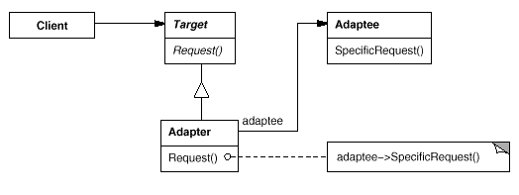
example

Slide 21
Summary
The client thinks he is talking to a Rectangle
The target is the Rectangle class. This is what the client invokes method on.
Rectangle *r = new RectangleAdapter(x,y,w,h);
r->draw()

Slide 22
Code explanation
Note that the adapter class uses multiple inheritance.
class RectangleAdapter: public Rectangle, private LegacyRectangle {
...
}
The Adapter RectangleAdapter lets the LegacyRectangle responds to request (draw() on a Rectangle) by inheriting BOTH classes.

Slide 23
Code Exaplanation 2
The LegacyRectangle class does not have the same methods (draw()) as Rectangle,
but the Adapter(RectangleAdapter) can take the Rectangle method calls and turn around and invoke method on the LegacyRectangle, oldDraw()

Slide 24
class RectangleAdapter: public Rectangle, private LegacyRectangle {
public:
RectangleAdapter(int x, int y, int w, int h):
LegacyRectangle(x, y, x + w, y + h) {
std::cout << "RectangleAdapter(x,y,x+w,x+h)\n";
}
void draw() {
std::cout << "RectangleAdapter: draw().\n";
oldDraw();
}

Slide 25
Conclusion
Adapter design pattern translates the interface for one class into a compatible but different interface. So, this is similar to the proxy pattern in that it's a single-component wrapper. But the interface for the adapter class and the original class may be different.

Slide 26
Any Questions?

