Slide 1

Build Tools
Mohamed Saied

Slide 2
Motivation
Why should we learn build tools ?
Previous approach Build Small Programs
Source Files
.cpp .hpp
g++ -c hello World.cpp hello.cpp
g++ -o main.exe helloWorld.o hello.o
g++
.exe
Build and link with single lines using manual commands
up to 10 files

Slide 3
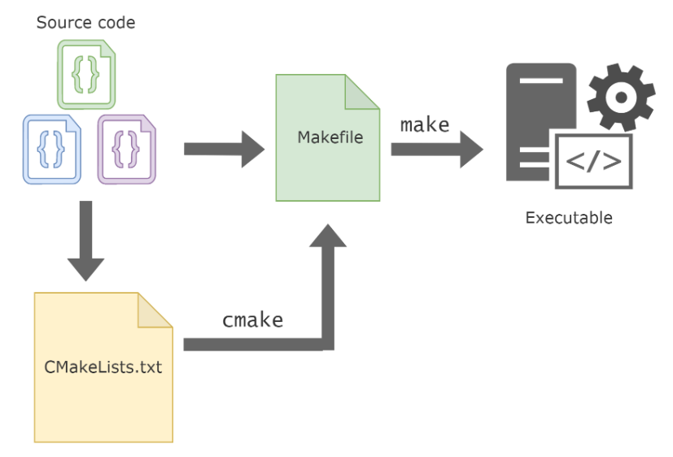
Building SW In Industry
IDE
Thousands of lines
& hundreds of files

Slide 4
Motivation – continued
Problems:
Long files are harder to manage
(for both programmers and machines)
Every change requires compilation of all constituent files?
Many programmers cannot modify the
same file simultaneously
Large projects are not implemented in a single module/file

Slide 5
Motivation – continued
Solution : Separation of Concerns
Targets:
Proper and optimal division of components
Minimum compilation when something is
changed
Easy maintenance of project structure,
dependencies and creation

Slide 6
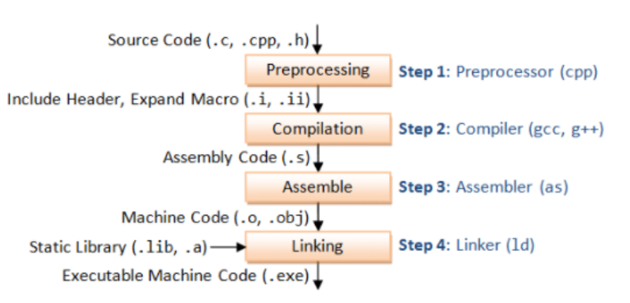
Recall Build Process

Slide 7
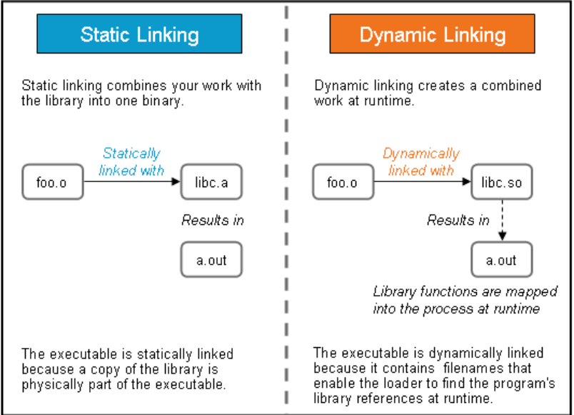
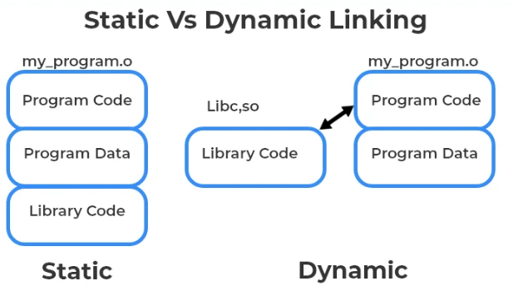
Recall Build Process Cont.

Slide 8
Project maintenance
Performed in Unix by the make utility
A makefile is a file (script) containing:
Project structure (files, dependencies)
Instructions for creation of object code, executables, other tasks
Note: A makefile script is not limited to C/C++ programs
make utility is a tool used to automate the process of building programs from source code.
GNU Make is the most widely used version of the make utility

Slide 9
Project structure
Project structure and dependencies can be represented as a DAG (= Directed Acyclic Graph)
Example :
Date class:
contains 3 files
Date.h, Date.cpp, TestDate.cpp
Date.h included in both .cpp files
Executable should be named testdate
.cpp
.h

Slide 10
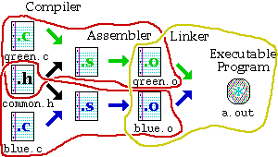
Makefiles
Provide a way for separate compilation.
Describe the dependencies among the project files.
The make utility.
Notes:
‹#›
Makefiles provide a way for separate compilation. When a file from a project is changed, only the files that depend on the changed file are compiled.

Slide 11
DAG
testdate (exe)
TestDate.o
Date.o
TestDate.c
Date.h
Date.c
Date.h

Slide 12
Rule syntax
TestDate.o: TestDate.c Date.h
gcc -c TestDate.c
This rule compiles TestDate.cpp, but does NOT create any executable, just TestDate.o
Target
Rule
tab
action
dependencies

Slide 13
Makefile Rules: Targets, Dependencies, and Associated Commands
Make_File.mk
-o → Link
→ object
1
#Rule 1
#Rule 2
#Rule3
testdate: Date.o TestDate.o
gcc -o testdate TestDate.o Date.o
TestDate.o: TestDate.c Date.h
gcc -c TestDate.c
Date.o: Date.c Date.h
gcc -c Date.c
Input
4
exe
3
#Rule3
Input
2
#Rule 2
Input
-c → Compile
→ object

Slide 14
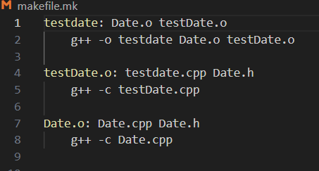
Lab 1 Practical Session 1
1-Lets write our 1st make File
# g++
Compile and link c++
# gcc
build c & c++
cannot link c++ files
# -o to specify executable file name (Compile and link)
# -c to compile only (no linking)

Slide 15
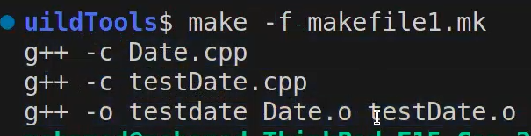

Continue . . Lab 1 2-Build Project
Make Commands:
make #build any file name is makefile.mk
make -f filename.mk # If file name is not makefile” or “Makefile”
1
If you do make after build without adding any change, you may get this message
2

Slide 16
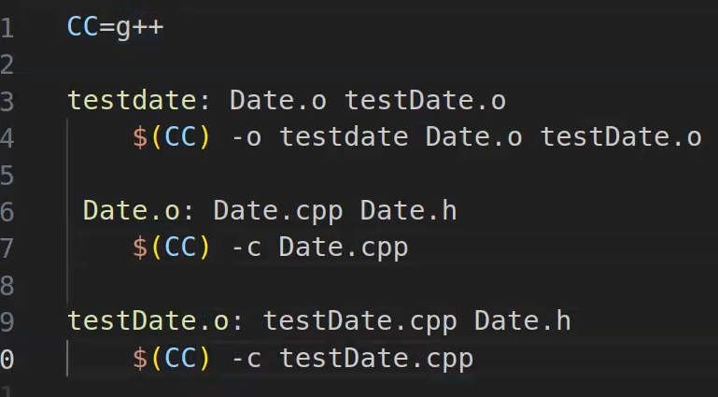
Continue . . Lab 1 - - 3-Add a variable

Slide 17
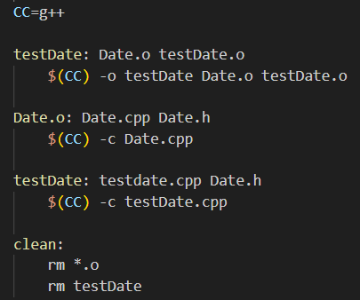
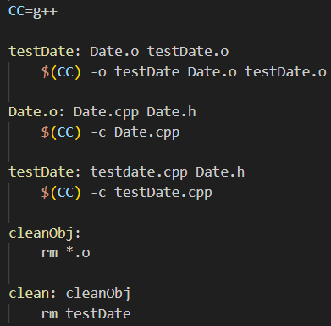
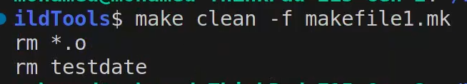
Continue . . Lab 1 - - 4-Add Clean Rule

Slide 18
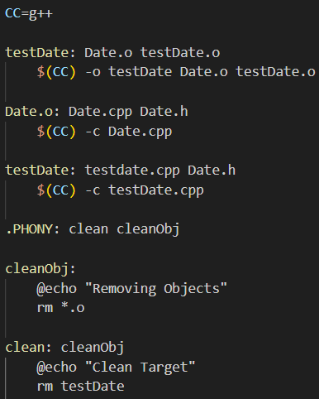
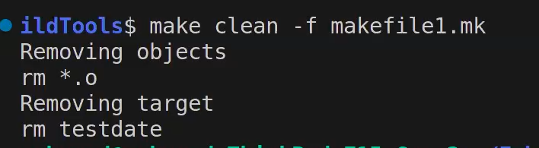
Continue . . Lab 1 - - - 5-Add PHONY

Slide 19
Macros
Macros are used to simplify and automate
Often used like constants in programs
We can compress identical dependencies and use built-in macros to get another (shorter) equivalent makefile :
testdate: TestDate.o Date.o
g++ –o $@ TestDate.o Date.o
Date.o: Date.cpp Date.h
gcc –c &<
Left Hand Side
Right Hand Side
Macro $@ Represents the name of output file.
$@ = testdate
Macro $< Represents filename of the first prerequisite.
$< = Date.cpp

Slide 20
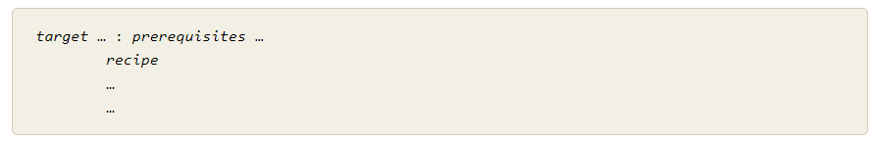
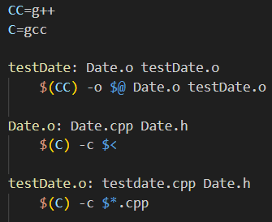
Macros
TestDate.o: Testdate.cpp Date.h
gcc –c $*.cpp
Macro $* represents target prefixes:
$* = TestDate, if target is TestDate.o
$* = Date, if target is Date.o

Slide 21
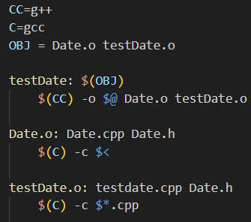
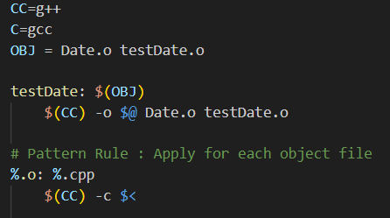
Generic Rules
To avoid making build rule for each object
acts as for loop , applied for each object dependency
% replaces with file name

Slide 22
Lab 2 Practice Session 2
Make you make file & use the following:
varabiles
macros
pattern rule

Slide 23
Conditional statements - example
sum: main.o sum.o
gcc –o sum main.o sum.o
main.o: main.c sum.h
gcc –c main.c
#deciding which file to compile to create sum.o
ifeq ($(USE_SUM), 1)
sum.o: sum1.c sum.h
gcc –c sum1.c –o $@
else
sum.o: sum2.c sum.h
gcc –c sum2.c –o $@
endif

Slide 24
make options
-f filename - when the makefile name is not standard
-t - (touch) mark the targets as up to date
-q - (question) are the targets up to date, exits with 0 if true
-n - print the commands to execute but do not execute them
/* -t, -q, and -n, cannot be used together * /
-s - silent mode : Don't print commands
-k - keep going – compile all the prerequisites even if not able to link them !!

Slide 25
VPATH
VPATH variable – defines directories to be searched if a file is not found in the current directory.
VPATH = dir : dir …
/* VPATH = src:../headers */
vpath directive (lower case!) – more selective directory search:
vpath pattern directory
/ vpath %.h headers /
GPATH:
GPATH – if you want targets to be stored in the same directory as their dependencies.
Notes:
‹#›

Slide 26
make operation
Project’s dependency tree is constructed
Target of first rule is to be created
Go down the dependency tree to see if there is a target that should be recreated:
target file is older than one of its dependencies
recreate the target file according to the action specified, on our way up the tree. Consequently, more files may need to be recreated
If something is changed, linking is usually necessary
Top target in dependency tree

Slide 27
make operation - continued
make operation ensures minimum compilation, when the project structure is written properly
Do not write something like:
testdate: TestDate.c Date.c Date.h
gcc -o testdate TestDate.c Date.c
which requires compilation of all files when something is changed
Example: If Date.cpp changes, why compile TestDate.cpp?

Slide 28
Passing parameters to makefile
Parameters can be passed to a makefile by specifying them along with their values in the command line.
For example:
make PAR1=1 PAR2=soft1
will call the makefile with 2 parameters: PAR1 is assigned the value “1” and PAR2 is assigned the value “soft1”. The same names should be used within the makefile to access these variables (using the usual “$(VAR_NAME)” syntax)

Slide 29
Passing parameters - continued
Note that assigning a value to a variable within the makefile overrides any value passed from the command line.
For example:
command line : make PAR=1
in the makefile:
PAR = 2
PAR value within the makefile will be 2, overriding the value sent from the command line

Slide 30
Example
For example, if you have the following source files in some project of yours:
ccountln.h
ccountln.c
fileops.h
fileops.c
process.h
process.c
parser.h
parser.c
You could compile every C file and then link the object files generated, or use a single command for the entire thing.
This becomes unfriendly when the number of files increases; hence, use Makefiles!
NOTE: you don’t NEED to compile .h files explicitly.
‹#›

Slide 31
Example (2)
One by one:
gcc -g -Wall -ansi -pedantic -c ccountln.c
gcc -g -Wall -ansi -pedantic -c parser.c
gcc -g -Wall -ansi -pedantic -c fileops.c
gcc -g -Wall -ansi -pedantic -c process.c
This will give you four object files that you need to link and produce an executable:
gcc ccountln.o parser.o fileops.o process.o -o ccountln
‹#›

Slide 32
Example (3)
You can do this as well:
gcc -g -Wall -ansi -pedantic ccountln.c parser.c fileops.c process.c -o ccountln
Instead of typing this all on a command line, again: use a Makefile.
‹#›

Slide 33
Example (4)
# Simple Makefile with use of gcc could look like this
CC=gcc
CFLAGS=-g -Wall -ansi -pedantic
OBJ:=ccountln.o parser.o process.o fileops.o
EXE=ccountln
all: $(EXE)
$(EXE): $(OBJ)
$(CC) $(OBJ) -o $(EXE)
ccountln.o: ccountln.h ccountln.c
$(CC) $(CFLAGS) -c ccountln.c
...
‹#›

Slide 34
makefiles content
Makefiles content
rules : implicit, explicit
variables (macros)
directives (conditionals)
# sign – comments everything till the end of the line
\ sign - to separate one command line on two rows

Slide 35
Sample makefile
Makefiles main element is called a rule:
Example:
my_prog : eval.o main.o
g++ -o my_prog eval.o main.o
eval.o : eval.c eval.h
g++ -c eval.c
main.o : main.c eval.h
g++ -c main.c
_________________________
# -o to specify executable file name
# -c to compile only (no linking)
target : dependencies
TAB commands #shell commands

Slide 36
Variables
The old way (no variables) A new way (using variables)
Defining variables on the command line:
Take precedence over variables defined in the makefile.
make C=cc
C = g++
OBJS = eval.o main.o
HDRS = eval.h
my_prog : eval.o main.o
$(C) -o my_prog $(OBJS)
eval.o : eval.c
$(C) –c –g eval.c
main.o : main.c
$(C) –c –g main.c
$(OBJS) : $(HDRS)
my_prog : eval.o main.o
g++ -o my_prog eval.o main.o
eval.o : eval.c eval.h
g++ -c –g eval.c
main.o : main.c eval.h
g++ -c –g main.c

Slide 37
Implicit rules
Implicit rules are standard ways for making one type of file from another type.
There are numerous rules for making an .o file – from a .c file, a .p file, etc. make applies the first rule it meets.
If you have not defined a rule for a given object file, make will apply an implicit rule for it.
Example:
Our makefile The way make understands it
my_prog : eval.o main.o
$(C) -o my_prog $(OBJS)
$(OBJS) : $(HEADERS)
my_prog : eval.o main.o
$(C) -o my_prog $(OBJS)
$(OBJS) : $(HEADERS)
eval.o : eval.c
$(C) -c eval.c
main.o : main.c
$(C) -c main.c
Notes:
‹#›

Slide 38
Defining implicit rules
%.o : %.c
$(C) -c –g $<
C = g++
OBJS = eval.o main.o
HDRS = eval.h
my_prog : eval.o main.o
$(C) -o my_prog $(OBJS)
$(OBJS) : $(HDRS)
Avoiding implicit rules - empty commands
target: ; #Implicit rules will not apply for this target.
Notes:
‹#›
The target is considered a pattern for matching file names;

Slide 39
Automatic variables
Automatic variables are used to refer to specific part of rule components.
eval.o : eval.c eval.h
g++ -c eval.c
$@ - The name of the target of the rule (eval.o).
$< - The name of the first dependency (eval.c).
$^ - The names of all the dependencies (eval.c eval.h).
$? - The names of all dependencies that are newer than the target
target : dependencies
TAB commands #shell commands

Slide 40
Phony targets
Phony targets:
Targets that have no dependencies.
Used only as names for commands that you want to execute.
clean :
rm $(OBJS)
__________________
To invoke it: make clean
Typical phony targets:
all – make all the top level targets
.PHONY : all
all: my_prog1 my_prog2
clean – delete all files that are normally created by make
print – print listing of the source files that have changed
.PHONY : clean
clean:
rm $(OBJS)
or

Slide 41
Conditionals (directives)
Possible conditionals are:
if ifeq ifneq ifdef ifndef
All of them should be closed with endif.
Complex conditionals may use elif and else.
Example:
libs_for_gcc = -lgnu
normal_libs =
ifeq ($(CC),gcc)
libs=$(libs_for_gcc) #no tabs at the beginning
else
libs=$(normal_libs) #no tabs at the beginning
endif

