Slide 1
Inter-Integrated Circuit
Mohamed Saied

Slide 2
History of I2C
I²C was originally developed in 1982 by Philips for various Philips chips. The original spec allowed for only 100kHz communications, and provided only for 7-bit addresses, limiting the number of devices on the bus to 112 (there are several reserved addresses, which will never be used for valid I²C addresses).
adding a 400kHz fast-mode as well as an expanded 10-bit address space
device support for I²C ends at this point. There are three additional modes specified: fast-mode plus, at 1MHz; high-speed mode, at 3.4MHz; and ultra-fast mode, at 5MHz.

Slide 3
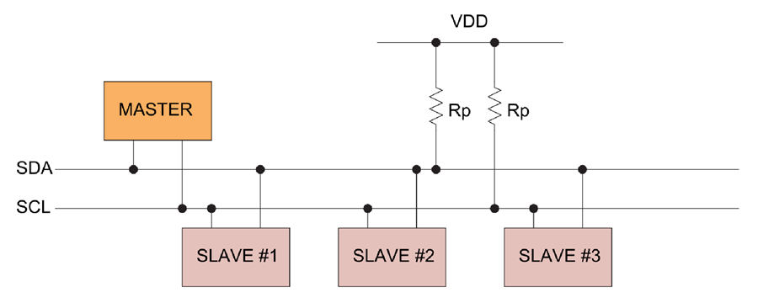
How it works?
the I²C bus drivers are open drain ,meaning that they can pull the corresponding signal line low, but cannot drive it high. Thus, there can be no bus contention where one device is trying to drive the line high while another tries to pull it low
Each signal line has a pull up resistor on it, to restore the signal to high when no device is asserting it low.

Slide 4
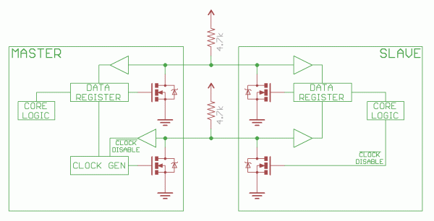
Internal hardware architecture

Slide 5
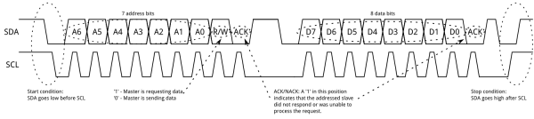
Protocol
Messages are broken up into two types of frame: an address frame, where the master indicates the slave to which the message is being sent, and one or more data frames, which are 8-bit data messages passed from master to slave or vice versa. Data is placed on the SDA line after SCL goes low, and is sampled after the SCL line goes high. The time between clock edge and data read/write is defined by the devices on the bus and will vary from chip to chip.

Slide 6
Start Condition
To initiate the address frame, the master device leaves SCL high and pulls SDA low.
This puts all slave devices on notice that a transmission is about to start.
If two master devices wish to take ownership of the bus at one time, whichever device pulls SDA low first wins the race and gains control of the bus.
It is possible to issue repeated starts, initiating a new communication sequence without relinquishing control of the bus to other masters; we'll talk about that later.

Slide 7
Address frame
For a 7-bit address, the address is clocked out most significant bit (MSB) first, followed by a R/W bit indicating whether this is a read (1) or write (0) operation.
The 9th bit of the frame is the NACK/ACK bit. This is the case for all frames (data or address).
Once the first 8 bits of the frame are sent, the receiving device is given control over SDA.
If the receiving device does not pull the SDA line low before the 9th clock pulse, it can be inferred that the receiving device either did not receive the data or did not know how to parse the message.
In that case, the exchange halts, and it's up to the master of the system to decide how to proceed.

Slide 8
Stop condition
Once all the data frames have been sent, the master will generate a stop condition. Stop conditions are defined by a 0->1 (low to high) transition on SDA after a 0->1 transition on SCL, with SCL remaining high. During normal data writing operation, the value on SDA should not change when SCL is high, to avoid false stop conditions.

Slide 9
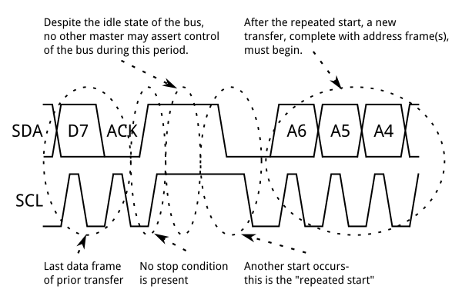
Repeated Start Conditions
Sometimes, it is important that a master device be allowed to exchange several messages in one go, without allowing other master devices on the bus to interfere. For this reason, the repeated start condition has been defined.
To perform a repeated start, SDA is allowed to go high while SCL is low, SCL is allowed to go high, and then SDA is brought low again while SCL is high. Because there was no stop condition on the bus, the previous communication wasn't truly completed and the current master maintains control of the bus.
At this point, the next message can begin transmission. The syntax of this new message is the same as any other message--an address frame followed by data frames. Any number of repeated starts is allowed, and the master will maintain control of the bus until it issues a stop condition.

Slide 10
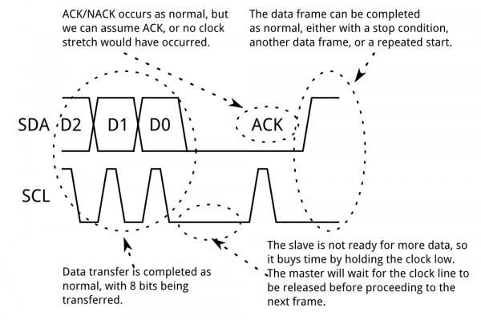
Clock stretching
At times, the master's data rate will exceed the slave's ability to provide that data. This can be because the data isn't ready yet (for instance, the slave hasn't completed an analog-to-digital conversion yet) or because a previous operation hasn't yet completed (say, an EEPROM which hasn't completed writing to non-volatile memory yet and needs to finish that before it can service other requests).
In this case, some slave devices will execute what is referred to as "clock stretching". Nominally, all clocking is driven by the master device--slaves simply put data on the bus or take data off the bus in response to the master's clock pulses. At any point in the data transfer process, an addressed slave can hold the SCL line low after the master releases it. The master is required to refrain from additional clock pulses or data transfer until such time as the slave releases the SCL line.

