Slide 1
I2C LAB01
Mohamed Saied

Slide 2
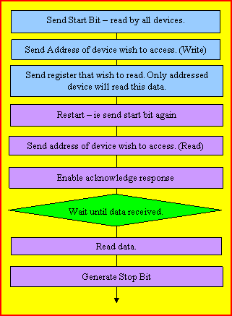
I2C Flow Chart

Slide 3
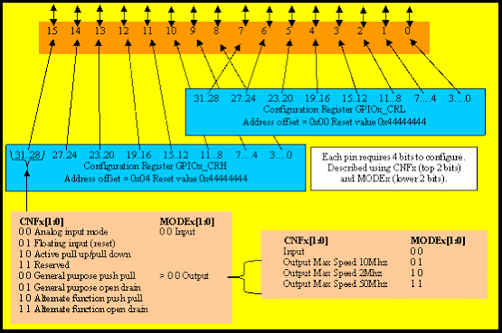
I2C pin Configuration
With I2C1 remapped PB8 = Clock, PB9 = SDA Both output open drain GPIOB->CRH |= 0x000000FF; //PB8,9 Open drain - max speed 50Hz

Slide 4
Configure I2C
void | I2C_Init( ) {
 | RCC->APB2ENR |= 1 << 6; | /* Enable GPIOE clock */
 | GPIOE->CRH = 0x33333333; | /* Configure GPIOE for LEDs */
 | RCC->APB2ENR |= (1 << 3) | (1 << 0); | //PortB and AF Clock
 | RCC->APB1ENR |= (1 << 21); | // I2C clock
 | AFIO->MAPR |= 0x00000002; | //Remap I2C
 | GPIOB->CRH |= 0x000000FF; | //PB8,9 Open drain - max speed 50Hz
 | I2C1->CR1 = 0x0000;
 | I2C1->CR2 = 0x0008; | //8MHz HSI
 | I2C1->CCR = 40; | //0x0028; //100kHz
 | I2C1->TRISE = 0x0009;
 | I2C1->CR1 = 0x0001; | // enable peripheral
}

Slide 5
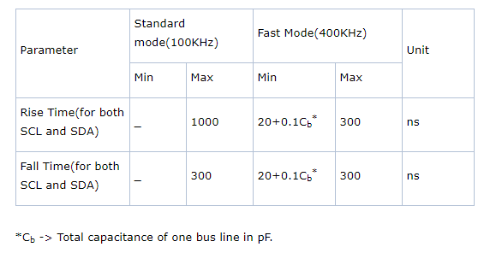
I2C Speed Modes

Slide 6
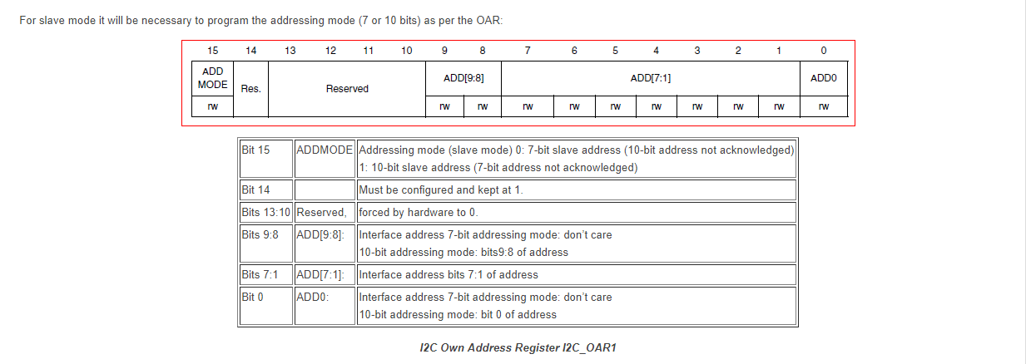
Slave Own Address Register

Slide 7
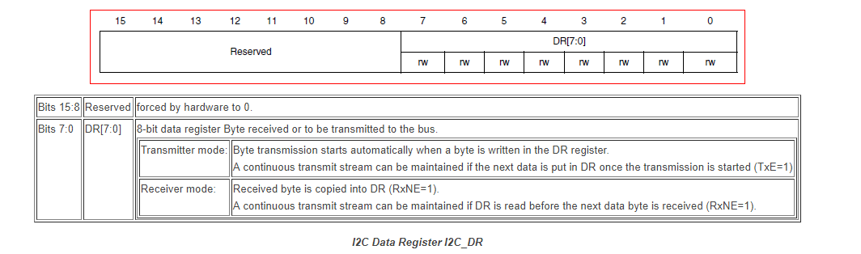
Data Register

Slide 8
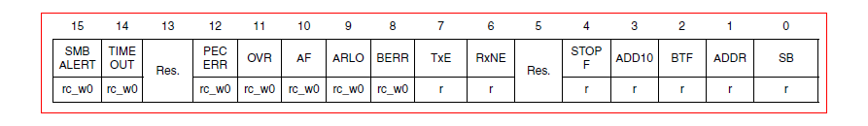
Status Register 1
Bit 15 | SMBALERT: | SMBus alert
Bit 14 | TIMEOUT: | Timeout or Tlow error
Bit 12 | PECERR: | PEC Error in reception
Bit 11 | OVR: | Overrun/Underrun
Bit 10 | AF: | Acknowledge failure
Bit 9 | ARLO: | Arbitration lost (master mode)
Bit 8 | BERR: | Bus error
Bit 7 | TxE: | Data register empty (transmitters)
Bit 6 | RxNE: | Data register not empty (receivers)
Bit 4 | STOPF: | Stop detection (slave mode)
Bit 3 | ADD10: | 10-bit header sent (Master mode)
Bit 2 | BTF: | Byte transfer finished
Bit 1 | ADDR: | Address sent (master mode)/matched (slave mode)
Bit 0 | SB: | Start bit (Master mode)

Slide 9
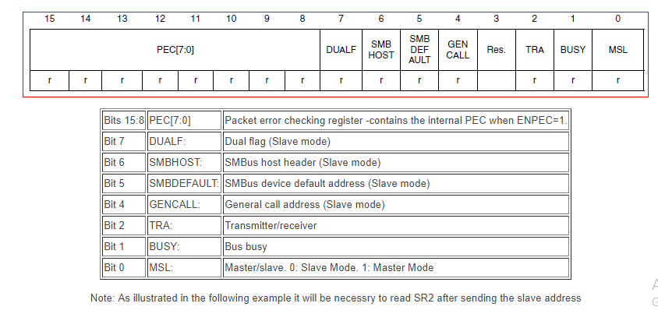
Status Register 2

Slide 10
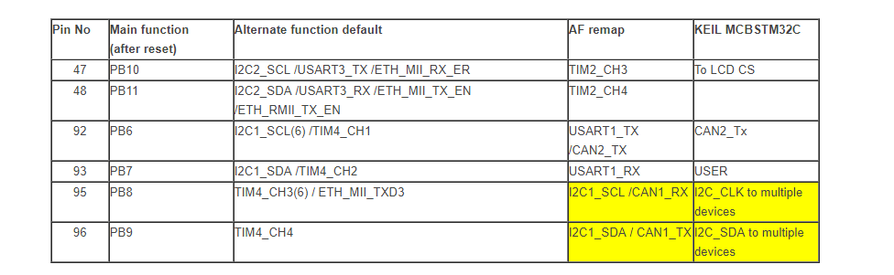
I2C pins

Slide 11
I2C Registers
CR1: ‘Control Register 1’ – this register is used to enable and disable the peripheral and generate start and stop conditions.
CR2: ‘Control Register 2’ – this register hold’s the timer’s current counter value. It counts up from 0 once the timer is started.
CCR: ‘Clock Control Register’ – Holds the value of the clock rate to work in standard mode or fast mode
TRISE: ‘Rise Time Register’ –
OAR: ‘Own Address Register’ –
DR: ‘Data Register’ – Register that holds the data to be transmitted or received
SR: ‘Status Register’ – Register that holds the data to be transmitted or received
SR2: ‘Status Register 2’ – Register that holds the busy flags

Slide 12
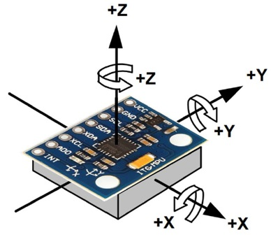
Motion Processing Unit (Accel & Gyro)

Slide 13
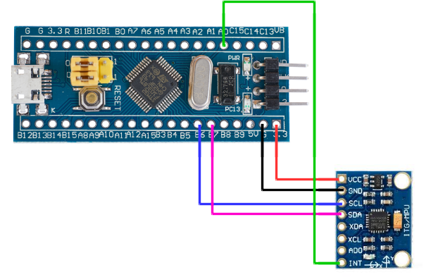
STM32 with MPU6050

