Slide 1

Serial Communication
Mohamed Saied

Slide 2
Transmission Modes
The transmission of binary data across a link can be accomplished in either parallel or serial mode. In parallel mode, multiple bits are sent with each clock tick. In serial mode, 1 bit is sent with each clock tick. While there is only one way to send parallel data, there are three subclasses of serial transmission: asynchronous, synchronous, and isochronous.
Topics discussed in this section:
Parallel Transmission
Serial Transmission

Slide 3
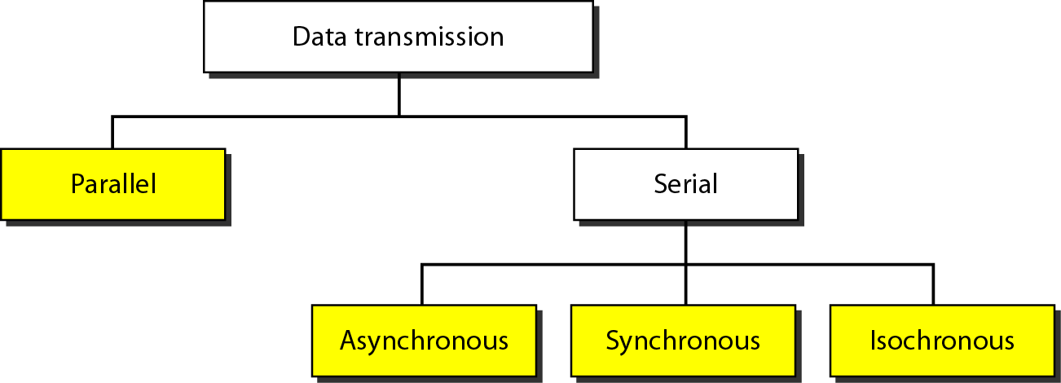
Transmission Modes

Slide 4
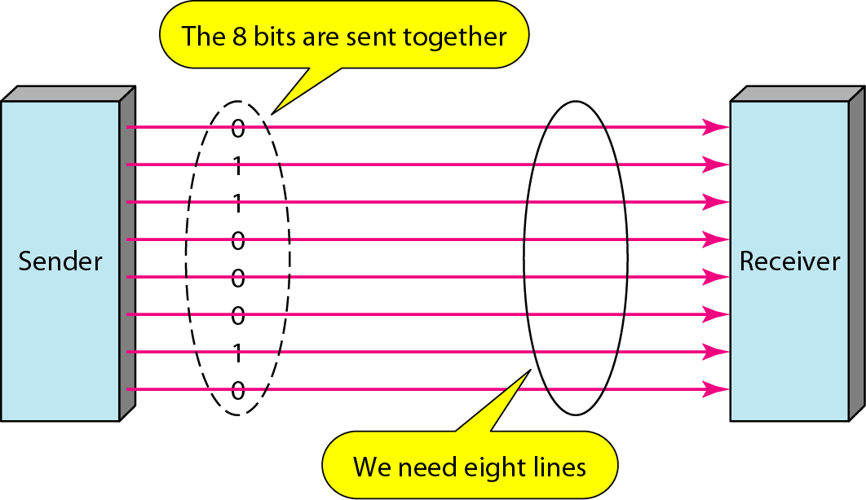
Parallel Communication

Slide 5
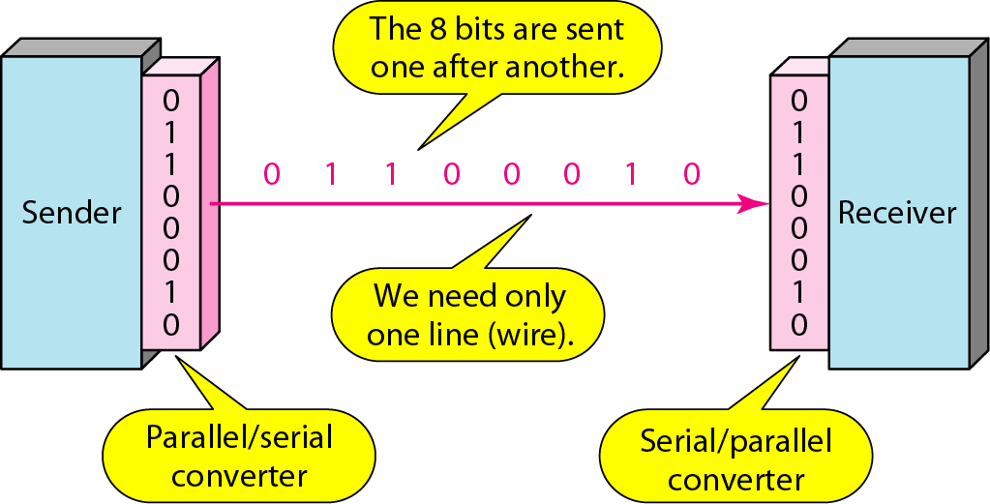
Serial Communication

Slide 6
Note
In asynchronous transmission, we send 1 start bit (0) at the beginning and 1 or more stop bits (1s) at the end of each byte. There may be a gap between each byte.
Asynchronous here means “asynchronous at the byte level,”
but the bits are still synchronized; their durations are the same.

Slide 7
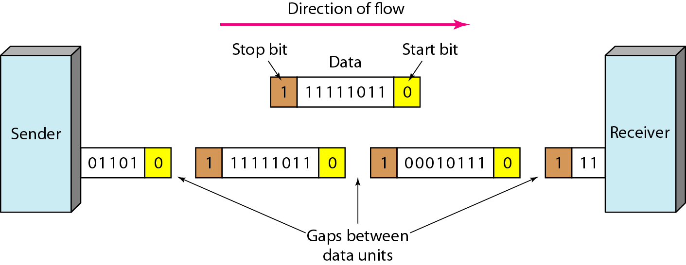
Asynchronous Transmission

Slide 8
Note
The transmission of binary data across a link can be accomplished in either parallel or serial mode. In parallel mode, multiple bits are sent with each clock tick. In serial mode, 1 bit is sent with each clock tick. While there is only one way to send parallel data, there are three subclasses of serial transmission: asynchronous, synchronous, and isochronous.

Slide 9
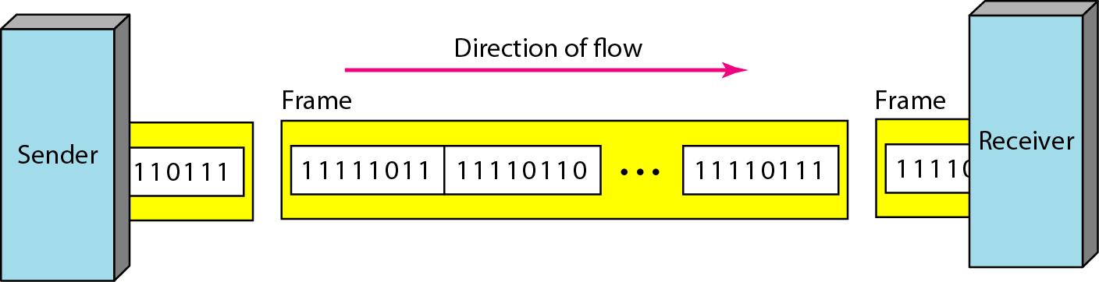
Synchronous Transmission

Slide 10
Asynchronous Transmission

Slide 11
Synchronous Transmission
In synchronous transmission, we send bits one after another without start or stop bits or gaps. It is the responsibility of the receiver to group the bits. The bits are usually sent as bytes and many bytes are grouped in a frame. A frame is identified with a start and an end byte.

Slide 12
Synchronous Transmission

Slide 13
Note
In isochronous transmission we cannot have uneven gaps between frames.
Transmission of bits is fixed with equal gaps.

Slide 14
Universal Synchronous Asynchronous Receiver Transmitter USART
INTRO
UART Protocol
What is RS232?
UART in AVR

Slide 15
UART
UART is the asynchronous part from the USART

Slide 16
Connection with PC

Slide 17
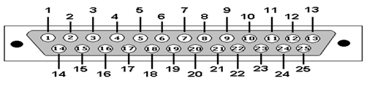
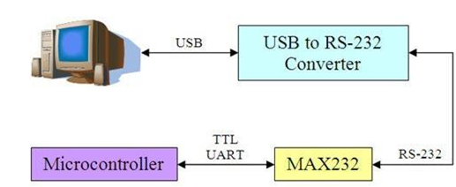
RS232

Slide 18
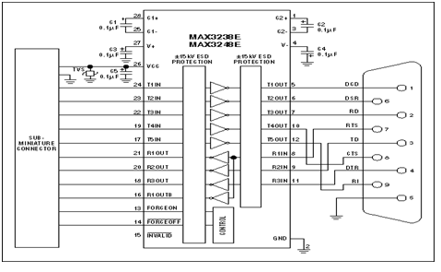
MicroController with MAX232

Slide 19
MAX232 Operation
Max 232 acts as a buffer driver for the processor. It accepts the standard digital logic values of 0 & 5 volts and converts them to the RS232 standard of +10 & -10 volts. Few Microcontrollers have built in serial ports which allow for direct connection with the RS232 serial port of the PC. However many microcontrollers give a 0 to 5V output and require a intermediate buffer circuit to convert the 0 to 5 volts to +10 and -10V required by the RS232 port.
The Max 232 IC consists of two transmitter-receiver arrangement such that two serial ports can be connected using the same chip. 5 capacitors of each 1microFarad are used to generate the required RS232 standard voltage from the TTL/CMOS voltage. The transmitters convert the TTL/CMOS level to RS232 level whereas the receiver receives the RS232 input and converts them to TTL level voltage.

Slide 20
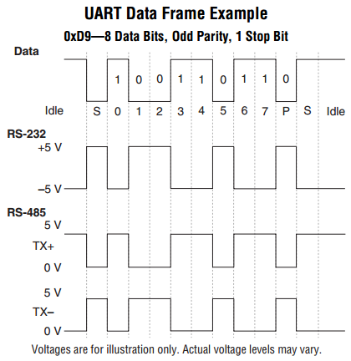
RS232 Transmission

Slide 21
UART Properties
Serial Protocol which Can work in Full duplex mode since it has different transmit/receive lines and buffers.
It also has a high resolution baud rate generator
Supports Serial Frames with 5, 6, 7, 8, or 9 Data bits and 1 or 2 Stop Bits

Slide 22
USART Modes
The USART of the AVR can be operated in three modes, namely:
Asynchronous Normal Mode
Asynchronous Double Speed Mode
Synchronous Mode

Slide 23
Asynchronous Mode
Asynchronous Normal Mode
In this mode of communication, the data is transmitted/received asynchronously, i.e. we do not need (and use) the clock pulses, as well as the XCK pin. The data is transferred at the BAUD rate we set in the UBBR register. This is similar to the UART operation.
Asynchronous Double Speed Mode
This is higher speed mode for asynchronous communication. In this mode also we set the baud rates and other initializations similar to Normal Mode. The difference is that data is transferred at double the baud we set in the UBBR Register.

Slide 24
Steps for Setting UART
The first step is to set the baud rate in both, the master and the slave. The baud rate has to be the same for both – master and slave.
Set the number of data bits, which needs to be sent.
Then enable the transmitter/receiver according to the desired usage.
Get the buffer ready! In case of transmission (from AVR to some other device), load it up with the data to be sent, whereas in case of reception, save the previous data so that the new received data can be overwritten onto it.
UART Can be used in Polling or Interrupt

Slide 25
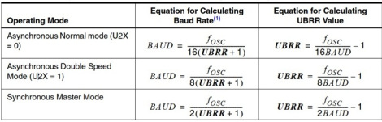
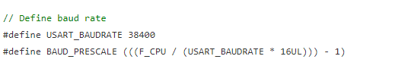
Baud Rate

Slide 26
UART Settings
Open Datasheet on USART Section and Start Designing UART Driver
According to UART Operation needing to Initialize UART,Recv via UART and Send data using UART
Note : What’s Register Banking?

Slide 27
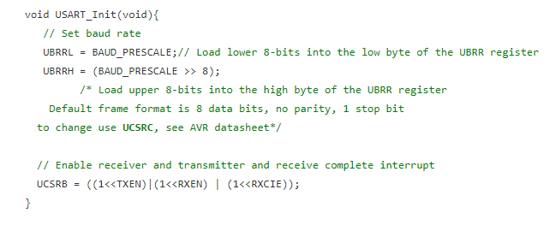
UART Initialize Example

Slide 28
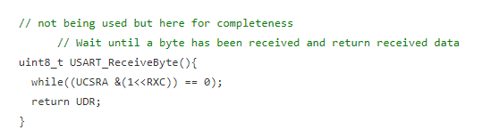
UART Receive in Interrupt Mode

Slide 29
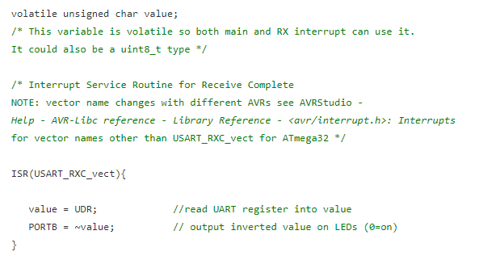
Interrupt for UART Receive

Slide 30
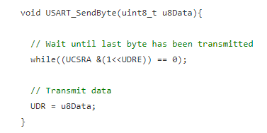
UART Send in polling Mode

Slide 31
LAB
Extend the UART Driver to have more functions such as :
Void UART_SendString(char *data);
Use USB to Serial TTL Module to communicate with PC
Or
Use Bluetooth Module to send data to be displayed to Mobile App such as BlueTerm

Slide 32
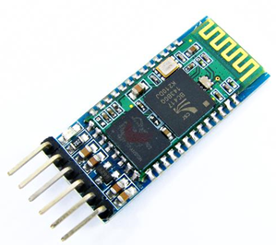
Bluetooth Module
HC-05 Technical Specifications
Serial Bluetooth module for microcontrollers
Operating Voltage: 4V to 6V (Typically +5V)
Operating Current: 30mA
Range: <100m
Works with Serial communication (USART) and TTL compatible
Follows IEEE 802.15.1 standardized protocol
Uses Frequency-Hopping Spread spectrum (FHSS)
Can operate in Master, Slave or Master/Slave mode
Can be easily interfaced with Laptop or Mobile phones with Bluetooth
Supported baud rate: 9600,19200,38400,57600,115200,230400,460800.

Slide 33
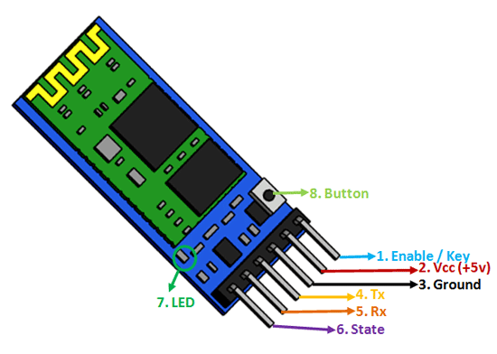
Bluetooth pin configuration
HC-05 Default Settings
Default Bluetooth Name: “HC-05”
Default Password: 1234 or 0000
Default Communication: Slave
Default Mode: Data Mode
Data Mode Baud Rate: 9600, 8, N, 1
Command Mode Baud Rate: 38400, 8, N, 1
Default firmware: LINVOR

Slide 34
Settings to Start Bluetooth with Mobile
First you need to pair HC05 with your Mobile
01
Second you need to install BlueTerm App or similar app on your Mobile
02
Third you need to connect your app to the HC05
03
Then Data will be displayed if the HC05 is sending or you can send characters to the HC05
04

Slide 35
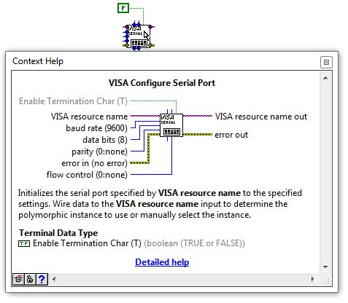
Configure port

Slide 36
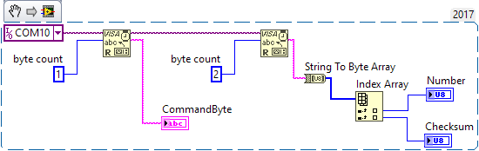
Labview Visa Library

