Slide 1


Intro. to OS
Mohamed Saied

Slide 2
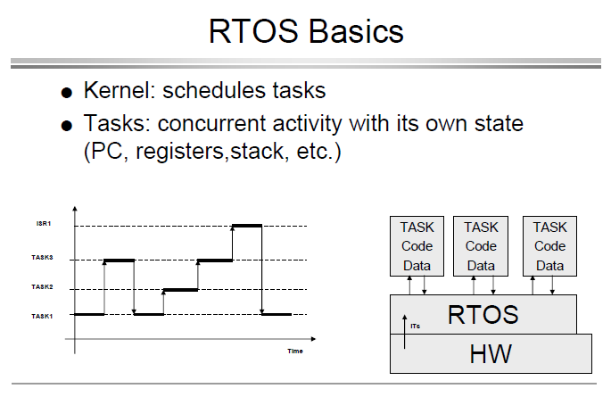

Slide 3
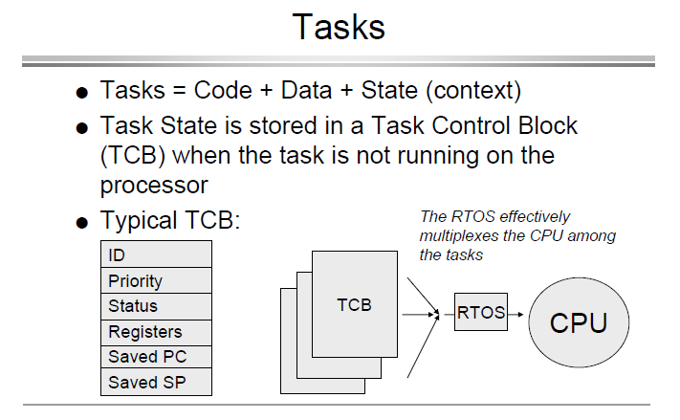

Slide 4
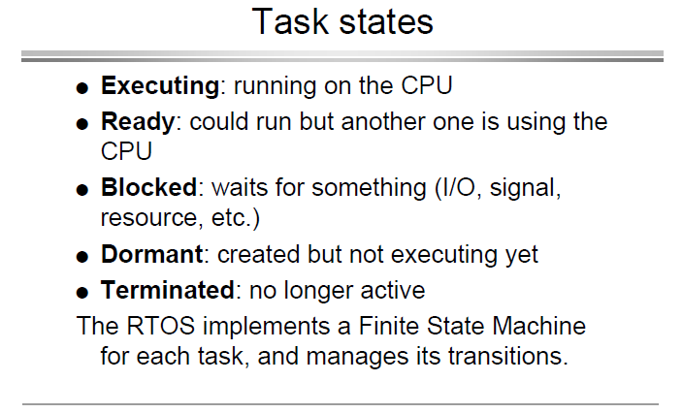

Slide 5
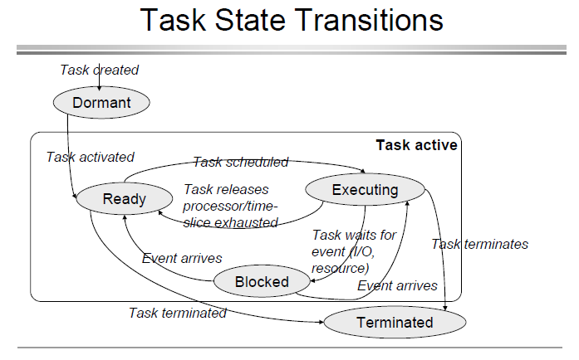

Slide 6
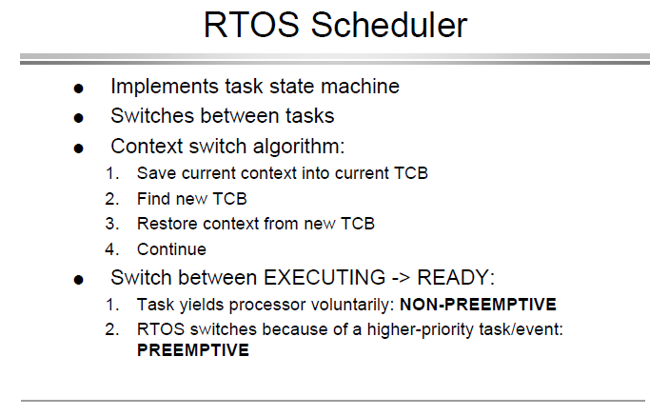

Slide 7
CPU Scheduling Criteria
CPU Utilization: CPU should be kept as busy as possible. (40 to 90 percent)
Throughput: Work is being done. No. Of processes per unit time
Turnaround time: For a particular process how long it takes to execute. (Interval between time of submission to time of completion)
Waiting time: Total time process spends in ready queue.
Response: First response of process after submission

Slide 8
Optimization criteria
It is desirable to
Maximize CPU utilization
Maximize throughput
Minimize turnaround time
Minimize start time
Minimize waiting time
Minimize response time
In most cases, we strive to optimize the average measure of each metric
In other cases, it is more important to optimize the minimum or maximum values rather than the average

Slide 9
Soft/Hard Real Time
Soft real-time requirements: state a time deadline—but breaching the deadline would not render the system useless.
Hard real-time requirements: state a time deadline—and breaching the deadline would result in absolute failure of the system.
Cortex-M4 has only one core executing a single Thread at a time.
Cortex-A (i.e Cortex-A65) is a multithreaded CPU, delivering highest levels of throughput efficiency. It can process two threads simultaneously and scales up to eight cores in a single cluster.
The kernel decides which thread should be executing by examining the priority assigned to each thread by the application designer.
Application designer could assign higher priorities to hard-real-time-threads and lower priorities to soft real-time

Slide 10
Why Use a Real-time Kernel?
Abstracting away timing information
Maintainability/Reusability/Extensibility
Modularity
Team development
Improved efficiency (No Polling)
Idle time:
The Idle task is created automatically when the kernel is started. It executes whenever there are no application tasks wishing to execute. The idle task can be used to measure spare processing capacity, to perform background checks, or simply to place the processor into a low-power mode.
Flexible interrupt handling:
Interrupt handlers can be kept very short by deferring most of the required processing to handler RTOS tasks.

Slide 11
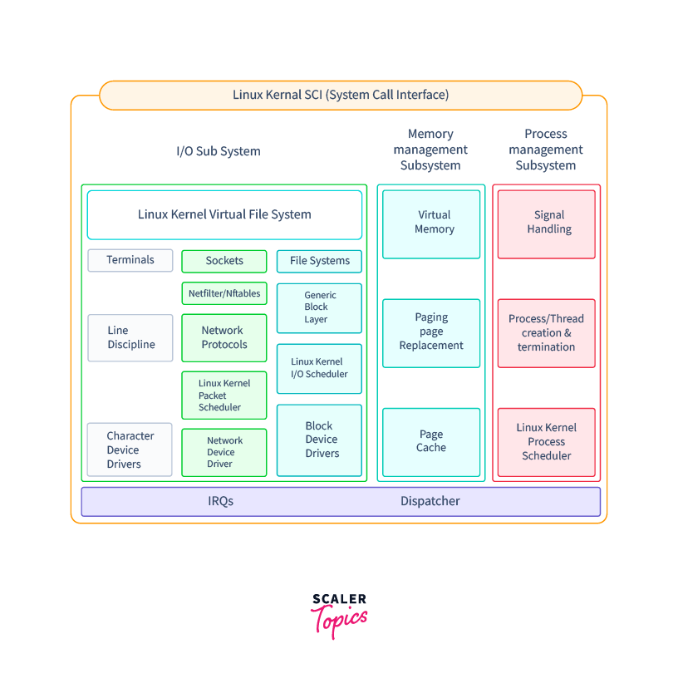
Linux Kernel System Call
Scheduling Criteria
FIFO
Round Robin
Completely Fair Scheduling

Slide 12
Scheduling Criteria
SCHED_FIFO – First In First Out real-time policy – threads of the same priority are queued in the order of arrival. Then, the first thread obtains the CPU
SCHED_RR – simple round-robin real-time scheduling which extends the FIFO scheme. All threads with the same priority receive the CPU in turn
SCHED_OTHER – time-sharing scheduling, implemented as the Completly Fair Scheduling (CFS)

