Slide 1
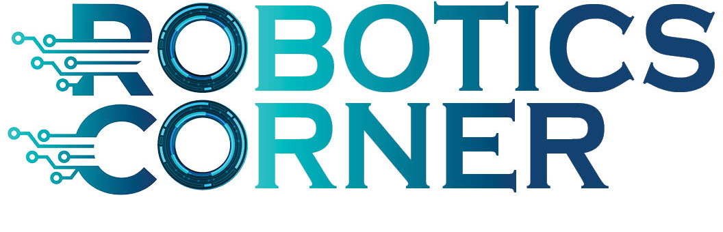
DevOps
Mohamed Said

Slide 2

Agenda
What’s DevOps?
DevOps Concepts
DevOps Driven by Agile
DevOps Models
DevOps tools
Source Control
Containers platforms
Configuration Management: CI/CD
Pipelines
Get Started with Jenkins

Slide 3
DevOps

Slide 4
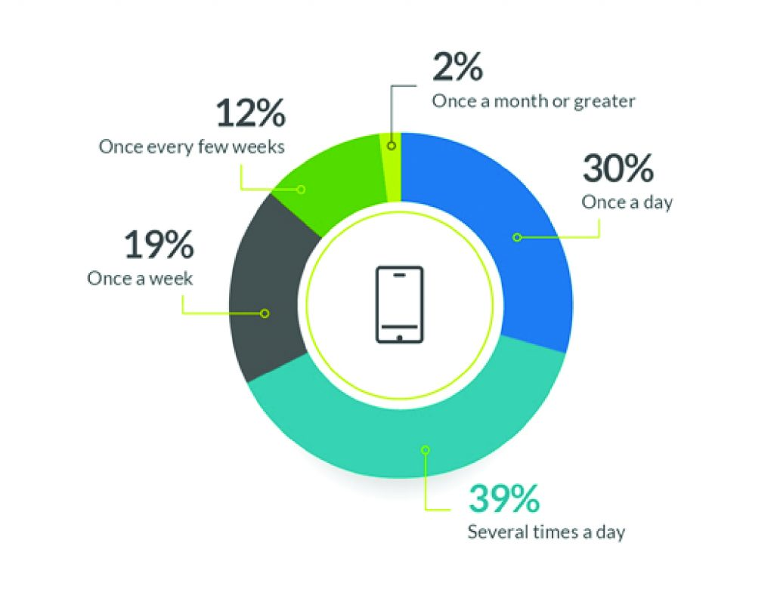
The Need of Automation
Rate of Application Deployment

Slide 5
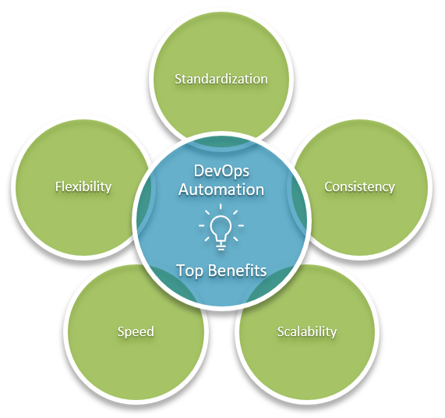
DevOps Automation

Slide 6
Agile Principles drive DevOps
Early and continuous delivery of high-value software.
Welcome to change
Working software is the primary method of tracking progress.
Frequently deliver software.
Continuous attention to achieving technical excellence and great design.
Developers and business leaders must collaborate daily.
Simplicity, or finding the value in saving workers from performing extra work.
Self-organizing teams are the foundation for the best architectures, designs, and requirements.
Face-to-face communications are the most effective way to share information.
At routine intervals, teams reflect on how they can improve the product

Slide 7
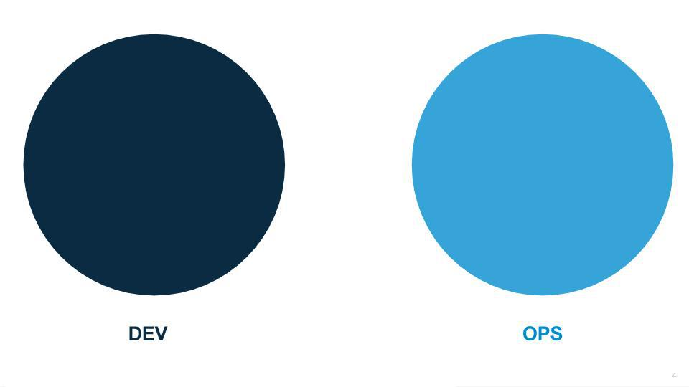
DevOps
There were always a gap between Development and IT operations, This Separation doesn’t allow automation to take a place in the SDLC

Slide 8
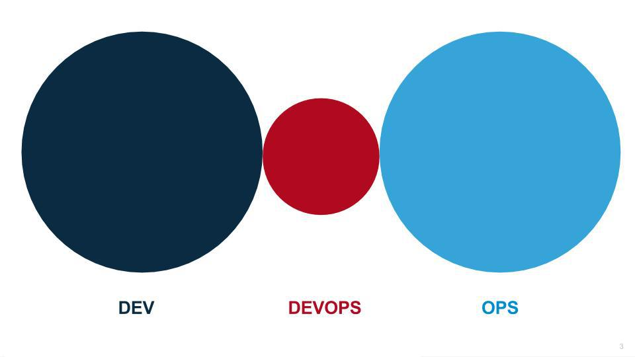
DevOps
And then DevOps arise to fill this gap since, It’s a mix of Development and IT Operations.
In this model, a new element of separation is inserted between Dev and Ops and a “build it and they will come” mindset leads to more shadow IT as the Dev’s needs continue to go unmet

Slide 9
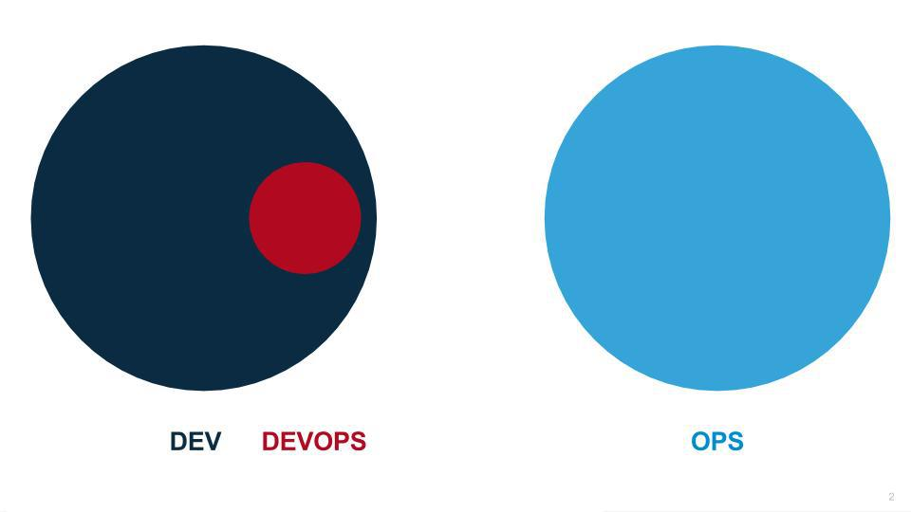
Dev/No Ops Model
In this model, development teams script away the ops team and provision all of their own infrastructure as code. After all, infrastructure provisioning is their biggest bottleneck. The downside to this approach is that Devs are not experts at networking, security, compliance, support and many other capabilities that have been provided for them by various shared service groups. So although the Dev groups can now move much faster, they drastically increase risks for their company that can have catastrophic consequences.

Slide 10
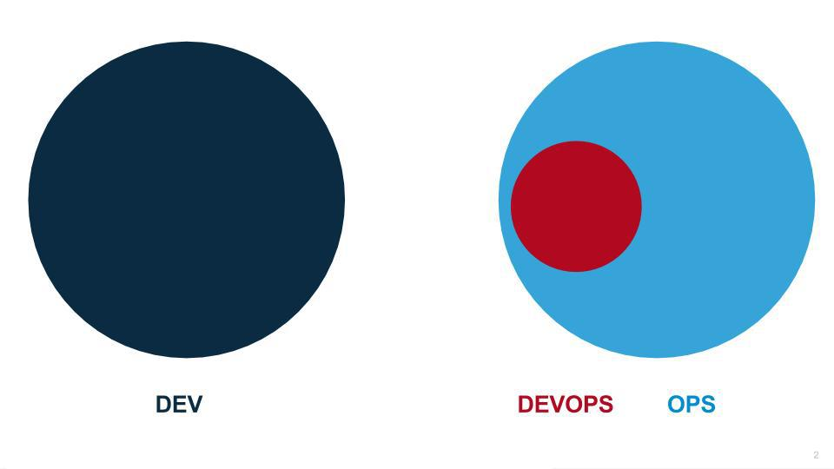
Rebranding Sys admins as DevOps Engineers
In this model, nothing really changes other than the sysadmins’ titles and resumes. All of the bottlenecks that keep work from flowing left to right remain, but some really cool scripts get built. Often, too many scripts are built, and now Ops is buried in script hell trying to manage thousands of lines of scripts, sometimes not checked into a repository. This “build it and they will come” approach often either backfires or just creates new bottlenecks. The Ops team often sees efficiency in their day-to-day tasks, but at the expense of newly wasted time in the Dev’s day-to-day tasks.

Slide 12
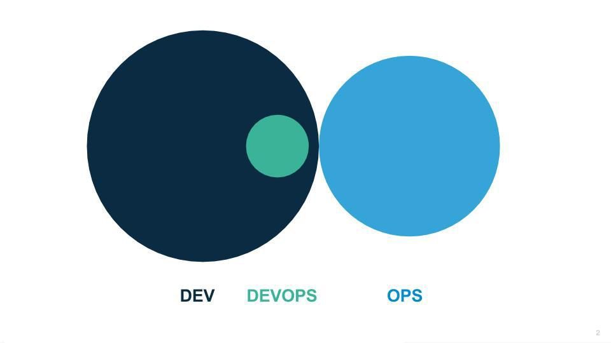
DevOps Correct Model
In this model the Ops team is responsible for providing and operating the platform, and the developers are responsible for operating their applications, which are built on top of the enterprise guard rails. In stage 3 we finally get to “you build it, you run it.”

Slide 13
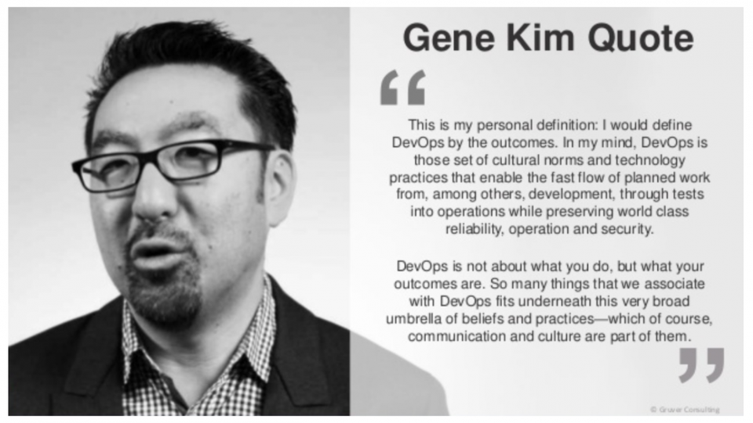
DevOps Simple definition

Slide 14
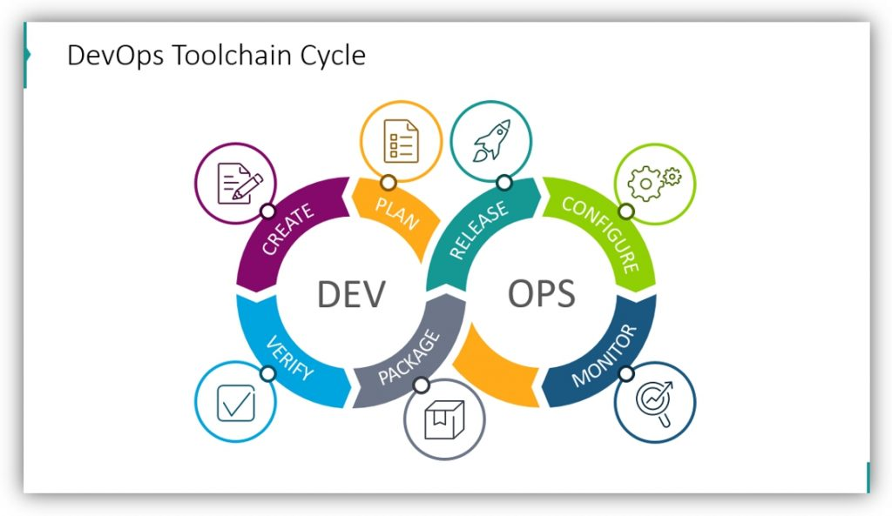
Basic Concepts

Slide 15
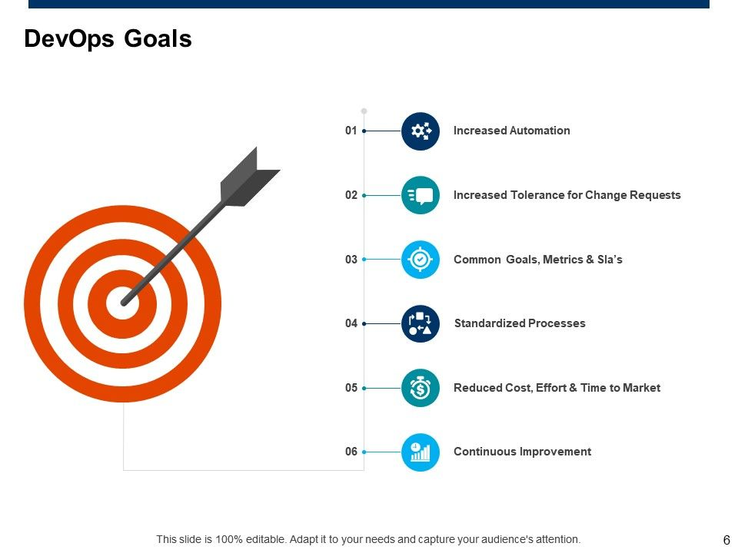

Slide 16
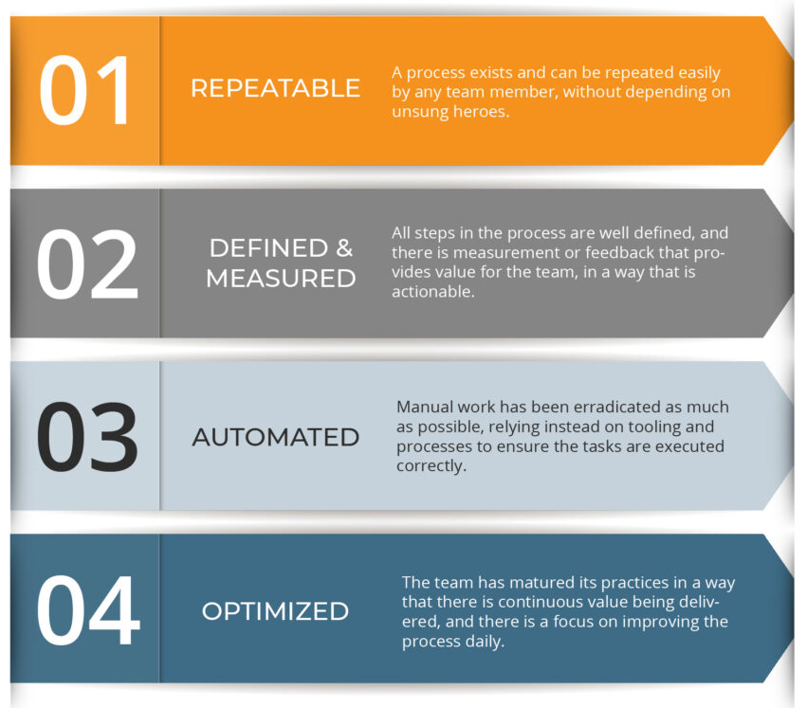
4 Stages of DevOps Maturity Model

Slide 17
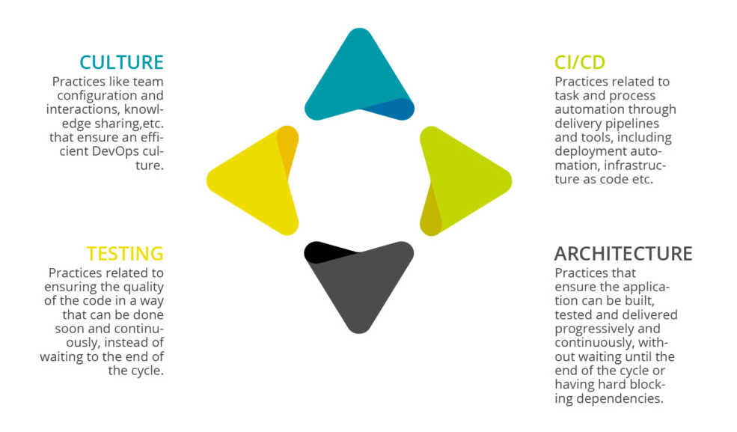
Process Orientation

Slide 18
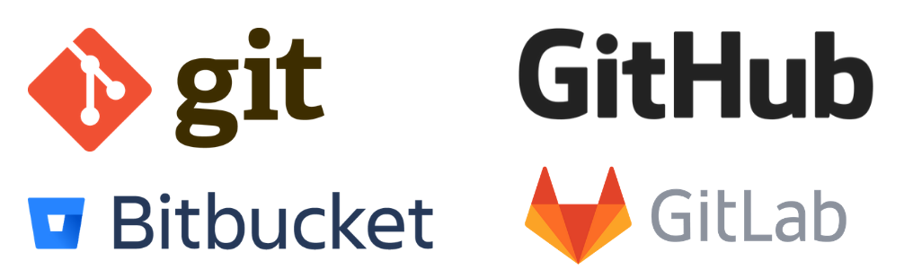
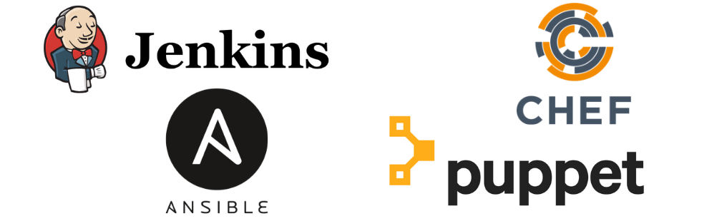
DevOps Tools
Source code control
DevOps CI/CD and configuration management tools

Slide 19
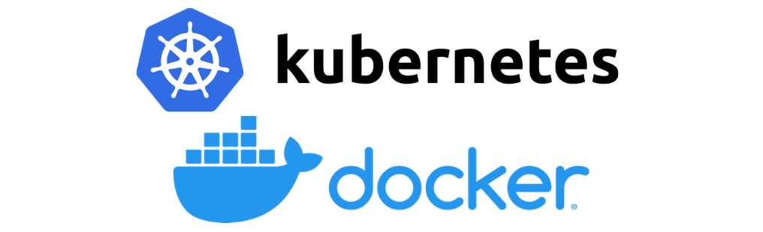
DevOps Tools Cont’ : Container platforms
The use and implementation of container platforms and microservices. Whether you choose Kubernetes or Docker Swarm as your container orchestration tool, your choice is dependent on your architecture and the goals you’re trying to achieve by containerizing applications or services. Breaking large applications and products into microservices running on containers can greatly benefit development speed as well as reliability through limited blast radiuses.

Slide 20
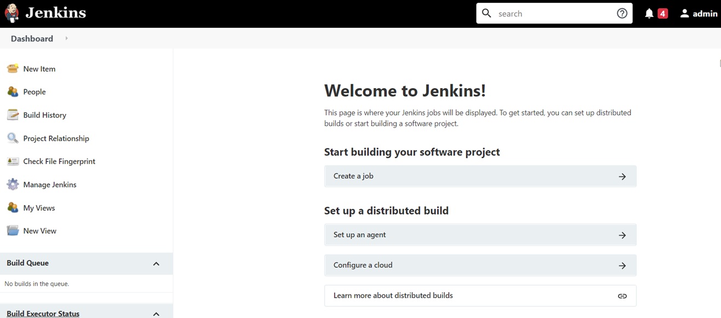
Jenkins CI/CD
Download and run Jenkins
Download Jenkins.
Open up a terminal in the download directory.
Browse to http://localhost:8080.
Follow the instructions to complete the installation.
Run java -jar jenkins.war --httpPort=8080.

Slide 21
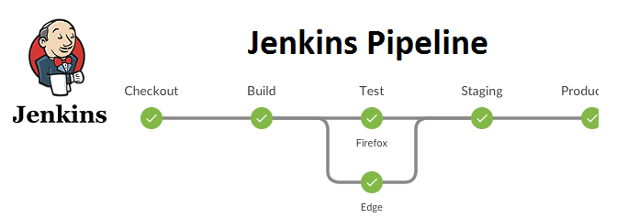
Jenkins Pipeline

Slide 22
Thank you.

