Slide 1
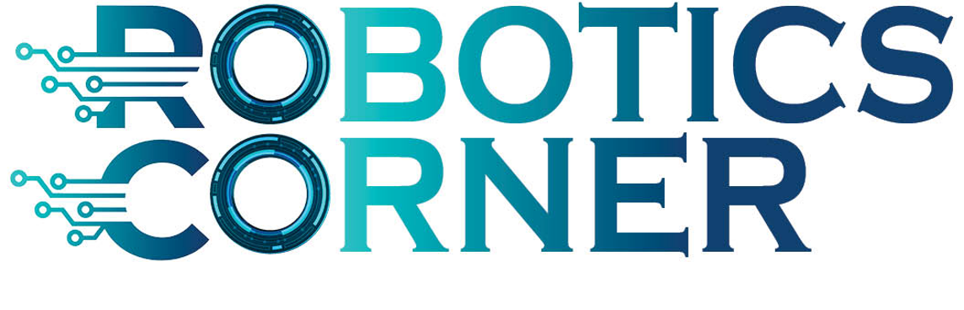
Software Engineering

Slide 2
Agenda
Definitions in Software Industry
Software Development Life Cycle
Requirements Analysis
Design phase
Design types
Design tools
Testing and validation
SDLC Process Models
Waterfall
V Model
Agile
Documentation tools

Slide 3
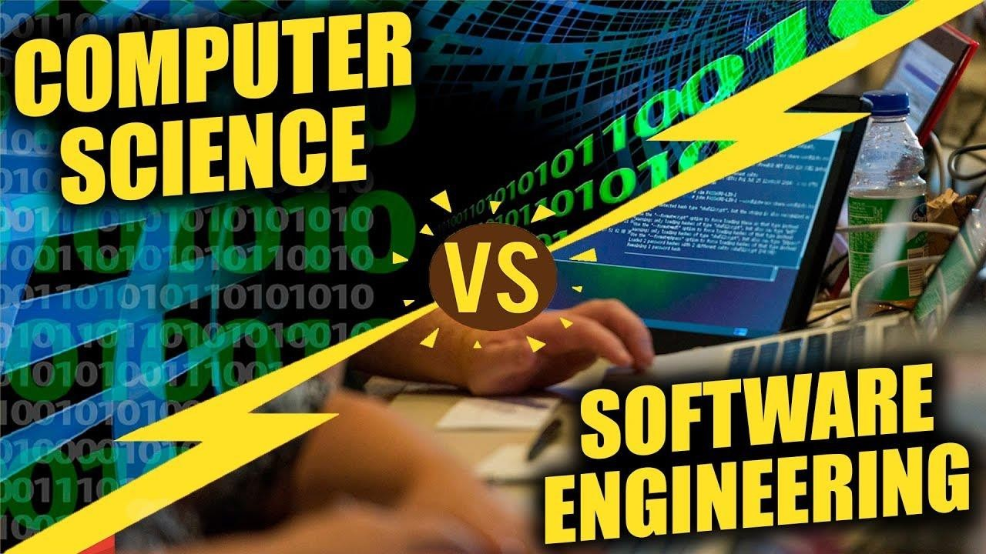
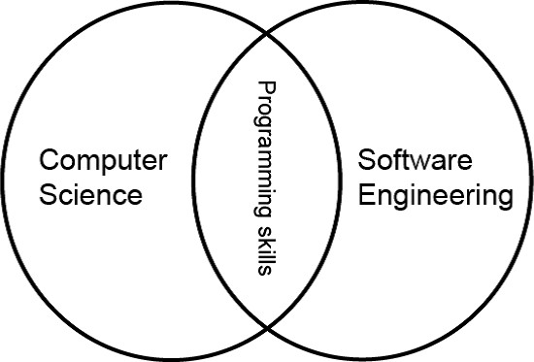
Software Engineering vs Computer Science
Computer Science is concerned with theory
and
Fundamentals, while Software Engineering is concerned with the practicalities of development and delivering a useful Software
Software: Computer programs and associated documentation. Software products may be developed for a particular customer or may be developed for a general market.

Slide 4
Attributes of a good Software
Product characteristic | Description
Maintainability | Software should be written in such a way so that it can evolve to meet the changing needs of customers. This is a critical attribute because software change is an inevitable requirement of a changing business environment.
Dependability and security | Software dependability includes a range of characteristics including reliability, security and safety. Dependable software should not cause physical or economic damage in the event of system failure. Malicious users should not be able to access or damage the system.
Efficiency | Software should not make wasteful use of system resources such as memory and processor cycles. Efficiency therefore includes responsiveness, processing time, memory utilisation, etc.
Acceptability | Software must be acceptable to the type of users for which it is designed. This means that it must be understandable, usable and compatible with other systems that they use.

Slide 5
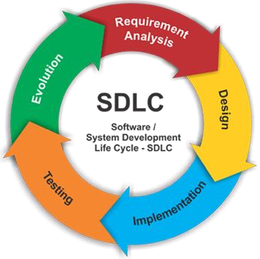
Requirements
Design
Software Development Life Cycle
Implementation
Testing
Evolution

Slide 6
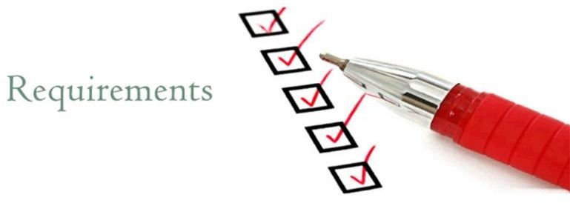
Requirement Analysis
Requirement Types
User requirements
Statements in natural language plus diagrams of the services the system provides and its operational constraints. Written for customers.
System requirements
A structured document setting out detailed descriptions of the system’s functions, services and operational constraints. Defines what should be implemented so may be part of a contract between client and contractor.

Slide 7
Requirements
Business requirements. These include high-level statements of goals, objectives, and
needs.
Stakeholder requirements. The needs of discrete stakeholder groups are also specified to define what they expect from a particular solution.
Solution requirements. Solution requirements describe the characteristics that a product must have to meet the needs of the stakeholders and the business itself.
Functional requirements describe how a product must behave, what its features and functions.
Nonfunctional requirements describe the general characteristics of a system.They are also known as quality attributes.

Slide 8
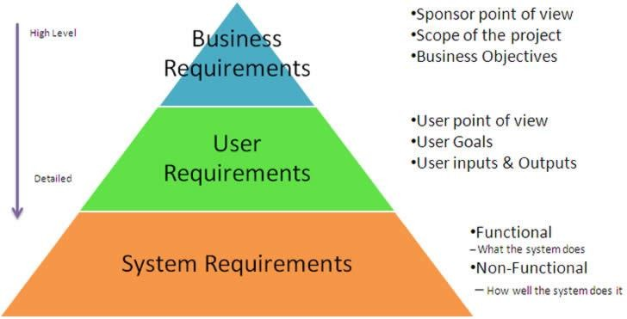
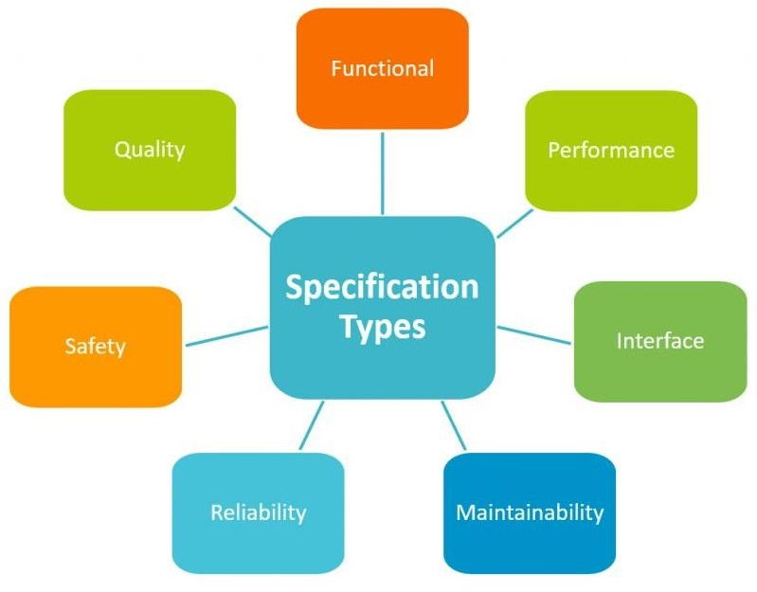
Software Requirement Specifications
TODO

Slide 9
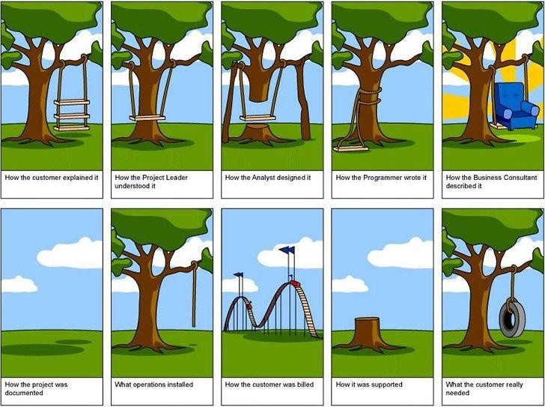
Requirements

Slide 10
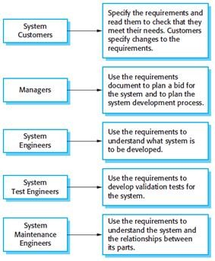
Requirement Documents
The usage of requirement documents by the system Actors from system Customers, Managers, System Engineers and quality control engineers
Each actor uses the requirements to do his job

Slide 11
Design
Designing The system is first stage by High Level Design HLD
Breaking down the system into components each has its own component Detailed Design CDD
Design types are:
Dynamic Design which describes how the system behave
Static Design describes the Architecture and structure of the System which relates to files and implementation

Slide 12

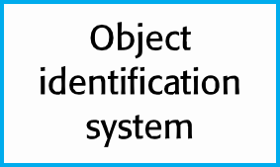
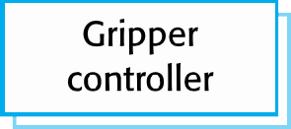
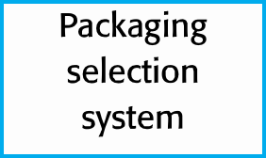
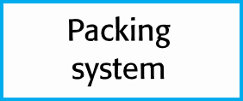
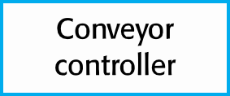
Architecture Design
Architectural design is concerned with understanding how a software system should be organized and designing the overall structure of that system.
Architectural design is the critical link between design and requirements engineering, as it identifies the main structural components in a system and the relationships between them.
This is Architecture Model of packing Robot Control System

Slide 13
UML
UML stands for Unified Modeling Language
UML is a diagramming language designed for Object Oriented programming
UML can be used to describe:
the organization of a program
how a program executes
how a program is used
how a program is deployed over a network
…and more
FAQ:Why UML is used in Embedded Systems?
UML is not just class diagrams, it includes state diagrams and flowcharts, which are useful also outside of an object oriented setting.
Also, many C programs are written in a way that borrows a few concepts from OOP.

Slide 14
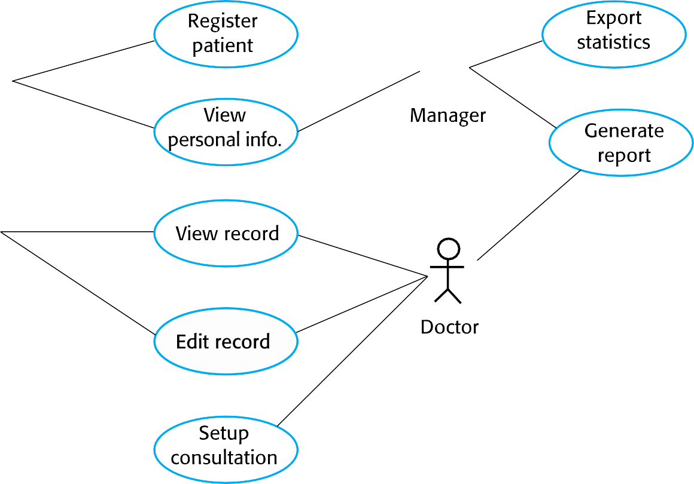




Use Case
Actors. These are the users outside the system that interact with the system.
System.The system is described by functional requirements that define an intended
behavior of the product.
Goals.The purposes of the interaction between the users and the system are outlined as goals.

Slide 15
Sequence Diagram
Sequence diagrams are part of the UML and are used to model the interactions between the actors and the objects within a system.
A sequence diagram shows the sequence of interactions that take place during a particular use case or use case instance.
The objects and actors involved are listed along the top of the diagram, with a dotted line drawn vertically from these.
Interactions between objects are indicated by annotated arrows.

Slide 16
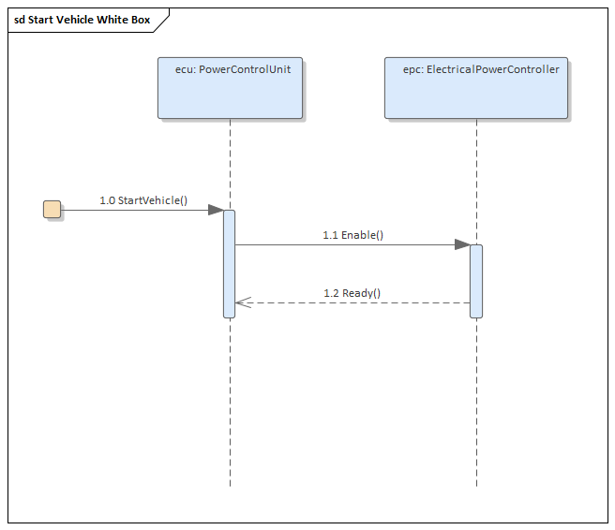
Sequence Diagram
Sequence diagrams are part of the UML and are used to model the interactions between the actors and the objects within a system.
A sequence diagram shows the sequence of interactions that take place during a particular use case or use case instance.
The objects and actors involved are listed along the top of the diagram, with a dotted line drawn vertically from these.
Interactions between objects are indicated by annotated arrows.

Slide 17

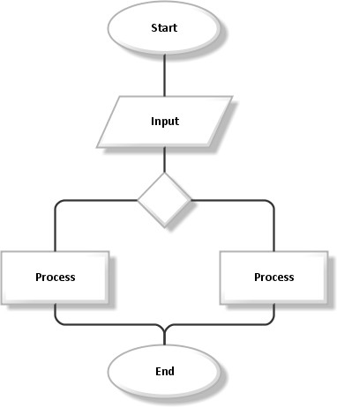



Flow Chart
Used for start and end
Processing steps
Decision 1 input multiple Output
Data illustrates input and output

Slide 18
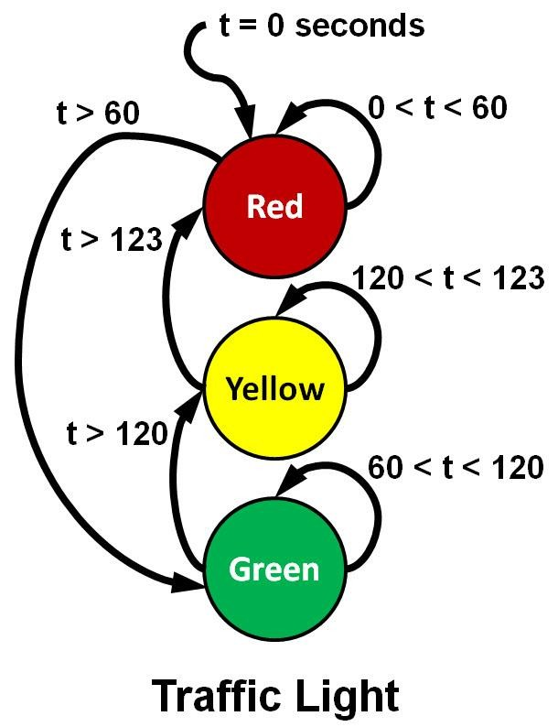
Finite State Machine
Every system has to have finite number of states
The system transients from state to another state according to the input of the state which is the output of the previous state
Example Traffic Light System :
Inputs are the timer value
RED state when time=0 stay for 60 s
GREEN state when the timer = 60 &&time <120
YELLOW state stay for 3s then go to RED
RED reset the time and start over

Slide 19
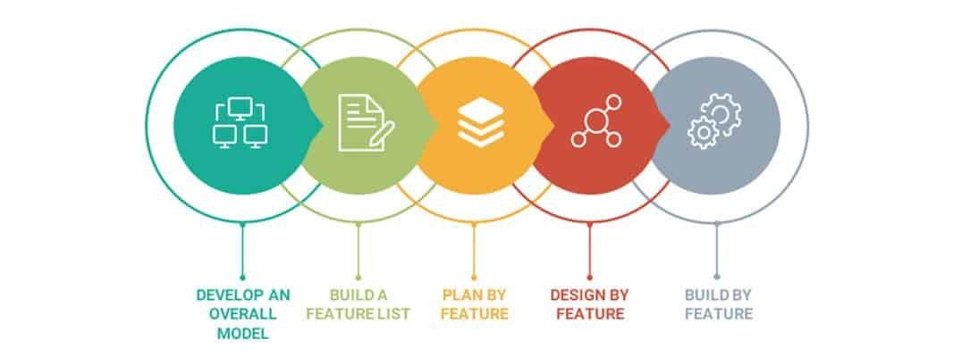
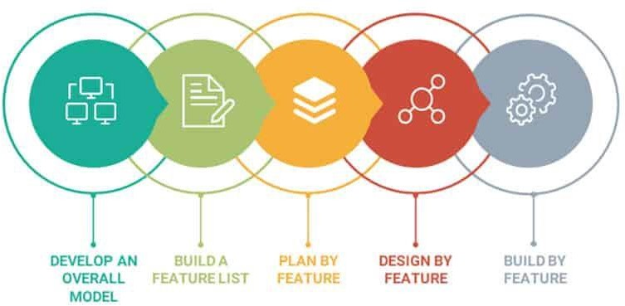
Implementation/Development Techniques
Plan Driven Development
Feature Driven Development

Slide 20
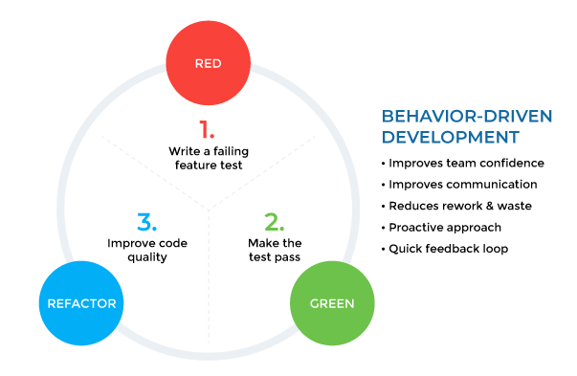
Implementation Techniques
Test-Driven Development(TDD) approach first, the test is developed which specifies and validates what the code will do. In simple terms, test cases are created before code is written. The purpose of TDD is to make the code clearer, simple and bug- free.
Behavior-Driven Development(BDD) is also a test-first approach, but differs by testing the actual behavior of the system from the end users perspective.

Slide 21
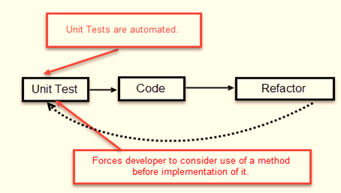
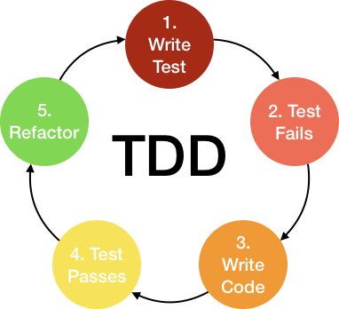
TDD Techniques

Slide 22
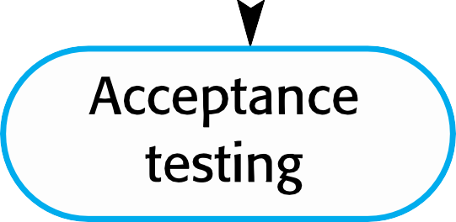
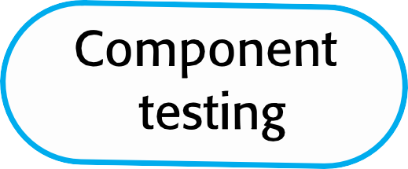
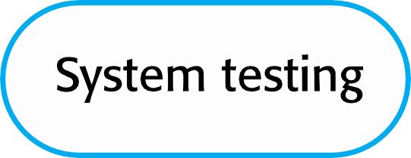

Testing and validation
1. Each Component will need to be have its own unit Testing and when its integrated with other components will be a part of Integration Testing then System Testing and the customer will do the acceptance testing

Slide 23
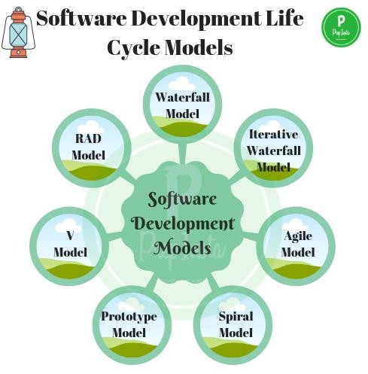

Software Process Models
Why The need of Software development Models?
Different types of models
The Advantages and the drawbacks of each
model

Slide 24
Software Process Models
SDLC phases are not enough by their own to produce a software product and combine it with the business needs, cost estimation and customer satisfaction.
So Software development phases have to fit in a model that serve the overall aim which might be adapting to the change of customer requirements or developing high quality Software
Some of the models are customer centric where the customer plays important role in the feedback process and development team adapts according to the change of requirements i.e Agile used for new products and innovations
Other SDLC Models are used when quality control is the key essence of the product such as V-Model which is used in Safety critical applications such as Automotive.

Slide 25

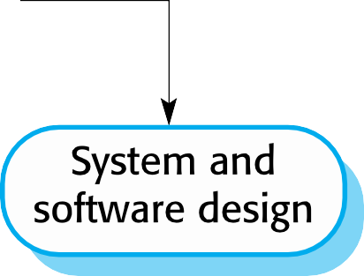
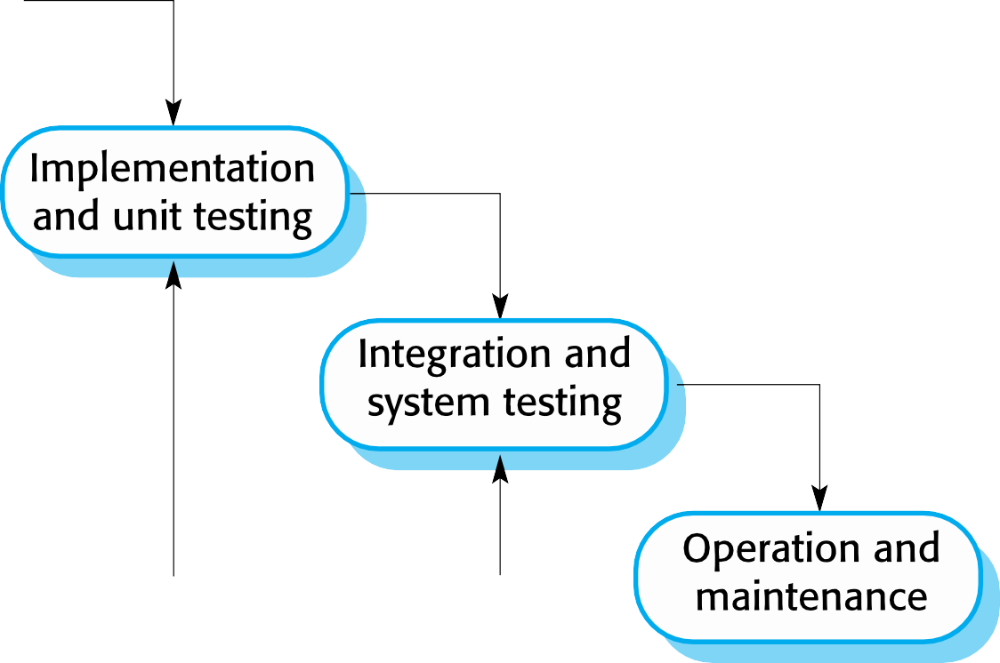
Waterfall Model

Slide 26
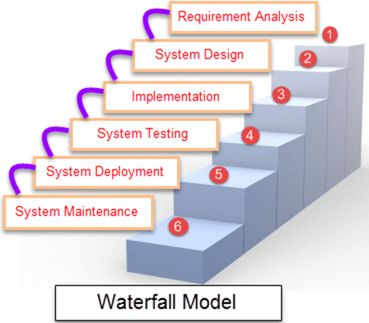
Advantages and Disadvantages
When to use Waterfall?
Projects which not focus on changing the requirements, for example, projects initiated from a
request for proposals ,the customer has a very clear documented requirements
Advantages | Disadvantages
Easy to explain to the users. Structures approach. Stages and activities are well defined. Helps to plan and schedule the project. Verification at each stage ensures early detection of errors/misunderstanding. Each phase has specific deliverables. | Assumes that the requirements of a system can be frozen. Very difficult to go back to any stage after it finished. A little flexibility and adjusting scope is difficult and expensive. Costly and required more time, in addition to the detailed plan.

Slide 27
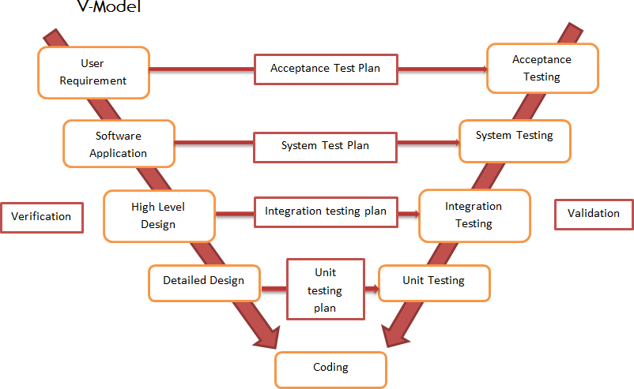
V-Model

Slide 28
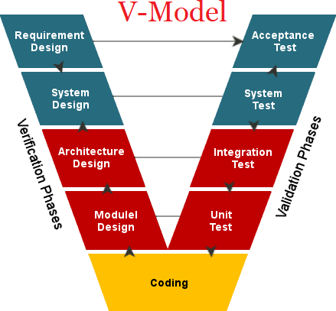
V-Model
The usage
Software requirements clearly defined and known
Software development technologies and tools are well-known
Advantages | Disadvantages
Simple and easy to use Each phase has specific deliverables. Higher chance of success over the waterfall model due to the development of test plans early on during the life cycle. Works well for where requirements are easily understood. Verification and validation of the product in the early stages of product development. | Very inflexible, like the waterfall model. Adjusting scope is difficult and expensive. The software is developed during the implementation phase, so no early prototypes of the software are produced. The model doesn’t provide a clear path for problems found during testing phases. Costly and required more time, in addition to a detailed plan

Slide 29
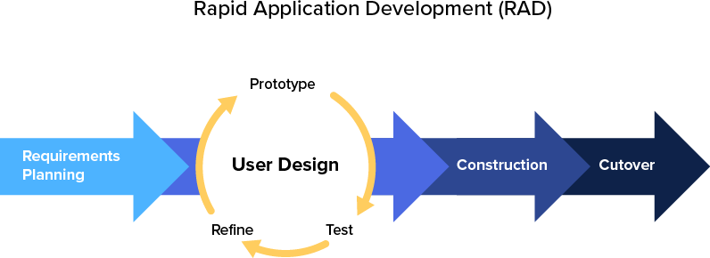
Rapid software development
Rapid development and delivery is now often the most
important requirement for software systems
Businesses operate in a fast changing requirement and it is practically impossible to produce a set of stable software requirements
Software has to evolve quickly to reflect changing business needs.
Plan-driven development is essential for some types of system but does not meet these business needs.
Agile development methods emerged in the late 1990s whose aim was to radically reduce the delivery time for working software systems

Slide 30
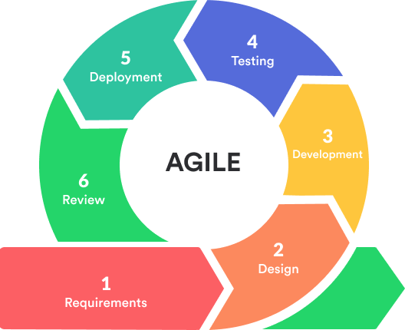
Agile development
Program specification, design and implementation are inter-leaved
The system is developed as a series of
versions or increments with stakeholders involved in version specification and evaluation
Frequent delivery of new versions for evaluation
Extensive tool support (e.g. automated testing tools) used to support development.
Minimal documentation – focus on working code
Quoted from Chapter 3 Agile Software Development
30

Slide 31
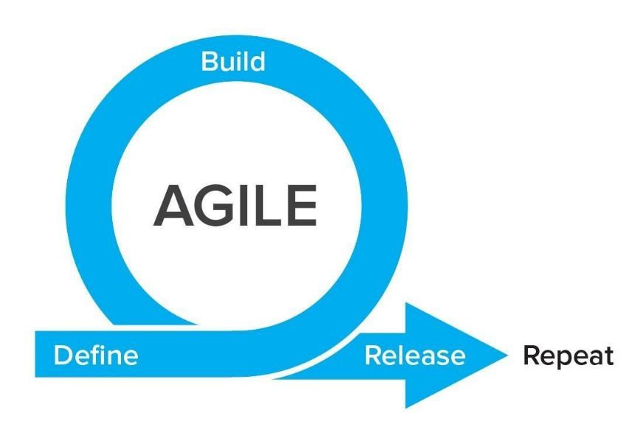
When to use Agile?
It can be used with any type of the project, but it needs more engagement from the customer and to be interactive. Also, we can use it when the customer needs to have some functional requirement ready in less than three weeks and the requirements are not
clear enough.
This will enable more valuable and workable piece for software early which also increase the customer satisfaction.
Advantages | Disadvantages
Decrease the time required to avail some system features. Face to face communication and continuous inputs from customer representative leaves no space for guesswork. The end result is the high-quality software in the least possible time duration and satisfied customer. | Scalability. The ability and collaboration of the customer to express user needs. Documentation is done at later stages. Reduce the usability of components. Needs special skills for the team.
31

Slide 32

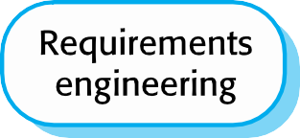
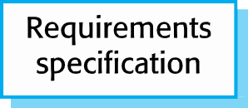
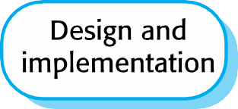



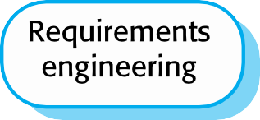

Plan-driven vs Agile development
Quoted from Software Engineering : Chapter 3 Agile Software Development
32

Slide 33
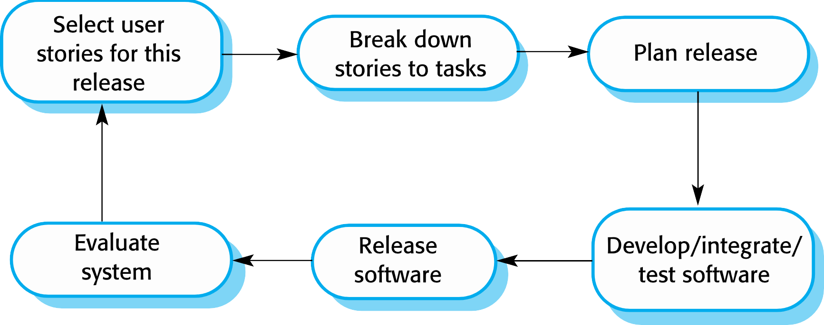
How Agile works
Quoted from Software Engineering : Chapter 3 Agile Software Development
33

Slide 34
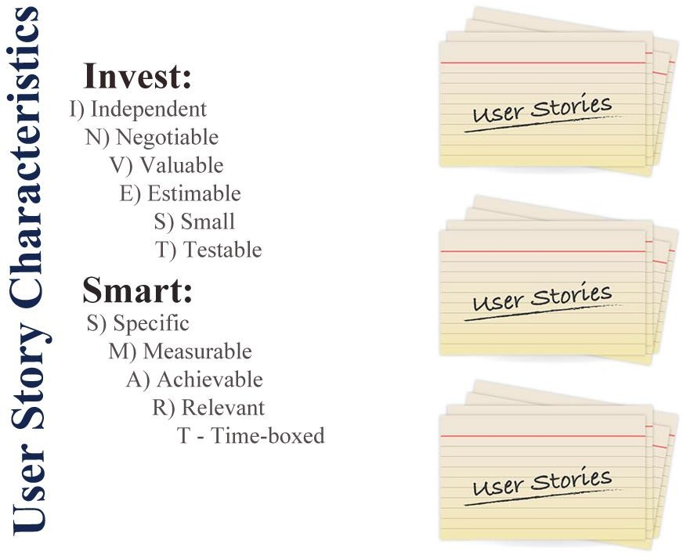
























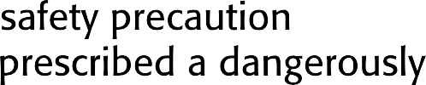

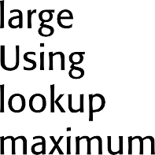

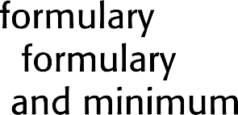















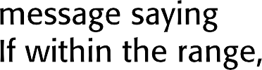

Examples of task cards for prescribing medication

Slide 35
SCRUM
Scrum is an agile method that focuses on managing iterative
development rather than specific agile practices.
There are three phases in Scrum.
The Initial phase is an outline planning phase where you establish the
general objectives for the project and design the software architecture.
This is followed by a series of sprint cycles, where each cycle develops an increment of the system.
The project closure phase wraps up the project, completes required documentation such as system help frames and user manuals and assesses the lessons learned from the project.

Slide 36
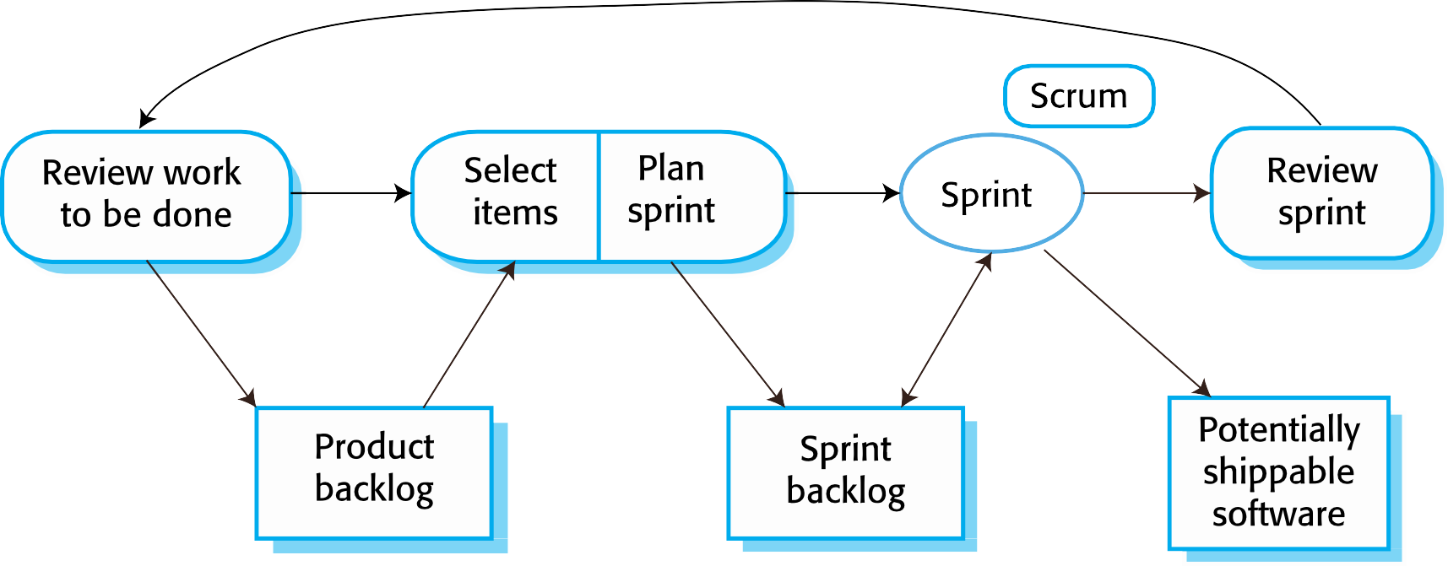
Scrum Sprint cycle
Sprints are fixed length, normally 2–4 weeks.
The starting point for planning is the product backlog, which is the list of work to be done on the project.
The selection phase involves all of the project team who work with the customer to select the features and functionality from the product backlog to be developed during the sprint.

Slide 37
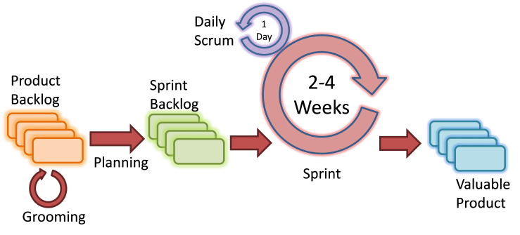
The Sprint Cycle
Once these are agreed, the team organize themselves to develop the software.
During this stage the team is isolated from the customer and the organization, with all communications channelled through the so-called ‘Scrum master’.
The role of the Scrum master is to protect the development team from external distractions.
At the end of the sprint, the work done is reviewed and presented to stakeholders.The next sprint cycle then begins.

Slide 38
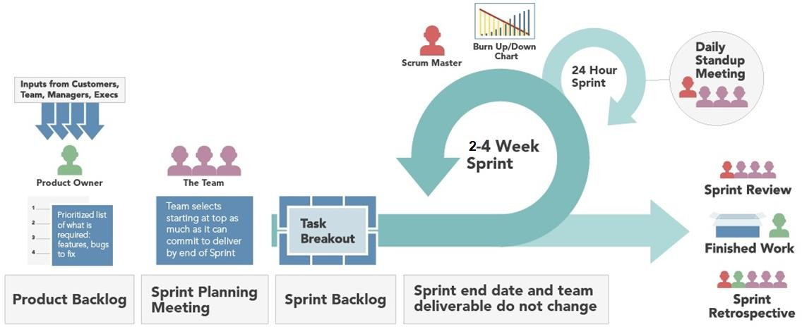
Agile Scrum Framework

Slide 39
JIRA tool
JIRA is a project management tool used for issues and bugs tracking system. It is widely used as an issue-tracking tool for all types of testing.This tutorial introduces the readers to the fundamental features, usage, and advantages of JIRA.This tutorial will guide the users on how to utilize this tool to track and report bugs in different applications.
JIRA is developed by Atlassian Inc., an Australian Company
JIRA is a commercial tool and available as a Trial version for a limited time.
To utilize JIRA services, a license is required.
JIRA provides free license for academic projects.
A 15-day trial version is available for an individual person to use.

Slide 40
Use of JIRA
Following are some of the most significant uses of JIRA.
JIRA is used in Bugs, Issues and Change Request Tracking.
JIRA can be used in Help desk, Support and Customer Services to create tickets and track the resolution and status of the created tickets.
JIRA is useful in Project Management,Task Tracking and Requirement Management.
JIRA is very useful in Workflow and Process management.

Slide 41
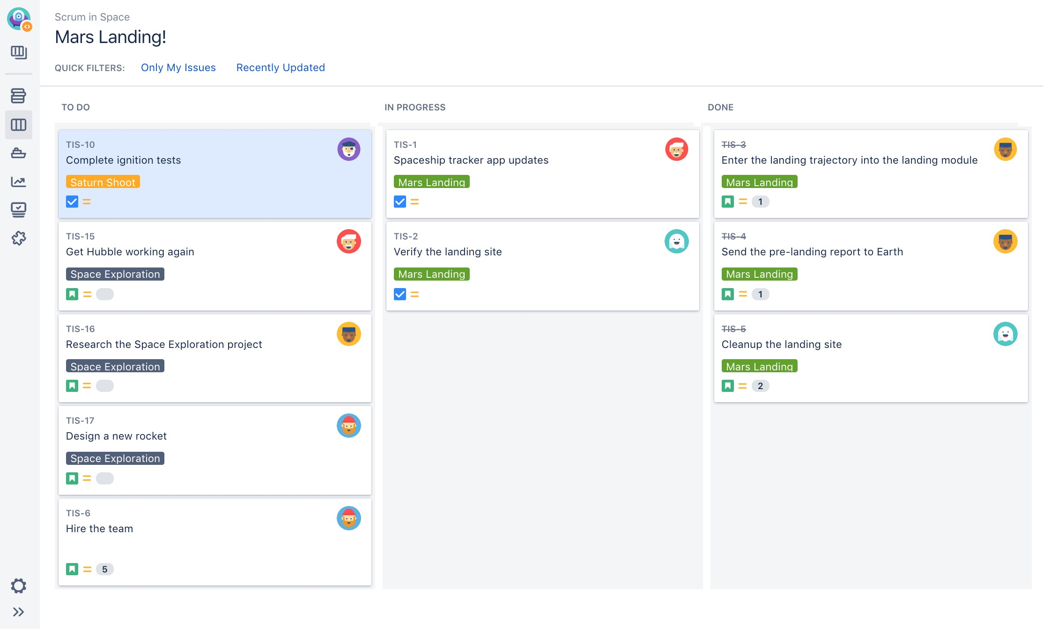
JIRA Boards

Slide 42

Markdown language for documentation
1. Markdown Language is a modern way of documentation for the web which you might need for documenting your project or your Repository on GitHub we always find the readme.md when creating a repo. But did you know how to make the title in Bold or add link ,That’s when you need Markdown language.
2. Let’s Get Started : create a readme.md for your own repo. Try some cool stuff of markdown language
1. You can use an online editor or Offline tools such as visual studio code, Dillinger is one of the best online editors for the Markdown language
Lab Time

Slide 43
References
Most of Diagrams and Software Engineering Concepts Are quoted from Sommerville https://iansommerville.com/software-engineering-book
Thanks to the open-source world
Markdown language guide https://www.markdownguide.org/
More tutorials
Scrum vs Kanban https://www.youtube.com/watch?v=rIaz-l1Kf8w

