Slide 1

Test Driven-Development
Mohamed Said

Slide 2
Testing principles
Testing
The execution of a program to find its faults
Verification
The process of proving the programs correctness.
Validation
The process of finding errors by executing the program in a real environment
Debugging
Diagnosing the error and correct it

Slide 3

Quality Assurance:
Quality assurance is a method of making the software application with less defects and mistakes when it is finally released to the end users. Quality Assurance is defined as an activity that ensures the approaches, techniques, methods and processes designed for the projects are implemented correctly. It recognizes defects in the process. Quality Assurance is completed before Quality Control

Slide 4
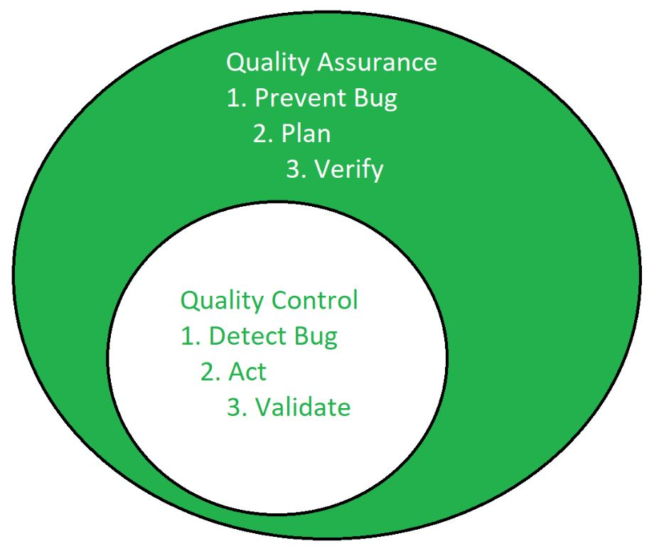
Quality Assurance vs Quality Control
Quality Control is a software engineering process that is used to ensure that the approaches, techniques, methods and processes are designed in the project are following correctly. Quality control activities operate and verify that the application meet the defined quality standards.
It focuses on examination of the quality of the end products and the final outcome rather than focusing on the processes used to create a product.

Slide 5
Types of testing
Unit Testing (White Box)
Integration Testing
Function Testing (Black Box)
Regression Testing
System Test
Acceptance and Installation Tests

Slide 6
Testing definitions
Unit tests deal with small hunks – modules, functions, objects, classes;
Integration tests deal with units constituting a subsystem or other major hunks of capability, and
System tests refer to the entire software package or system.

Slide 7
Integration testing
IT : has top-down approach and bottom-up approach
In Top-down approach:
The control program is tested first. Modules are integrated one at a time. Emphasize on interface testing
Advantages: No test drivers needed
Interface errors are discovered early
Modular features aid debugging
Disadvantages: Test stubs are needed
Errors in critical modules at low levels are found late.

Slide 8
Bottom-up
Test
Drivers
Test
Drivers
Test
Drivers
Level N
Level N
Level N
Test
Drivers
Test
Drivers
Level N-1
Level N-1

Slide 9
Unit testing
Individual components are tested.
It is a path test.
To focus on a relatively small segment of code and aim to exercise a high percentage of the internal path
Disadvantage: the tester may be biased by previous experience. And the test value may not cover all possible values.

Slide 10
Validation vs Verification
Validation is a process in which the requirements of the customer are actually met by the software functionality. Validation is done at the end of the development process and takes place after verifications are completed.
Verification is a process that determines the quality of the software. Verification includes all the activities associated with producing high quality software, i.e.: testing, inspection, design analysis, specification analysis, and so on. Verification is a relatively objective process, in that if the various processes and documents are expressed precisely enough, no subjective judgement should be needed in order to verify software.

Slide 11
Types of Development
Domain Driven Development DDD
Test Driven Development TDD

Slide 12
Unit testing frameworks
Catch
Googletest
Cpp test

Slide 13
Install GoogleTest Windows
First you need cmake : https://cmake.org/download/
Then go to C:/mysys64/mingw64
And clone github.com/google/googletest.git
cd googletest
mkdir build
cmake –G “MINGW Makefiles”
make

Slide 14
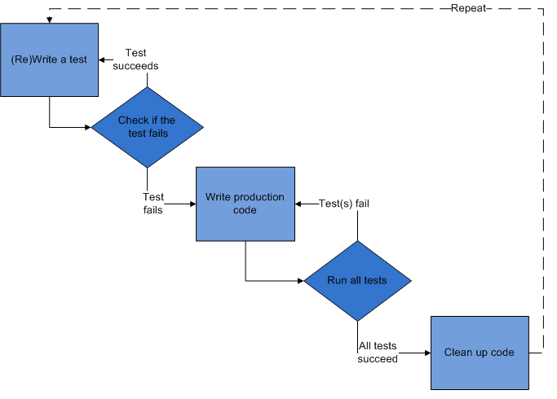
TDD

Slide 15
How it works
How It Works –
Add a Test
Use Cases / User Stories are used to understand the requirement clearly
Run all tests and see the new one fail
Ensures test harness is working correctly
Ensures that test does not mistakenly pass
Write some code
Only code that is designed to pass the test
No additional functionality should be included because it will be untested [4]

Slide 16
How it works [2]
Run
Run the automated tests and see them succeed
If tests pass, programmer can be confident code meets all tested requirements
Refactor
Refactor code
Cleanup the code
Rerun tests to ensure cleanup did not break anything
Repeat
Repeat [4]

Slide 17
First test vs last test
Pick a piece of functionality
Write a test that expresses a small task that fails
Write production code until test passes
Run all tests
Rework code until all tests pass
Repeat [1]
Pick a piece of functionality
Write production code that implements entire functionality
Write tests to validate all functionality
Run all tests
Rework code until all tests pass [1]

Slide 18
Research Study - Hypotheses
Test-First programmers write more test per unit of programming effort [1]
Test-First programmers produce high quality programs [1]
Test-First programmers are more productive overall [1]
Writing more tests improve quality [1]
Writing more tests increase productivity [1]

Slide 19
Research study - Result
Quality
Test-First subjects did not result in an increase in quality
Productivity
Better task understanding
Better task focus
Faster learning
Lower rework effort
Wrote more test per unit of programming
Higher number of programmer tests lead to proportionally higher levels of productivity

Slide 20
TDD Limitations
Counterproductive and hard to learn [1]
Difficult in Some Situations
GUIs, Relational Databases, Web Service
Requires mock objects
TDD does not often include an upfront design [2]
Focus is on implementation and less on the logical structure

