Slide 1
QNX – A real-time operating system
PRANSHU GUPTA
CS550

Slide 2
Operating system – Basically, it is a resource manager that manages all the available resources on a computer system.
A few types of operating systems are:
Single-user single tasking
Single-user multitasking
Multi-user
Real-time

Slide 3
Types of Real-time operating systems
Hard real time
Soft real time
Safety-Critical
QNX is a hard real-time operating system. It provides applications like Multitasking, Priority-driven, Preemptive scheduling, Fast context switching. It supports processor families like x86, ARM, XScale, PowerPC, MIPS, and SH-4.

Slide 4
QNX achieves its degree of efficiency through two fundamental principles:
Microkernel architecture - structures the operating system by removing all non-essential components of the kernel.
Message-based inter-process communication
i) It provides a mechanism for processes to communicate.
ii) Helpful in distributed environment.

Slide 5
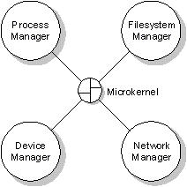
The QNX Microkernel and system managers
Two essential functions of the microkernel in QNX:
Message passing
Scheduling

Slide 6
Inter-process communication
Primary form of IPC – message-passing
QNX Neutrino offers the following forms of IPC
Service:
Implemented in:
Message-passing
kernel
Signals
kernel
Message queues
external process
Shared memory
process manager
Pipes
external process
FIFOs
external process

Slide 7
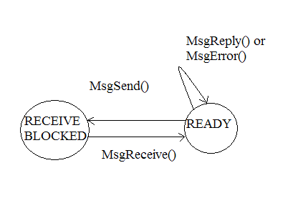
Message-passing

Slide 8
Signals - In a multi-threaded process,
The signal actions are maintained at the process level.
The signal mask is maintained at the thread level.
An un-ignored signal targeted at a thread will be delivered to that thread alone.
An un-ignored signal targeted at a process is delivered to the first thread that doesn't have the signal blocked.
Message queues - nonblocking message-passing facility
Shared memory - processes with access to an object can directly read and write into it
Pipes – used when two processes run in parallel
FIFOs – same as pipes with one difference

Slide 9
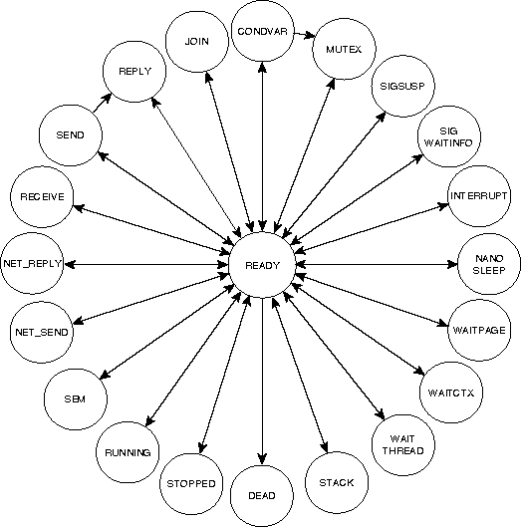

THREAD STATES
Source:http://www.qnx.com/developer/docs/momentics621_docs/neutrino/sys_arch/kernel.html

Slide 10
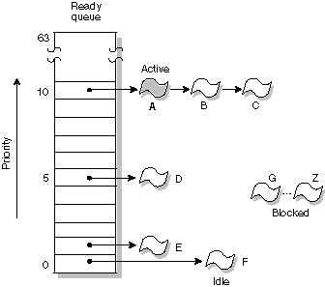
Scheduling
The ready queue
Source:http://www.qnx.com/developer/docs/momentics621_docs/neutrino/sys_arch/kernel.html

Slide 11
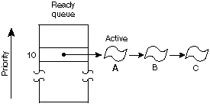
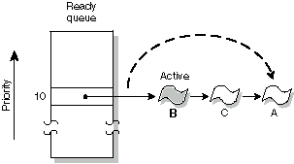
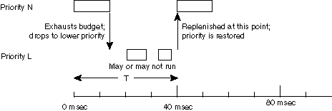
Scheduling
FIFO
Round-robin
Sporadic
Source:http://www.qnx.com/developer/docs/momentics621_docs/neutrino/sys_arch/kernel.html

Slide 12
Facilities provided for synchronization
Mutual exclusion locks
A mutex is used to ensure exclusive access to data shared between threads. It is typically acquired and released around the code that accesses the shared data (usually a critical section).
Reader/writer locks
These locks are used when the access pattern for a data structure consists of many threads reading the data, and (at most) one thread writing the data.

Slide 13
Is QNX Successful?
Control systems run nonstop with QNX
Daewoo selected QNX for in-car navigation system
Telecom OEMs (original equipment manufacturer) scale up with QNX

Slide 14
END

