Slide 1
Session Ten Robot Localization Package
Mohamed Saied

Slide 2
What’s robot_localization package
robot_localization is a collection of state estimation nodes, each of which is an implementation of a nonlinear state estimator
for robots moving in 3D space. It contains two state estimation nodes, ekf_localization_node and ukf_localization_node.
In addition, robot_localization provides navsat_transform_node, which aids in the integration of GPS data.
All state estimation nodes track the 15-dimensional state of the vehicle: (X,Y,Z,roll,pitch,yaw,X˙,Y˙,Z˙,roll˙,pitch˙,yaw˙,X¨,Y¨,Z¨)(X,Y,Z,roll,pitch,yaw,X˙,Y˙,Z˙,roll˙,pitch˙,yaw˙,X¨,Y¨,Z¨).

Slide 3

frames
So, remember we have the map, odom, and base_link frames to keep track of?
There are two transforms:
map -> odom
Accounts for the robot's global pose
Tracks the offset needed to compensate for overall sensor drift as the robot drives around, allowing the robot to more robustly create global path plans
Is discontinuous (jumps around)
Is published by the AMCL node (or any other global pose estimators!)
odom -> base_link
Accounts for the robot's local pose
Is best for local obstacle avoidance
Is continuous, but drifts over time due to sensor drift
Is published by the odometry node (which should be taking into account encoders, IMUs and other sensors like laser scan matching nodes, etc.)

Slide 4
Message types used in robot_localization
nav_msgs/Odometry
Position, Orientation, and Velocity
geometry_msgs/PoseWithCovarianceStamped
Position and Orientation
geometry_msgs/TwistWithCovarianceStamped
Velocity
sensor_msgs/Imu
Angular Velocity and Linear Acceleration

Slide 5
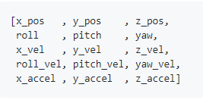
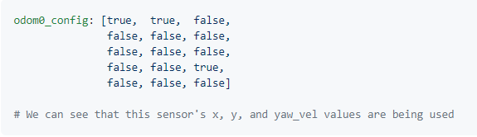

Odom config

Slide 6
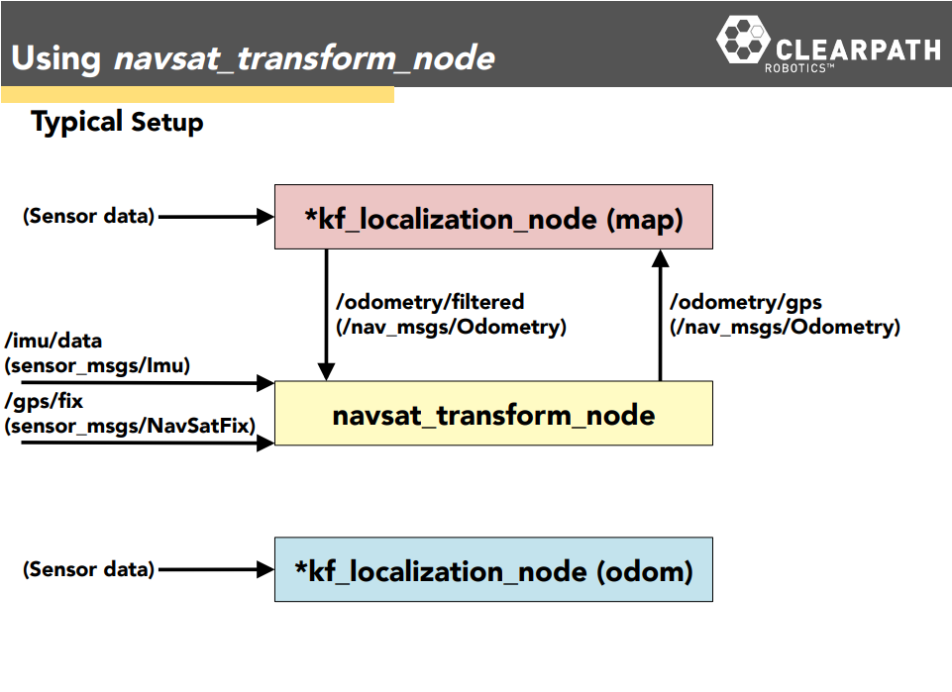

Slide 7
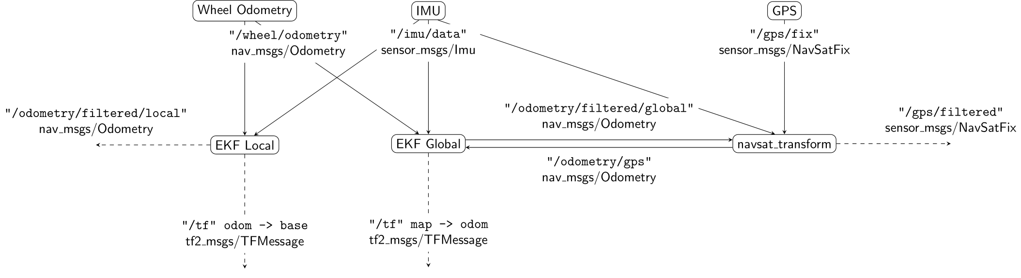
Navsat transform

Slide 8
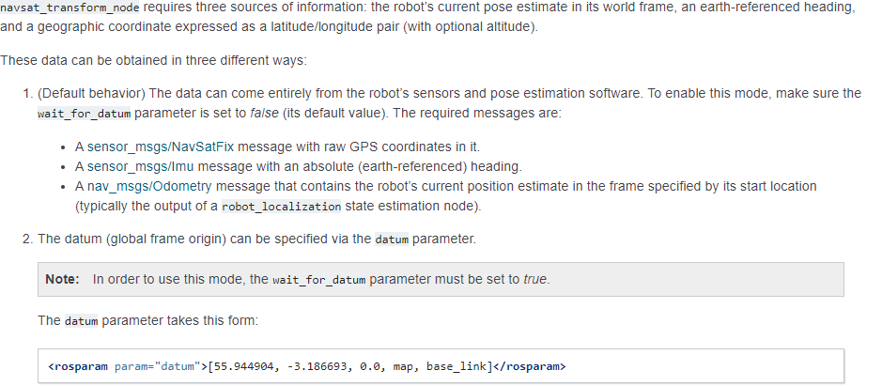
navsat transform node:Required Inputs
wait_for_datum: true, we get an odom->utm transform.
wait_for_datum: false, we get a map->utm transform.

Slide 9
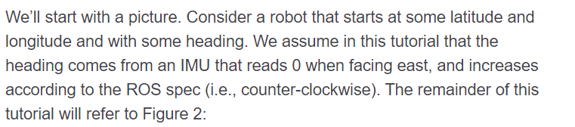
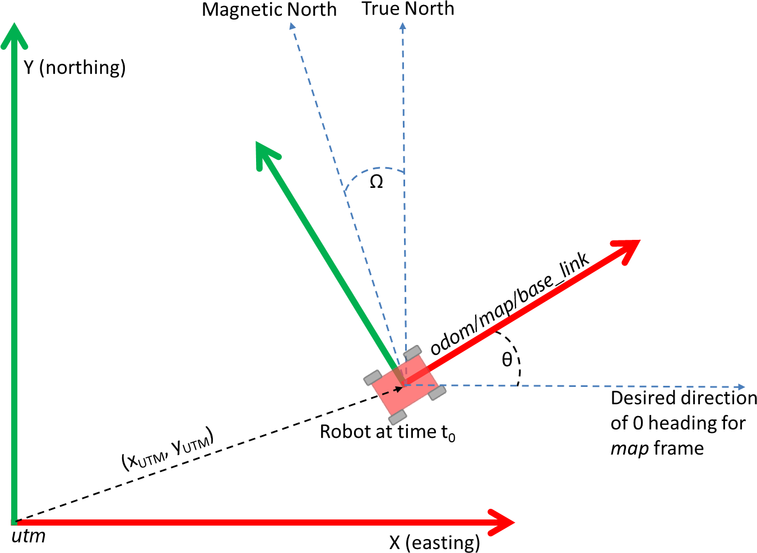
Required inputs cont’

Slide 10
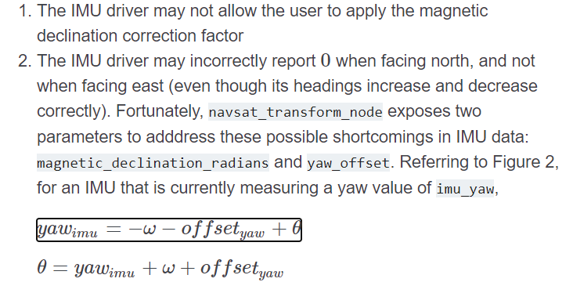
How it works

Slide 11
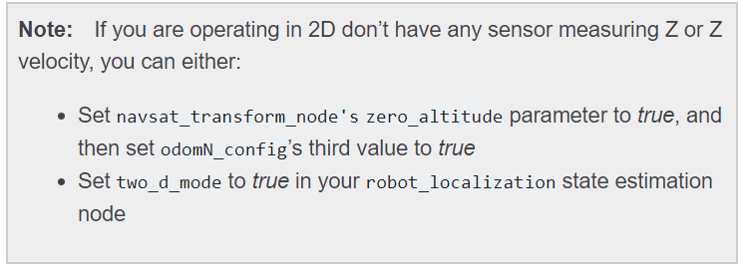
Notes on fusing GPS
Run one instance of a robot_localization state estimation node that fuses only continuous data, such as odometry and IMU data. Set the world_frame parameter for this instance to the same value as the odom_frame parameter. Execute local path plans and motions in this frame.
Run another instance of a robot_localization state estimation node that fuses all sources of data, including the GPS. the world_frame parameter for this instance to the same value as the map_frame parameter.

Slide 12
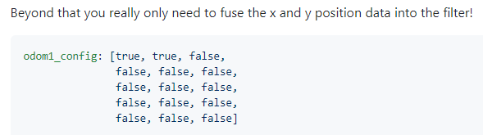
Launch file
<launch>
<node pkg="robot_localization" type="navsat_transform_node" name="navsat_transform_node" respawn="true">
<param name="magnetic_declination_radians" value="0"/>
<param name="yaw_offset" value="0"/>
<remap from="/imu/data" to="/your/imu/topic" />
<remap from="/gps/fix" to="/your/gps/fix/topic" />
<remap from="/odometry/filtered" to="/your/robot_localization/output/topic" />
</node>
</launch>

Slide 13
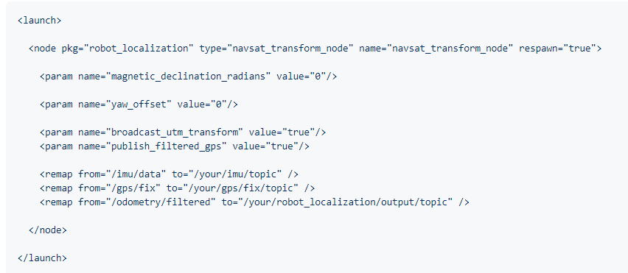
Launch file for navsat_transform_node

Slide 14
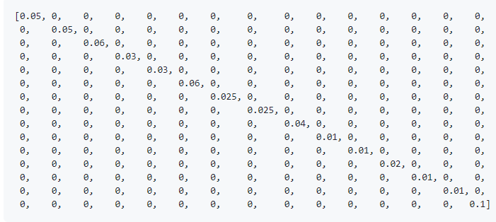
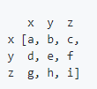
Noise Covariance Matrix

Slide 15
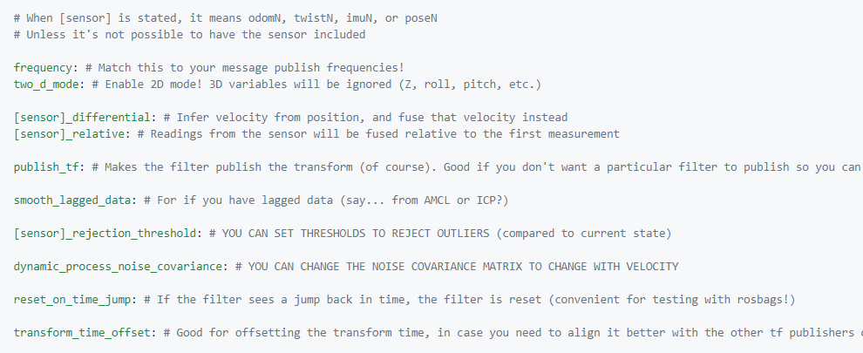
Configuration parameters
Using ekf_template.yaml

Slide 16
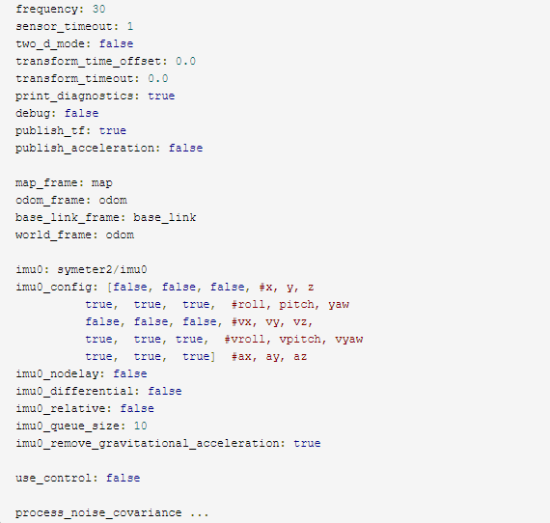
Config example

Slide 17
Reference
https://github.com/methylDragon/ros-sensor-fusion-tutorial/blob/master/01%20-%20ROS%20and%20Sensor%20Fusion%20Tutorial.md
Ekf_localization_Node
http://docs.ros.org/jade/api/robot_localization/html/configuring_robot_localization.html
REP 105
http://docs.ros.org/melodic/api/robot_localization/html/index.html
Calculate quaternion
http://wiki.ros.org/navigation/Tutorials/RobotSetup/Odom

