Slide 1
Kalman Filter
Mohamed Saied

Slide 2
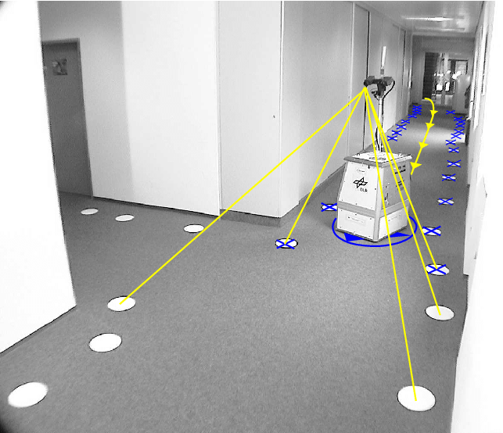
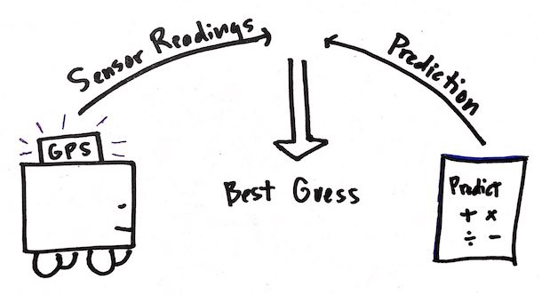
Localization problem

Slide 3
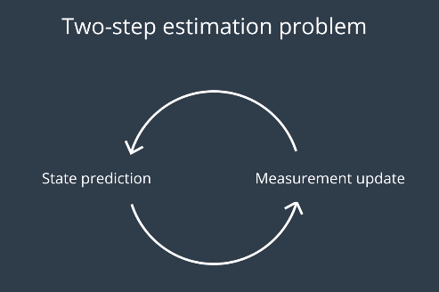
State estimate

Slide 4
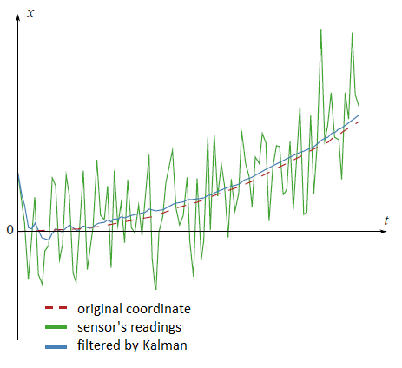
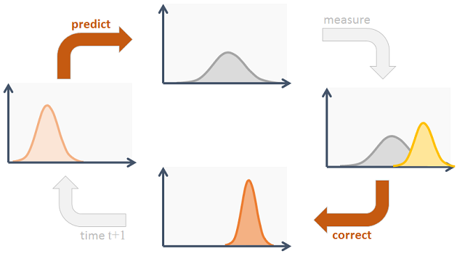
State Estimator

Slide 5
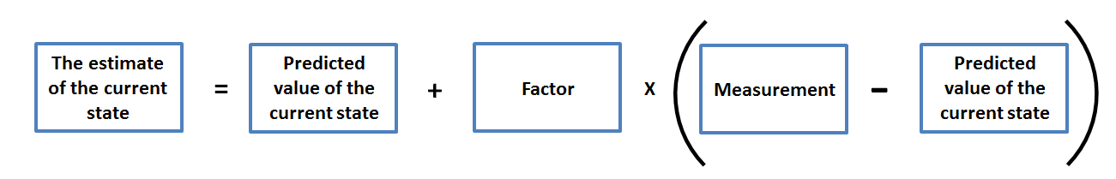
The Black Magic of the Kalman Filter
This is the Estimation Algorithm of the Kalman filter
Estimating the current state from the predicted values plus Kalman Gain multiplied by the Error

Slide 6
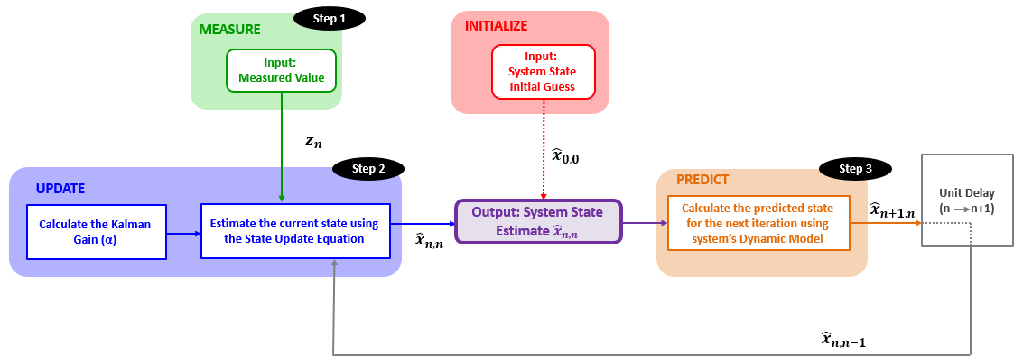
How it works?

Slide 7
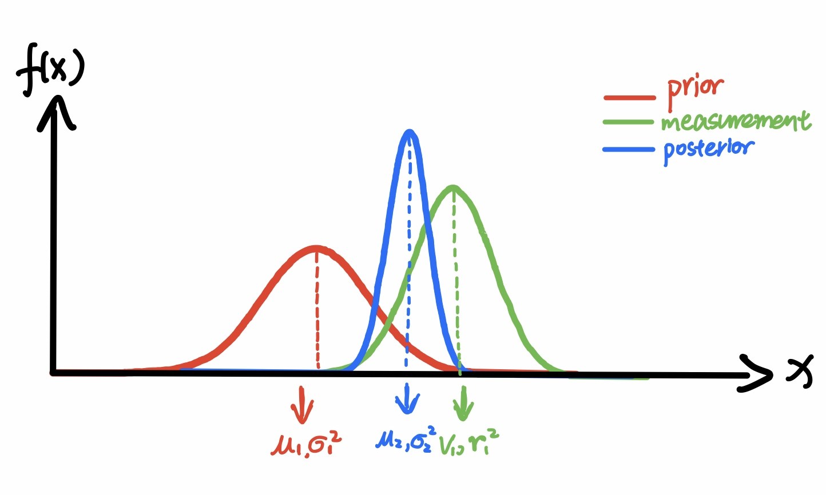
Designing a Kalman Filter
The system position

Slide 8
Kalman Filter types
Linear Kalman Filter
Extended Kalman filter (Multi-dimentional)

Slide 9
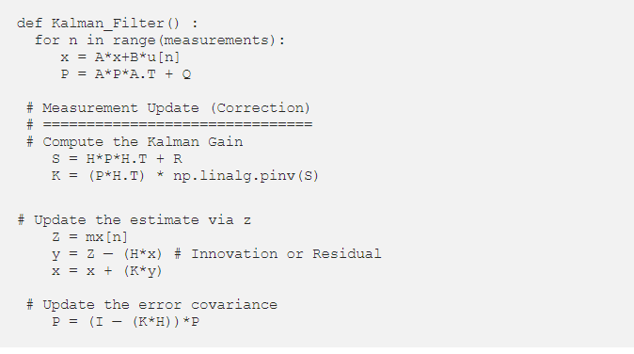
Python implementation of the Kalman filter

Slide 10
Yaw Angle
Now, there are four possible ways to update yaw information:
From a model using inputs (throttle and steering angle).
Magnetometer for angle relative to magnetic North.
Gyro readings from IMU
Heading required to move in a straight line from the previous GPS fix to the current GPS fix.

Slide 11
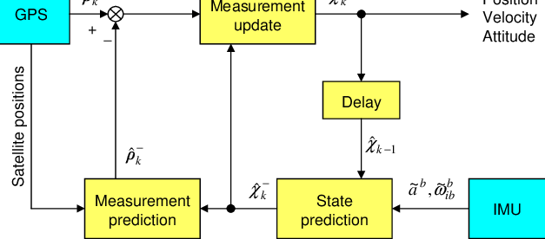
Robot localization

Slide 12
Motion equation
Velocity final equals the initial velocity plus acceleration multiplied by the time
v = v₀ + at [1]
Final Position is calculated as the initial position plus initial velicity multiplied by the time plus half of the acceleration multiplied by the time square
p = p₀ + v₀t + ½at² [2]

Slide 13
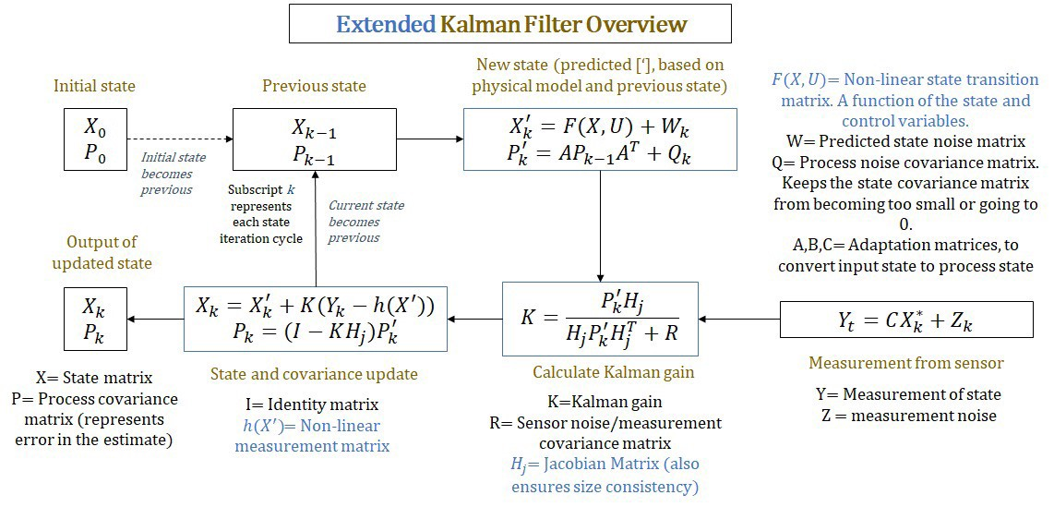
Extended Kalman filter

Slide 14
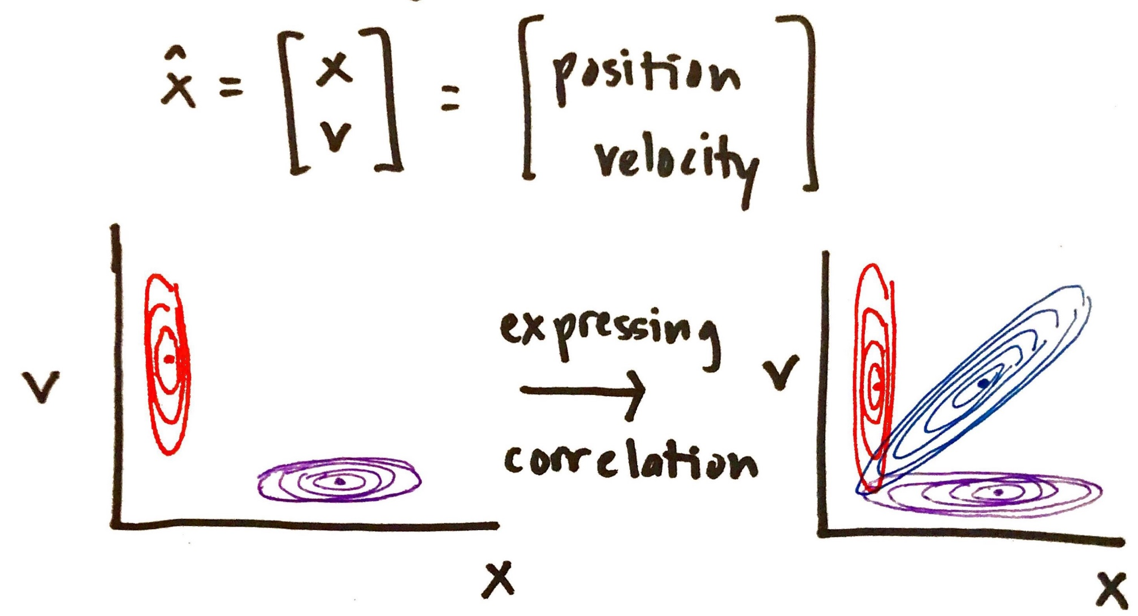
Estimated state

Slide 15
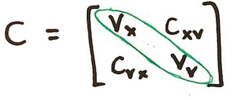
Understanding Covariance Matrix
property: symmetric
diagonal elements: variances
non-diagonal elements: covariances

Slide 16
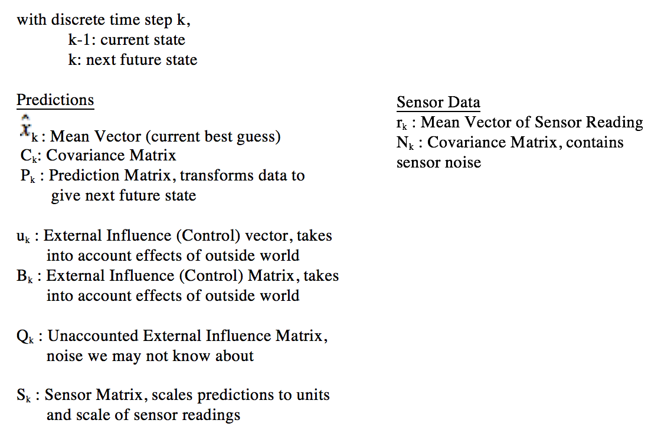
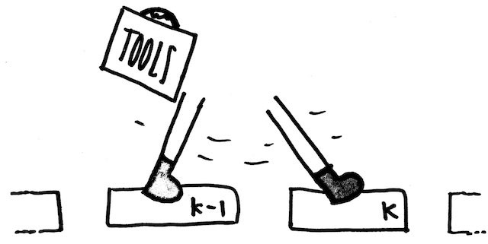

Slide 17
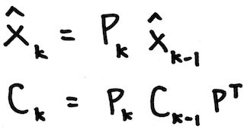
First step
predict

Slide 18
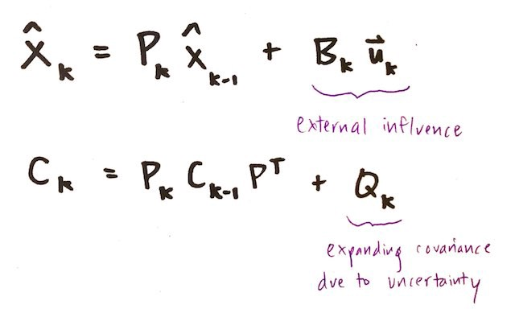
Second step
correct

Slide 19
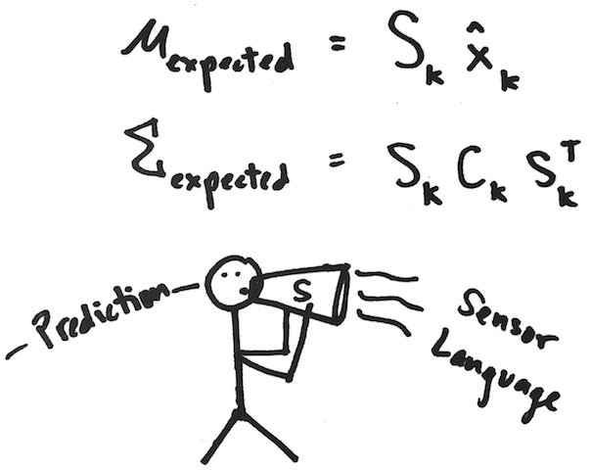
Third step
Transform Corrected Prediction (speak the same language as our sensors)

Slide 20
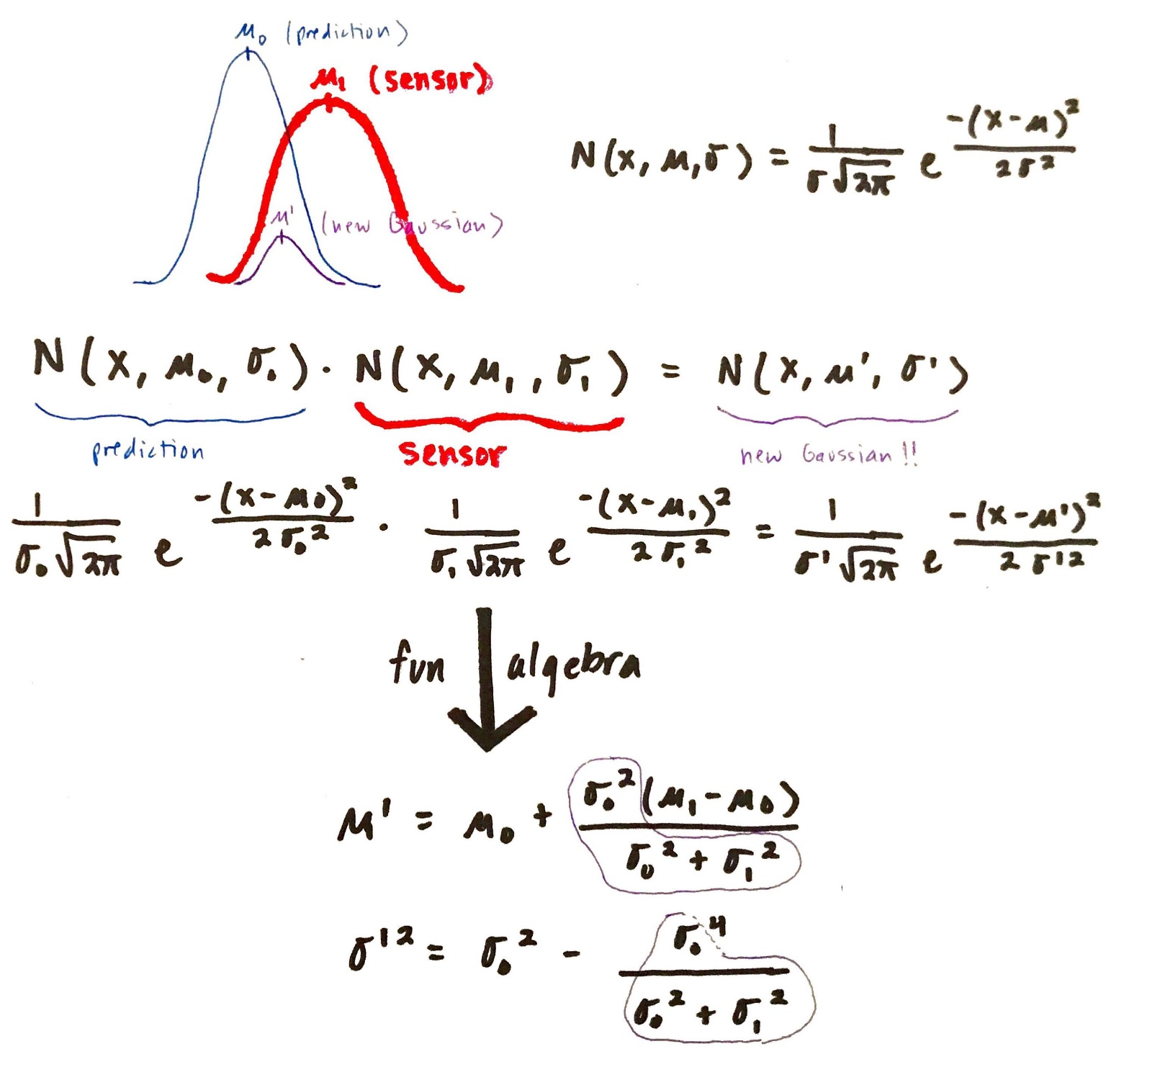
Fourth step
Read Sensors
Read sensors
Fifth step

Slide 21
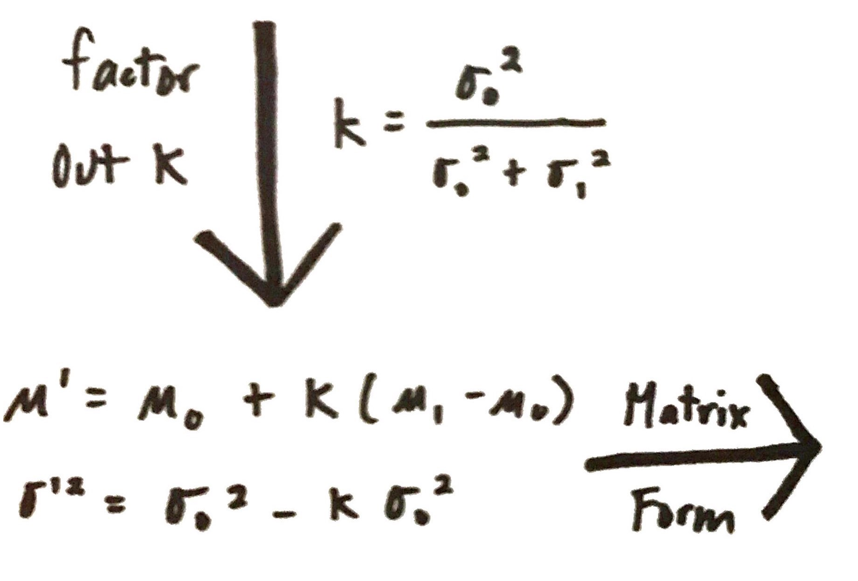
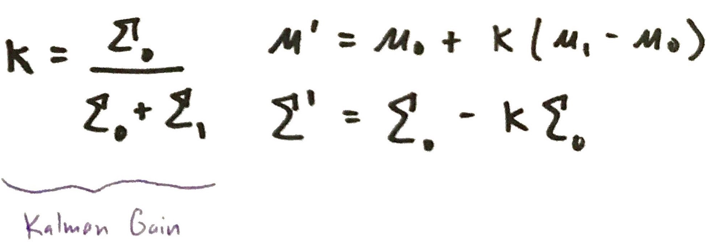
Sixth step Find Kalman gain

Slide 22
Kalman filter simulation
https://www.cs.utexas.edu/~teammco/misc/kalman_filter/
Kalman filter tutorial 1
https://www.youtube.com/watch?v=FkCT_LV9Syk
Covariance
https://www.youtube.com/watch?v=85Ilb-89sjk
More tutorials
https://github.com/rlabbe/Kalman-and-Bayesian-Filters-in-Python
Other Localization Techniques MonteCarlo
http://aslanfmh65.com/robotic-localization-kalman-filter-mcl/

