Slide 1
Compass
Mohamed Saied

Slide 2
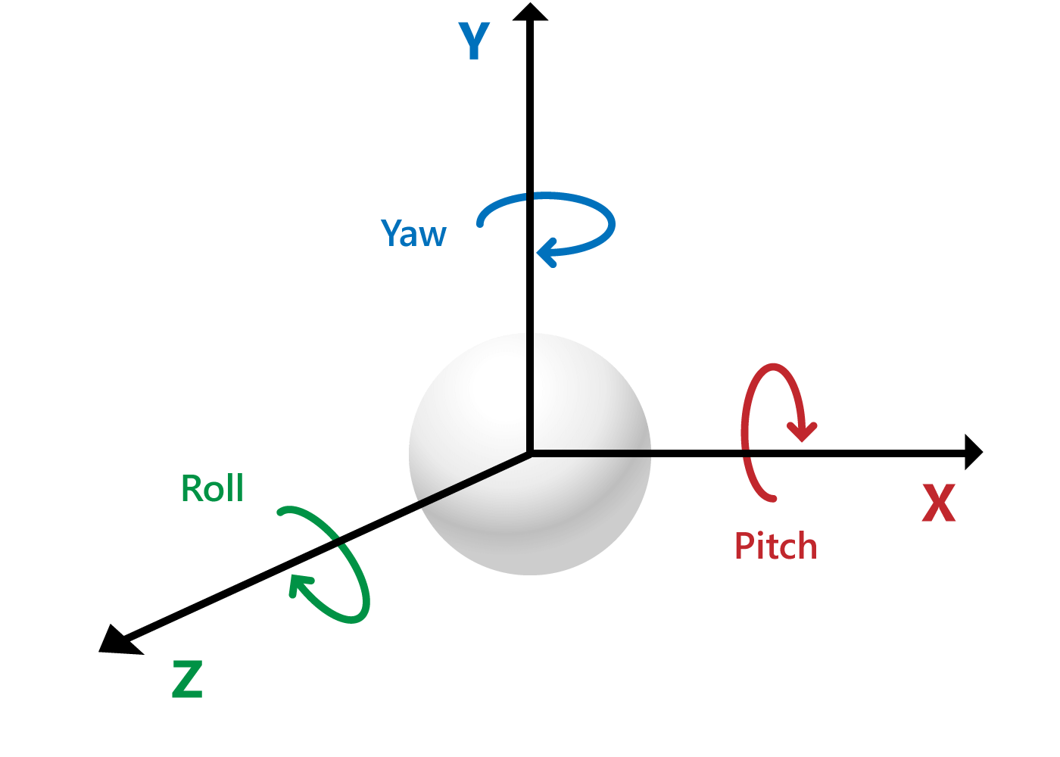
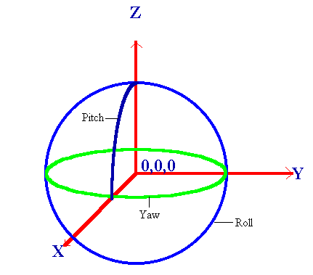
Roll pitch and yaw

Slide 3
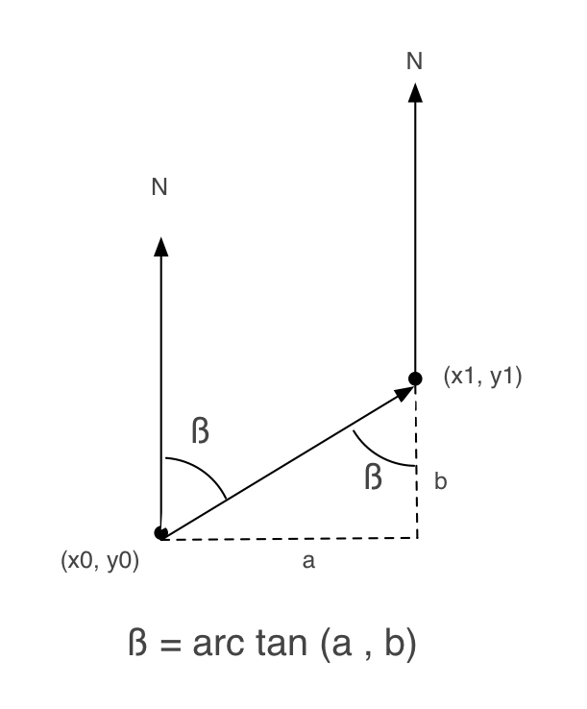
Heading Angle
yaw = atan2(Ax,Ay) * RAD_TO_DEG;
bearing is the horizontal angle between the direction of an object and another object, or between it and that of true north.

Slide 4
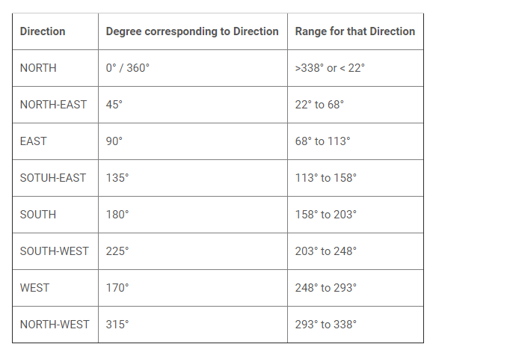
Directions

Slide 5
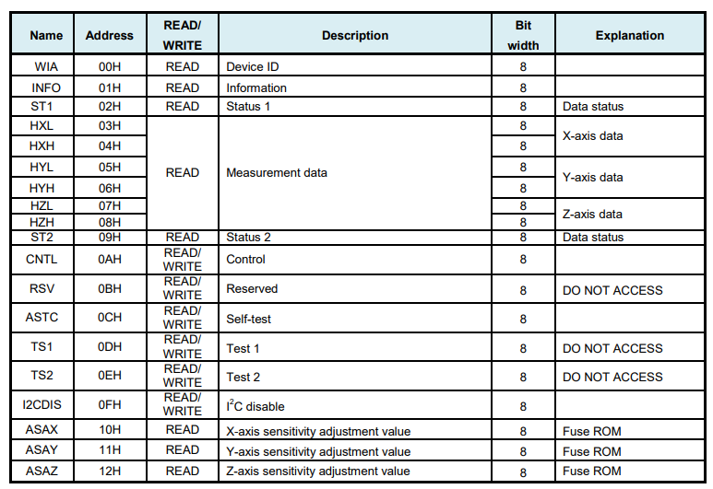
Compass

Slide 6
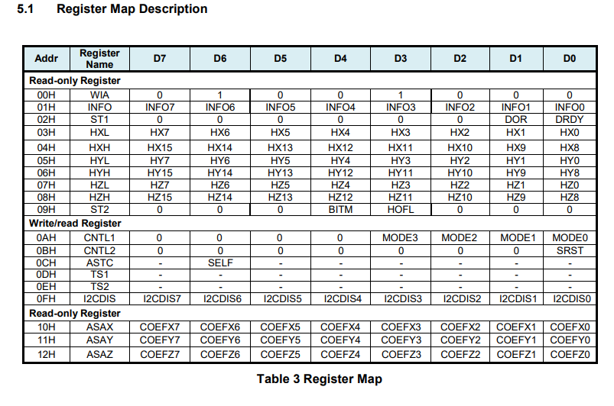
Registers

Slide 7
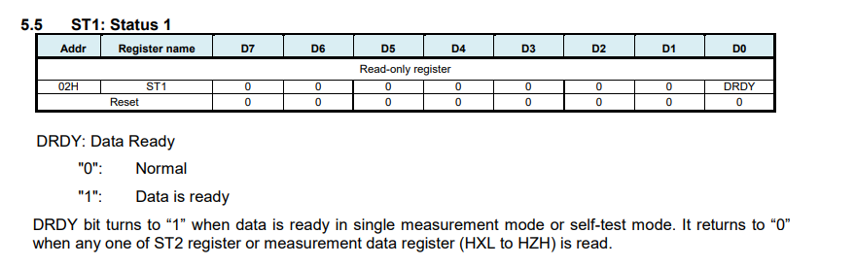
Status Register

Slide 8
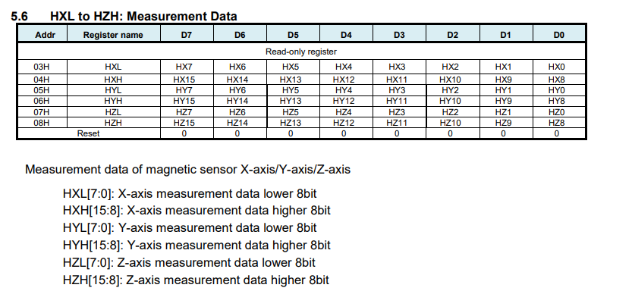
Data Measurement

Slide 9
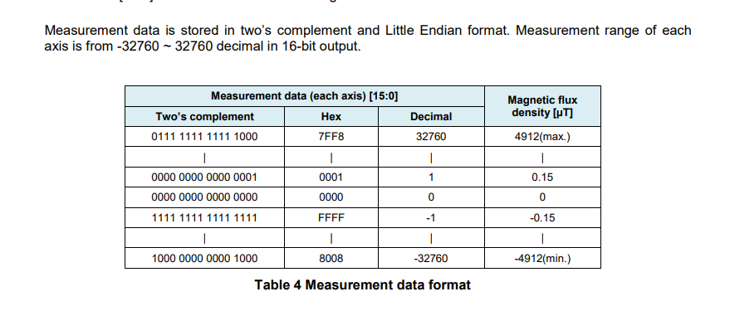
Measurement format

Slide 10
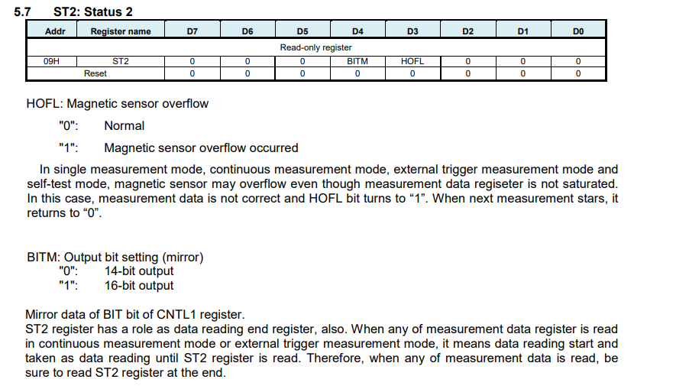
Status register 2

Slide 11
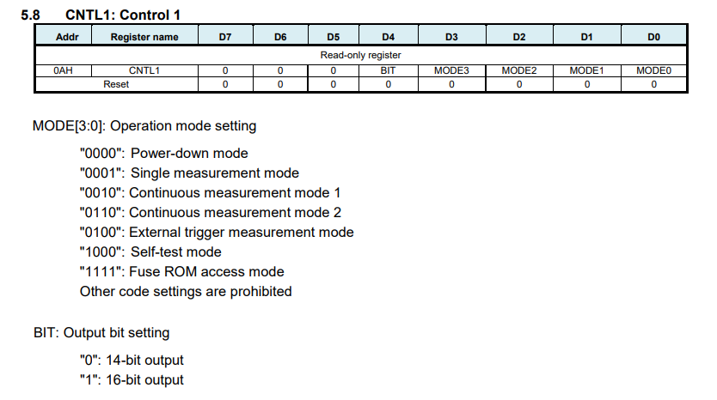
Control register 1
When CNTL register is accessed to be written, registers from 02H to 09H are initialized.

Slide 12
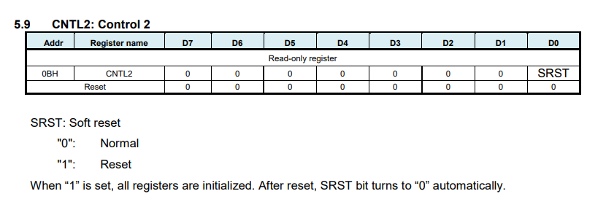
Control register 2

Slide 13
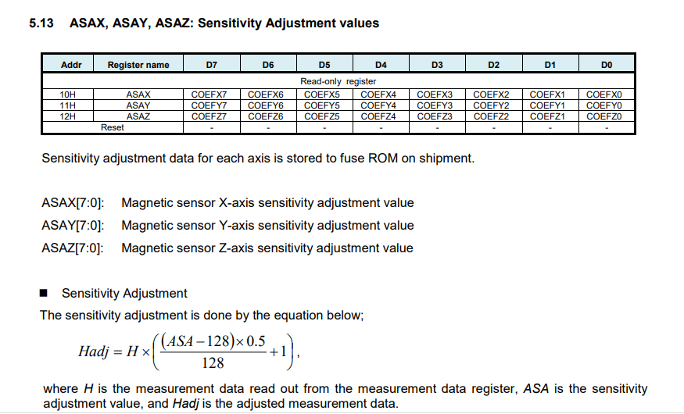
Sensitivity adjust

