Slide 1

END-TO-END DATA ANALYTICS & BI CASE STUDY
01 / 08
TRANSPORTATION &
LOGISTICS
ANALYTICS DASHBOARD
Exploring shipment delays, operational bottlenecks, and performance drivers through data.
6,773 SHIPMENTS | MARCH 2019 - SEPTEMBER 2020
PYTHON | SQL | POWER BI
MOHAMED TAREK | DATA ANALYST
github.com/Mohamedtarek00212/Transportation-Logistics
Notes:
[Sources]
- User-provided Power BI dashboard image: Power BI/Screenshot 2026-08-31 111930.png
- Cleaned dataset: cleaned_transportation_logistics_data.xlsx
[/Sources]

Slide 2
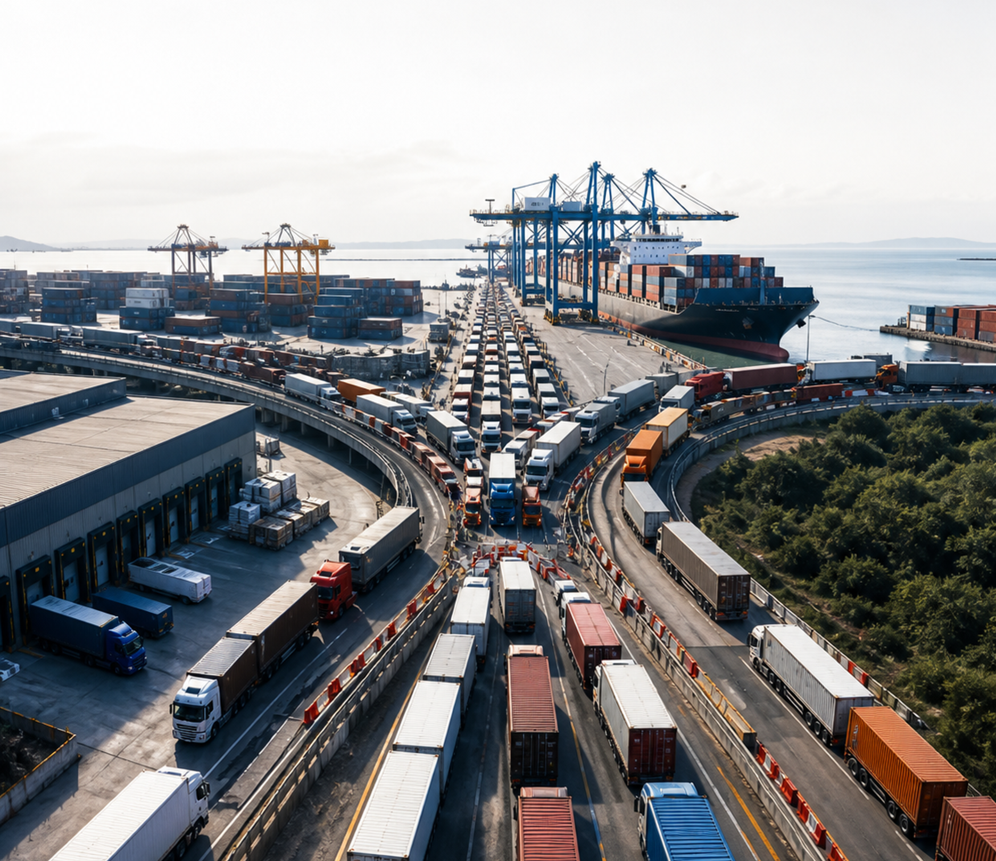
BUSINESS PROBLEM
02 / 08
WHY ARE SHIPMENTS
DELAYED?
Operational data was scattered across suppliers, vehicles, routes, GPS providers, and delivery events. Without one connected view, teams could see delays but not where the operation was breaking down.
WHERE?
WHO?
WHAT NEXT?
Where do delays concentrate?
Who drives the greatest risk?
What should change operationally?
TRANSPORTATION & LOGISTICS ANALYTICS
MOHAMED TAREK | DATA ANALYST
Notes:
[Sources]
- Logistics_EDA.ipynb: project scope, analytical dimensions, and business questions
- cleaned_transportation_logistics_data.xlsx: shipment, supplier, customer, vehicle, route, and GPS fields
- storytelling.txt: business-problem narrative
- AI-generated conceptual logistics bottleneck visual created for this case study; no factual claims are encoded in the image
[/Sources]

Slide 3
EXPLORATORY DATA ANALYSIS
03 / 08
62.9% OF SHIPMENTS
WERE DELAYED
The data revealed a systemic delivery performance problem, not isolated exceptions.
DELIVERY STATUS
WHAT THIS MEANS
Nearly 2 in every 3 shipments missed the planned ETA.
62.9%
DELAYED
SYSTEM-WIDE ISSUE
4,263 of 6,773 cleaned shipment records were classified as delayed.
NOT ISOLATED EXCEPTIONS
Delayed 4,263 | 62.9%
Delay patterns shifted across time, distance, suppliers, vehicle types, and GPS providers.
On-Time 2,510 | 37.1%
DELAY DEFINITION
Actual ETA > Planned ETA
NEXT
Structure the operation for deeper SQL analysis.
TRANSPORTATION & LOGISTICS ANALYTICS
MOHAMED TAREK | DATA ANALYST
Notes:
[Sources]
- cleaned_transportation_logistics_data.xlsx: 6,773 total records; 4,263 delayed; 2,510 on-time
- Logistics_EDA.ipynb: delivery-status definition and delay analysis
[/Sources]

Slide 4
THE SQL SOLUTION
04 / 08
A CONNECTED DATABASE FOR
END-TO-END SHIPMENT CONTROL
The solution transforms fragmented logistics records into a structured SQL Server data foundation.
SOLUTION ARCHITECTURE
I designed a relational SQL Server database to turn disconnected records into one traceable logistics system.
REFERENCE DATA
Countries
Shipment Status
13
10
Material
Failure Reasons
RELATIONAL TABLES
ANALYTICAL QUERIES
BUSINESS ENTITIES
Customers
Hubs
01
SINGLE SOURCE OF TRUTH
Employees
Couriers
Customers, hubs, reference data, and shipments are connected through validated relationships.
CORE
SHIPMENTS
Connects sender, receiver, hubs, status, material, and failure reason.
02
END-TO-END TRACEABILITY
Every tracking event, delivery attempt, payment, and proof of delivery remains linked to its shipment.
CONNECTED OPERATIONS
Tracking Events
Delivery Attempts
03
DECISION-READY FOUNDATION
Payments
Proof of Delivery
Ten reusable queries expose delays, courier performance, hub throughput, stuck shipments, POD, and revenue.
13 tables connected through primary and foreign keys
Simplified solution view · Full ERD documented in the project
RESULT
A trusted SQL foundation for operational monitoring and Power BI.
TRANSPORTATION & LOGISTICS ANALYTICS
MOHAMED TAREK | DATA ANALYST
Notes:
[Sources]
- Project_ERD.html: complete 13-table entity relationship model and documented relationships
- SQL/SQL_Script_Final.sql: final SQL Server schema and Q1-Q10 analytical queries
- SQL/Tables/*.csv: source tables used by the relational database
- Note: TrackingEvents, DeliveryAttempts, Payments, and ProofOfDelivery are assumed/demo transactional data used to test the proposed database and query layer; they are separate from the historical EDA KPI dataset
[/Sources]

Slide 5
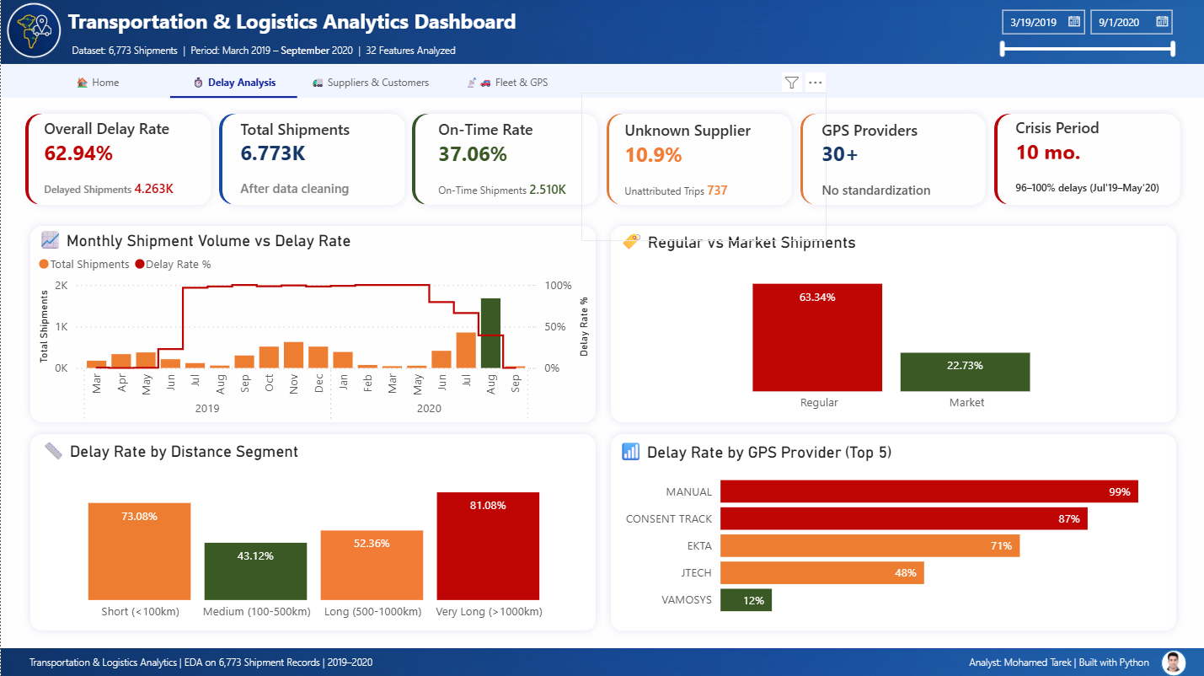
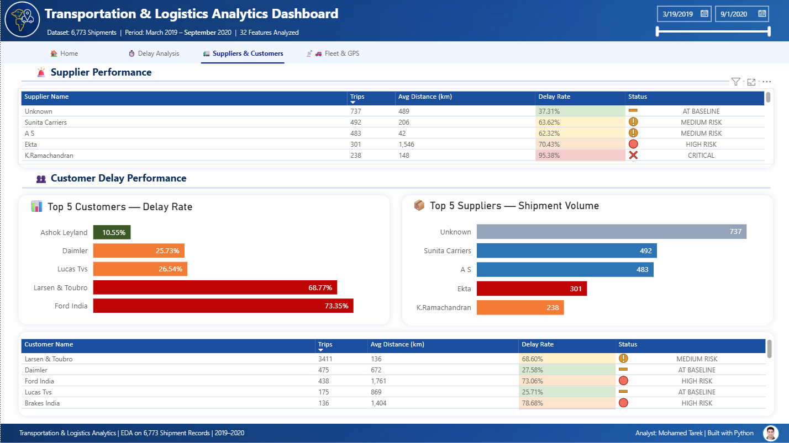
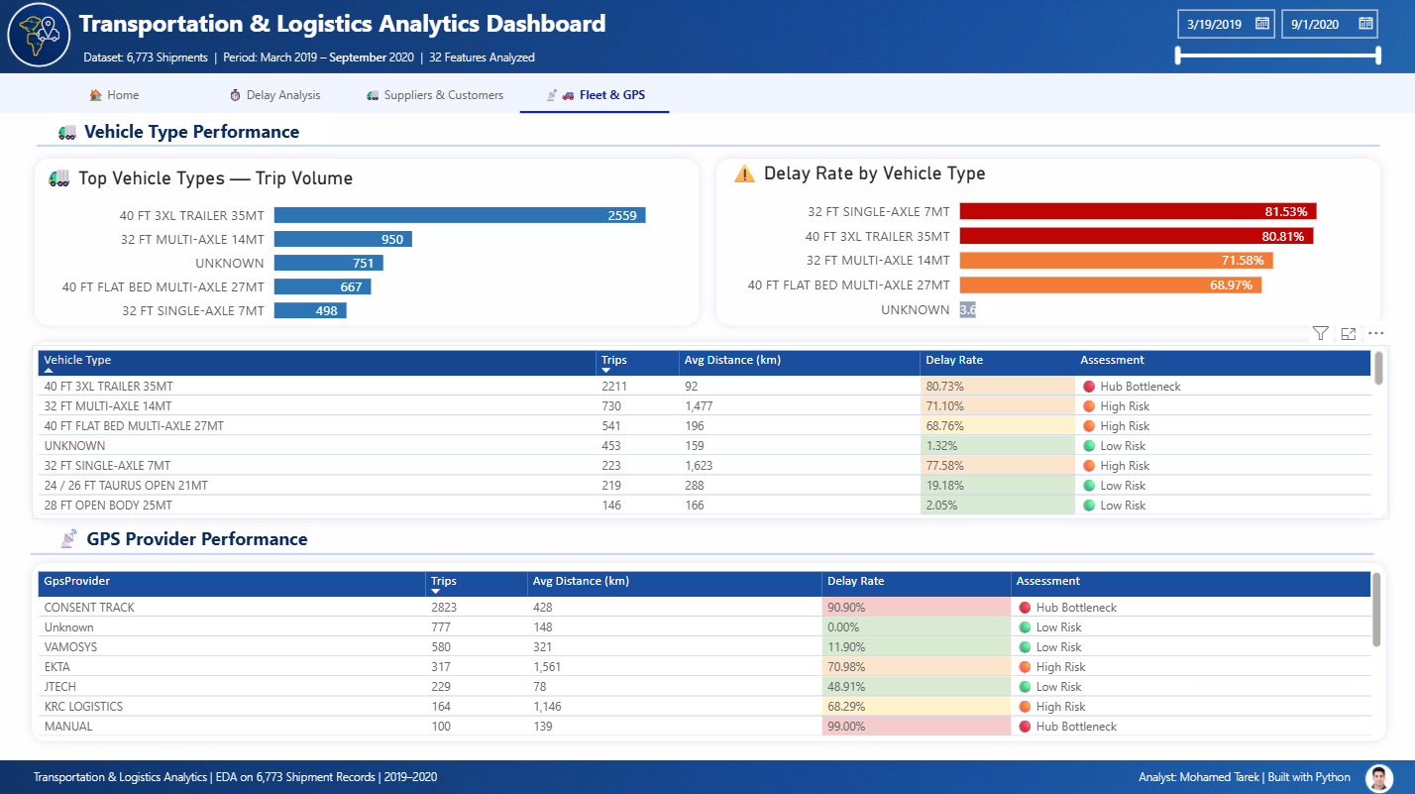
POWER BI DASHBOARD
05 / 08
ONE DASHBOARD. THREE
OPERATIONAL VIEWS.
Interactive pages move from the overall delay problem to the supplier, customer, vehicle, and GPS drivers behind it.
01 DELAY ANALYSIS
02 SUPPLIERS & CUSTOMERS
03 FLEET & GPS
FROM SQL MODEL TO INTERACTIVE MONITORING
6,773 SHIPMENTS · 32 FEATURES · MAR 2019–SEP 2020
TRANSPORTATION & LOGISTICS ANALYTICS
MOHAMED TAREK | DATA ANALYST
Notes:
[Sources]
- Power BI/⏱️ Delay Analysis.png: Delay Analysis dashboard page
- Power BI/🚛 Suppliers & Customers.png: Suppliers and Customers dashboard page
- Power BI/📡🚗 Fleet & GPS.png: Fleet and GPS dashboard page
- cleaned_transportation_logistics_data.xlsx: 6,773 shipments and March 2019–September 2020 analysis period
[/Sources]

Slide 6
KEY INSIGHTS
06 / 08
THE DELAY PROBLEM HAS
CLEAR OPERATIONAL DRIVERS
The risk is concentrated across time, distance, tracking quality, vehicle type, and partner performance.
CRISIS MONTHS
monthly delay rate reached 96–100%
JUL '19 – MAY '20 WINDOW
10
01 DISTANCE RISK
02 GPS PROVIDER GAP
Very long and short routes show the highest delay rates.
Tracking-provider performance varies dramatically.
VERY LONG
81.08%
MANUAL
99%
SHORT
73.08%
CONSENT
87%
LONG
52.36%
EKTA
71%
MEDIUM
43.12%
VAMOSYS
12%
03 VEHICLE PRESSURE
04 PARTNER HOTSPOTS
81.53%
80.81%
SUPPLIER
CUSTOMER
32 FT SINGLE-AXLE 7MT
40 FT 3XL TRAILER 35MT
95.38%
73.35%
K. Ramachandran
Ford India
2,559 trips on the highest-volume 40 FT 3XL trailer
Delay risk is concentrated, not evenly distributed across partners.
TAKEAWAY
A single blanket fix will not work—the response must target routes, tracking providers, vehicle types, and high-risk partners.
TRANSPORTATION & LOGISTICS ANALYTICS
MOHAMED TAREK | DATA ANALYST
Notes:
[Sources]
- Power BI/⏱️ Delay Analysis.png: 10 months at or above the 96% delay threshold within the July 2019–May 2020 window; April 2020 has no shipment records
- Power BI/⏱️ Delay Analysis.png: distance-segment and GPS-provider delay rates
- Power BI/📡🚗 Fleet & GPS.png: vehicle-type volume and delay rates
- Power BI/🚛 Suppliers & Customers.png: supplier and customer delay rates
[/Sources]

Slide 7
BUSINESS RECOMMENDATIONS
07 / 08
TURN INSIGHTS INTO
AN OPERATING PLAN
Each action targets a bottleneck exposed by the EDA, SQL analysis, and Power BI dashboard.
PRIORITY ACTIONS
MANAGEMENT CONTROL LOOP
01
CONTROL HIGH-RISK ROUTES
MONITOR
81.08% very long · 73.08% short
01
Power BI flags changes
Create route-specific service rules, capacity plans, and exception alerts instead of one operating standard for every distance band.
02
INVESTIGATE
SQL traces the driver
02
STANDARDIZE GPS DATA
MANUAL 99% · CONSENT TRACK 87%
03
ACT
Reduce manual tracking, standardize provider names, and monitor GPS completeness and provider-level delay performance.
Operations owns response
04
REVIEW
INTERVENE BY VEHICLE TYPE
KPIs confirm movement
03
81.53% single-axle · 80.81% 3XL trailer
Audit dispatch, maintenance, load planning, and route assignment for the vehicle types carrying the highest delay exposure.
WHAT SUCCESS LOOKS LIKE
04
ENFORCE PARTNER ACCOUNTABILITY
✓
Lower delay rate
95.38% supplier · 73.35% customer
✓
Higher on-time rate
Run root-cause reviews with high-risk partners, define service-level ownership, and resolve the 737 unknown-supplier records.
✓
Cleaner GPS and supplier data
✓
Fewer failed or stuck shipments
OPERATING PRINCIPLE
Use the dashboard as a recurring management system, not a one-time report.
TRANSPORTATION & LOGISTICS ANALYTICS
MOHAMED TAREK | DATA ANALYST
Notes:
[Sources]
- Power BI/⏱️ Delay Analysis.png: distance and GPS-provider risk evidence
- Power BI/📡🚗 Fleet & GPS.png: vehicle-type delay evidence
- Power BI/🚛 Suppliers & Customers.png: partner delay evidence and 737 unknown supplier records
- Recommendations are analytical proposals derived from the documented findings; no unverified performance targets are asserted
[/Sources]

Slide 8
PROJECT REPOSITORY
08 / 08
EXPLORE THE FULL
END-TO-END PROJECT
From raw logistics data to business recommendations, the complete analytical workflow is structured for GitHub.
MOHAMEDTAREK00212 /
</>
Transportation-Logistics
Transportation & Logistics Analytics
End-to-End Data Analytics and BI Case Study
GITHUB
VIEW THE PROJECT
github.com/Mohamedtarek00212/Transportation-Logistics
LINKEDIN | mohamedtarek-aboelkhir
LIVE POWER BI | INTERACTIVE DASHBOARD
END-TO-END PROJECT SCOPE
01
CLEANED DATASET
02
EDA NOTEBOOK
03
SQL DATABASE
Validated analysis-ready records
Cleaning, exploration, and findings
ERD, 13 tables, and 10 queries
04
QUERY OUTPUTS
05
POWER BI
06
REPORT & STORY
Evidence from analytical SQL
Three interactive dashboard views
English report and business narrative
PROJECT JOURNEY
DATA
>
EDA
>
SQL
>
POWER BI
>
DECISIONS
TRANSPORTATION & LOGISTICS ANALYTICS
MOHAMED TAREK | DATA ANALYST
Notes:
[Sources]
- GitHub repository URL provided by the project author: https://github.com/Mohamedtarek00212/Transportation-Logistics
- LinkedIn profile URL provided by the project author: https://www.linkedin.com/in/mohamedtarek-aboelkhir/
- Public Power BI report verified on 2026-08-31: https://app.powerbi.com/view?r=eyJrIjoiNDc1N2JkOTAtNjk1OS00NTg5LTg5ZDEtZTUzY2VhMDQ4YThlIiwidCI6IjJiYjZlNWJjLWMxMDktNDdmYi05NDMzLWMxYzZmNGZhMzNmZiIsImMiOjl9
- Project scope derived from the user-provided notebook, cleaned dataset, SQL files, screenshots, report, and storytelling file
[/Sources]

