Slide 1












Multi-Site Company Network Design and Implementation
Using Cisco Packet Tracer for Secure and Scalable Network Infrastructure
Cisco Packet Tracer

Slide 2














Project Overview and Objectives
Project Overview
This project focuses on the comprehensive design and implementation of a secure and scalable multi-site company network utilizing Cisco Packet Tracer. The primary goal is to establish a robust network infrastructure that supports two distinct branches connected via a central main router, ensuring efficient and secure communication.
Core Objectives
Secure & Scalable Network
VLAN Implementation
Building a robust network infrastructure supporting two branches via a central router
Implementing VLANs for departmental segmentation and broadcast domain control
OSPF Routing Configuration
Access Control Lists
Configuring dynamic routing protocol for efficient packet forwarding across sites
Establishing ACLs for granular traffic control and network security
DHCP & DNS Services
NAT & Port Security
Setting up automated IP assignment and name resolution services
Deploying NAT for IP conservation and security enhancements
Multi-Site Company Network Design
Page 2 of 13

Slide 3

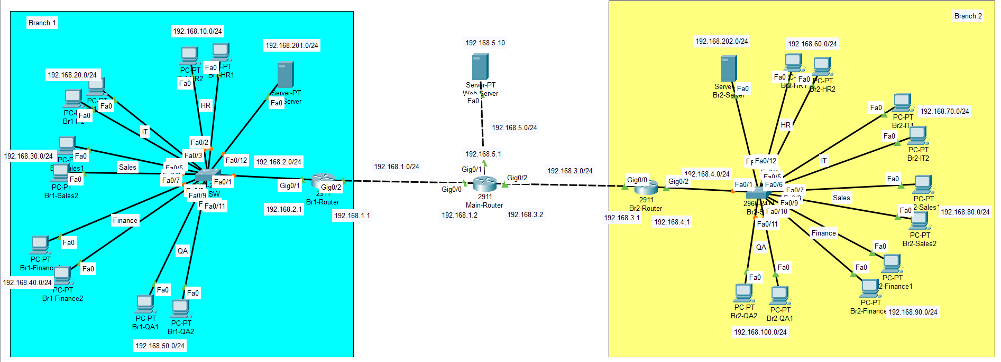




Network Topology and Architecture
Dual-Branch Topology
Network Topology Diagram
The network uses a dual-branch topology with Branch 1 and Branch 2 connected via a Main Router. This facilitates inter-branch communication and centralized management.
Three-Tier Hierarchical Model
Access Layer
Connects end devices to the network. Implemented through VLANs for departmental segmentation.
Distribution Layer
Interconnects different VLANs and enforces security policies. Handles routing and filtering.
Core Layer
Provides high-speed backbone connectivity between branches. Uses OSPF for optimal path selection.
Multi-Site Company Network Design
Page 3 of 13

Slide 4












IP Addressing Scheme
Structured IP Addressing Plan
A well-structured IP addressing scheme is critical for efficient network operation. The following table outlines the IP addressing plan for both branches and core WAN links.
BRANCH
DEPARTMENT
VLAN ID
SUBNET
GATEWAY
BRANCH 1
HR (LAN)
10
192.168.10.0/24
192.168.10.1
IT (LAN)
20
192.168.20.0/24
192.168.20.1
Sales (LAN)
30
192.168.30.0/24
192.168.30.1
Finance (LAN)
40
192.168.40.0/24
192.168.40.1
BRANCH 2
HR (LAN)
60
192.168.60.0/24
192.168.60.1
IT (LAN)
70
192.168.70.0/24
192.168.70.1
Sales (LAN)
80
192.168.80.0/24
192.168.80.1
Finance (LAN)
90
192.168.90.0/24
192.168.90.1
WAN/CORE
Links
IP Ranges
Gateways
Br1-WAN1: 192.168.1.0/24, Br2-WAN2: 192.168.3.0/24, Central Web: 192.168.5.0/24
Multi-Site Company Network Design
Page 4 of 13

Slide 5










VLAN Implementation and Inter-VLAN Routing
VLAN Implementation
Router-on-a-Stick Configuration
VLANs segment the network into distinct broadcast domains, enhancing security and managing traffic efficiently. Each department is assigned a unique VLAN ID.
Inter-VLAN communication is facilitated using a single physical interface with multiple sub-interfaces.
Key Benefits:
Enhanced security through network segmentation
G0/1.10
G0/1.20
Reduced broadcast traffic
VLAN 10
VLAN 20
Improved network performance
G0/1.60
G0/1.70
VLAN Assignments
VLAN 60
VLAN 70
Branch Networks
Branch 1 HR
Branch 1 IT
VLAN 10
VLAN 20
Example Configuration:
Branch 2 HR
Branch 2 IT
VLAN 60
VLAN 70
interface g0/1
no ip address
shutdown
interface g0/1.10
encapsulation dot1Q 10
ip address 192.168.10.1 255.255.255.0
no shutdown
Multi-Site Company Network Design
Page 5 of 13

Slide 6


OSPF Routing Configuration
Dynamic Routing Protocol
OSPF (Open Shortest Path First) is a link-state routing protocol that ensures optimal path selection and rapid convergence in case of network changes.
Key Benefits:
Optimal path selection
Rapid convergence
Scalability
Configuration Commands:
$ router ospf 1
network 192.168.0.0 0.0.255.255 area 0
Multi-Site Company Network Design
Page 6 of 13

Slide 7








DHCP and DNS Services
DHCP Services
DNS Services
Automates IP address assignment across all departments
Enables name resolution for network resources
Centralized servers in each branch (VLAN 201 & 202)
Allows access using domain names instead of IPs
Simplifies access to central web server
Challenge:
DHCP broadcasts don't cross VLAN boundaries
Benefits:
Enhances user experience
Solution:
Simplifies network resource access
Configured ip helper-address on router sub-interfaces
ip helper-address 192.168.201.10
Points to DHCP server for all departmental VLANs
Multi-Site Company Network Design
Page 7 of 13

Slide 8








NAT and Port Security Implementation
Network Address Translation (NAT)
Port Security
Purpose & Benefits
Purpose & Benefits
IP Conservation: Internal hosts use single public IP for external access
Access Control: Prevents unauthorized device connections
MAC Address Protection: Mitigates MAC address spoofing
Security: Hides internal private IPs from external networks
Port Security Configuration
NAT Configuration
Switch(config)# interface range fastEthernet 0/2 - 10
Router(config)# access-list 100 permit ip 192.168.10.0 0.0.0.255 192.168.5.0 0.0.0.255
Switch(config-if-range)# switchport mode access
Switch(config-if-range)# switchport port-security
Router(config)# ip nat inside source list 100 interface gigabitEthernet 0/0
Switch(config-if-range)# switchport port-security maximum 1
Switch(config-if-range)# switchport port-security mac-address sticky
Router(config)# interface gigabitEthernet 0/0
Router(config-if)# ip nat outside
Violation Mode
Key Points
Restrict Mode:
Only traffic to Central Web Server is NATed
Drops unauthorized traffic
Inter-branch traffic bypasses NAT for security inspection
Logs the violation
Keeps port active
Multi-Site Company Network Design
Page 8 of 13

Slide 9
















Access Control Lists Security Policies
Extended ACLs were implemented on the ingress path of each departmental sub-interface, enforcing the principle of Least Privilege to enhance network security.
IT Administrator Access
IT Reverse Protection
IT department has full outbound access to all networks
Blocks non-IT users from initiating connections to IT devices
HR Inbound Protection
Finance Total Isolation
HR can initiate traffic, but inbound access is blocked
No external network allowed to access Finance VLAN
Branch Isolation
Cross-Branch Access
HR, Finance, and QA restricted to their own local branch
IT and Sales can access their respective networks in remote branches
ACLs implemented on all branch routers
Multi-Site Company Network Design
Page 9 of 13

Slide 10







Network Validation and Testing Results
Comprehensive testing procedures were conducted to ensure network functionality and effective enforcement of security policies across all segments.
Intra-Branch Communication
Inter-Branch Connectivity
Tests confirmed expected communication patterns within each branch and enforcement of ACLs for departmental isolation.
Validation of secure communication between Branch 1 and Branch 2 through the central Main Router.
ACL Enforcement
Service Accessibility
Verification that Access Control Lists properly restrict unauthorized access between departments while allowing legitimate traffic.
Testing confirmed DHCP, DNS, and web services are accessible to authorized users across all network segments.
Results Summary
All network segments successfully established connectivity
ACL rules properly enforced data locality and security policies
DHCP services functional across all branches
NAT and Port Security configurations effective
Multi-Site Company Network Design
Page 11 of 13

Slide 11










Challenges and Solutions
DHCP Issue – Devices Not Receiving IP Addresses
PCs were unable to receive IP addresses from the DHCP server due to DHCP broadcasts not crossing VLAN boundaries.
Solution: ip helper-address
Configured the ip helper-address command on router sub-interfaces to relay DHCP requests from each VLAN to the centralized DHCP server.
Unrestricted Inter-VLAN Routing
By default, inter-VLAN routing allowed all departments to communicate without restrictions, creating a security risk.
Solution: Extended ACLs
Implemented Extended Access Control Lists on departmental sub-interfaces to control and restrict communication between different departments, enforcing the principle of least privilege.
Multi-Site Company Network Design
Page 12 of 13

Slide 12










Project Summary and Achievements
This project successfully designed and implemented a secure and scalable multi-site company network utilizing Cisco Packet Tracer. By integrating key networking features, the network achieved its core objectives of secure departmental segmentation, efficient inter-branch communication, and robust external connectivity.
Key Achievements
Comprehensive Network Integration
Enhanced Security Framework
Successfully integrated VLANs, STP, NAT, ACLs, DHCP, and DNS services to create a cohesive network infrastructure
Implemented layered security measures including ACLs, NAT, and Port Security to protect network resources
Seamless Inter-Branch Communication
Automated Services Implementation
Established secure connections between Branch 1 and Branch 2 while maintaining departmental isolation
Deployed DHCP and DNS services for efficient IP address allocation and name resolution
Project Outcome: The practical application of these concepts demonstrated a comprehensive understanding of modern network infrastructure design and implementation, providing a solid foundation for real-world networking challenges.
Multi-Site Company Network Design
Page 13 of 13

