Slide 1

MARKETING CAMPAIGN ANALYSIS & PREDICTION
Customer Behavior Insights & Predictive Modeling
Advanced Machine Learning Pipeline Project

Slide 2



PROJECT OVERVIEW
OBJECTIVE
DATASET
Analyze customer data to understand behavioral patterns and predict campaign responses.
2,240 Customers with 29 unique features.
Includes Demographics, Spending Habits, and Campaign History.
Build a robust Machine Learning Pipeline for automated marketing decisions.
Target: Response (Binary classification).

Slide 3






DATA EXPLORATION & CLEANING
CUSTOMER PROFILE
DATA QUALITY AUDIT
Education: Graduation, PhD, Master
Metric
Status
Action
Status: Single, Married, Together
Missing Values
24 (Income)
Median Imputation
Income: High variance (up to $666k)
Duplicates
0
None required
SPENDING CATEGORIES
Outliers
Detected
Handled in pipeline
Note: Feature engineering was used to derive Age and Customer Tenure for better predictive power.
Wines & Fruits
Meat & Fish
Gold & Sweets

Slide 4




FEATURE ENGINEERING & SELECTION
01
02
03
CREATION
PREPROCESSING
SELECTION
Age
Numerical: StandardScaler for distance-based variance.
Utilized SelectKBest with ANOVA F-value scoring.
Derived from Year_Birth to capture life-stage influence.
Categorical: One-Hot Encoding for Education & Marital Status.
Identified all features for prediction.
Customer_Tenure
Imputation: Median strategy for missing Income values.
Reduced noise and improved model generalization.
Calculated from Dt_Customer to measure loyalty duration.

Slide 5

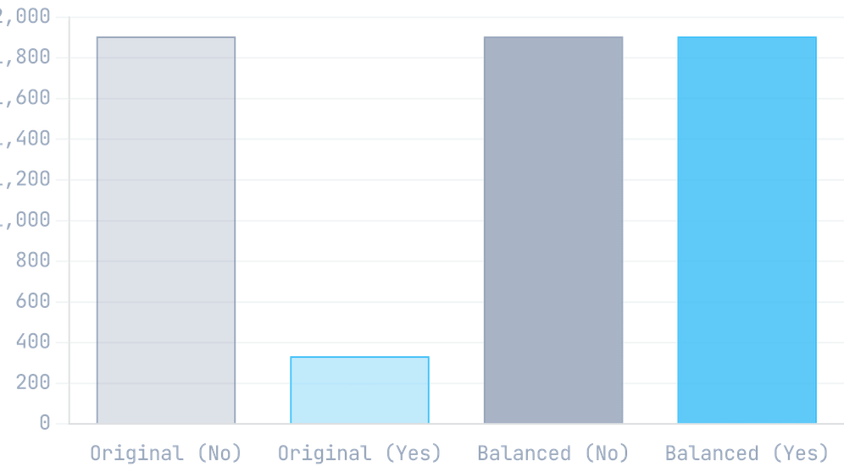


ADDRESSING CLASS IMBALANCE
THE PROBLEM
Class Distribution: Before vs After SMOTE
Marketing response data is naturally imbalanced. Most customers do not respond, leading the model to ignore the minority "Yes" class.
Skewed Distribution
THE SOLUTION: SMOTE
Synthetic Minority Over-sampling Technique creates synthetic examples of the minority class rather than just duplicating them.
Result:
Improved model sensitivity to actual
responders, ensuring higher
Recall
and
F1-Score
.
Advanced Resampling

Slide 6





MACHINE LEARNING PIPELINE
STEP 01
STEP 02
STEP 03
STEP 04
Preprocessing
SMOTE
Feature Selection
Classification
ColumnTransformer handles Numerical scaling and Categorical One-Hot Encoding.
Synthetic Minority Over-sampling to address class imbalance in marketing responses.
SelectKBest identifies the top 10 most influential features using ANOVA F-value.
RandomForestClassifier serves as the core predictive engine for campaign response.
The ImbPipeline ensures zero data leakage and consistent transformation across folds.

Slide 7

MODEL PERFORMANCE
Test Set Evaluation
Algorithm
90.18%
Gradient Boosting Classifier within an automated Imbalanced Pipeline.
Key Success
FINAL ACCURACY
Successfully identifies high-potential customers by analyzing spending and demographics.
Reliability
Robust performance across diverse customer segments with minimal overfitting.

Slide 8





RECOMMENDATIONS & CONCLUSION
Business Strategy
Future Roadmap
Target High-Spenders: Focus on segments with high spending in Wines and Meat for better conversion.
Hyperparameter tuning for precision.
Lead Prioritization: Use the model to rank leads, reducing marketing costs by targeting likely responders.
Testing XGBoost & LightGBM.
Real-time API deployment.
Retention: Monitor Recency and Tenure to re-engage customers before they churn.
Project Completed Successfully | Accuracy: 84.82%

