Slide 1

Real-Time Corporate CI/CD DevOps Pipeline Project

Slide 2
TABLE OF CONTENTS
01
Introduction
02
Infrastructure Layout
03
CI/CD Pipeline Workflow
03

Slide 3

INTRODUCTION
01
Welcome to our deep dive into our enterprise-grade CI/CD pipeline, where the infrastructure spans multiple virtual machines with dedicated responsibilities, focusing on security, scalability, and automated quality checks.

Slide 4

02
Infrastructure Layout

Slide 5
CI/CD Pipeline workflow
InFrastructure as Code
a) Terraform
Defines and provisions cloud infrastructure: Jenkins VM
1) Kubernetes Cluster Nodes (1 master, 2 workers)
2) Monitoring VM
3) SonarQube VM
Manages infrastructure state
Enables version-controlled infrastructure
b) Ansible
Configures and manages servers
Ensures consistent environment setup
Playbooks:
1. Docker Playbook: Installs and configures Docker on required VMs
2. Jenkins Playbook: Sets up Jenkins on the dedicated VM
3. Kubernetes Cluster Playbook: Installs and configures Kubernetes on master and worker nodes
4. SonarQube Playbook: Installs and configures SonarQube on its dedicated VM

Slide 6
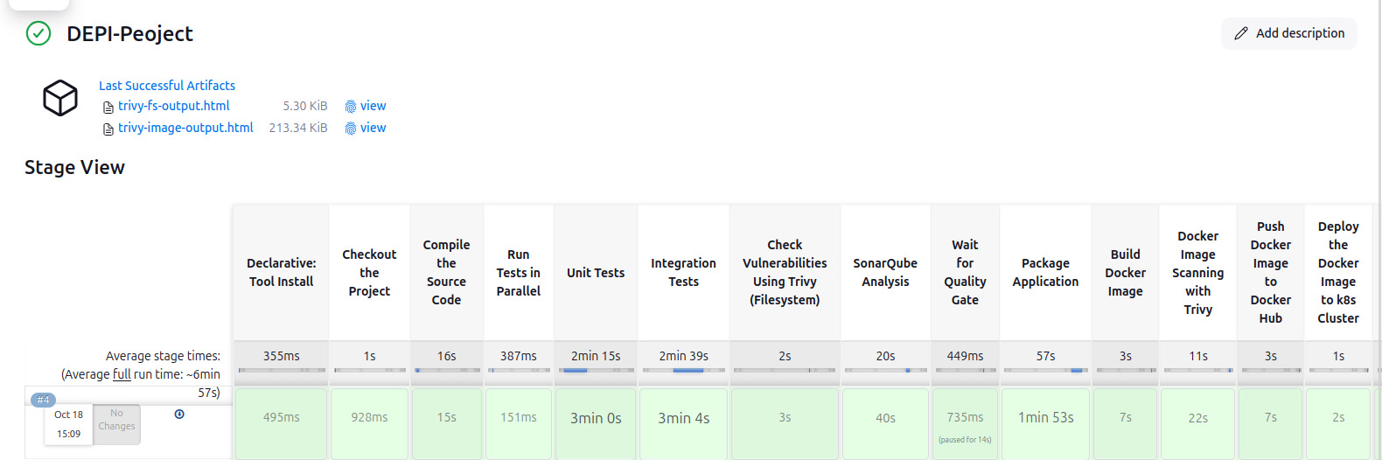
Infrastructure Layout
1. Dedicated Virtual Machines Jenkins VM: Our pipeline orchestrator runs on a dedicated high-performance VM with IP 172.200.209.8 , 2 CPU cores and 8 GB RAM. This ensures smooth pipeline execution even under heavy load with multiple concurrent builds.

Slide 7
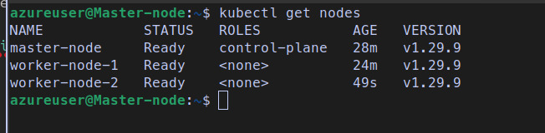
Infrastructure Layout
2. Kubernetes Cluster Nodes: Our production environment consists of a multi-node Kubernetes cluster.
We maintain:
One master nodes with IP 20.106.221.225 .
Two worker nodes with Ips ( 20.106.222.59 , 51.8.89.123 ) for application workloads .
Each node is provisioned with 4GB RAM and 2 CPU cores .

Slide 8
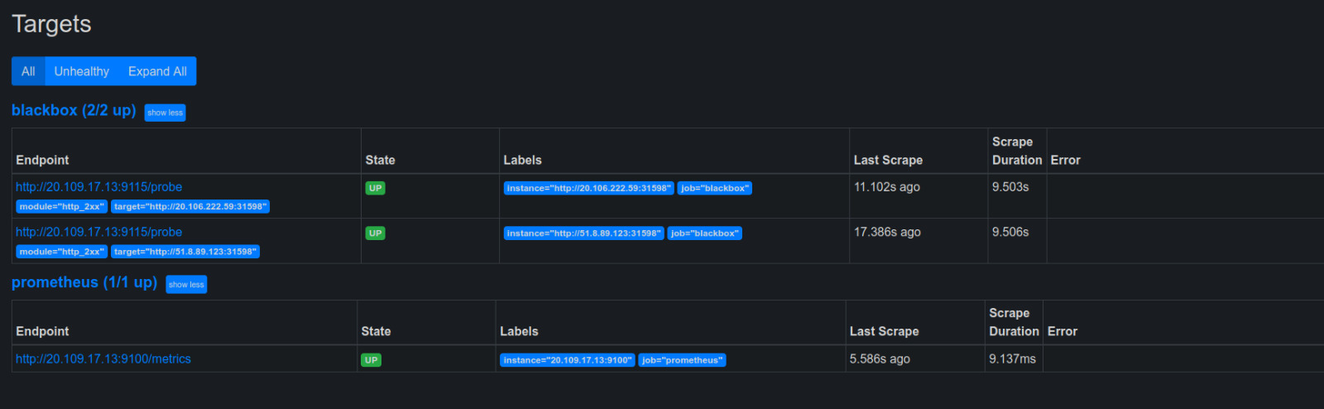
Infrastructure Layout
3. Monitoring VM: Houses our observability stack with:
Prometheus for metrics collection and storage.
Grafana for visualization and dashboarding.
Alert Manager for intelligent alert routing.
It’s IP 20.109.17.13 , 4GB RAM and 2 CPU cores for handling metric processing.

Slide 9
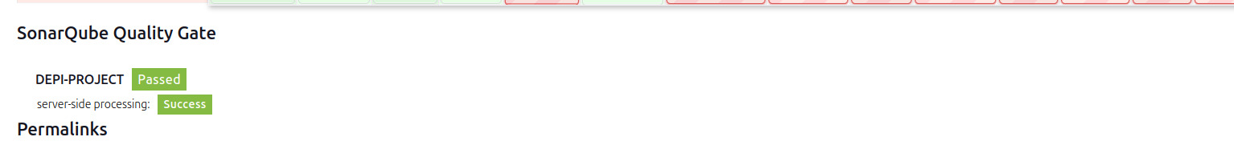
Infrastructure Layout
5. SonarQube VM:
Continuous code quality and security analysis
Seamless integration with CI/CD pipelines.
Detection of code smells, bugs, and security vulnerabilities.
Operating on IP 13.91.61.42 .

Slide 10


CI/CD Pipeline workflow
Development Phase
Version Control (GitHub)
Jenkins Pipeline
Build & Test (Maven)
Security Scanning
Artifact Management
Containerization
Kubernetes Deployment
Monitoring Setup
Benchmarking

Slide 11
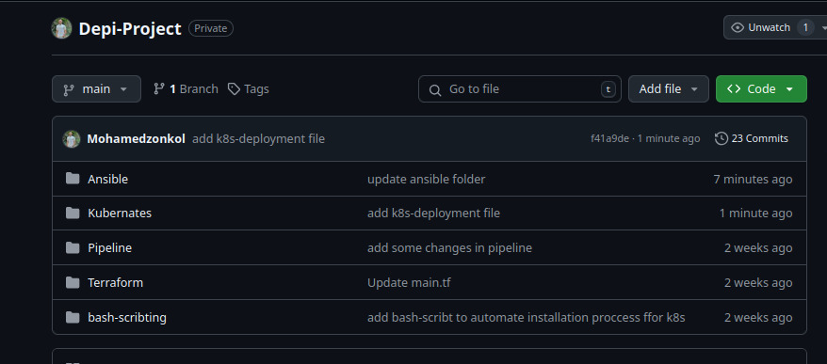
CI/CD Pipeline workflow
1) Development Phase
Developers write code locally, ensuring that it follows established coding standards and conducting local testing before pushing the changes to the repository.
Integration tests are run locally before pushing to ensure basic functionality
2) Version Control (GitHub)
All code changes pushed to GitHub
with branch protection rules enforced
a pull request workflow is followed for code reviews.

Slide 12
CI/CD Pipeline workflow
3) Jenkins Pipeline
Jenkins pulls the latest code.
Pipeline orchestrates the entire build process.
Parallel execution of independent stages for faster builds.
4) Build & Test (Maven)
Maven compiles the application and runs unit test cases.
Runs parallel testing:
1. Unit tests .
2.Integration tests .
Generates comprehensive test reports.
.

Slide 13
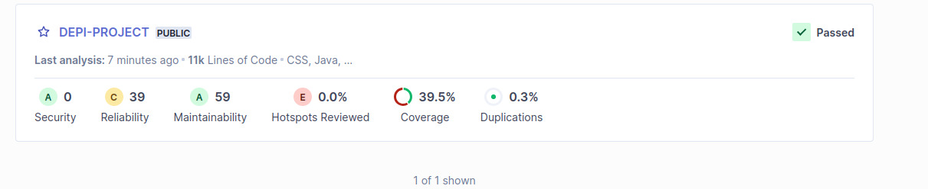
CI/CD Pipeline workflow
5) Security Scanning
a) Trivy Scan (First Phase)
Scans for known vulnerabilities
Checks dependencies
Creates security reports
Can block pipeline on critical findings
b) SonarQube Analysis
Code quality assessment
Static code analysis
Security vulnerability checks
Waits for quality gate passage
.

Slide 14
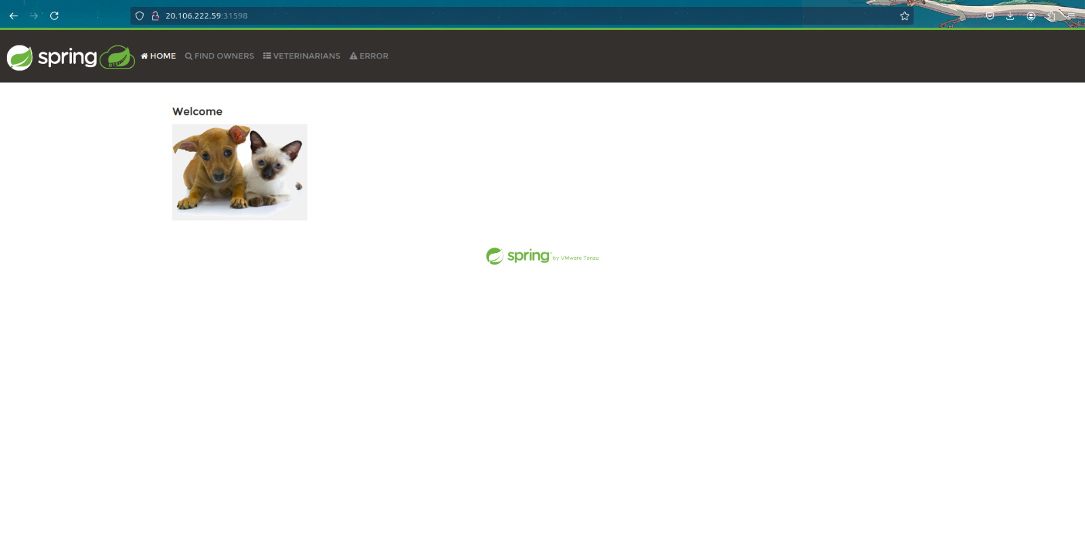
CI/CD Pipeline workflow
6) ArtiFact Management
Maven builds the final package , artifacts are stored in Docker Hub.
Version control is maintained for Docker images and ensure secure storage and retrieval of images
7) Containerization
a) Docker Build Process:
Creates Docker images.
Tags images appropriately.
b) Security Measures:
Trivy scans Docker images.
Checks for container vulnerabilities.
Validates security best practices.

Slide 15
CI/CD Pipeline workflow
8) Kubernetes Deployment
1) K8s Setup :
Virtual Machines:
Created three VMs (1 master, 2 workers) for the Kubernetes cluster
Kubeadm Tool:
Used kubeadm to initialize the master node and join worker nodes to the cluster

Slide 16
CI/CD Pipeline workflow
8) Kubernetes Deployment
2) Deploying the Application:
Containerized Application and Deployed Spring PetClinic to Kubernetes cluster
Deployment Strategy:
- Used Kubernetes Deployment YAML files to describe the application's desired state.
- Created Kubernetes resources such as Deployments, Services, and Pods.
Scaling: the application can scale across the worker nodes to handle increased load by increasing the number of replicas

Slide 17
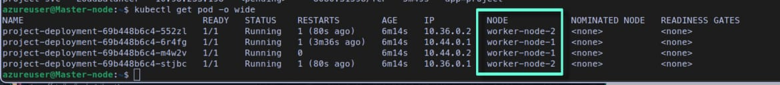
CI/CD Pipeline workflow
8) Kubernetes Deployment
3) Load Balancing:
Configured a Kubernetes Service of type LoadBalancer to expose the application to external traffic .
Load Distribution : automatically balances the incoming traffic across multiple replicas of the application running on the worker nodes

Slide 18
CI/CD Pipeline workflow
9) Monitoring Setup
a) Infrastructure Monitoring:
Prometheus collects metrics.
Grafana provides dashboards.
Real-time performance monitoring
Node Exporter for RAM and CPU metrics collection

Slide 19
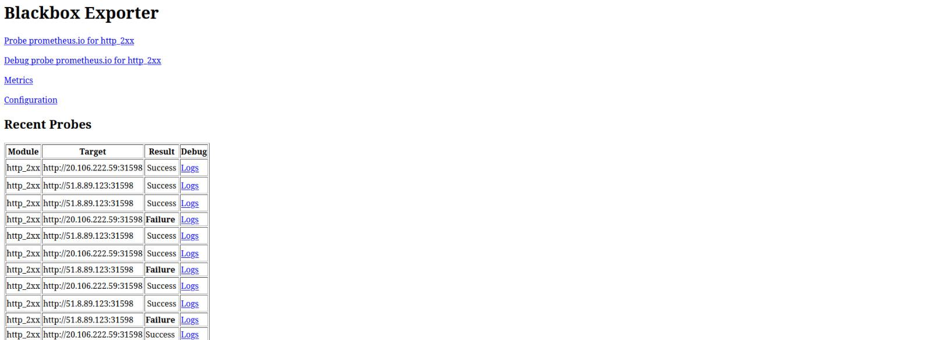
CI/CD Pipeline workflow
9) Monitoring Setup
b) Application Monitoring:
Tracks custom metrics.
Tracks response times.
Monitors error rates.

Slide 20
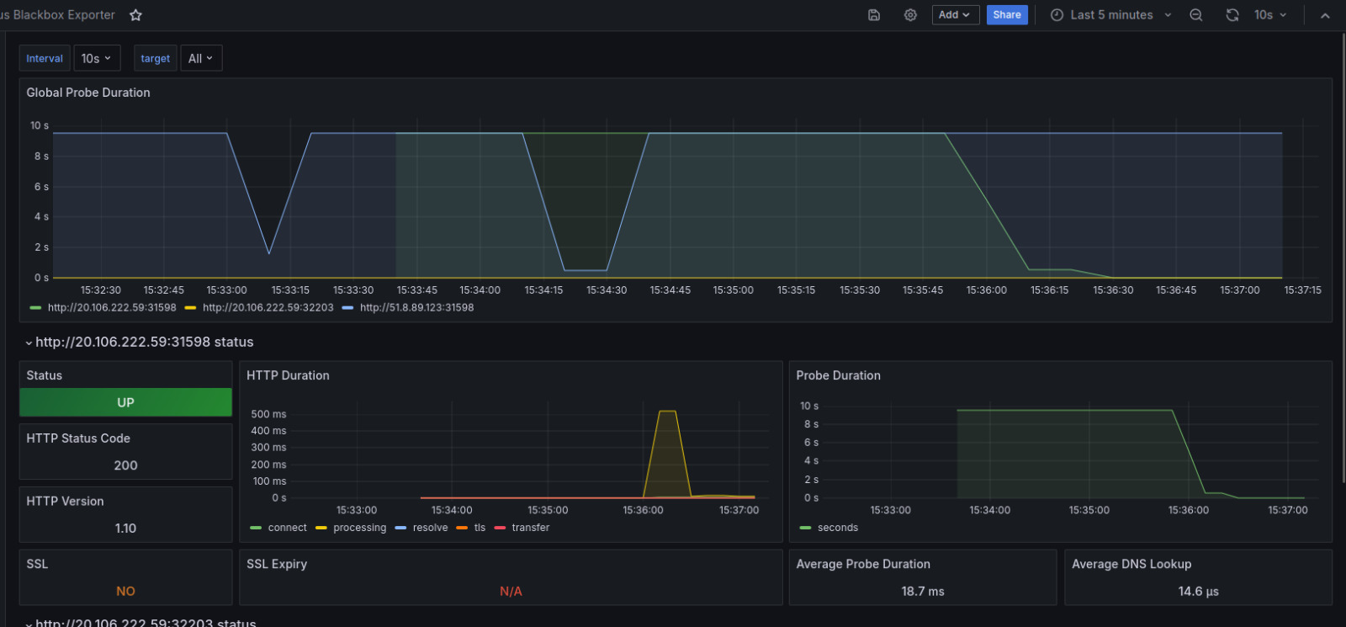
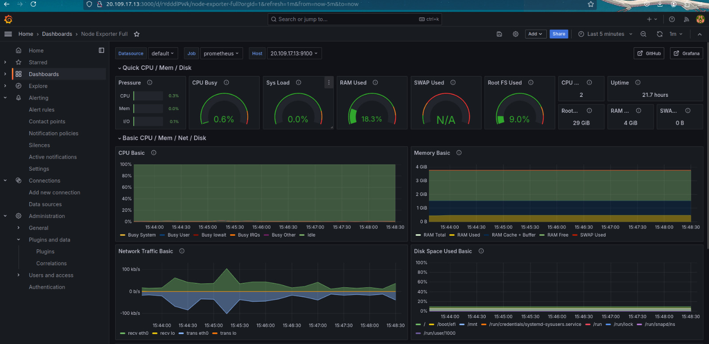
CI/CD Pipeline workflow
9) Monitoring Setup
a) Traffic Monitoring:
Monitor incoming and outgoing network traffic .
Analyze traffic patterns and potential bottlenecks .

Slide 21
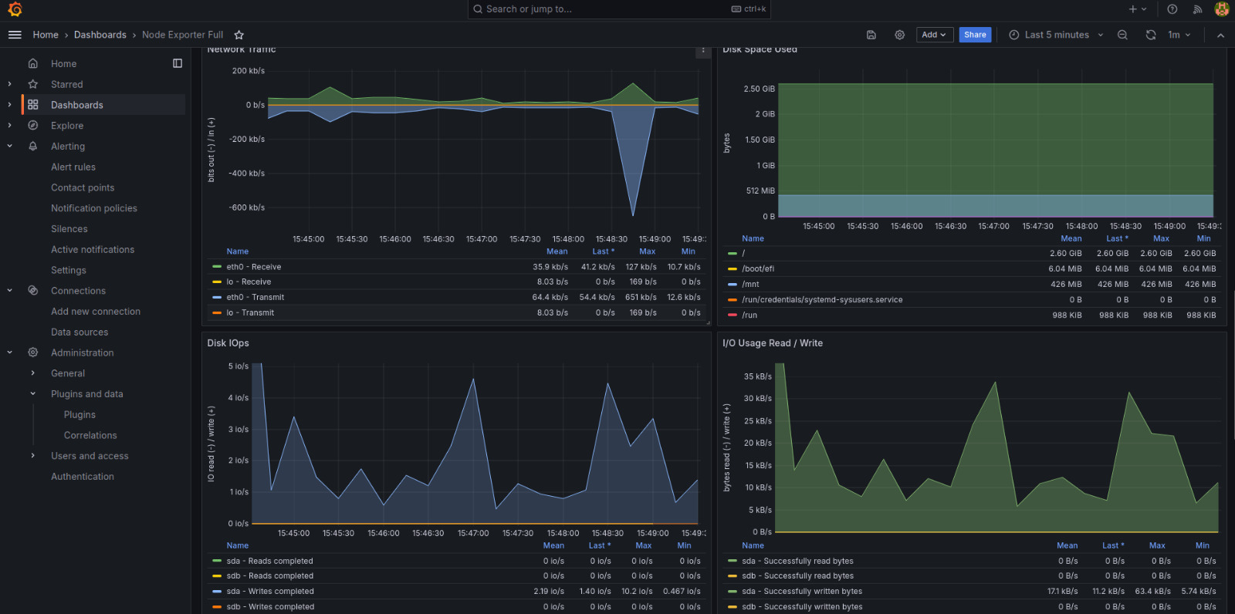
CI/CD Pipeline workflow
Grafana
The image shows a Grafana dashboard displaying performance metrics alongside an ApacheBench (ab) terminal output, indicating a benchmarking test being performed on an application.
1)Load Generation:
ApacheBench is being used to generate load on the application.
The terminal shows that 1500 requests have been completed to the IP 20.106.222.59.
2) Response Time Monitoring:
The Grafana dashboard displays various graphs showing HTTP duration and probe duration.
These metrics help visualize how the application responds under load over time.

Slide 22
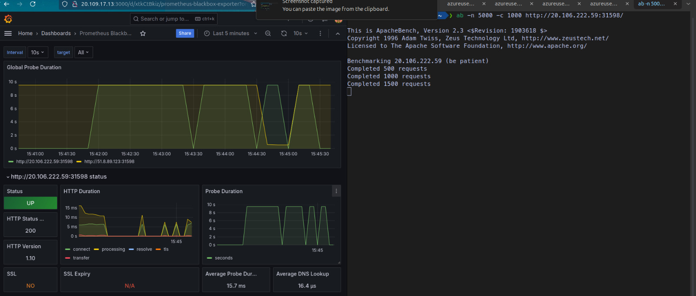
CI/CD Pipeline workflow
10) Benchmarking
This benchmarking setup allows the team to observe how the application performs under significant traffic, helping identify potential performance issues, bottlenecks, or areas for optimization in real-time.

Slide 23

Members roles
Mohammed Elsayed
K8s and Monitoring tools
Amr Yasser
SonarQube and Jenkins
Tasneem Selim
Terraform and Ansible

Slide 24

Thank you

