Slide 1

Sleep Stage Classification from PSG Signals using Deep Learning
3ʳᵈ BME , Biomedical Signal Processing.
By : Ahmed Essam , Basel Ashraf
, Mohamed Wael.
Under Supervision of :
Dr. Ibrahim Sadek
Eng. Mirna Ahmed
Eng. Veronica William
Notes:
1

Slide 2
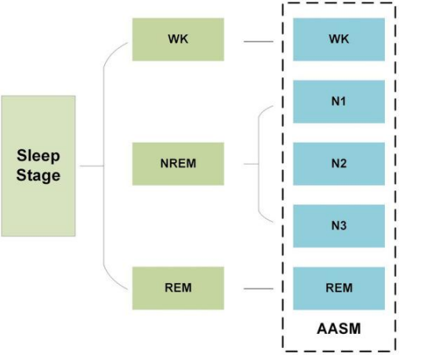
Project Description
Implementing a deep learning classifier to classify the sleep stages from a single channel PSG signal.
stages were classified as WK (wakefulness) , NREM (non-rapid eye movement /Normal), REM (rapid eye movement).

Slide 3
Content
Introduction
Dataset Description
Project Workflow
References

Slide 4
the current standard for the sleep quality is the polysomnography (PSG) which record various biological signals including EEG , ECG , EMG and EOG.
It provides a high accuracy classification ,but it requires attached electrodes for measurement which interrupts sleep .
requires specialized laps which is expensive and not suitable for home-use.
Introduction

Slide 5
Dataset is gathered from more than 2000 patients with different races.
The dataset have the signals and the annotations for each patient , the signal files is in .edf format (European Default Format) which contains all the biological signals be measured .
The annotations files is in .xml format (Extensible Markup Language) which is containing the labels for each segment, which is a Hierarchical Architecture easy for us to read and easy for computer to understand .
Dataset Description

Slide 6
EDF file example
Parameter | Value
Patient_id | mesa-sleep-xxxx
Sampling Rate | 256
Channels | EEG,EOG,.....EKG
Dataset Description

Slide 7
EDF file example
Time | EKG (mV) | EEG1 (uV) | ...
0.004 | 0.012 | -12.8 | ...
0.008 | 0.015 | -14.4 | ...
0.012 | 0.045 | -18.3 | ...
0.016 | 0.12 | 2.7 | ...
0.02 | 0.65 | 8.4 | ...
Dataset Description

Slide 8
From the dataset we are working on :
10 patients with there annotations.
Working on a single channel from the data set (EKG)
Reference Paper

Slide 9
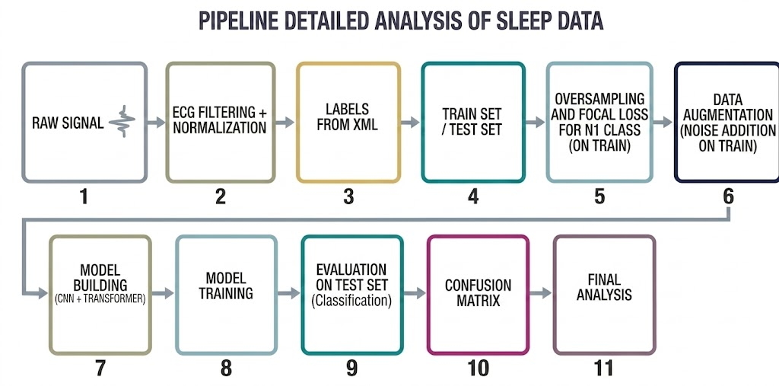
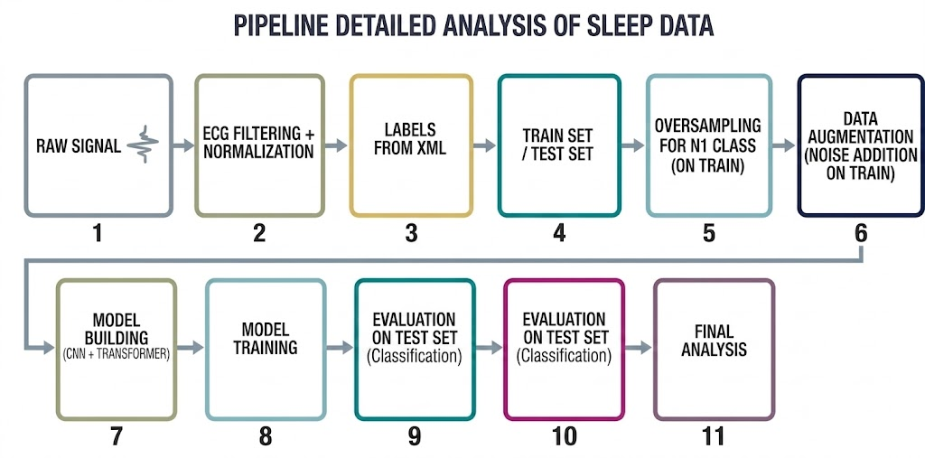
Project Workflow

Slide 10
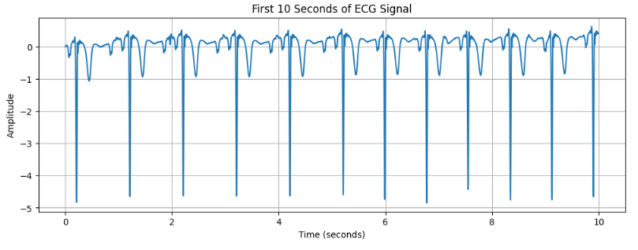
Raw ECG Signal
Using mne Library in python which reads , pre-process and visualize physiological data.
extracting the needed EKG signal from each patient.
X shape: (12758, 7680)
y shape: (12758,)
Class distribution:
Wake : 5569 ( 43.65 %)
N1 : 942 ( 7.38 %)
N2 : 4117 ( 32.27 %)
N3 : 869 ( 6.81 %)
REM : 1261 ( 9.88 %)

Slide 11
ECG Signal Processing Pipeline for Sleep Stage Classification
The code processes EDF signal files along with their corresponding XML annotations.
It extracts the ECG/EKG channel, applies filtering and normalization.
The signal is segmented into fixed 30-second windows, and each segment is assigned a label.
Finally, all segments and labels are aggregated into datasets (X_all, y_all), with summary statistics displayed.

Slide 12
Saving Processed Dataset Using Pickle
The code creates a directory to store the dataset if it does not already exist.
It then saves the processed data (X_all and y_all) into Pickle (.pkl) files.
Both the signal data and their corresponding labels are stored separately, allowing easy reloading later for training or analysis.

Slide 13
Project Workflow

Slide 14
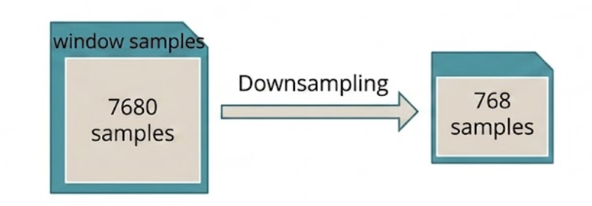
Data Downsampling and Train-Test Splitting
In this step, the data is reduced using downsampling (taking every 10th sample) to lower computational complexity.
Finally, the dataset is split into training (80%) and testing (20%) sets while preserving class distribution using

Slide 15
Handling Class Imbalance (Oversampling N1 Class)
This step addresses the issue of class imbalance in the training data.
First, all samples belonging to the N1 class are identified.
Then, these samples are duplicated twice (oversampling) and added back to the training set, increasing their representation.
This helps the model better learn the minority class and reduces bias toward dominant classes.

Slide 16
Data Augmentation
To improve the robustness of the model, data augmentation was applied by adding Gaussian noise to the training signals.
This simulates real-world signal variability and helps the model generalize better while reducing overfitting.

Slide 17
Focal Loss to Handle Class Imbalance
This code defines a custom loss function called Focal Loss, used to improve model performance in imbalanced datasets.
First, labels are converted into one-hot encoding, and categorical cross-entropy is computed.
Then, a modulating factor is applied to focus more on hard-to-classify samples and reduce the impact of easy ones.
Parameters:
gamma: controls the focus on hard samples
alpha: balances class importance
This loss function helps the model pay more attention to minority or difficult classes.

Slide 18
Deep Learning Model Architecture (CNN + Transformer)
This section defines a deep learning model for ECG signal classification.
The model starts with an input layer of shape (768, 1).
It uses Residual Blocks to extract meaningful features, followed by
Max Pooling for dimensionality reduction.
Then, multiple Transformer Encoder layers (5 layers) are applied.
Next, Global Average Pooling is used, followed by fully connected layers with Batch Normalization and Dropout to improve generalization and reduce overfitting.
Finally, a Softmax output layer with 5 neurons is used for multi-class classification of sleep stages.

Slide 19
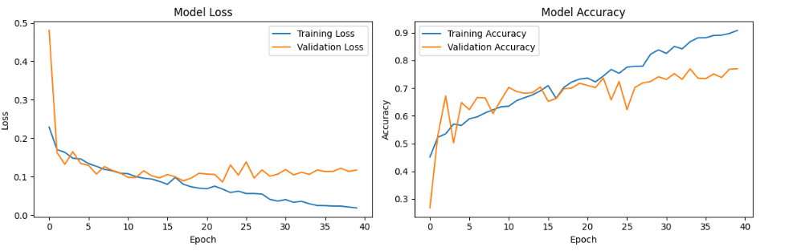
Model evaluation
1.Accuracy and loss metrics

Slide 20
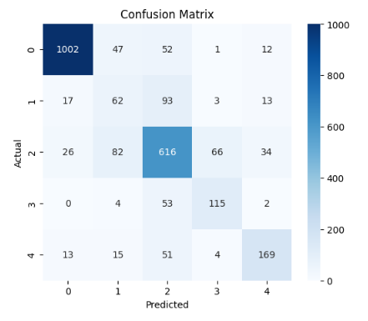
2.Confusion matrix visualization
Model Evaluation

Slide 21
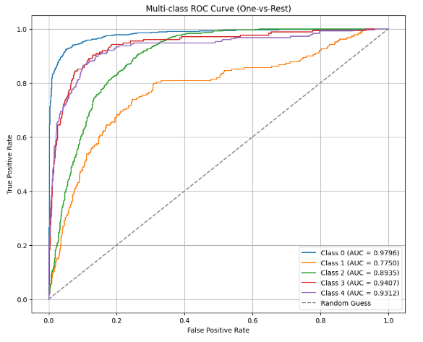
3. Multi class
ROC curve
Model Evaluation

Slide 22
Model evaluation
Classification Report:
precision recall f1-score support
0 0.95 0.90 0.92 1114
1 0.30 0.33 0.31 188
2 0.71 0.75 0.73 824
3 0.61 0.66 0.63 174
4 0.73 0.67 0.70 252
accuracy 0.77 2552
macro avg 0.66 0.66 0.66 2552
weighted avg 0.78 0.77 0.77 2552
accuracy: 0.7696 - loss: 0.1060

Slide 23
References
Deep Convolutional Recurrent Model for Automatic Scoring Sleep Stages Based on Single-Lead ECG Signal , Diagnosticcs.
This study proposes a Deep Convolutional Recurrent (DCR) model that uses only a raw single-lead ECG signal, eliminating the need for manual feature extraction or intermediate signals like Heart Rate Variability (HRV).

Slide 24
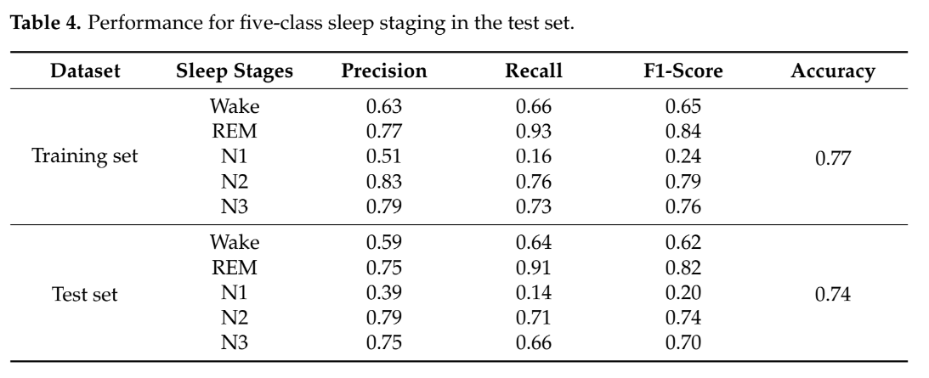
References

Slide 25
References
Our Model:
precision recall f1-score support
WK 0.95 0.90 0.92 1114
N1 0.30 0.33 0.31 188
N2 0.71 0.75 0.73 824
N3 0.61 0.66 0.63 174
REM 0.73 0.67 0.70 252
accuracy 0.77 2552

