Slide 1


Slide 2

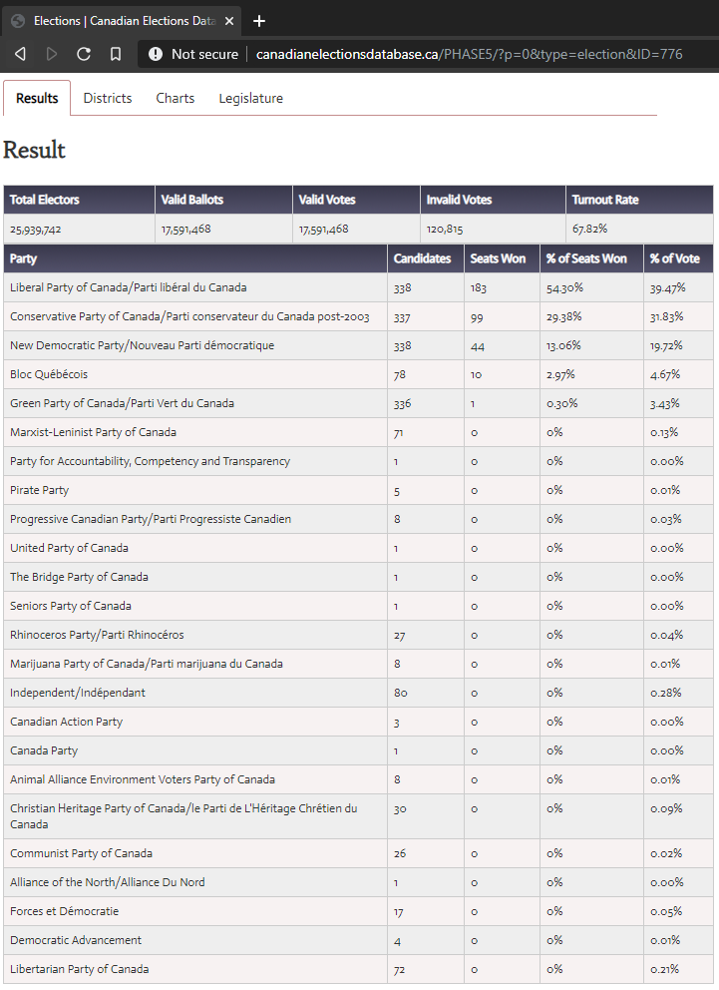
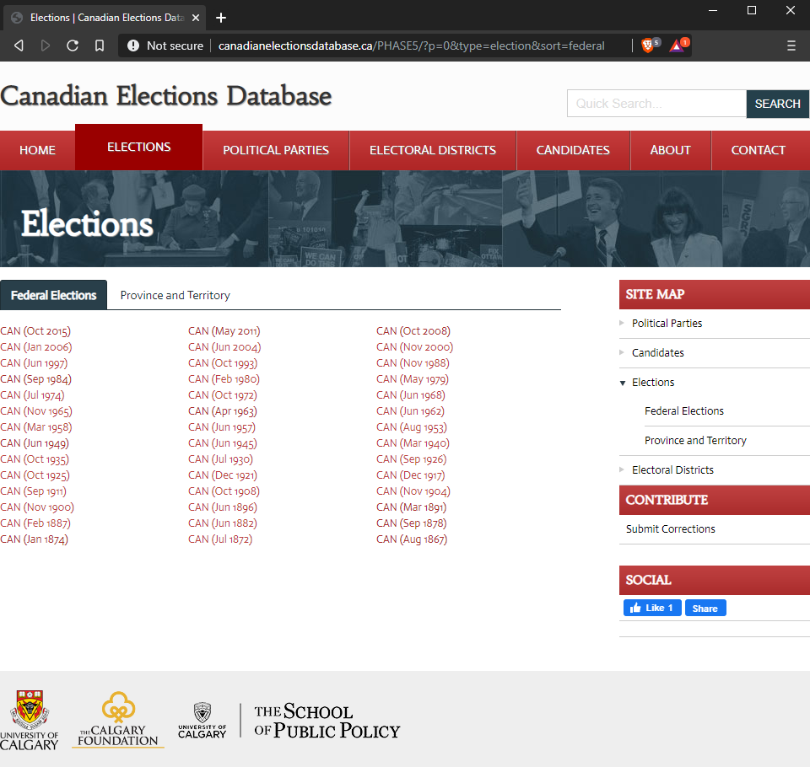
Data Extraction (Static Pages)

Slide 3
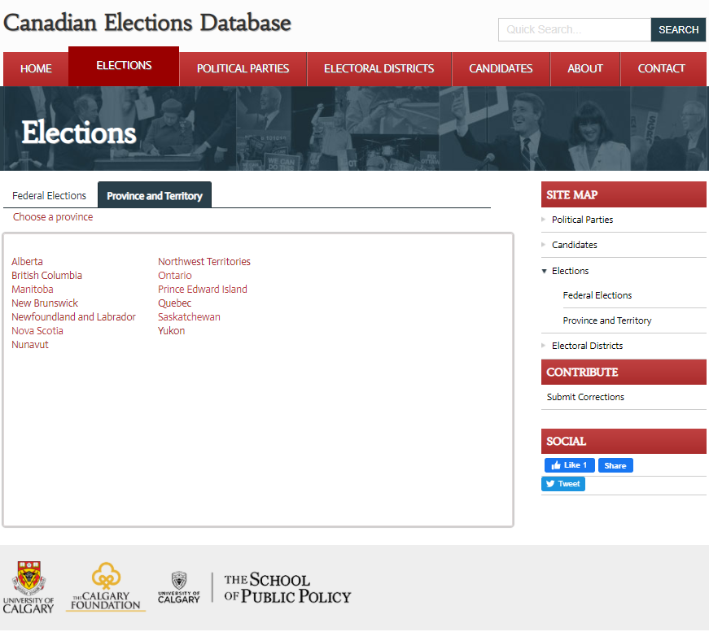
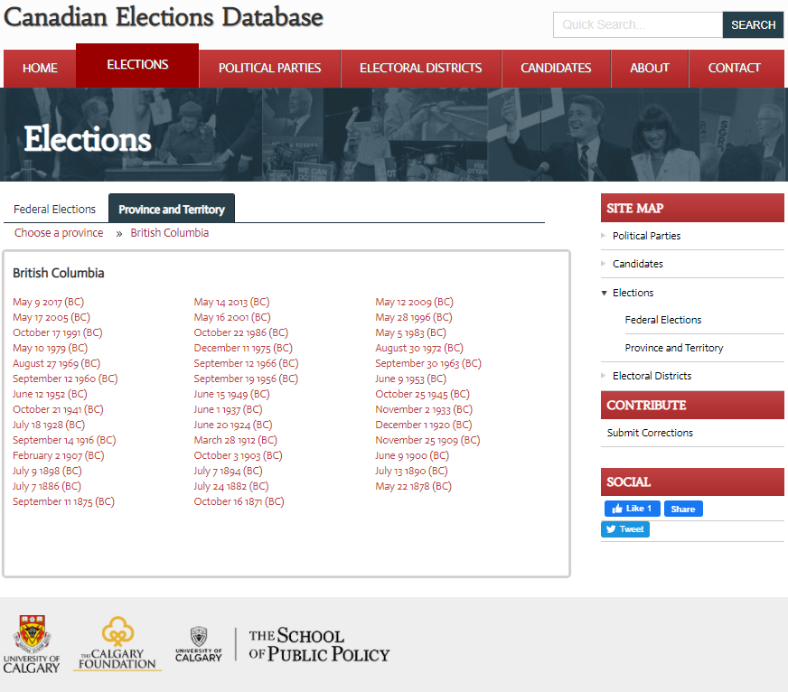
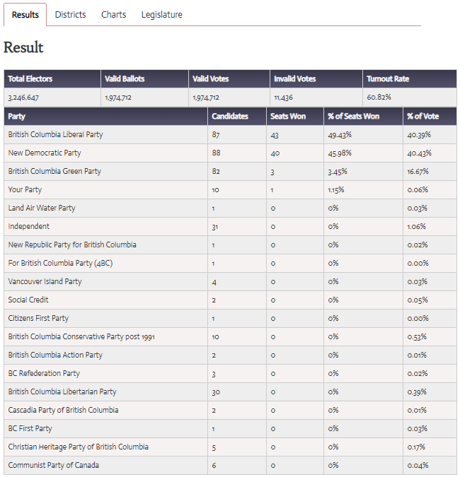
Data Extraction (Dynamic Pages)

Slide 4
Data Extraction: Python Scraper
As no downloadable options were provided by the developers of the “Canadian Election Database”, the database must be extracted using some sort of web-scraper. I have taken the opportunity to develop a scraper using Python, as Python provides compact and robust modules to scrape web-sites with different architecture.
I have used 2 different scraper program to accommodate myself to extract usable, consistent data by thoroughly crawling both static and dynamic pages. This task was particularly challenging as Python’s most popular module “Beautiful Soup” do not support when Webpages communicate to Database using AJAX or JS request. I had to write completely different program to handle the problem.
GitHub Link to the program-files are given below:
https://github.com/Mohammad-Abdul-Hadi/scraper-for-canadianelectionsdatabase.ca/blob/master/Canadian%20Elections%20Database%20Scraper.ipynb (Static Page-Scraper)
https://github.com/Mohammad-Abdul-Hadi/scraper-for-canadianelectionsdatabase.ca/blob/master/Canadian%20Elections%20Database%20Scraper%20(Province%20and%20Territory-wise).ipynb

Slide 5
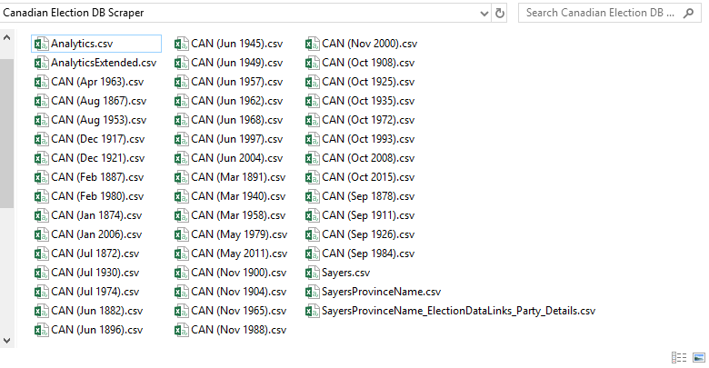
Data Extraction: Python Scraper (Phase 1 extraction)

Slide 6
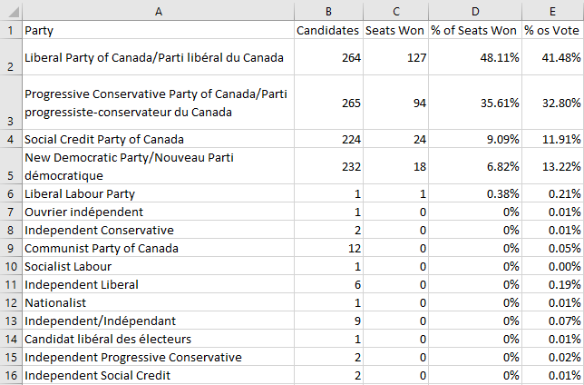
Data Extraction: Python Scraper output (Phase 1 extraction)

Slide 7
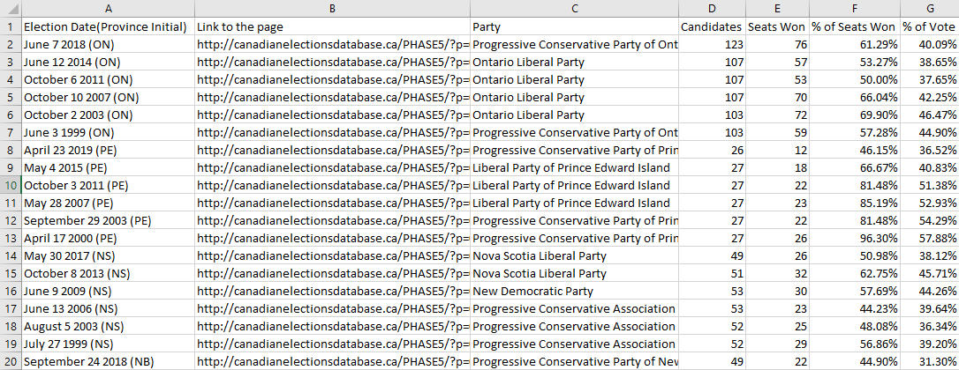
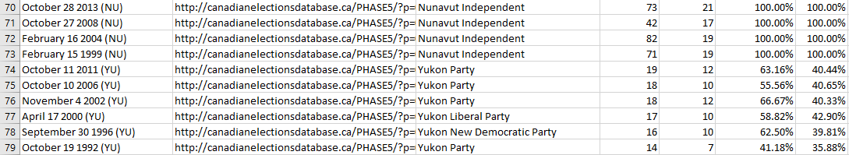
Data Extraction: Python Scraper output (Phase 1 extraction)

Slide 8


Slide 9
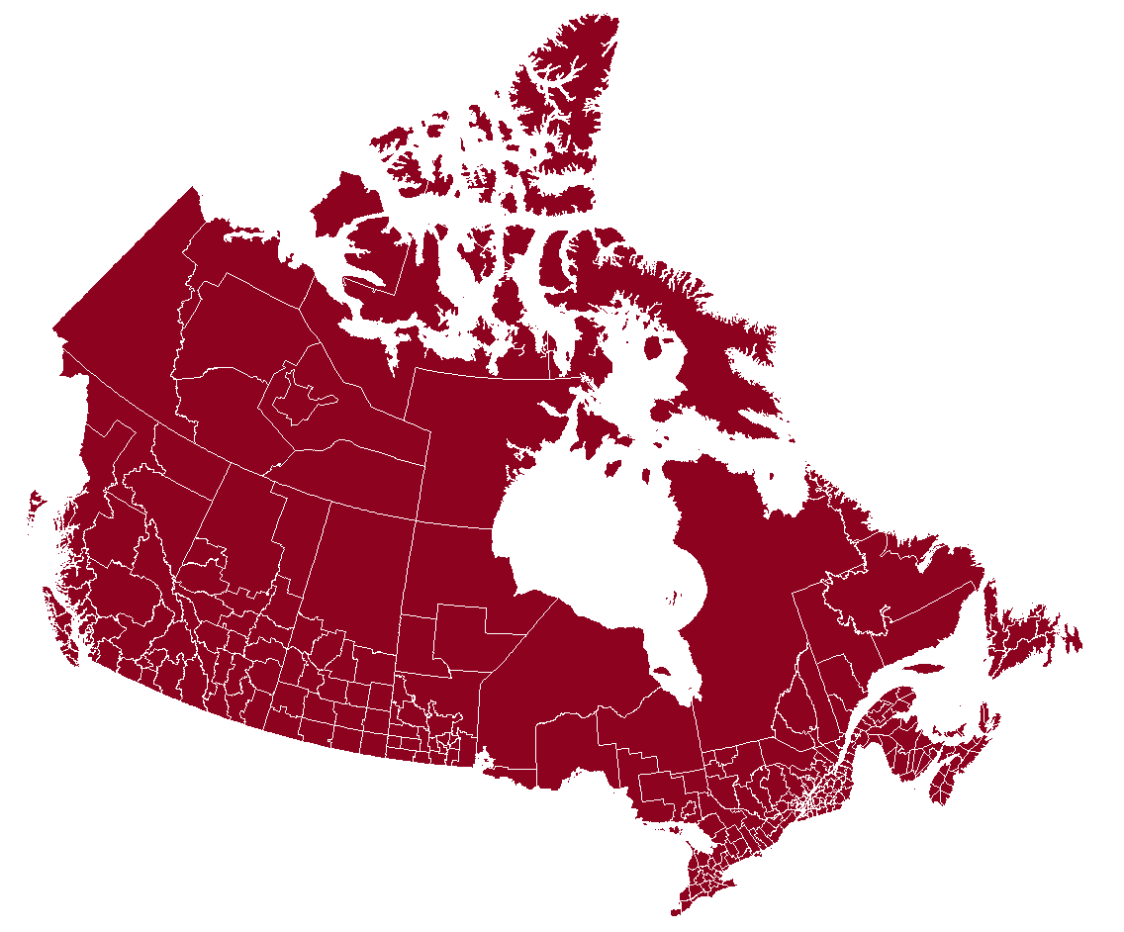
Data Visualization: R
Geo-spatial map of Canada has been generated using R script. We needed get the actual map data. This was the hardest bit. In the case of Canada, central statistics agency provided map shape files that we could use. The Shape File format (.shp) is the most widely-used standard for maps. I grabbed the files to convert them to a format the tidyverse library can use.
Link of the data: https://www12.statcan.gc.ca/census-recensement/2011/geo/bound-limit/bound-limit-2011-eng.cfm
Here 37 census division has been used to identify the segment of different election districts.
Link to the R-script is given below: https://github.com/Mohammad-Abdul-Hadi/Canada-Map-R-Visualization-for-Election-Data/blob/master/CanadaMap.R

Slide 10
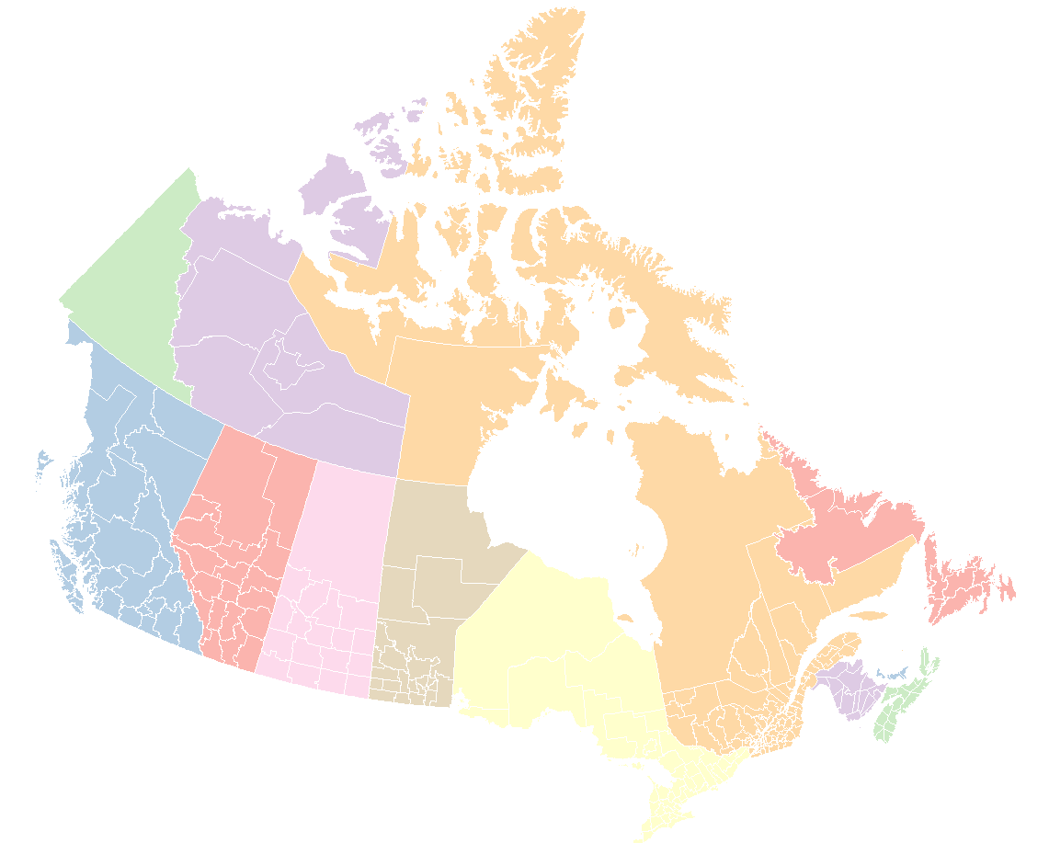
Data Visualization: R
Here PRUID has been used to join all the census divisions; PRUID uniquely identifies a province or territory. Total 13 provinces have been labelled as factor against each of the census division.
PR list has been given below:
10 Newfoundland and Labrador
11 Prince Edward Island
12 Nova Scotia
13 New Brunswick
24 Quebec
35 Ontario
46 Manitoba
47 Saskatchewan
48 Alberta
59 British Columbia
60 Yukon
61 Northwest Territories
62 Nunavut

Slide 11
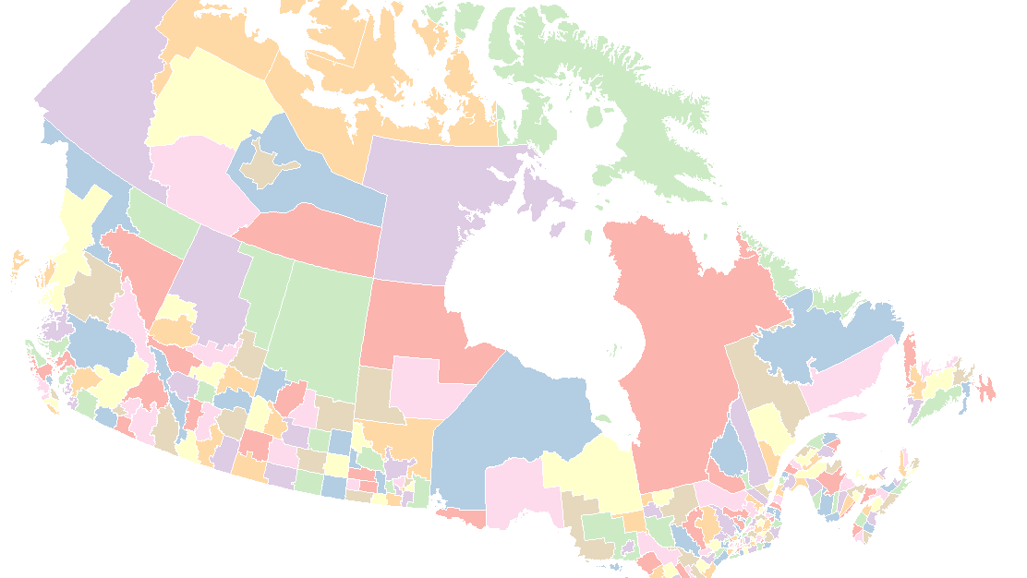
Here CDUIDs has been used to distinctly identify all the census divisions; CDUID uniquely identifies a district/ electoral division in each province or territory. Total 37 provinces have been labelled as factor against each of the province or territory.

Slide 12
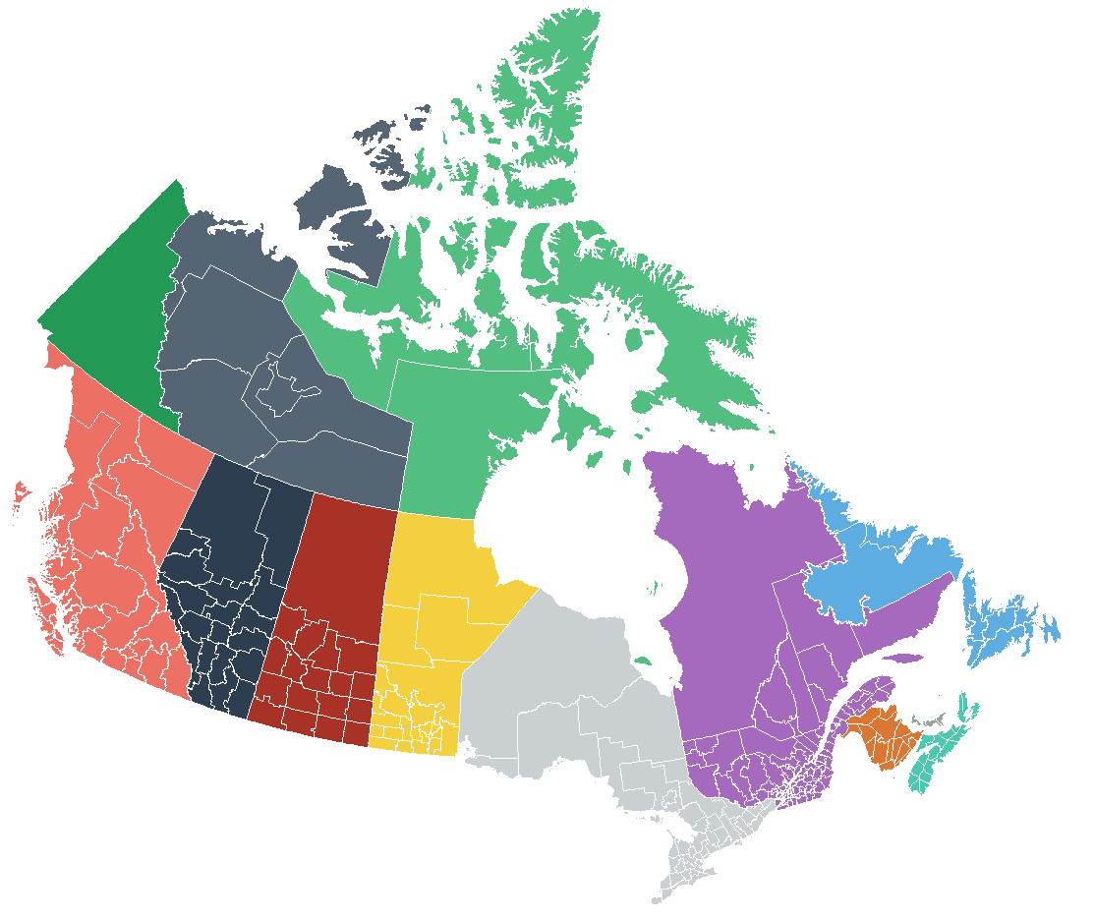
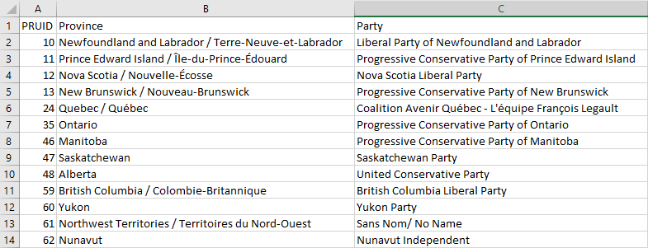
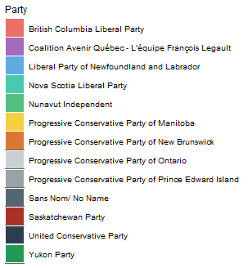
Following Election information of Territorial Elections with the winning parties have been represented in the plot ->

Slide 13
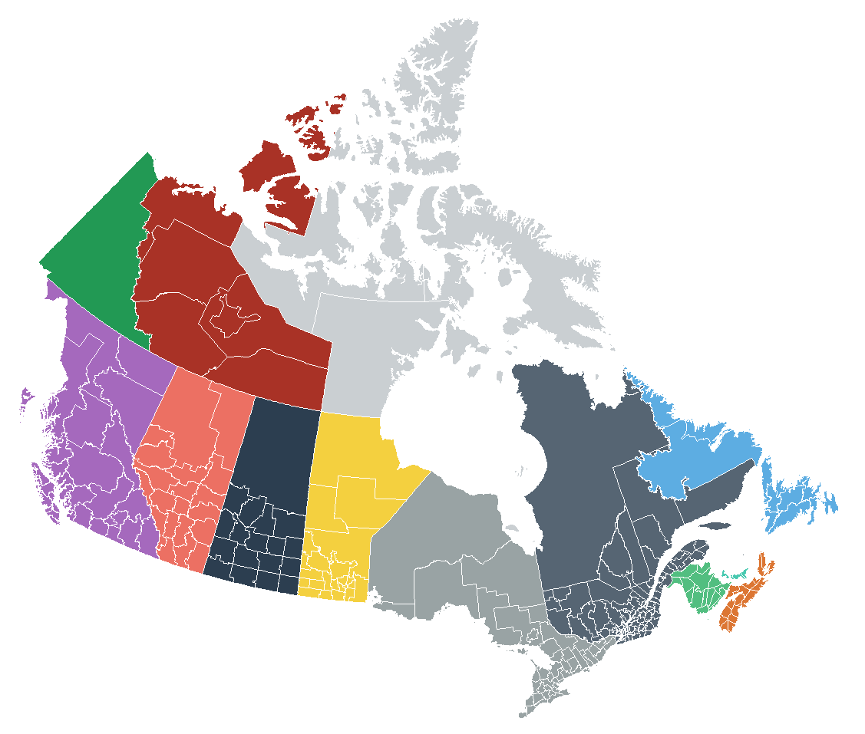
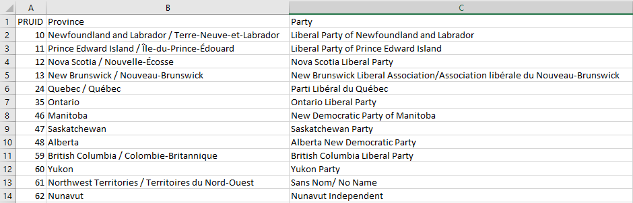
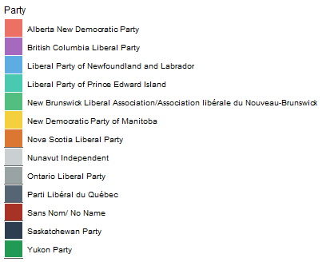
Following Election information of Territorial Elections with the winning parties have been represented in the plot ->

Slide 14
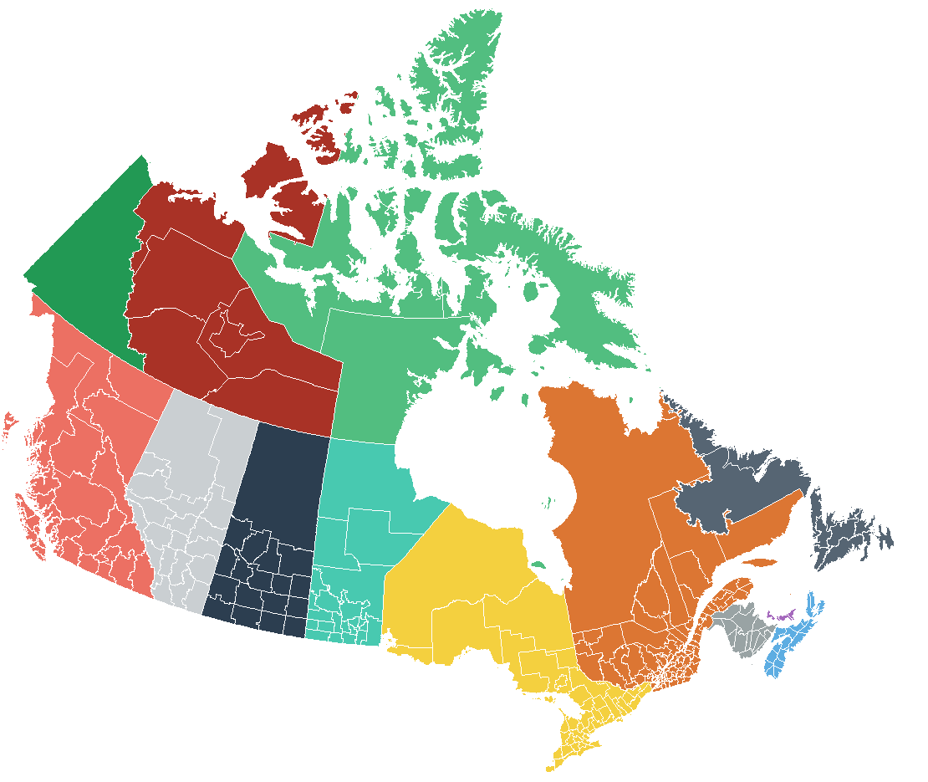
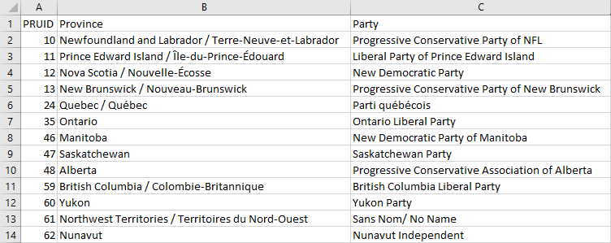
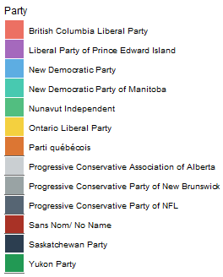
Following Election information of Territorial Elections with the winning parties have been represented in the plot ->

Slide 15
Data Visualization: R
Please note that all the election data (on an average: 31 election outcome from each of the province (13 province) can be represented using the R-script). To avoid redundancy, I just demonstrated 3 election outcome. Also, all the data are already scraped and saved according to our need and requirements. No further polishing. Cleaning of the data is required for this particular type of MAP representation.

Slide 16


Slide 17
Data Visualization: Tableau
I used Tableau to further study the whole outcome of Canadian Election and to analyze the trend so that it can help people to extrapolate and make educated guess about the election outcome; both provincial and Federal.
Unfortunately, I have used the 10 days online trial of tableau which does not permit me to download my code. Hence, I am attaching the screenshots.
Tableau public Workbook Link:
https://10ay.online.tableau.com/t/data501/authoring/DATA501/Sheet1#1
https://10ay.online.tableau.com/t/data501/authoring/DATA501/Sheet2#1
https://10ay.online.tableau.com/t/data501/authoring/DATA501/Sheet2#1
https://10ay.online.tableau.com/t/data501/authoring/DATA501/Sheet2#1
https://10ay.online.tableau.com/t/data501/authoring/DATA501/Sheet2#1
https://10ay.online.tableau.com/t/data501/authoring/DATA501/Sheet2#1
https://10ay.online.tableau.com/t/data501/authoring/DATA501/Sheet2#1

Slide 18
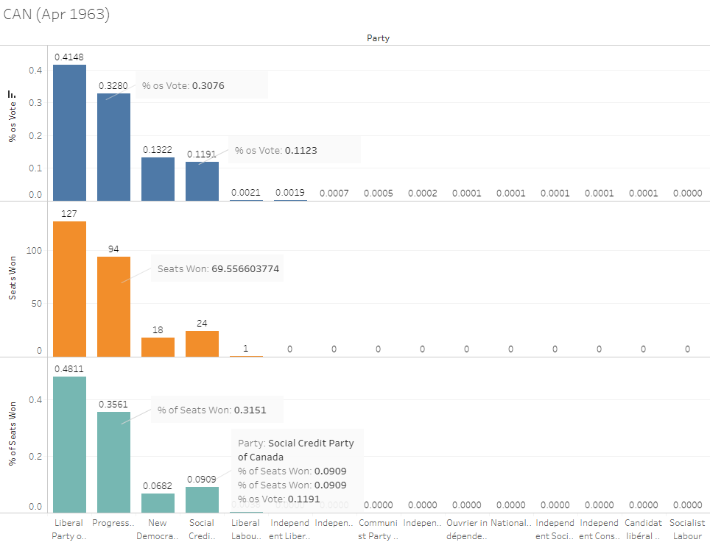

Slide 19
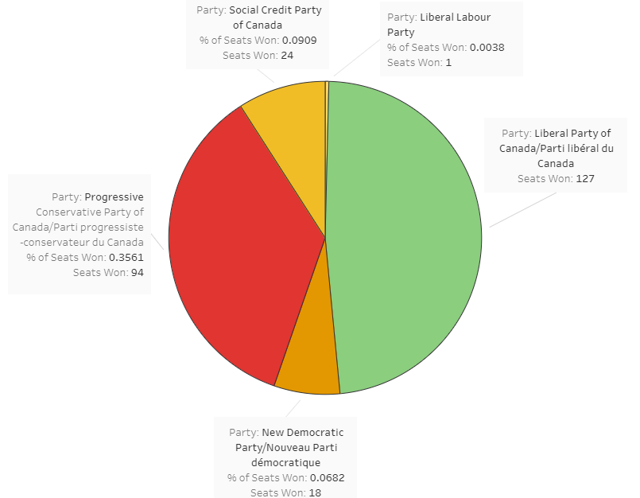
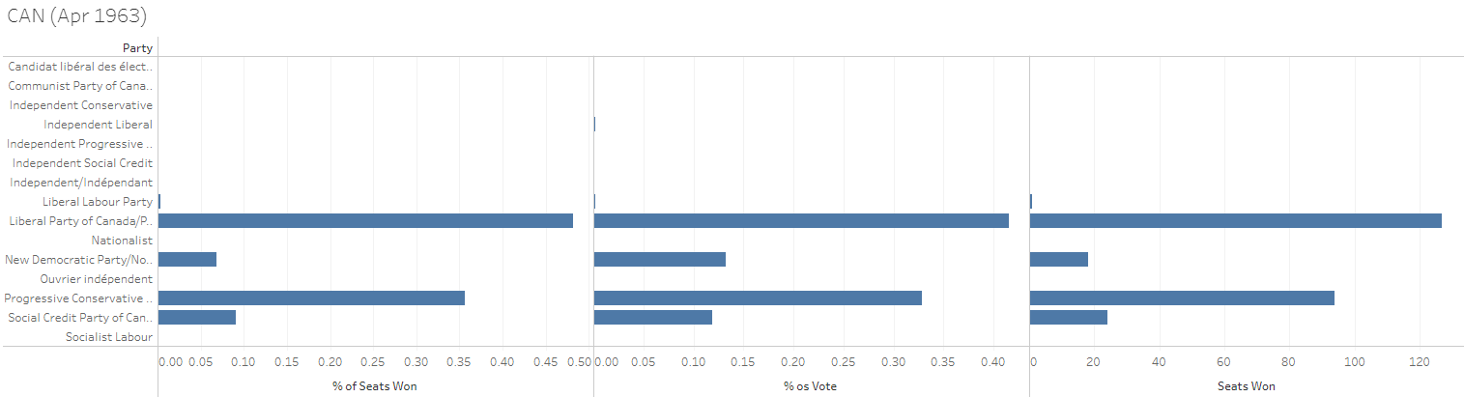
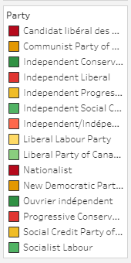

Slide 20
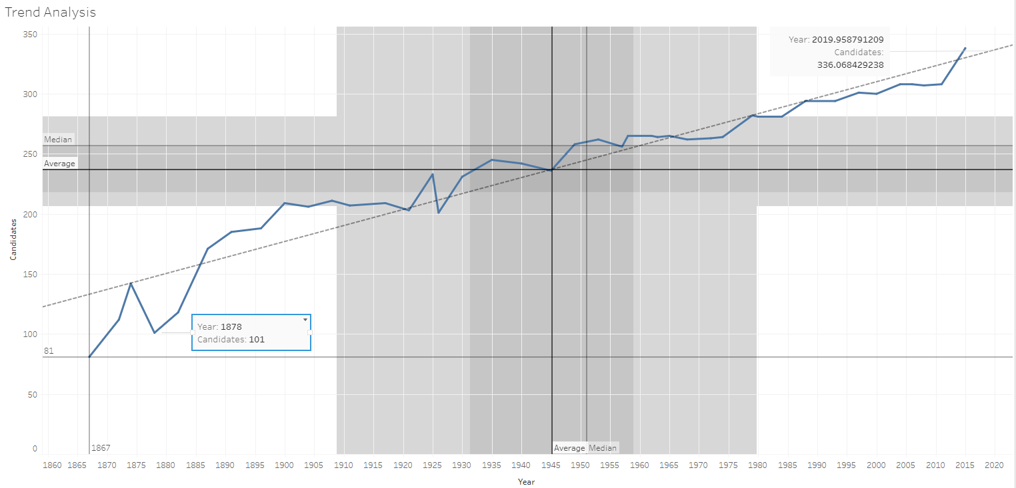

Slide 21
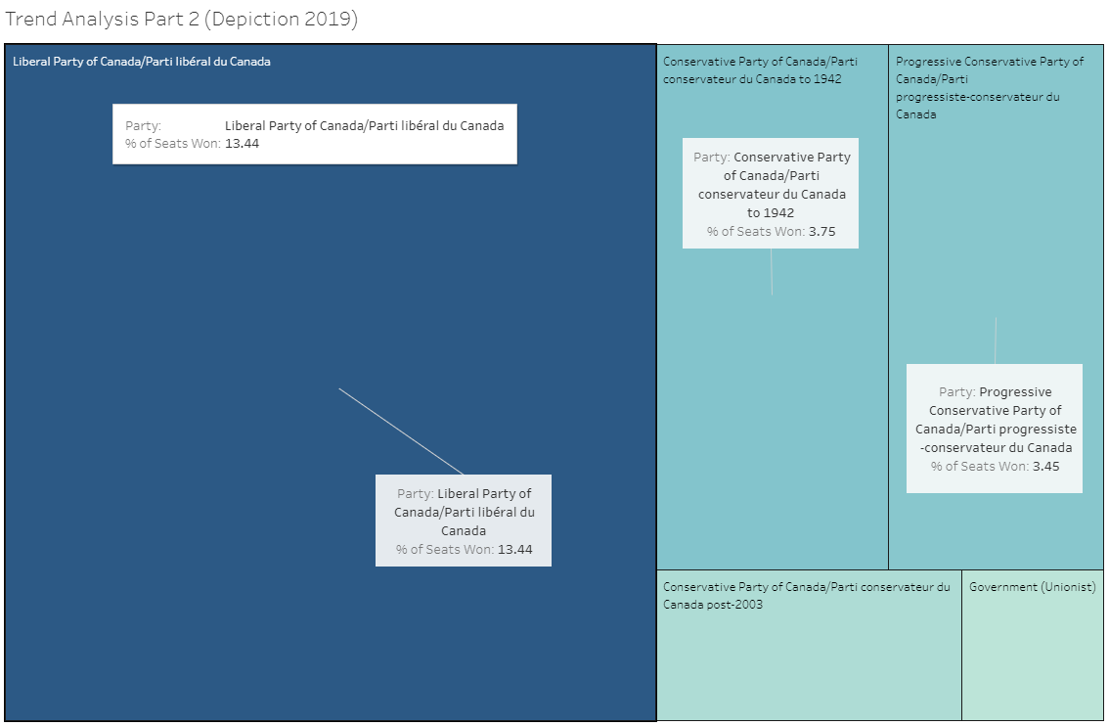

Slide 22
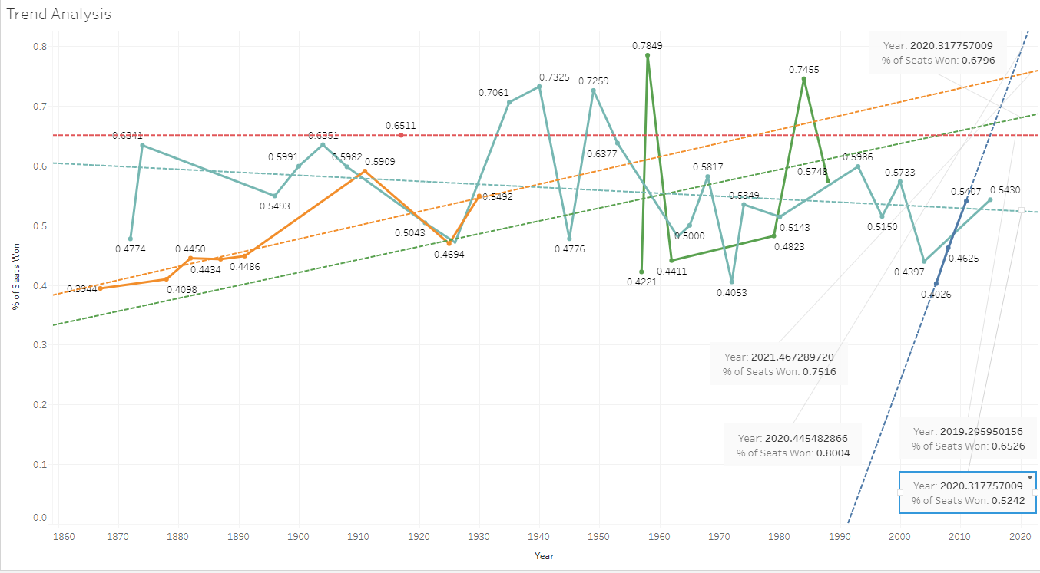
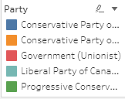

Slide 23
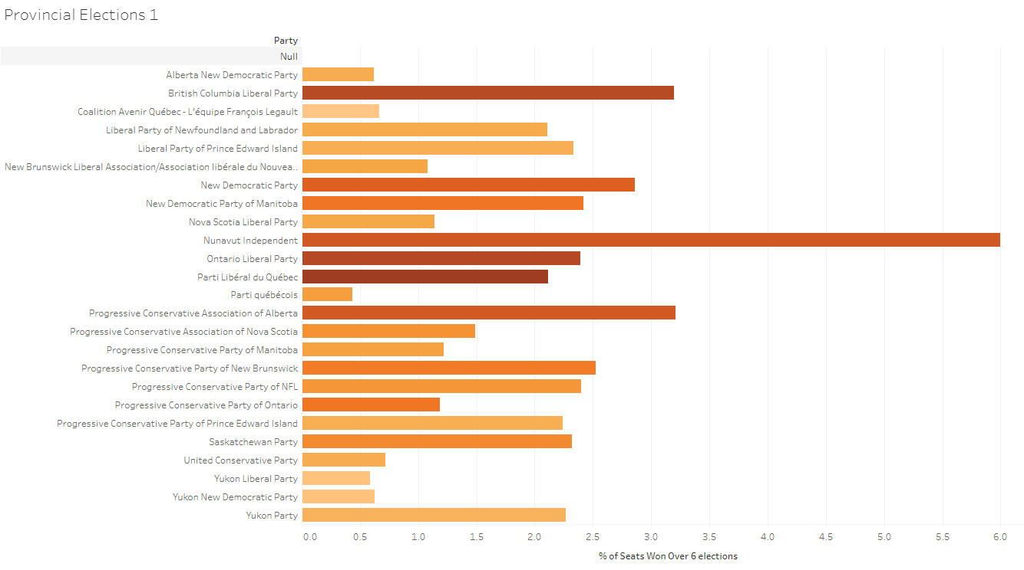

Slide 24
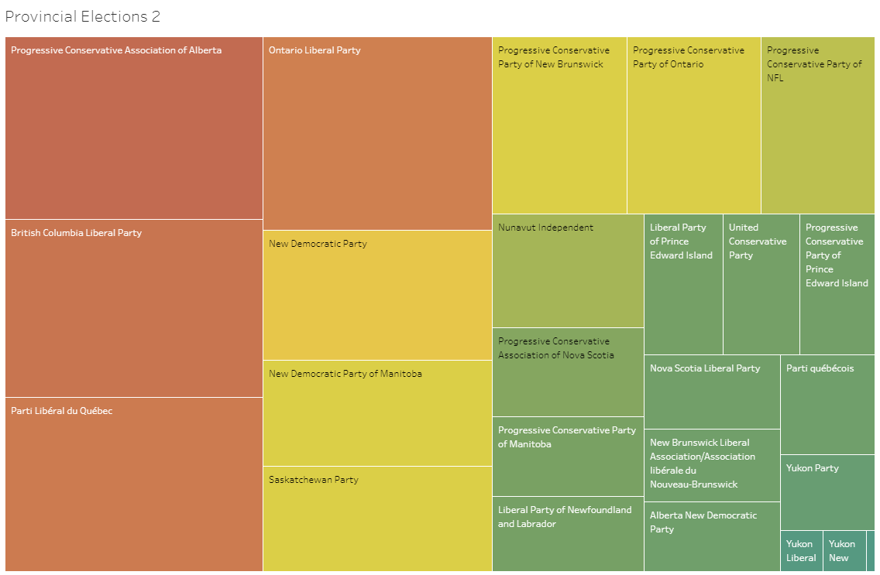

Slide 25


