Slide 1

Online Pharmacy store
Muhammad Ali 080
Muhammad Mutti Ur Rehman 085

Slide 2
Introduction of the system
In recent years, the healthcare industry has changed a lot in how we get medical help and medicines
Impact of digital technology and the internet
Shift in how individuals interact with pharmacies
Emergence of online pharmacy stores
Easy access to medications and healthcare products

Slide 3

Problem Statement
Challenges of Traditional Pharmacies
Limited operating hours
Long wait times
Requirement for physical visits
Impact of COVID-19 Pandemic
Highlighted importance of remote healthcare access
Solution: The Online Pharmacy Store System
Digital platform bridging the gap
Making it easier, more convenient, and safer for patients to get what they need.

Slide 4

Business Objectives
Business Objectives:
Ensure patients can access medications and healthcare products easily
protect customer data
Generate revenue through online sales
Build Trust and Reputation
Improve Efficiency
Adapt to Market Trends
Provide 24/7 availability

Slide 5
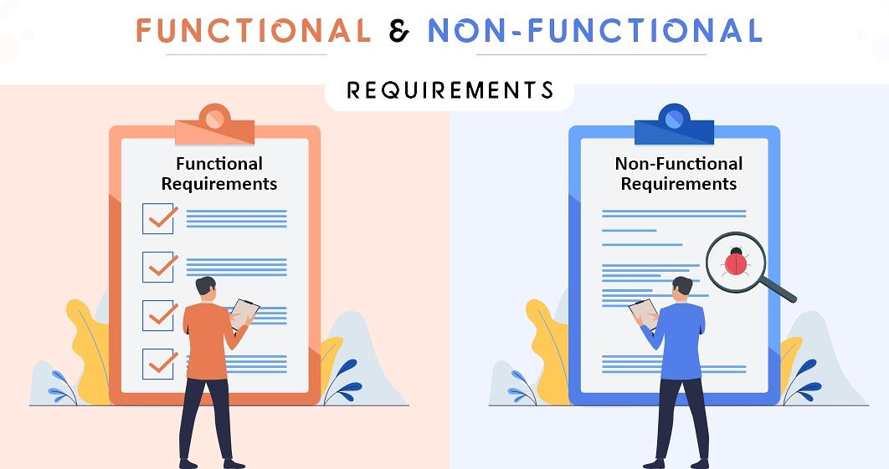
Preliminary Requirements
Functional Requirements:
User Registration and Authentication
Product Catalog
Medication Ordering
Health Information and Education
Order Tracking
Secure Payment Processing

Slide 6
Preliminary Requirements
NON-Functional Requirements:
Security: Protecting User Data up to 90%
Scalability: Handling Growth Smoothly up to 100%
Performance: Fast and Responsive up to 95%
User Experience: User-Friendly Design up to 95%

Slide 7

Schedule Estimate
Estimated Completion Time of Project:
The estimated project timeline is approximately 4 months, including the following phases:
Requirements gathering and analysis: 2 week
System design and architecture: 4 week
Development and testing: 4 week
Deployment: 3 week
Post-launch monitoring and optimization: Ongoing

Slide 8

Potential Risks and Mitigation Plan
Potential Risks:
Security Concerns
Market Competition
Regulatory Changes
Contingency Plans:
If there are major project delays: Activatation of an accelerated development plan.
In the event of unexpected security breaches:Initiation of a response and recovery plan.

Slide 9

Technologies Used
HTML
CSS
JAVASCRIPT
BOOTSTRAP
PHP MY SQL

