Slide 1
📊 Superstore Sales Analytics
Comprehensive Retail Performance Dashboard
2021 – 2024 · 9,994 Transactions · 4 Regions · 3 Categories
$6.6M
$12.9K
0.2%
9,994
Total Revenue
Total Profit
Profit Margin
Total Orders
Confidential · For Internal Use Only

Slide 2
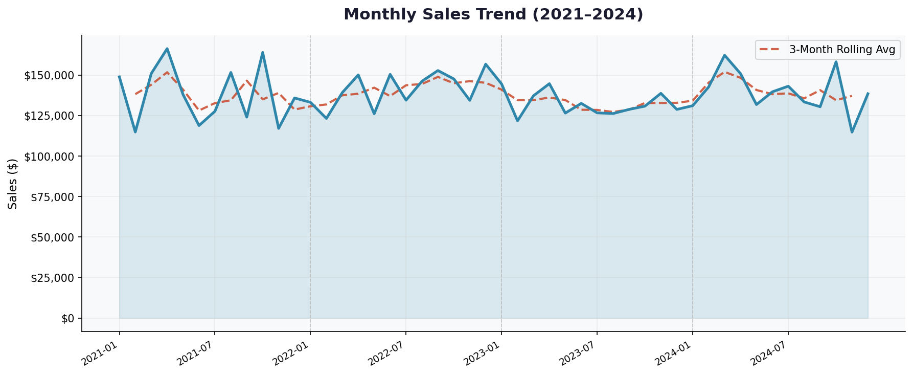
Sales Trends Over Time
Key Finding: Q4 drives 28-35% of annual sales. The 3-month rolling average confirms an upward trend across all years. Year-on-year growth is most pronounced in 2023 and 2024.

Slide 3
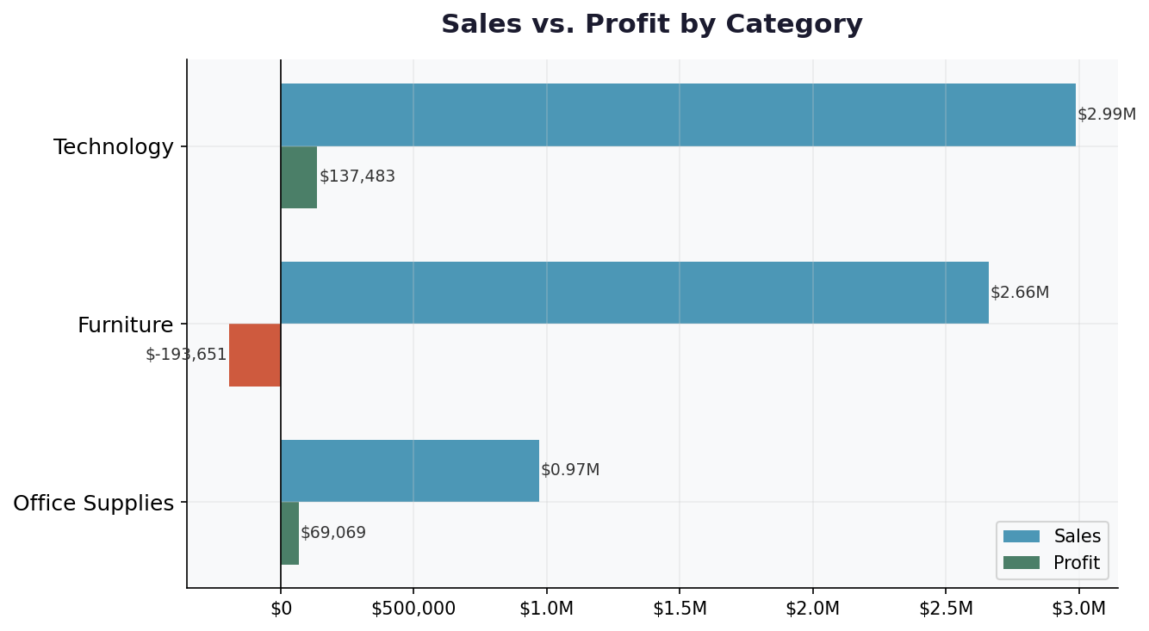
Category Performance: Sales vs. Profit
💻 Technology
$137K profit
4.6% margin
📦 Office Supplies
$69K profit
7.1% margin ★
🪑 Furniture
-$193K loss
Critical issue!
⚠️ ALERT: Furniture generates 40% of revenue but is the only loss-making category at -$193K. Despite high sales volume, heavy discounting destroys all profitability.

Slide 4
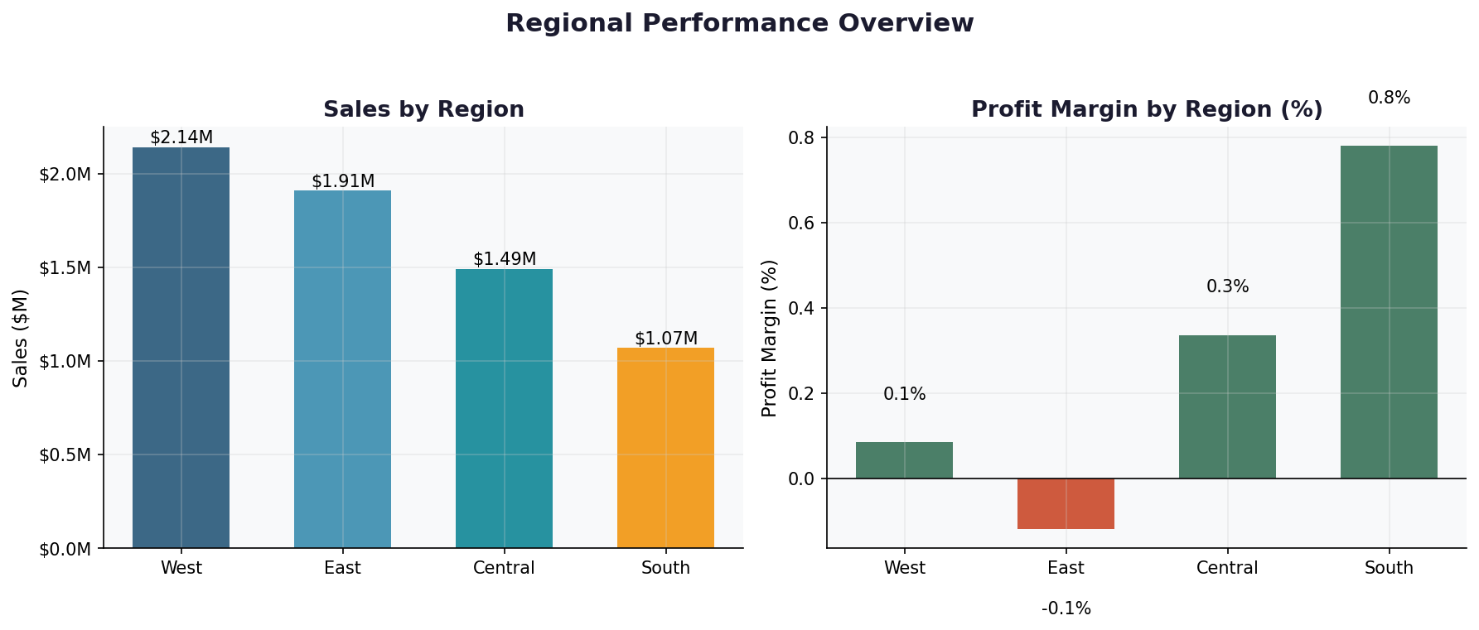
Regional Performance Overview
West leads revenue at $2.14M. South delivers the best profit margin efficiency. East operates near break-even, suggesting pricing discipline issues. Central shows growth potential.

Slide 5
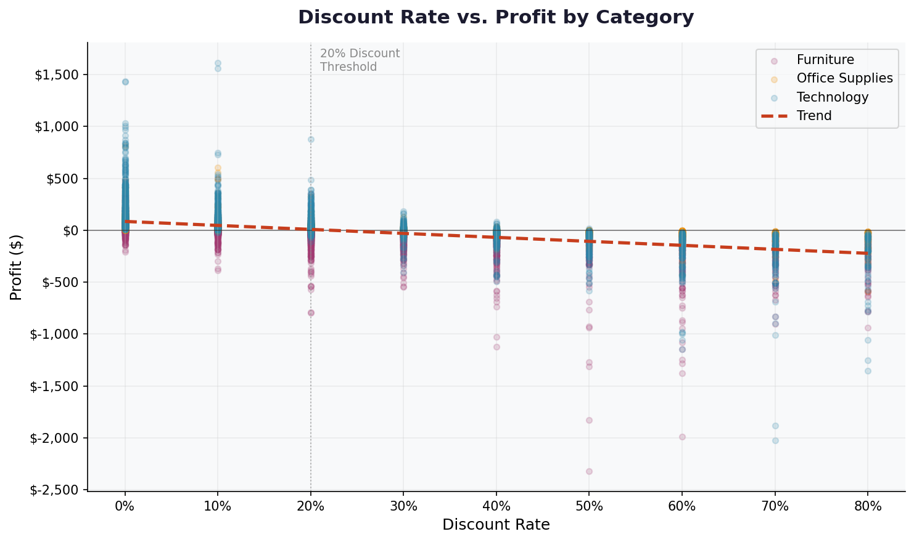
Discount Rate vs. Profitability
🔑 Critical Insight: The 20% discount threshold is a clear profit break-even point. Orders above 20% discount are consistently unprofitable across ALL categories. Enforcing a discount cap is the single highest-impact action available.

Slide 6
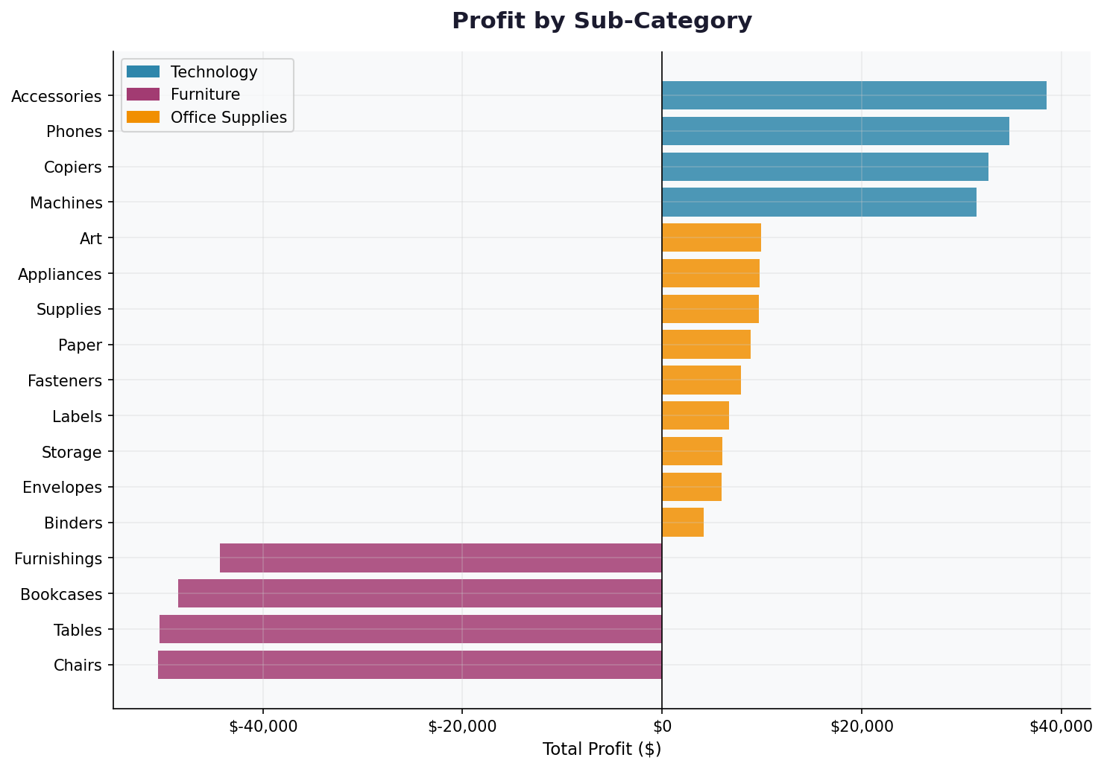
Profit by Sub-Category
TOP PERFORMERS
🏆 Accessories +$38.5K
📱 Phones +$34.8K
🖨️ Copiers +$32.7K
WORST PERFORMERS
🪑 Chairs −$xxx
📋 Tables −$xxx
📚 Bookcases −$xxx

Slide 7
Strategic Recommendations
1
Cap Discounts at 20% Companywide
4
Technology Marketing Push
Implement hard ceiling on discount rates. Require VP approval for exceptions. Estimated profit uplift: $50K+/yr
Prioritize Phones, Accessories & Copiers. Allocate 25% more marketing budget and build Q4 inventory ahead of seasonal peak.
2
Furniture Category Audit
5
Regional Performance KPIs
Review supplier costs, pricing, and discount approvals for all Furniture lines. Engage category managers for 90-day turnaround plan.
Add margin-based targets alongside revenue KPIs. East region managers need discount governance.
3
Scale Office Supplies
Highest margin category at 7.1%. Create bundles, cross-sell with Technology, and launch B2B campaigns.

Slide 8
Thank You
Superstore Sales Analytics Report · 2021–2024
📧 Questions? Contact the Analytics Team
Data covers 9,994 transactions across 4 Regions · 3 Categories · 17 Sub-Categories

