Slide 1
CSE 471: MACHINE LEARNING
Learning from Examples

Slide 2
Outline
Forms of learning
Decision trees
Model Selection and Optimization
The Theory of Learning
Linear Regression and Classification
Nonparametric Models
Ensemble Learning
Developing Machine Learning Systems

Slide 3
Machine Learning
A computer program is said to learn from
  experience E (not in traditional algorithm e.g. Dijkstra algorithm)
with respect to some class of
  task T and performance measure P if its
  performance at tasks in T
  as measured by P
  improves with experience E (not in traditional algorithm)

Slide 4
Material to cover in next 6 weeks
Book
  Artificial Intelligence A Modern Approach (4th Edition)
    Stuart J. Russell and Peter Norvig
Chapters
  Probabilistic Reasoning (Chapter 13)
  Probabilistic Reasoning over Time (Chapter 14)
  Learning from Examples (Chapter 19)
  Learning Probabilistic Models (Chapter 21)
  Reinforcement Learning (Chapter 23)

Slide 5
Learning from Examples
Supervised Learning
  Labeled observations
  Classification vs. Regression
Unsupervised Learning
  Unlabeled observations
  Clustering
Notes:
Going from a specific set of observations to a general rule is called induction. The inductive conclusions may be incorrect,

Slide 6
Learning from Examples
Reinforcement Learning
  Reward & punishment scheme
  Example: Learning from a chess game
    Win → Reward
    Loss → Punishment
    Agent itself determines what actions were fruitful!
Notes:
Going from a specific set of observations to a general rule is called induction. The inductive conclusions may be incorrect,

Slide 7
Datasets & Validations
Datasets
  Training set
  Validation set
  Test set
Validations
  Validation Test
  K-fold cross validation Test
  Independent Test

Slide 8
The hypothesis space (H)
How do we choose a hypothesis space
  Prior knowledge
  Exploratory data analysis
    Visualizations
      histograms
      scatter plots
      Box plots
      Etc.
Consistent Hypothesis
  Gives correct answer for the data point

Slide 9
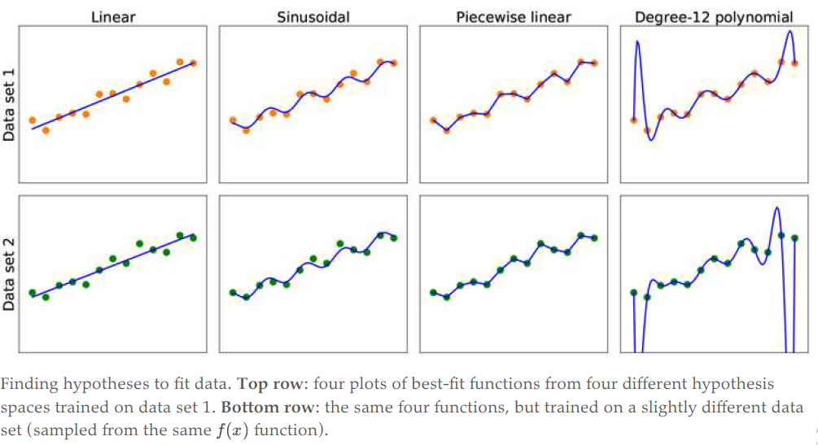
The hypothesis space (H)
Notes:
Discuss generalization and overfitting
Bias and variance of a hypothesis
Bias often results from restrictions imposed by the hypothesis space. (Underfitting)
variance means the amount of change in the hypothesis due to fluctuation in the training data (Overfitting)
Bias-variance tradeoff
Ockham’s razor

Slide 10
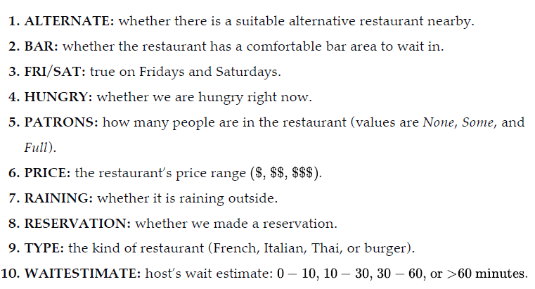
Example: Will we wait for a table?

Slide 11
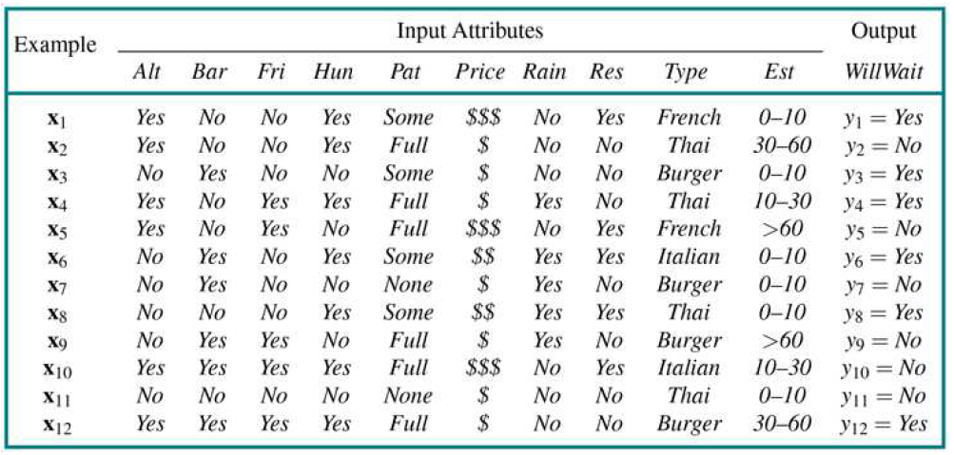
Will we wait for a table?

Slide 12
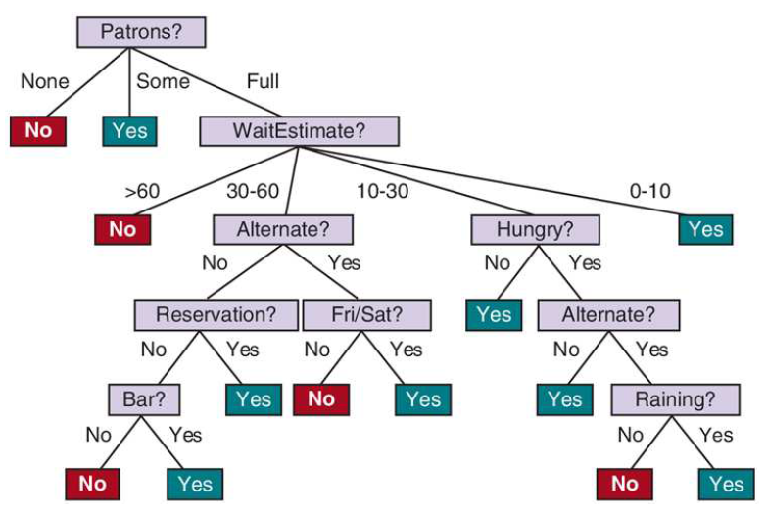
Will we wait for a table?

Slide 13
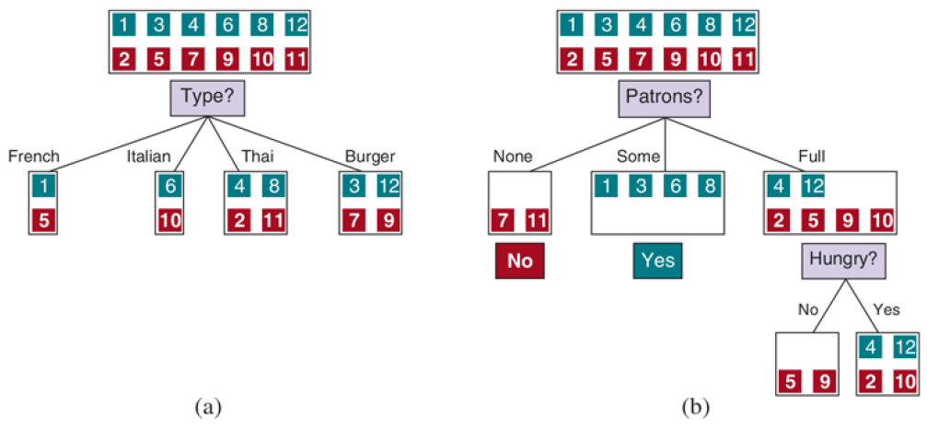
How to select the best attribute?

Slide 14
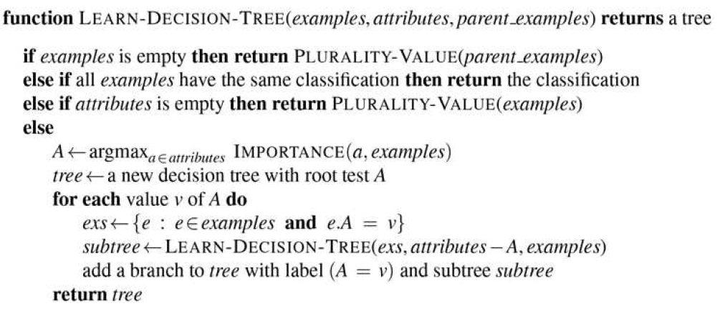
Decision tree algorithm
Notes:
The function IMPORTANCE is described later.
The function PLURALITY-VALUE selects the most common output value among a set of examples, breaking ties randomly.

Slide 15
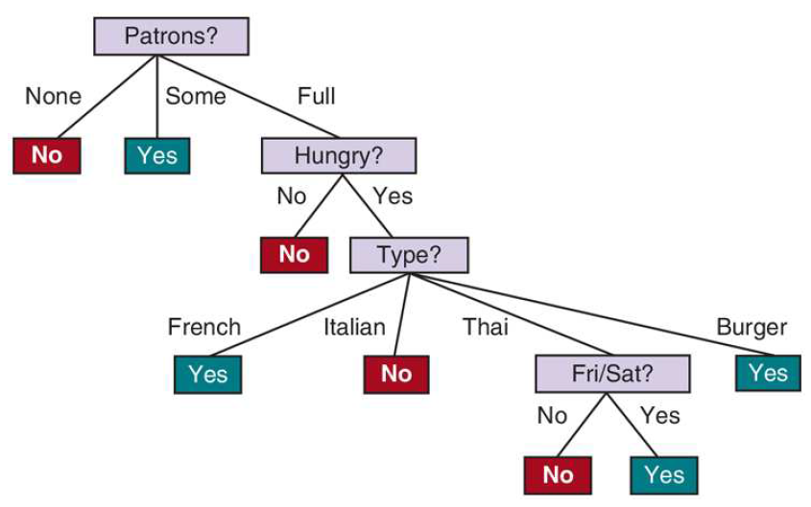
The resulting tree
Notes:
The tree is different than the input tree, this is fine.
The learnt hypothesis is not only consistent with all the examples, but is considerably simpler than the original tree!

Slide 16
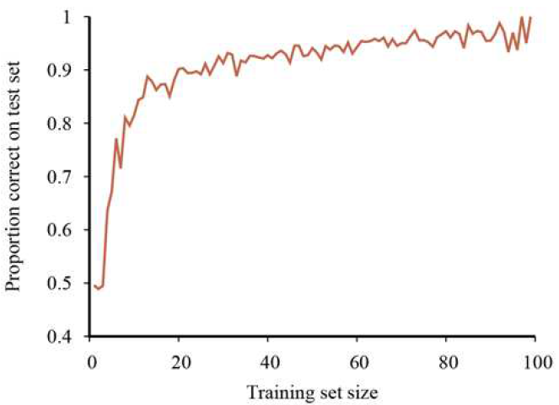
The learning curve
Notes:
A learning curve for the decision tree learning algorithm on 100 randomly generated examples in the restaurant domain.
Each data point is the average of 20 trials.

Slide 17
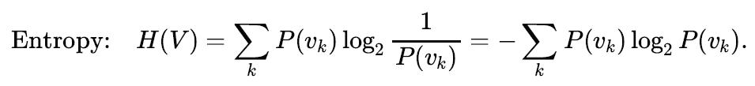
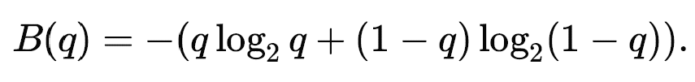

Choosing attribute tests
B(q) is the entropy of a Boolean random variable
that is true with probability q
The entropy of the output variable
on the whole set

Slide 18
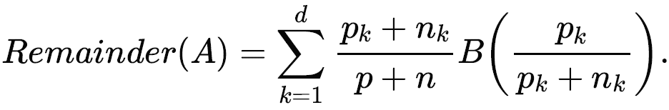
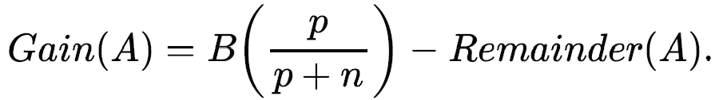
Choosing attribute tests
Information Gain

Slide 19
Performance Metrics
Accuracy,
Sensitivity (Recall)
Specificity
Precision
F1-score
MCC
Etc.

Slide 20

Confusion Matrix
Predicted Class
 | WillWait = True | WillWait = False
WillWait = True | 4 (TP) | 2 (FN)
WillWait = False | 3 (FP) | 3 (TN)
https://en.wikipedia.org/wiki/Confusion_matrix

Slide 21
Useful Resources
Learning From Data (MOOC @ CALTECH)
  Prof. Yaser Abu-Mostafa
Machine Learning (Coursera Course)
  Prof. Andrew Ng
Essence of Linear Algebra
  Grant Sanderson (3Blue1Brown)
Practice and Compete at Kaggle
Learn Python

