Slide 1
Bank Marketing (Campaign)
I have done final project individually
Name : Mohammad Aminian
Email: aminanmuhamad24@gmail.com
Country : Iran
College/Company : Tehran Kharazmi University
Specialization : Data Science

Slide 2
Problem description
ABC Bank wants to sell it's term deposit product to customers and before launching the product they want to develop a model which help them in understanding whether a particular customer will buy their product or not (based on customer's past interaction with bank or other Financial Institution).

Slide 3
Business understanding
ABC Bank wants to get clear undrestanding of its customers and predict customers response
By analyzing their features.find the customers who are more likely to subscribe to term deposits.

Slide 4
Project lifecycle
1) Business Understanding
2) Data Acquisition
3) Data Cleaning
4) EDA Perfomed on Data
5) EDA presentation for business users
6) Model Building
7) Final Report and Code

Slide 5
Data Intake report
Bank-additional-full.csv
Total number of observations | 41188
Total number of files | 1
Total number of features | 21
Base format of the file | csv
Size of the data | 4.7MB

Slide 6
Data understanding
ABC Bank wants to get clear undrestanding of its customers and predict customers response
By analyzing their features.find the customers who are more likely to subscribe to term deposits.

Slide 7
Data understanding
There are 4 Data sets Provided in links:
bank-additional-full.csv with 41188 rows and 20 columns that is our desired data set to do EDA with.
bank-additional.csv
bank-full.csv
bank.csv

Slide 8
Data understanding
Data set columns are:
1 - age (numeric)
2 - job : type of job (categorical: 'admin.','blue-
collar','entrepreneur','housemaid','management','retired','self-
employed','services','student','technician','unemployed','unknown')
3 - marital : marital status (categorical: 'divorced','married','single','unknown'; note: 'divorced'
means divorced or widowed)
4 - education (categorical:
'basic.4y','basic.6y','basic.9y','high.school','illiterate','professional.course','university.degree','
unknown')
5 - default: has credit in default? (Categorical: 'no','yes','unknown')
6 - housing: has housing loan? (Categorical: 'no','yes','unknown')
7 - loan: has personal loan? (categorical: 'no','yes','unknown')
# related with the last contact of the current campaign:
8 - contact: contact communication type (categorical: 'cellular','telephone')

Slide 9
Data understanding
9 - month: last contact month of year (categorical: 'jan', 'feb', 'mar', ..., 'nov', 'dec')
10 - day_of_week: last contact day of the week (categorical: 'mon','tue','wed','thu','fri')
11 - duration: last contact duration, in seconds (numeric). Important note: this attribute highly
affects the output target (e.g., if duration=0 then y='no'). Yet, the duration is not known
before a call is performed. Also, after the end of the call y is obviously known. Thus, this
input should only be included for benchmark purposes and should be discarded if the
intention is to have a realistic predictive model.
# other attributes:
12 - campaign: number of contacts performed during this campaign and for this client
(numeric, includes last contact)
13 - pdays: number of days that passed by after the client was last contacted from a
previous campaign (numeric; 999 means client was not previously contacted)
14 - previous: number of contacts performed before this campaign and for this client
(numeric)

Slide 10
Data understanding
15 - poutcome: outcome of the previous marketing campaign (categorical:
'failure','nonexistent','success')
# social and economic context attributes
16 - emp.var.rate: employment variation rate - quarterly indicator (numeric)
17 - cons.price.idx: consumer price index - monthly indicator (numeric)
18 - cons.conf.idx: consumer confidence index - monthly indicator (numeric)
19 - euribor3m: euribor 3 month rate - daily indicator (numeric)
20 - nr.employed: number of employees - quarterly indicator (numeric)
Output variable (desired target):
21 - y - has the client subscribed a term deposit? (Binary: 'yes','no')

Slide 11
Data understanding
The data doesnt have any missing values.
Some columns have outlires that we get dive into them in EDA in next weeks(This is Our method for overcome problems like NA value, outlier).
The data is in CSV format.

Slide 12

Exploratory Data Analysis
Bank Marketing(Campaign)
11-Dec-2021

Slide 13
Bank Marketing
● I have done final project individually
● Name : Mohammad Aminian
● Email: aminanmuhamad24@gmail.com
● Country : Iran
● College/Company : Tehran Kharazmi University
● Specialization : Data Science

Slide 14
Data Exploration
ABC Bank wants to sell it's term deposit product to customers and before launching the product they want to develop a model which help them in understanding whether a particular customer will buy their product or not (based on customer's past interaction with bank or other Financial Institution).
Bank wants to use ML model to shortlist customer whose chances of buying the product is more so that their marketing channel (tele marketing, SMS/email marketing etc) can focus only to those customers whose chances of buying the product is more.
This will save resource and their time ( which is directly involved in the cost ( resource billing)).
Develop model with Duration and without duration feature and report the performance of the model.
Duration feature is not recommended as this will be difficult to explain the result to business and also it will
be difficult for business to campaign based on duration.

Slide 15
Data Exploration
Input variables:
# bank client data:
1 - age (numeric)
2 - job : type of job (categorical: 'admin.','blue-collar','entrepreneur','housemaid','management','retired','self-employed','services','student','technician','unemployed','unknown')
3 - marital : marital status (categorical: 'divorced','married','single','unknown'; note: 'divorced' means divorced or widowed)
4 - education (categorical: 'basic.4y','basic.6y','basic.9y','high.school','illiterate','professional.course','university.degree','unknown')
5 - default: has credit in default? (categorical: 'no','yes','unknown')
6 - housing: has housing loan? (categorical: 'no','yes','unknown')
7 - loan: has personal loan? (categorical: 'no','yes','unknown')
# related with the last contact of the current campaign:
8 - contact: contact communication type (categorical: 'cellular','telephone')

Slide 16
Data Exploration
9 - month: last contact month of year (categorical: 'jan', 'feb', 'mar', ..., 'nov', 'dec')
10 - day_of_week: last contact day of the week (categorical: 'mon','tue','wed','thu','fri')c)
11 - duration: last contact duration, in seconds (numeric). Important note: this attribute highly affects the output target (e.g., if duration=0 then y='no')
# other attributes:
12 - campaign: number of contacts performed during this campaign and for this client (numeric, includes last contact)
13 - pdays: number of days that passed by after the client was last contacted from a previous campaign (numeric; 999 means client was not previously contacted)
14 - previous: number of contacts performed before this campaign and for this client (numeric)
15 - poutcome: outcome of the previous marketing campaign (categorical: 'failure','nonexistent','success')

Slide 17
Data Exploration
# social and economic context attributes
16 - emp.var.rate: employment variation rate - quarterly indicator (numeric)
17 - cons.price.idx: consumer price index - monthly indicator (numeric)
18 - cons.conf.idx: consumer confidence index - monthly indicator (numeric)
19 - euribor3m: euribor 3 month rate - daily indicator (numeric)
20 - nr.employed: number of employees - quarterly indicator (numeric)
Output variable (desired target):
21 - y - has the client subscribed a term deposit? (binary: 'yes','no')

Slide 18
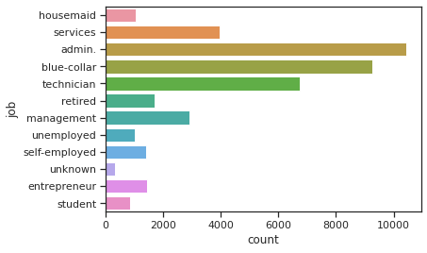
Profit Analysis
Categorical EDA
As we see in graph
most of the customers
that have jobs as "admin",
"blue-collar" or "technician"
We see how many people
Work as each job as well in
Chart.

Slide 19
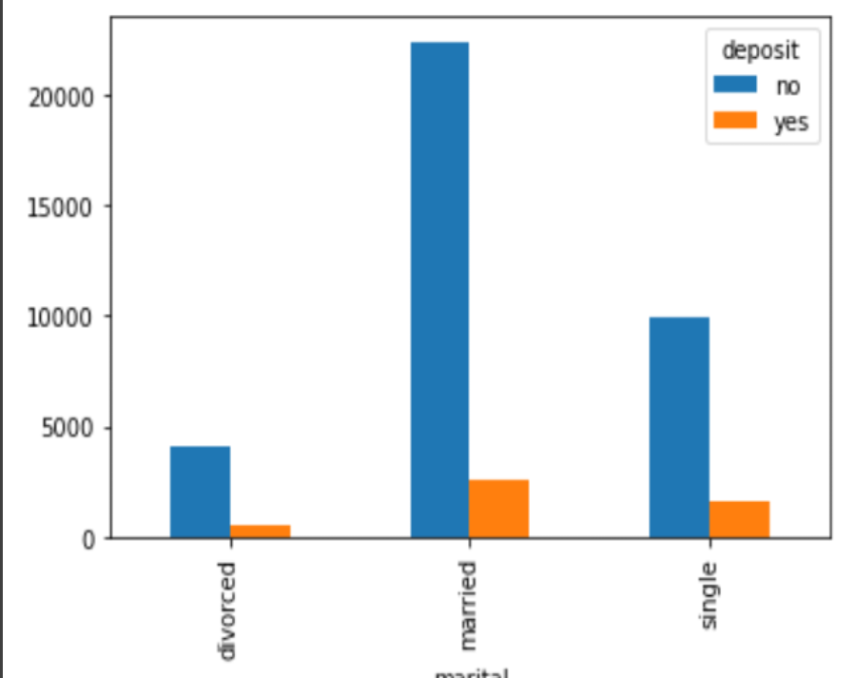
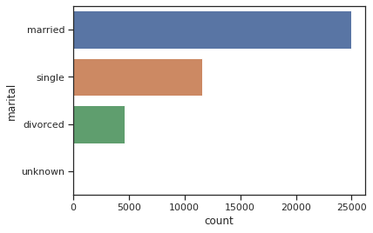
Profit Analysis
Categorical EDA
Effect of Marital on deposit
Possiblity.
Very few percent of marrital is
Unknown.
We also see the most of customers contacted were married.

Slide 20
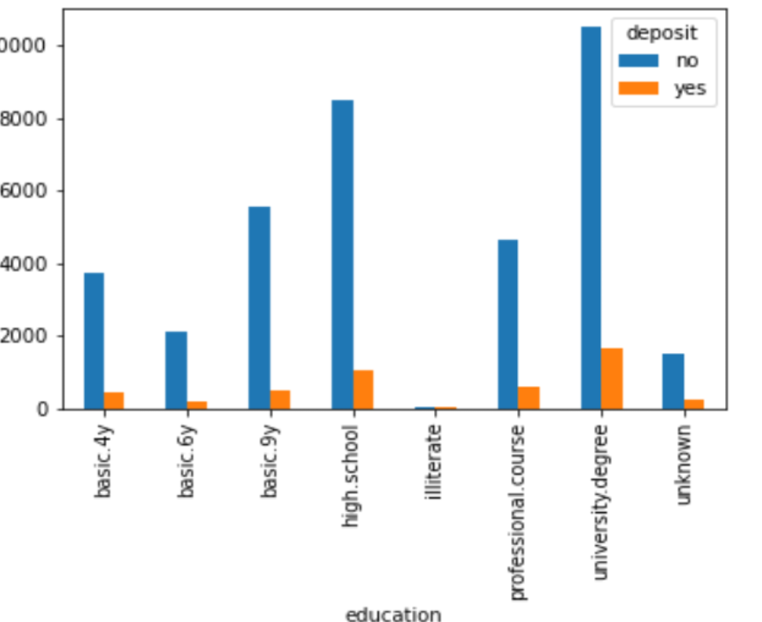
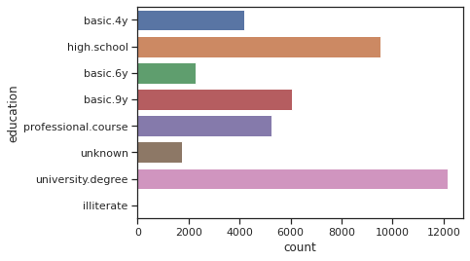
Profit Analysis
Categorical EDA
Effect of Education on deposit
Possiblity.
People with university degree have most deposit in each yes,no situation.

Slide 21
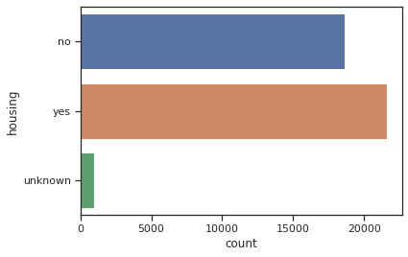
Profit Analysis
Categorical EDA
People who have housing loan contacted more.
About 1000 people have unknown housing.
And people have no housing are aboot 18000-19000 that is pretty much.

Slide 22
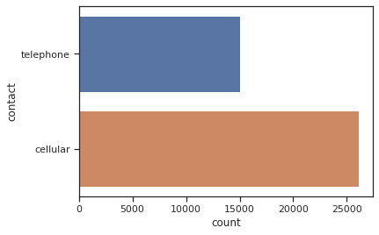
Profit Analysis
Categorical EDA
Most pepole contacted in cellular as it has been shown
In image.about 1.4x of telephone.

Slide 23
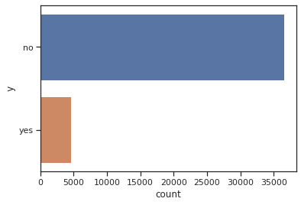
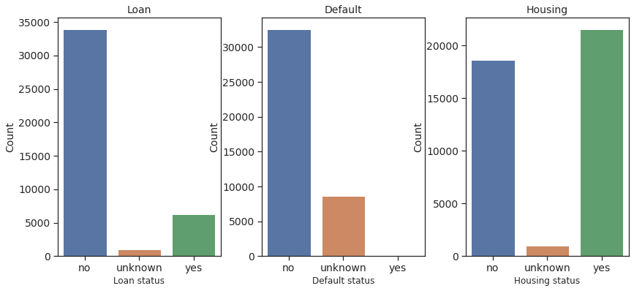
Profit Analysis
Categorical EDA

Slide 24
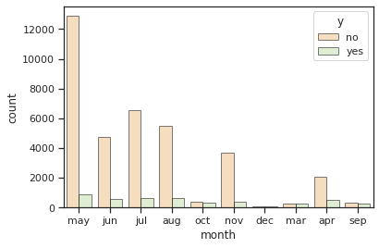
Profit Analysis
Categorical EDA
People are being
contacted the most in
the month of May.more
People subscribed in may too.
Very few people contacted on
December.
Also people weren’t contacted
On jan,feb.

Slide 25
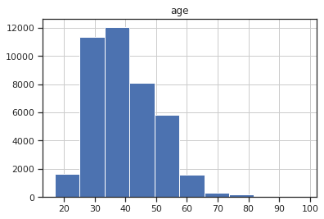
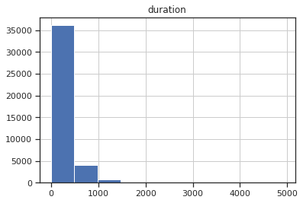
Profit Analysis
Numerical EDA

Slide 26
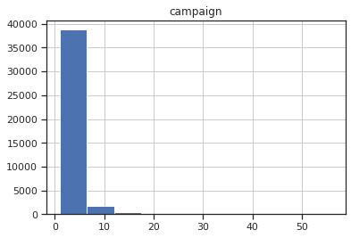
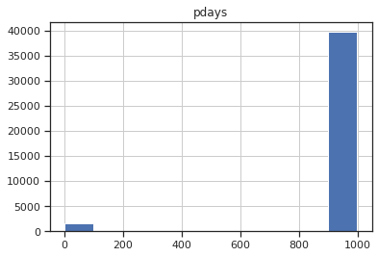
Profit Analysis
Numerical EDA

Slide 27
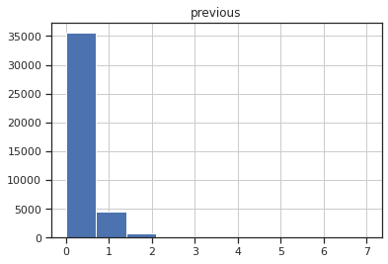
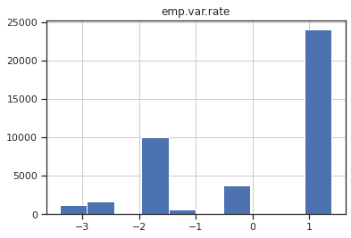
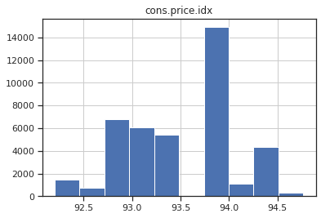
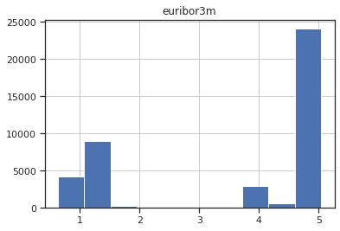
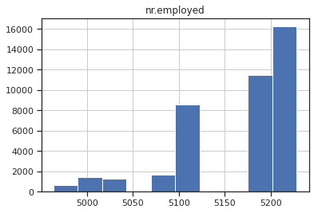
Profit Analysis
Numerical EDA

Slide 28
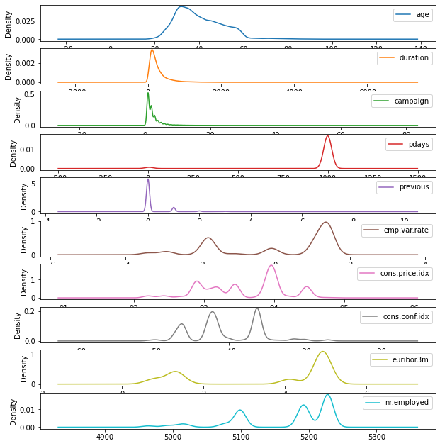
Profit Analysis
Numerical EDA
All Numerical Variable density Chart

Slide 29
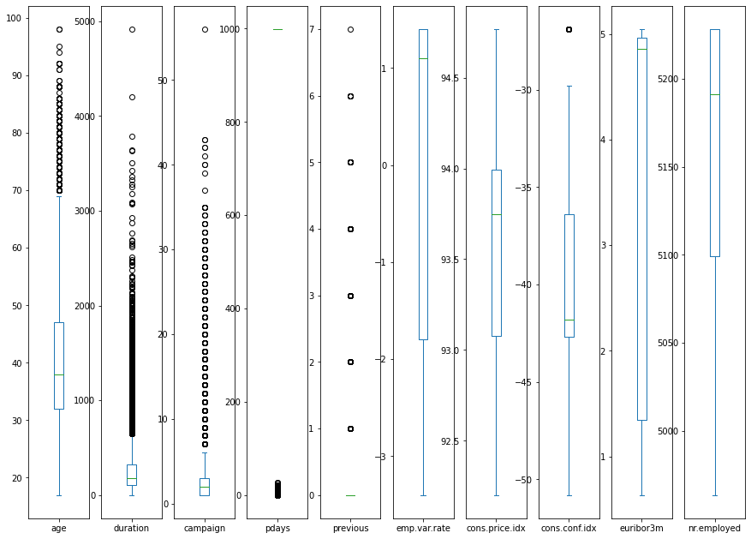
Profit Analysis
Numerical EDA
All Numerical Variables
Box plot

Slide 30
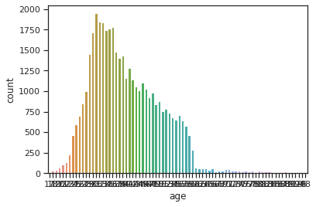
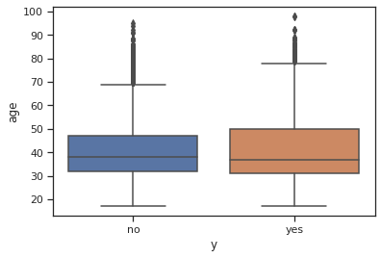
Profit Analysis
Numerical EDA
Majority of People are between age 35-40.

Slide 31
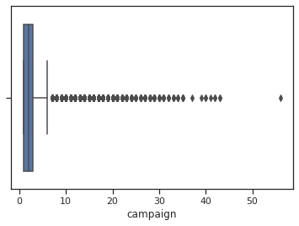
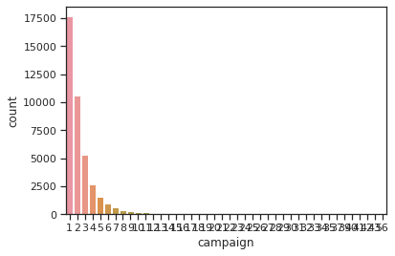
Profit Analysis
Numerical EDA

Slide 32
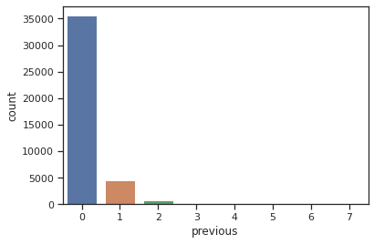
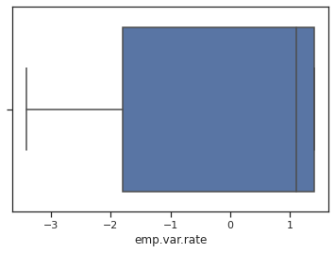
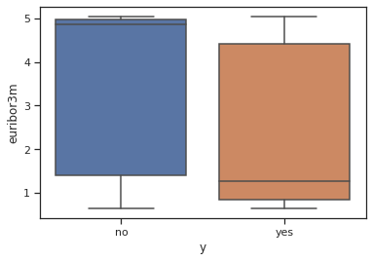
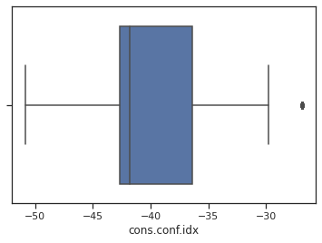
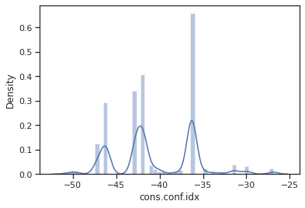
Profit Analysis
Numerical EDA

Slide 33
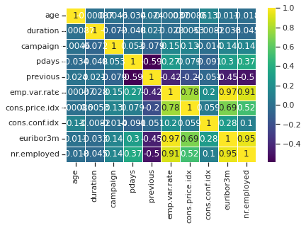
Profit Analysis
Numerical EDA
Emp.var. Rate, euribor3m,
nr.employedand cons.price.idx
have higher correlation

Slide 34
Profit Analysis
RECOMMENDED MODELS
1-Logistic Regression
2-XGboos
3-Decition Tree
4-Random Forest
5-SVM

Slide 35

Thank You

Slide 36
Thank You

