Slide 1

Oracle Database Architecture
An Oracle server:
Is a database management system that provides an open, comprehensive, integrated approach to information management
Consists of an Oracle instance and an Oracle database
Notes:
Oracle Database Architecture
The Oracle server is the key to information management. In general, an Oracle server must reliably manage a large amount of data in a multiuser environment so that many users can concurrently access the same data. All this must be accomplished while delivering high performance. An Oracle server must also prevent unauthorized access and provide efficient solutions for failure recovery.

Slide 2

Database Structures
Memory structures
Instance
System Global Area (SGA)
Process structures
Background processes
Storage structures
Database files
Notes:
Database Structures
Each running Oracle database is associated with an Oracle instance. When a database is started on a database server, the Oracle software allocates a shared memory area called the System Global Area (SGA) and starts several Oracle background processes. This combination of the SGA and the Oracle processes is called an Oracle instance.
After starting an instance, the Oracle software associates the instance with a specific database. This is called mounting the database. The database is then ready to be opened, which makes it accessible to authorized users. Multiple instances can execute concurrently on the same computer, each accessing its own physical database.
You can look at the Oracle database architecture as various interrelated structural components.
An Oracle database uses memory structures and processes to manage and access the database. All memory structures exist in the main memory of the computers that constitute the database server. Processes are jobs that work in the memory of these computers. A process is defined as a “thread of control” or a mechanism in an operating system that can run a series of steps.

Slide 3
Physical Database Structure .
Control files
Data files
Online redo log files
Parameter file
Archive log files
Backup files
Password file
Alert and trace log files
Notes:
Physical Database Structure
The files that constitute an Oracle database are organized into the following:
Control files: Contain data about the database itself (that is, physical database structure information). These files are critical to the database. Without them, you cannot open data files to access the data within the database.
Data files: Contain the user or application data of the database
Online redo log files: Allow for instance recovery of the database. If the database crashes and does not lose any data files, then the instance can recover the database with the information in these files.
The following additional files are important to the successful running of the database:
Parameter file: Is used to define how the instance is configured when it starts up
Password file: Allows users to connect remotely to the database and perform administrative tasks
Backup files: Are used for database recovery. You typically restore a backup file when a media failure or user error has damaged or deleted the original file.
Archive log files: Contain an ongoing history of the data changes (redo) that are generated by the instance. Using these files and a backup of the database, you can recover a lost data file. That is, archive logs enable the recovery of restored data files.

Slide 4
Files of a database
A data file is a physical file on disk that was created by Oracle Database and contains data structures such as tables and indexes.
A control file contains information such as the following: the database name, information about data files, online redo log files, tablespace information, etc.
The online redo log is a set of files containing records of changes made to data files. Online redo log is the most crucial structure for recovery.
Alert log is a file that provides a chronological log of database messages and errors.

Slide 5
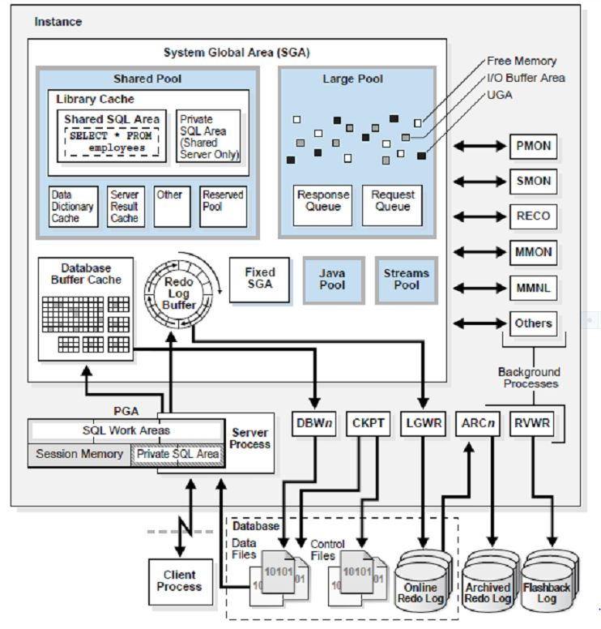

Slide 6
Data Dictionary Views
 | Who Can Query | Contents | Subset of | Notes
DBA_ | DBA | Everything | N/A | May have additional columns meant for DBA use only
ALL_ | Everyone | Everything that the user has privileges to see | DBA_ views | Includes user’s own objects
USER_ | Everyone | Everything that the user owns | ALL_ views | Is usually the same as ALL_ except for the missing OWNER column. Some views have abbreviated names as PUBLIC synonyms.
Notes:
Data Dictionary Views
The view prefixes indicate what or how much data a given user can see. The global view of everything is accessed only by users with DBA privileges, using the DBA_ prefix. The next level of privilege is at the ALL_ prefix level, which represents all objects that the querying user is privileged to see, whether he or she owns them or not. For example, if USER_A has been granted access to a table owned by USER_B, then USER_A sees that table listed in any ALL_ view dealing with table names. The USER_ prefix represents the smallest scope of visibility. This shows only those objects that the querying user owns; that is, those that are present in his or her own schema.

Slide 7
Data Dictionary: Usage Examples
SELECT table_name, tablespace_name FROM user_tables;
a
SELECT sequence_name, min_value, max_value, increment_by FROM all_sequences WHERE sequence_owner IN ('MDSYS','XDB');
b
c
SELECT USERNAME, ACCOUNT_STATUS FROM
dba_users WHERE ACCOUNT_STATUS = 'OPEN';
d
DESCRIBE dba_indexes;
Notes:
Static Data Dictionary: Usage Examples
The examples in the slide show queries that answer these questions:
a. What are the names of the tables (along with the name of the tablespace where they reside) that have been created in your schema?
b. What is the significant information about any sequences in the database that you have access to?
c. What users in this database are currently able to log in?
d. What are the columns of the DBA_INDEXES view? This shows you what information you can view about all the indexes in the database. The following is a partial output of this command:
SQL> DESCRIBE dba_indexes;
Name Null? Type
--------------- -------- -------------
OWNER NOT NULL VARCHAR2(30)
INDEX_NAME NOT NULL VARCHAR2(30)
INDEX_TYPE VARCHAR2(27)
TABLE_OWNER NOT NULL VARCHAR2(30)
TABLE_NAME NOT NULL VARCHAR2(30)

Slide 8



What Is a Schema?
owns
HR schema
HR user
Notes:
What Is a Schema?
A schema is a collection of database objects that are owned by a particular user. Typically, for a production database, this user does not represent a person, but an application. A schema has the same name as the user that owns the schema. Schema objects are the logical structures that directly refer to database’s data. Schema objects include structures such as tables, views, and indexes.
You can create and manipulate schema objects by using SQL or Enterprise Manager. When you use Enterprise Manager, the underlying SQL is generated for you.
Note: A schema does not necessarily have to be directly related to a single tablespace. You can define configurations such that objects in a single schema can be in different tablespaces, and a tablespace can hold objects from different schemas.

Slide 9
Schema Objects
In Oracle Database, a database schema is a collection of logical data structures, or schema objects. A database schema is owned by a database user and has the same name as the username.

Slide 10

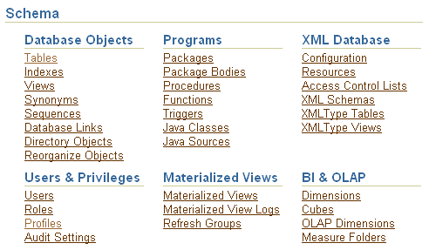
Accessing Schema Objects
Notes:
Accessing Schema Objects
You can quickly access many types of schema objects from the Schema region of the Database Administration page.
After clicking one of the links, the Results page is displayed. In the Search region of the page, you can enter a schema name and object name to search for a specific object. In addition, you can search for other types of objects from the Search region by selecting the object type from the drop-down list. The drop-down list includes additional object types that are not shown as links on the Database Administration page.

Slide 11
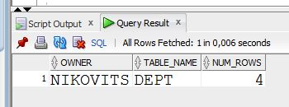
Tables
CREATE TABLE dept
(deptno NUMBER(2), dname VARCHAR2(42), loc VARCHAR2(39));
SELECT owner, table_name, num_rows
FROM DBA_TABLES
WHERE owner='NIKOVITS' AND table_name='DEPT';
(!) ANALYZE TABLE DEPT COMPUTE STATISTICS;
(!) ANALYZE TABLE DEPT DELETE STATISTICS;
Notes:
Sequences
To retrieve the next value from a sequence, you reference it by its name; there is no association of a sequence to a table or a column.
After a given number is issued, it will not be issued again, unless the sequence is defined as cyclical. Sometimes an application requests a value it never ends up using or storing in the database. This may result in gaps in the numbers that reside in the table that they are being stored into.
Caching of sequence numbers improves performance because a set of numbers is preallocated in memory for faster access. If there is an instance failure, any cached sequence numbers are not used, which results in gaps.
Note: If an application requires that there be no gaps, then the application should implement a custom number generator. However, this method can result in very poor performance. If you use a table to store a value, and increment that value and update the table for each request, that process would be a systemwide bottleneck. This is because every session would have to wait for that mechanism, which, to guarantee no duplicates or gaps, can handle only a single request at a time.

Slide 12
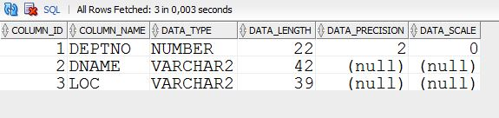
Tables
CREATE TABLE dept
(deptno NUMBER(2), dname VARCHAR2(42), loc VARCHAR2(39));
SELECT column_id, column_name, data_type, data_length, data_precision, data_scale
FROM DBA_TAB_COLUMNS
WHERE owner='NIKOVITS' AND table_name='DEPT';
Notes:
Sequences
To retrieve the next value from a sequence, you reference it by its name; there is no association of a sequence to a table or a column.
After a given number is issued, it will not be issued again, unless the sequence is defined as cyclical. Sometimes an application requests a value it never ends up using or storing in the database. This may result in gaps in the numbers that reside in the table that they are being stored into.
Caching of sequence numbers improves performance because a set of numbers is preallocated in memory for faster access. If there is an instance failure, any cached sequence numbers are not used, which results in gaps.
Note: If an application requires that there be no gaps, then the application should implement a custom number generator. However, this method can result in very poor performance. If you use a table to store a value, and increment that value and update the table for each request, that process would be a systemwide bottleneck. This is because every session would have to wait for that mechanism, which, to guarantee no duplicates or gaps, can handle only a single request at a time.

Slide 13

Views
CREATE VIEW v1 AS
SELECT deptno, AVG(sal) AvgSal FROM emp GROUP BY deptno;
SELECT view_name, text
FROM DBA_VIEWS
WHERE owner='NIKOVITS' AND view_name='V1';
Notes:
Sequences
To retrieve the next value from a sequence, you reference it by its name; there is no association of a sequence to a table or a column.
After a given number is issued, it will not be issued again, unless the sequence is defined as cyclical. Sometimes an application requests a value it never ends up using or storing in the database. This may result in gaps in the numbers that reside in the table that they are being stored into.
Caching of sequence numbers improves performance because a set of numbers is preallocated in memory for faster access. If there is an instance failure, any cached sequence numbers are not used, which results in gaps.
Note: If an application requires that there be no gaps, then the application should implement a custom number generator. However, this method can result in very poor performance. If you use a table to store a value, and increment that value and update the table for each request, that process would be a systemwide bottleneck. This is because every session would have to wait for that mechanism, which, to guarantee no duplicates or gaps, can handle only a single request at a time.

Slide 14

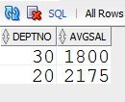
Synonyms
CREATE SYNONYM syn1 FOR v1;
SELECT * FROM DBA_SYNONYMS
WHERE owner='NIKOVITS' AND synonym_name='SYN1';
SELECT * FROM syn1 WHERE deptno > 10;
Notes:
Sequences
To retrieve the next value from a sequence, you reference it by its name; there is no association of a sequence to a table or a column.
After a given number is issued, it will not be issued again, unless the sequence is defined as cyclical. Sometimes an application requests a value it never ends up using or storing in the database. This may result in gaps in the numbers that reside in the table that they are being stored into.
Caching of sequence numbers improves performance because a set of numbers is preallocated in memory for faster access. If there is an instance failure, any cached sequence numbers are not used, which results in gaps.
Note: If an application requires that there be no gaps, then the application should implement a custom number generator. However, this method can result in very poor performance. If you use a table to store a value, and increment that value and update the table for each request, that process would be a systemwide bottleneck. This is because every session would have to wait for that mechanism, which, to guarantee no duplicates or gaps, can handle only a single request at a time.

Slide 15

Sequences
A sequence is a mechanism for automatically generating integers that follow a pattern.
A sequence has a name, which is how it is referenced when the next value is requested.
A sequence is not associated with any particular table or column.
The progression can be ascending or descending.
The interval between numbers can be of any size.
A sequence can cycle when a limit is reached.
1
2
3
4
5
Notes:
Sequences
To retrieve the next value from a sequence, you reference it by its name; there is no association of a sequence to a table or a column.
After a given number is issued, it will not be issued again, unless the sequence is defined as cyclical. Sometimes an application requests a value it never ends up using or storing in the database. This may result in gaps in the numbers that reside in the table that they are being stored into.
Caching of sequence numbers improves performance because a set of numbers is preallocated in memory for faster access. If there is an instance failure, any cached sequence numbers are not used, which results in gaps.
Note: If an application requires that there be no gaps, then the application should implement a custom number generator. However, this method can result in very poor performance. If you use a table to store a value, and increment that value and update the table for each request, that process would be a systemwide bottleneck. This is because every session would have to wait for that mechanism, which, to guarantee no duplicates or gaps, can handle only a single request at a time.

Slide 16

Sequences
CREATE SEQUENCE seq1
MINVALUE 1 MAXVALUE 100 INCREMENT BY 5
START WITH 50 CYCLE;
SELECT * FROM DBA_SEQUENCES
WHERE sequence_name='SEQ1';
Notes:
Sequences
To retrieve the next value from a sequence, you reference it by its name; there is no association of a sequence to a table or a column.
After a given number is issued, it will not be issued again, unless the sequence is defined as cyclical. Sometimes an application requests a value it never ends up using or storing in the database. This may result in gaps in the numbers that reside in the table that they are being stored into.
Caching of sequence numbers improves performance because a set of numbers is preallocated in memory for faster access. If there is an instance failure, any cached sequence numbers are not used, which results in gaps.
Note: If an application requires that there be no gaps, then the application should implement a custom number generator. However, this method can result in very poor performance. If you use a table to store a value, and increment that value and update the table for each request, that process would be a systemwide bottleneck. This is because every session would have to wait for that mechanism, which, to guarantee no duplicates or gaps, can handle only a single request at a time.

Slide 17
Using a Sequence
Next value from sequence:
INSERT INTO dept VALUES(seq1.NEXTVAL, 'IT', 'Budapest');
Current value from sequence:
INSERT INTO emp(deptno, empno, ename, job, sal)
VALUES(seq1.CURRVAL, 1, 'Tailor', 'SALESMAN', 100);
Current value from sequence:
INSERT INTO emp(deptno, empno, ename, job, sal)
VALUES(seq1.CURRVAL, 2, 'Sailor', 'SALESMAN', 200);
Notes:
Sequences
To retrieve the next value from a sequence, you reference it by its name; there is no association of a sequence to a table or a column.
After a given number is issued, it will not be issued again, unless the sequence is defined as cyclical. Sometimes an application requests a value it never ends up using or storing in the database. This may result in gaps in the numbers that reside in the table that they are being stored into.
Caching of sequence numbers improves performance because a set of numbers is preallocated in memory for faster access. If there is an instance failure, any cached sequence numbers are not used, which results in gaps.
Note: If an application requires that there be no gaps, then the application should implement a custom number generator. However, this method can result in very poor performance. If you use a table to store a value, and increment that value and update the table for each request, that process would be a systemwide bottleneck. This is because every session would have to wait for that mechanism, which, to guarantee no duplicates or gaps, can handle only a single request at a time.

Slide 18
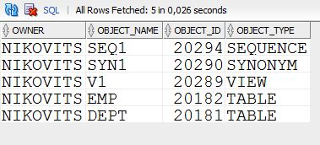
ANY Object
SELECT owner, object_name, object_id, object_type
FROM DBA_OBJECTS
WHERE owner='NIKOVITS‚ and created > sysdate - 1;
Notes:
Sequences
To retrieve the next value from a sequence, you reference it by its name; there is no association of a sequence to a table or a column.
After a given number is issued, it will not be issued again, unless the sequence is defined as cyclical. Sometimes an application requests a value it never ends up using or storing in the database. This may result in gaps in the numbers that reside in the table that they are being stored into.
Caching of sequence numbers improves performance because a set of numbers is preallocated in memory for faster access. If there is an instance failure, any cached sequence numbers are not used, which results in gaps.
Note: If an application requires that there be no gaps, then the application should implement a custom number generator. However, this method can result in very poor performance. If you use a table to store a value, and increment that value and update the table for each request, that process would be a systemwide bottleneck. This is because every session would have to wait for that mechanism, which, to guarantee no duplicates or gaps, can handle only a single request at a time.

