Slide 1
How Table Data Is Stored
A datafile with records
 | KING … | 5000 | … 10
 | MILLER … | 1300 | … 10
10 | ACCOUNTING | NEW YORK
← EMP record
← EMP record
← DEPT record
SELECT SUM(sal) FROM EMP NATURAL JOIN DEPT
WHERE dname=’ACCOUNTING’;
Notes:
How Table Data Is Stored
When a table is created, a segment is created to hold its data. A tablespace contains a collection of segments. Logically, a table contains rows of column values. A row is ultimately stored in a database block in the form of a row piece. It is called a row piece because under some circumstances the entire row may not be stored in one place. This happens when an inserted row is too large to fit into a single block or when an update causes an existing row to outgrow its current space.

Slide 2
Physical Database Structure .
Control files
Data files
Online redo log files
Parameter file
Archive log files
Backup files
Password file
Alert and trace log files
Notes:
Physical Database Structure
The files that constitute an Oracle database are organized into the following:
Control files: Contain data about the database itself (that is, physical database structure information). These files are critical to the database. Without them, you cannot open data files to access the data within the database.
Data files: Contain the user or application data of the database
Online redo log files: Allow for instance recovery of the database. If the database crashes and does not lose any data files, then the instance can recover the database with the information in these files.
The following additional files are important to the successful running of the database:
Parameter file: Is used to define how the instance is configured when it starts up
Password file: Allows users to connect remotely to the database and perform administrative tasks
Backup files: Are used for database recovery. You typically restore a backup file when a media failure or user error has damaged or deleted the original file.
Archive log files: Contain an ongoing history of the data changes (redo) that are generated by the instance. Using these files and a backup of the database, you can recover a lost data file. That is, archive logs enable the recovery of restored data files.

Slide 3
Tablespaces and Data Files
Tablespaces consist of one or more data files.
Data files belong to only one tablespace.
Data file 1
Data file 2
USERS tablespace
Notes:
Tablespaces and Data Files
A database is divided into logical storage units called tablespaces, which can be used to group related logical structures together. Each database is logically divided into one or more tablespaces. One or more data files are explicitly created for each tablespace to physically store the data of all logical structures in a tablespace.
Note: You can also create the bigfile tablespaces, which are tablespaces with a single but very large (up to 4 billion data blocks) data file. The traditional smallfile tablespaces (which are the default) can contain multiple data files, but the files cannot be as large. For more information about the bigfile tablespaces, see the Database Administrator’s Guide.

Slide 4
SYSTEM and SYSAUX Tablespaces
The SYSTEM and SYSAUX tablespaces are mandatory tablespaces.
They are created at the time of database creation.
They must be online.
The SYSTEM tablespace is used for core functionality (for example, data dictionary tables).
The auxiliary SYSAUX tablespace is used for additional database components (such as the Enterprise Manager Repository).
Notes:
SYSTEM and SYSAUX Tablespaces
Each Oracle database contains a SYSTEM tablespace and a SYSAUX tablespace. They are automatically created when the database is created. The system default is to create a smallfile tablespace. You can also create bigfile tablespaces, which enable the Oracle database to manage ultralarge files (up to 8 exabytes).
A tablespace can be online (accessible) or offline (not accessible). The SYSTEM tablespace is always online when the database is open. It stores tables that support the core functionality of the database, such as the data dictionary tables.
The SYSAUX tablespace is an auxiliary tablespace to the SYSTEM tablespace. The SYSAUX tablespace stores many database components, and it must be online for the correct functioning of all database components.

Slide 5
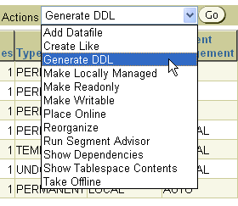
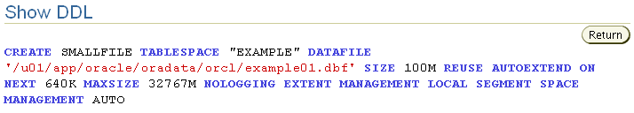
Actions with Tablespaces
Notes:
Actions with Tablespaces
Using the Actions menu, you can perform a variety of tasks with your tablespaces. Select a tablespace and then the action that you want to perform:
Add Datafile: Adds a data file to the tablespace, which makes the tablespace larger
Create Like: Creates another tablespace by using the tablespace as a template
Generate DDL: Generates the data definition language (DDL) statement that creates the tablespace. This can then be copied and pasted into a text file for use as a script or for documentation purposes.
Make Locally Managed: Converts the tablespace to locally managed if the tablespace is currently dictionary managed. This conversion is only one way; you cannot convert the tablespace back to dictionary managed.
Make Readonly: Stops all writes to the tablespace. Current transactions are allowed to complete, but no new DML or other write activities are allowed to start on the tablespace. This appears only if the tablespace is currently not read-only.
Make Writable: Allows DML and other write activities to be initiated on objects in the tablespace. This appears only if the tablespace is currently not writable.

Slide 6
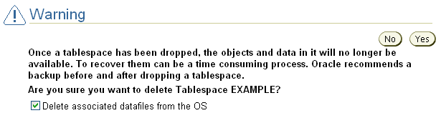
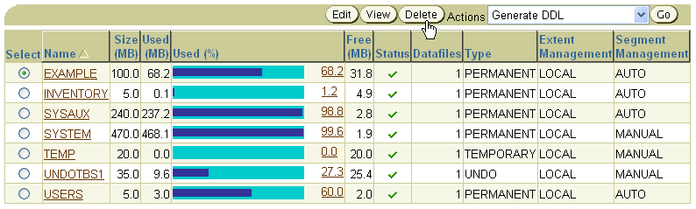
Dropping Tablespaces
Notes:
Dropping Tablespaces
You can drop a tablespace and its contents (the segments contained in the tablespace) from the database if the tablespace and its contents are no longer required. You must have the DROP TABLESPACE system privilege to drop a tablespace.
When you drop a tablespace, the file pointers in the control file of the associated database are removed. You can optionally direct the Oracle server to delete the operating system files (data files) that constitute the dropped tablespace. If you do not direct the Oracle server to delete the data files at the same time as it deletes the tablespace, you must later use the appropriate commands of your operating system if you want them to be deleted.
You cannot drop a tablespace that contains any active segments. For example, if a table in the tablespace is currently being used or the tablespace contains undo data that is needed to roll back uncommitted transactions, you cannot drop the tablespace. The tablespace can be online or offline, but it is best to take the tablespace offline before dropping it.

Slide 7

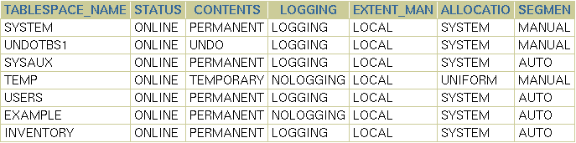
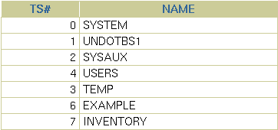
Viewing Tablespace Information
Notes:
Viewing Tablespace Information
Click View to see information about the selected tablespace. On the View Tablespace page, you can also click Edit to alter the tablespace.
Tablespace and data file information can also be obtained by querying the following:
Tablespace information:
DBA_TABLESPACES
V$TABLESPACE
Data file information:
DBA_DATA_FILES
V$DATAFILE
Temp file information:
DBA_TEMP_FILES
V$TEMPFILE

Slide 8




Segments, Extents, and Blocks
Segments exist within a tablespace.
Segments are made up of a collection of extents.
Extents are a collection of data blocks.
Data blocks are mapped to disk blocks.
Segment
Extents
Data blocks
Disk blocks
Notes:
Segments, Extents, and Blocks
Database objects, such as tables and indexes, are stored as segments in tablespaces. Each segment contains one or more extents. An extent consists of contiguous data blocks, which means that each extent can exist only in one data file. Data blocks are the smallest unit of I/O in the database.
When the database requests a set of data blocks from the operating system (OS), the OS maps this to an actual file system or disk block on the storage device. Because of this, you need not know the physical address of any of the data in your database. This also means that a data file can be striped or mirrored on several disks.
The size of the data block can be set at the time of the creation of the database. The default size of 8 KB is adequate for most databases. If your database supports a data warehouse application that has large tables and indexes, then a larger block size may be beneficial.
If your database supports a transactional application where reads and writes are random, then specifying a smaller block size may be beneficial. The maximum block size depends on your OS. The minimum Oracle block size is 2 KB and should rarely (if ever) be used.
You can have tablespaces with different block sizes. However, this should be used only for transportable tablespaces. For details, see the Database Administrator’s Guide.

Slide 9
Logical and Physical Database Structures
Logical
Physical
Database
Schema
Tablespace
Data file
Segment
Extent
Oracle data block
OS block
Notes:
Logical and Physical Database Structures
An Oracle database is a collection of data that is treated as a unit. The general purpose of a database is to store and retrieve related information. The database has logical structures and physical structures.
Tablespaces
A database is divided into logical storage units called tablespaces, which group related logical structures together. For example, tablespaces commonly group all of an application’s objects to simplify some administrative operations. You may have a tablespace for application data and an additional one for application indexes.
Databases, Tablespaces, and Data Files
The relationship among databases, tablespaces, and data files is illustrated in the slide. Each database is logically divided into one or more tablespaces. One or more data files are explicitly created for each tablespace to physically store the data of all logical structures in a tablespace. If it is a TEMPORARY tablespace, instead of a data file, then the tablespace has a temporary file.

Slide 10
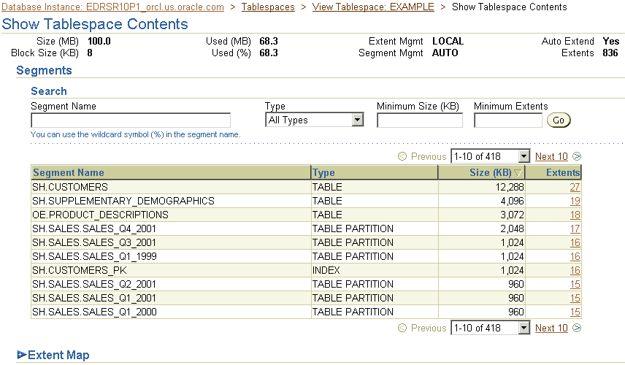
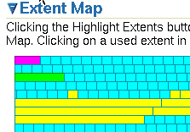

Viewing Tablespace Contents
12061_1_sel_ts_3
Notes:
Viewing Tablespace Contents
On the Show Tablespace Contents page, detailed information about the tablespace is displayed, including a list of the segments in the tablespace, the type of each segment, the segment size, and the number of extents that comprise each segment. Any of these four values can be used to sort the list by clicking the column header, or to filter the list by entering values in the Search region. For a dictionary-managed tablespace, additional columns are displayed:
Max Extents
Next
Percent Increase
To see a list of extents, click the link in the Extents column.
To view extents in a graphical way, expand the “Extent map” and move the cursor over individual extents. The following information is displayed:
Name of the segment the extent belongs to
Extent ID
Block ID
Extent size in blocks
Data file in which the extent is stored

Slide 11
How Table Data Is Stored
Columns
Blocks
Table A
Table B
Rows
Segment
Segment
Table
Tablespace
Row piece
Extent
Notes:
How Table Data Is Stored
When a table is created, a segment is created to hold its data. A tablespace contains a collection of segments. Logically, a table contains rows of column values. A row is ultimately stored in a database block in the form of a row piece. It is called a row piece because under some circumstances the entire row may not be stored in one place. This happens when an inserted row is too large to fit into a single block or when an update causes an existing row to outgrow its current space.

Slide 12
Anatomy of a Database Block
Block header
Growth
Free space
Row data
Notes:
Database Block: Contents
Oracle data blocks contain the following:
Block header: The block header contains the segment type (such as table or index), data block address, table directory, row directory, and transaction slots of size 23 bytes each, which are used when modifications are made to rows in the block. The block header grows downward from the top.
Row data: This is the actual data for the rows in the block. Row data space grows upward from the bottom.
Free space: Free space is in the middle of the block. This enables the header and the row data space to grow when necessary. Row data takes up free space as new rows are inserted or columns of existing rows are updated with larger values. The examples of events that cause header growth are when the row directory needs more row entries or more transaction slots are required than initially configured. Initially, the free space in a block is contiguous. However, deletions and updates may fragment the free space in the block. The free space in the block is coalesced by the Oracle server when necessary.

Slide 13
Tablespaces and Data Files
The Oracle database stores data logically in tablespaces and physically in data files.
Tablespaces:
Can belong to only one database
Consist of one or more data files
Are further divided into logical units of storage
Data files:
Can belong to only one tablespace and one database
Are a repository for schema object data
Database
Tablespace
Data files
Notes:
Tablespaces and Data Files
Databases, tablespaces, and data files are closely related but they have important differences:
An Oracle database consists of one or more logical storage units called tablespaces, which collectively store all the database’s data.
Each tablespace in an Oracle database consists of one or more files called data files, which are physical structures that conform to the operating system on which the Oracle software runs.
A database’s data is collectively stored in the data files that constitute each tablespace of the database. For example, the simplest Oracle database would have two tablespaces (the required SYSTEM and SYSAUX tablespaces), each with one data file. Another database can have three tablespaces, each consisting of two data files (for a total of six data files). A single database can potentially have as many as 65,534 data files.

Slide 14

Space Management in Tablespaces
Locally managed tablespace:
Free extents are managed in the tablespace.
A bitmap is used to record free extents.
Each bit corresponds to a block or group of blocks.
The bit value indicates free or used extents.
The use of locally managed tablespaces is recommended.
Dictionary-managed tablespace:
Free extents are managed by the data dictionary.
Appropriate tables are updated when extents are allocated or unallocated.
These tablespaces are supported only for backward compatibility.
Notes:
Space Management in Tablespaces
Tablespaces allocate space in extents. Tablespaces can be created to use one of the following two methods of keeping track of free and used space:
Locally managed tablespaces: The extents are managed within the tablespace via bitmaps. Each bit in the bitmap corresponds to a block or a group of blocks. When an extent is allocated or freed for reuse, the Oracle server changes the bitmap values to show the new status of the blocks.
Dictionary-managed tablespaces: The extents are managed by the data dictionary. The Oracle server updates the appropriate tables in the data dictionary whenever an extent is allocated or unallocated. This is for backward compatibility; it is recommended that you use locally managed tablespaces.

Slide 15
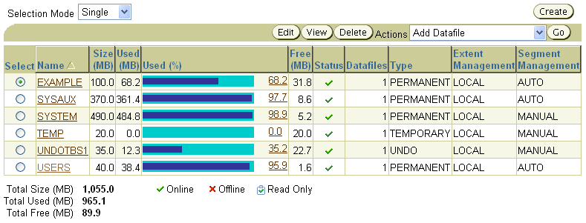
Tablespaces in the Preconfigured Database
SYSTEM
SYSAUX
TEMP
UNDOTBS1
USERS
EXAMPLE
Notes:
Tablespaces in the Preconfigured Database
The following tablespaces are created in the preconfigured database in this course:
SYSTEM: The SYSTEM tablespace is used by the Oracle server to manage the database. It contains the data dictionary and tables that contain administrative information about the database. These are all contained in the SYS schema and can be accessed only by the SYS user or other administrative users with the required privilege.
SYSAUX: This is an auxiliary tablespace to the SYSTEM tablespace. Some components and products that used the SYSTEM tablespace or their own tablespaces in earlier releases of the Oracle database, now use the SYSAUX tablespace. Every Oracle Database10g or later release must have a SYSAUX tablespace. In Enterprise Manager, you can see a pie chart of the contents of this tablespace. To do this, click Tablespaces on the Administration page. Select SYSAUX and click Edit. Then, click the Occupants tab. After creation, you can monitor the space usage of each occupant inside the SYSAUX tablespace by using EM. If you detect that a component is taking too much space in the SYSAUX tablespace, or if you anticipate that it will, you can move the occupant into a different tablespace by selecting one of the occupants and clicking Change Tablespace.

Slide 16

Enlarging the Database
You can enlarge the database in the following ways:
Creating a new tablespace
Adding a data file to an existing tablespace
Increasing the size of a data file
Providing for the dynamic growth of a data file
Database
SYSTEM
tablespace
INVENTORY
tablespace
Notes:
Enlarging the Database
These activities can be performed with Enterprise Manager or with SQL statements. In the end, the size of the database can be described as the sum of all of its tablespaces.

