Slide 1

WELCOME
2
Tableau Capstone Project
Thanks
about
4
Data_Source
5
6
1
1
1
3
Summary
DESIGNED BY Mohammad Dawood

Slide 2

Thanks
4
2
Data_Source
about
5
6
1
1
1
3
Summary
MESSAGE FROM
Mohammad Dawood
Hello Everyone. First of all Thank you very much for giving me this Precious Chance to Present my Tableau Capstone Project. Here I tried to analyze the Data of Covid-19 Pandemic…

Slide 3
Why we need to analyze Covid-19 Dataset?
In March 2020, WHO declared Covid-19 a pandemic, caused by the Novel-SARS-COV-2 virus. Soon a outbreak of Covid-19 started effecting various aspect of India. Here I tried to analyze the Covid-19 outbreak in India with the help of Data which I got for www.kaggle.com
Thanks
2
Thanks
about
4
Data_Source
4
5
5
6
6
1
1
1
1
1
1
3
Summary
3
Data Source

Slide 4
Object
Object
Object
1
3
5
Population
Testing
Daily Cases
To know the correct situation the Covid-19 outbreak, We really need to know the Population of India and its States.
In this line chart, we’ll closely analyze daily outbreak of Covid-19 cases.
New Covid-19 cases depends on How much Testing a States is doing. Here we’ll see the highest testing rates.
Object
Object
Object
Thanks
2
2
6
about
4
4
Data_Source
5
6
1
1
3
1
Summary
Covid cases
Infected
facilities
In the second chart, we will see the total no of Covid-19 confirmed/cured and death cases.
With the help of Bar chart and Top N function, Here we’ll see the top states on the Covid-19 cases.
When Covid-19 outbreak, The biggest question arise if the State’s medical facilities can handle the outbreak.

Slide 5
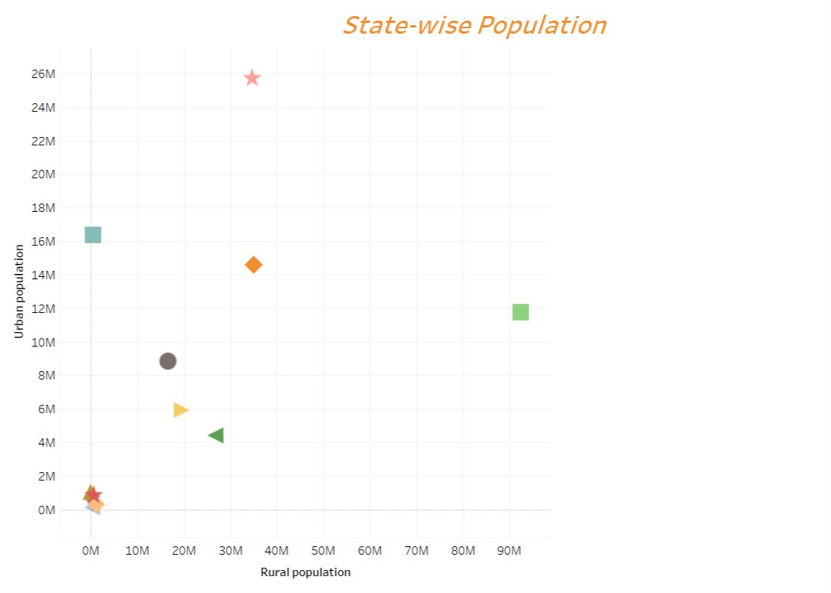
Thanks
2
1
about
4
1
Data_Source
5
6
3
Summary
This is a Dynamic Scatter plot Chart. With the help of this chart, We can see the different Population of different States. The different shapes in the chart is symbol to describe different States. The Population category is divided in two sub-cateagreies. 1= Rural Population and 2= Urban Population. The total of these two sub-categories is Population. The highest Population a state has, the more Covid-cases the State have.

Slide 6
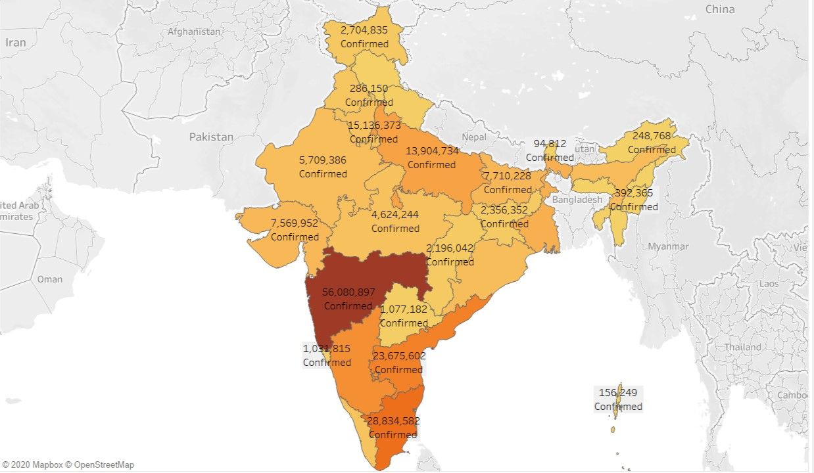
2
2
1
1
Thanks
1
2
about
2
Data_Source
4
2
5
6
3
Summary
This Map Chart is showing the total no of Confirmed , Cured and Death case in a State. In this Chart the darker color is showing the higher no. so if a state is colored in Dark color then People should worry.

Slide 7
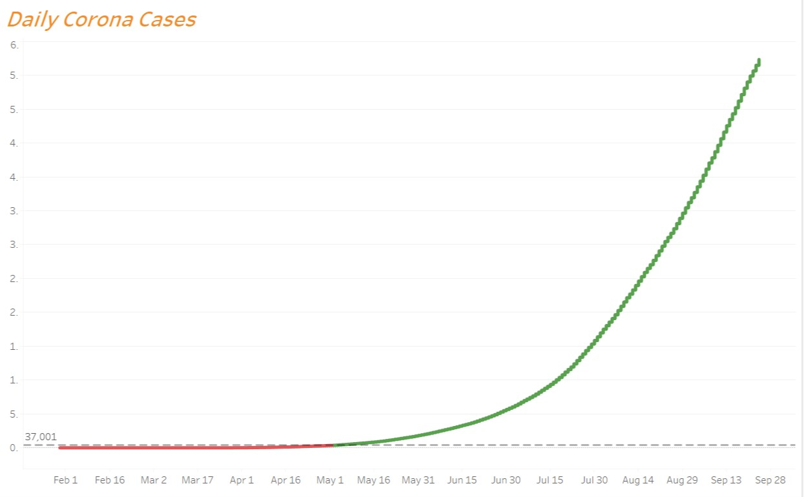
Thanks
2
about
4
Data_Source
5
6
1
1
1
3
Summary
This Line chart is a analysis of Daily Corona cases and it’s outbreak in India. A dynamic Average line is also connected to this Dynamic Line Chart. We can Filter this data with a parameter into three columns. 1= Confirmed cases, 2= Cured cases and Deaths. I have added the colors filter too.

Slide 8
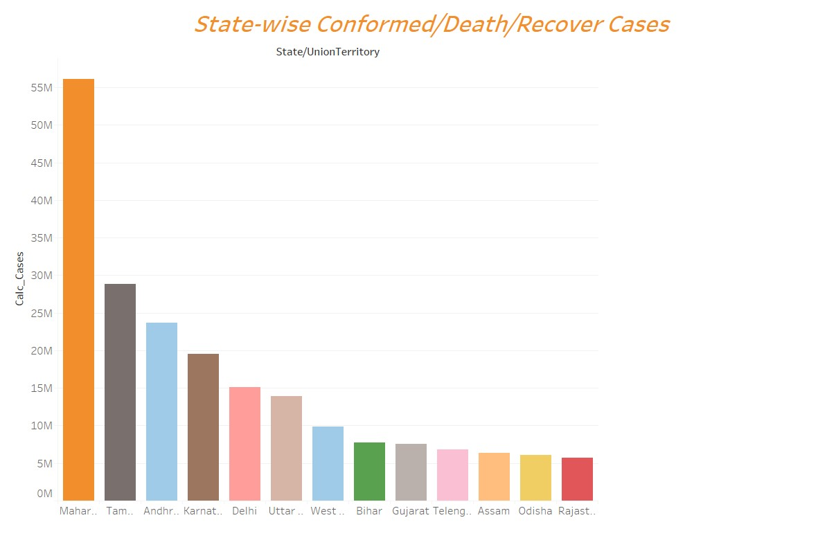
2
about
Thanks
4
1
Data_Source
1
1
5
Summary
6
3
This Color Bar chart is is showing the number of Confirmed covid case, Recovery case and Total Deaths. These bar is showing States name and when you hovering mouse curser over it, you will see the total value in Tooltip box. This Dynamic bar chart is also filter using Parameters.

Slide 9
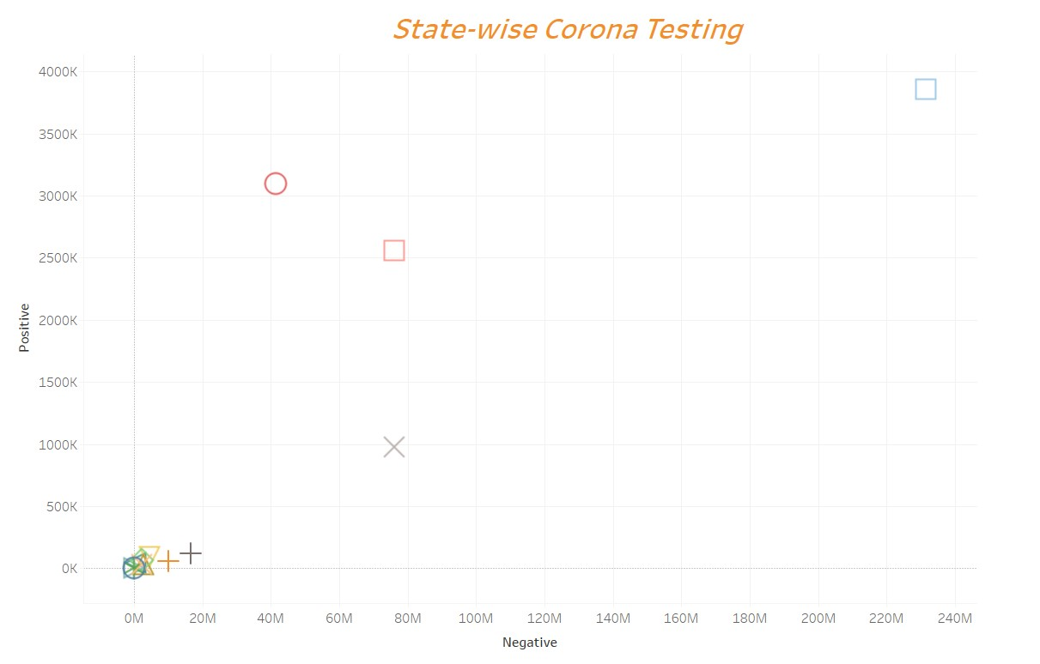
5
2
about
Thanks
4
1
Data_Source
1
6
1
3
Summary
This Scatter Plot chart is showing the results of Covid-19 testing. More a state Test the symptoms, new case will come in light. This is the reason the state with the highest test samples also have the highest Covid patients. These Colored symbols is showing the States rank according to their work.
This Line chart is a analysis of Daily Corona cases and it’s outbreak in India. A dynamic Average line is also connected to this Dynamic Line Chart. We can Filter this data with a parameter into three columns. 1= Confirmed cases, 2= Cured cases and Deaths. I have added the colors filter too.

Slide 10
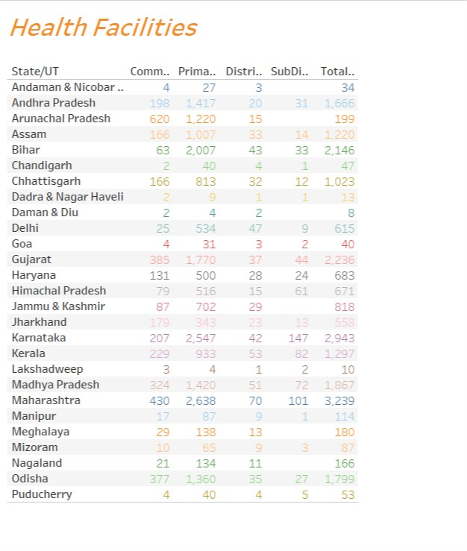
Thanks
2
about
4
Data_Source
5
6
1
1
1
3
Summary
This Dynamic Text Table is giving us a clear view of State’s Health facilities by comparing different State’s Health facilities. This chart look like a simple text table and that’s it’s beauty. There are 5 different columns which is showing Community, Primary, dist and sub-dist Hospitals list.

Slide 11
Thanks
Thanks
4
2
5
6
1
1
1
about
3
Data_Source
Summary

