Slide 1
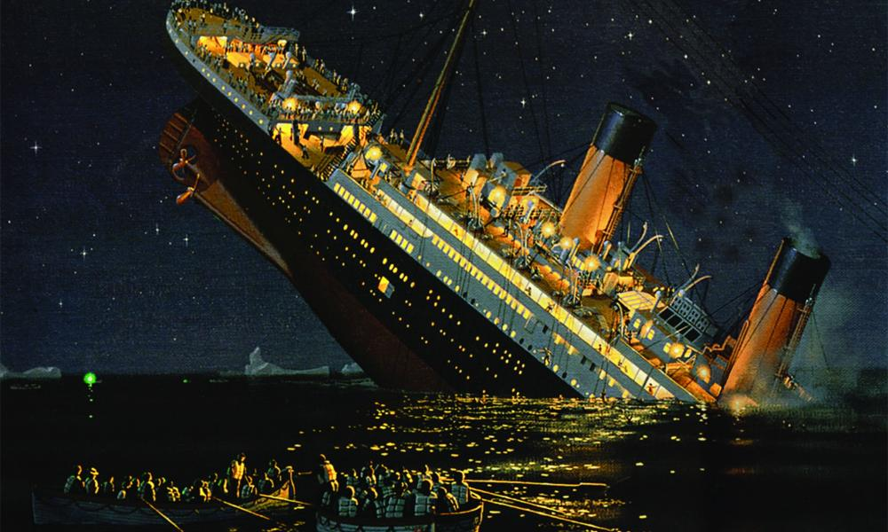
Analysis of Titanic
Submitted By:
Mohammad Dawood

Slide 2

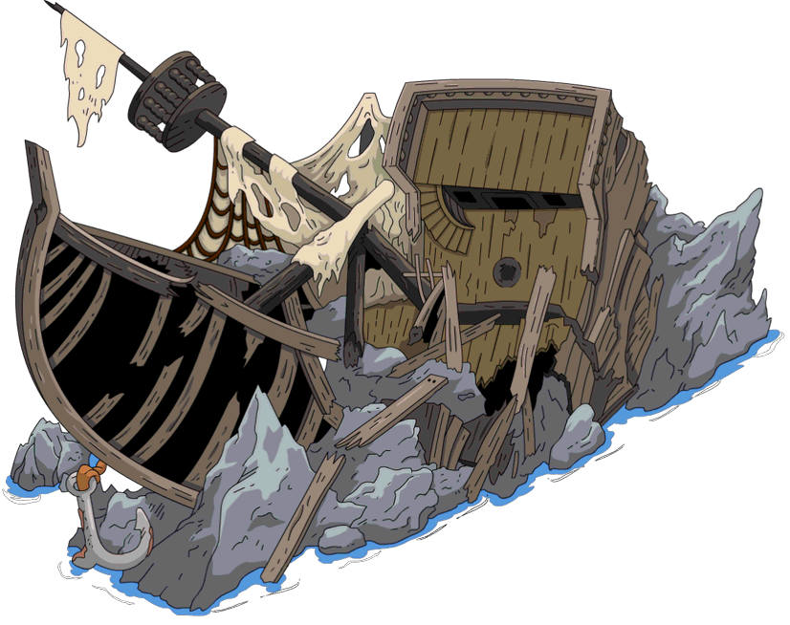
Why we need to analyze Titanic Dataset?
We need to analyze The famous Titanic dataset because It provides information on the fate of passengers on the Titanic, summarized according to economic status (class), sex, age and survival.
Data source
https://www.kaggle.com/c/titanic

Slide 3


Summary
Survived list
We have a list of Survived/Dead people of this Accident. 1 stands for the people who survived and 0 stands for the people who couldn’t. We have 466 Females and 843 Males. Among them only 385 Females and 109 Males could Survive.
Ports
In the Dataset, We have 3 Ports (C,S & Q) from where the people embarked on the Ship. S stands for Southampton, C stands for Cherbourg and Q stands for Queenstown.
1
3
Sex and Class
In the Dataset, we have Sex and Class data. There are 3 class in the ship. In the 1 class, there are 144 Females and 179 males. In the 2 class, there are 106 Females and 171 Males. In the 3 class, there are 216 Females and 493 Males.
2
4
SibSp
We have a list of Siblings and Spouse aboard in the ship. The total number of the siblings and spouse on the ship is 418.
Parch
We have a list of Parents and Children embarked on the Ship. The total number of the parents and the children on the ship is 307.
5
Summary_Video

Slide 4
Object 1 “Survived list”
We have a list of Survived/Dead people of this Accident. 1 stands for the people who survived and 0 stands for the people who couldn’t. We have 466 Females and 843 Males. Among them only 385 Females and 109 Males could Survive. The percentage of survived females is 77.94% and survived males is 22.06%. The total numbers of dead females are 81 and dead males are 734. The total percentage of dead females is 9.94% and dead males is 90.06%.

Slide 5
Object 2 “Ports”
Before the Accident.
After the Accident.
According to dataset, We have information that passengers embarked from the three different ports (C, S & Q) to the ship. S stands for Southampton, C stands for Cherbourg and Q stands for Queenstown. The total number of passengers embarked from Port C is 270. Among them, 113 are females and 157 are males. After the accident 104 females and 29 males survived and the rest of 9 females and 128 males died. The total number of passengers embarked from Port S is 914, among them there are 291 females and 623 males. After the accident 228 females and 77 males survived and the rest of 63 females and 546 males died. The total number of passengers embarked from Port Q is 123, among them, there are 60 females and 63 males. After the accident 51 females and 3 males survived and the rest of 9 females and 60 males died.

Slide 6
Object 3 “Sex ratio and Class”
Before the Accident.
After the Accident.
In the dataset, We have two separate dataset for Sex and Class. There are 2 Columns in Sex, One is females and one is Males. There are 2 different class in the ship, 1, 2 and the 3 class. In the class 1, there are 144 females and 179 males. Among them 141 females and 45 males survived the accident. The rest of 3 females and 134 males either died or lost in the Sea. In the class 2, there are 106 females and 171 males. Among them, 100 females and 17 males survived the accident. The rest of 6 females and 154 males couldn’t save their life. In the class 3, there are 216 females and 493 males. Among them, 144 females and 47 males could save their life. Rest of the 72 females and 446 males died in the Sea.

Slide 7
Object 4 “Age of Passengers”
Before the Accident.
After the Accident.
In the dataset, We can sort passengers according to their Age. We have created 8 different Age groups for the passengers. The first group is 0-10 Age group where the number of females are 39 and males are 43. After the accident, 28 females and 19 males survived while 11 females and 24 males died. The second group is 10-20 age group where the number of females are 64 and males 79. After the accident, 53 females and 7 males survived while 11 females and 24 males died. The third group is 20-30 age group where the number of females are 193 and males 414. After the accident, 156 females and 41 males survived while 37 females and 373 males died. The list goes in the same manner till 70-80 Age group.

Slide 8
Object 5 ``Parents and Children list.``
Before the Accident.
After the Accident.
In the list of Parents and Children, The total number of the Parents and Children embarked on the ship is 307. There are 9 different parch groups and all of them contains different number of people. The total numbers of Females in this group were 173 and the males were 134. After the accident of the ship, only 162 fortunate people survived. The rest 145 people died in the accident. Among them 133 Females survived and only 29 Males survived.

Slide 9
Object 6 ``Siblings and Spouse list``
Before the Accident.
After the Accident.
In the Dataset, We have a list of Siblings and spouse embarked on the ship. The total number of Siblings and Spouse on the ship is 418. In them, there are 214 males and 204 females. There are 7 different groups of Siblings and spouse which all contains different amount of people. After the accident, Only 196 fortunate people survive from this list and 222 people couldn’t survive. Among the survived people, the total number of females are 160 and the total number of males are 36. Among the dead people, the total number of females are 44 and the total number of males are 178.

Slide 10
Object 7 “Average age of passengers”
Before the Accident.
After the Accident.
In the dataset, We have The Age of the passengers and by using it we can create the Average age of Males and Females passengers. The total number of female passengers on the ship is 466 and their Average age is 29. The total number of male passengers on the ship is 843 and their Average age is 30. After the Accident, the total number of survived female passengers are 385 and their Average age is still 29. The total number of survived male passengers are 109 and their Average age is 28. The count of dead female passengers are 81 and their Average age is 26. The count of dead male passengers are 734 and their Average age is 31.

Slide 11
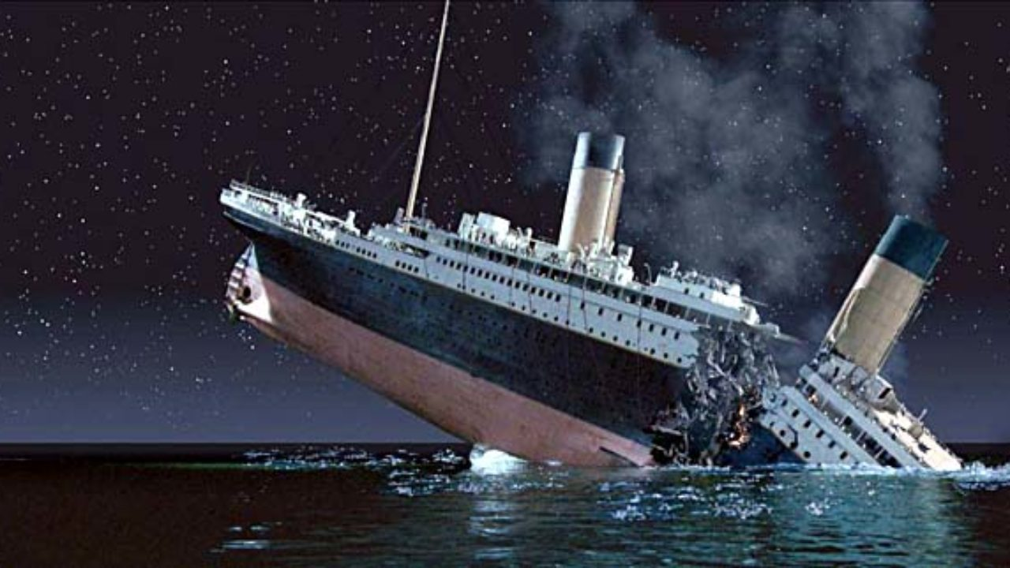
Conclusion
After analyzing the Data of Titanic, We can understand some Conclusion points →
The highest number of people embarked in The Titanic was from the Southampton Port.
The total number of passengers embarked on ship are 1309 among them 466 are females and 843 are males.
77.94% females and 22.04% males Survived in this tragic accident. 9.94% females and 90.06% males lost their life in this accident.
There are 3 class in the Titanic. The causalities of 1 class is very low in compare to the 3 class.
The passengers are from 0.17 year old to 80 year old but the highest number of passengers are from the Age group of 20-30.
There are some Parents-children group and also some siblings-spouse groups on the ship.
The average age of females passengers is 29 and the average age of male passengers is 30.

Slide 12
Thank you

