Slide 1
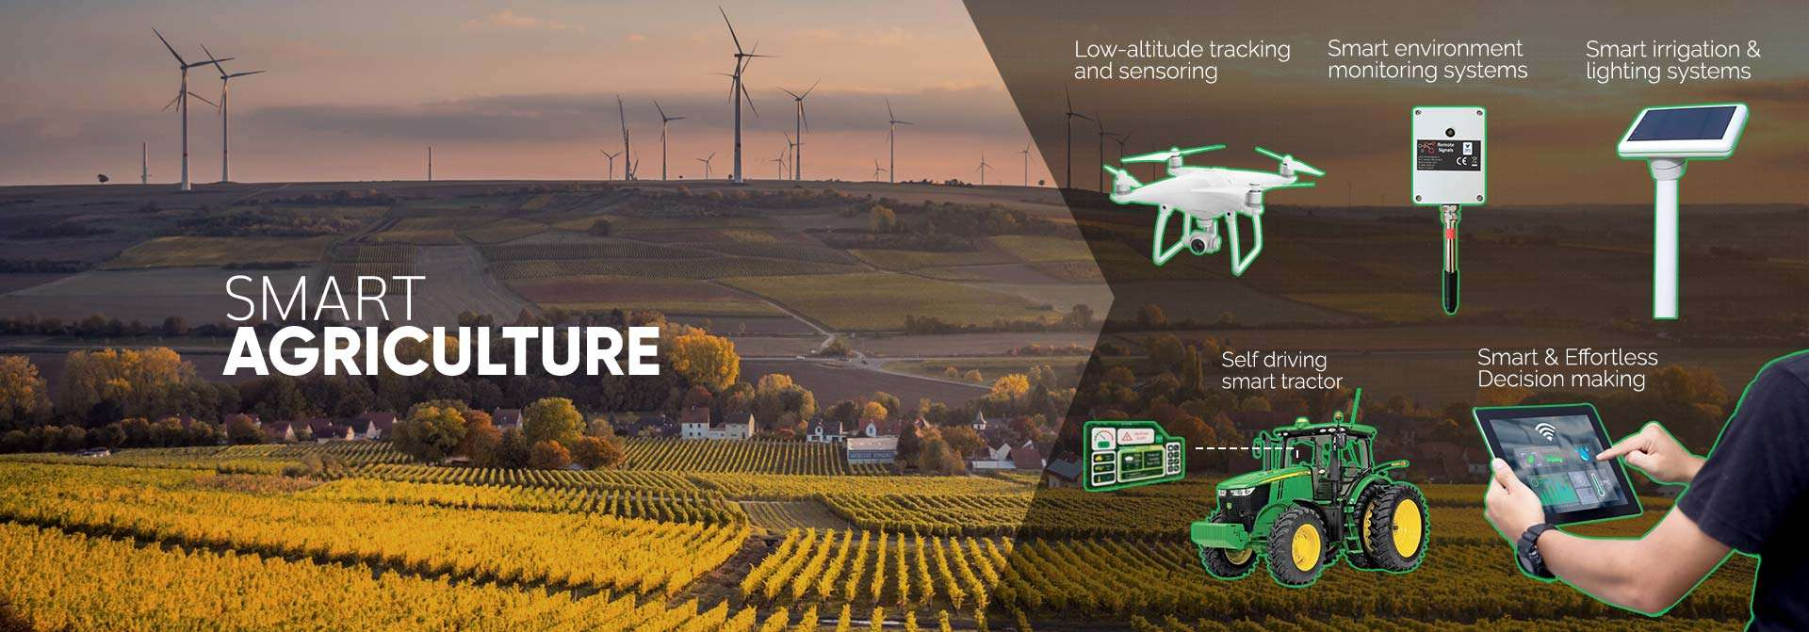
SYSTEM
SUBMITTED BY:-
MOHAMMAD FAIZ
MERAJ HUSSAIN KHAN
NABEEL SIDDIQUE
MOHAMMAD AASIF
SUBMITTED TO:-
Mr. ANAS HABIB ZUBERI

Slide 2
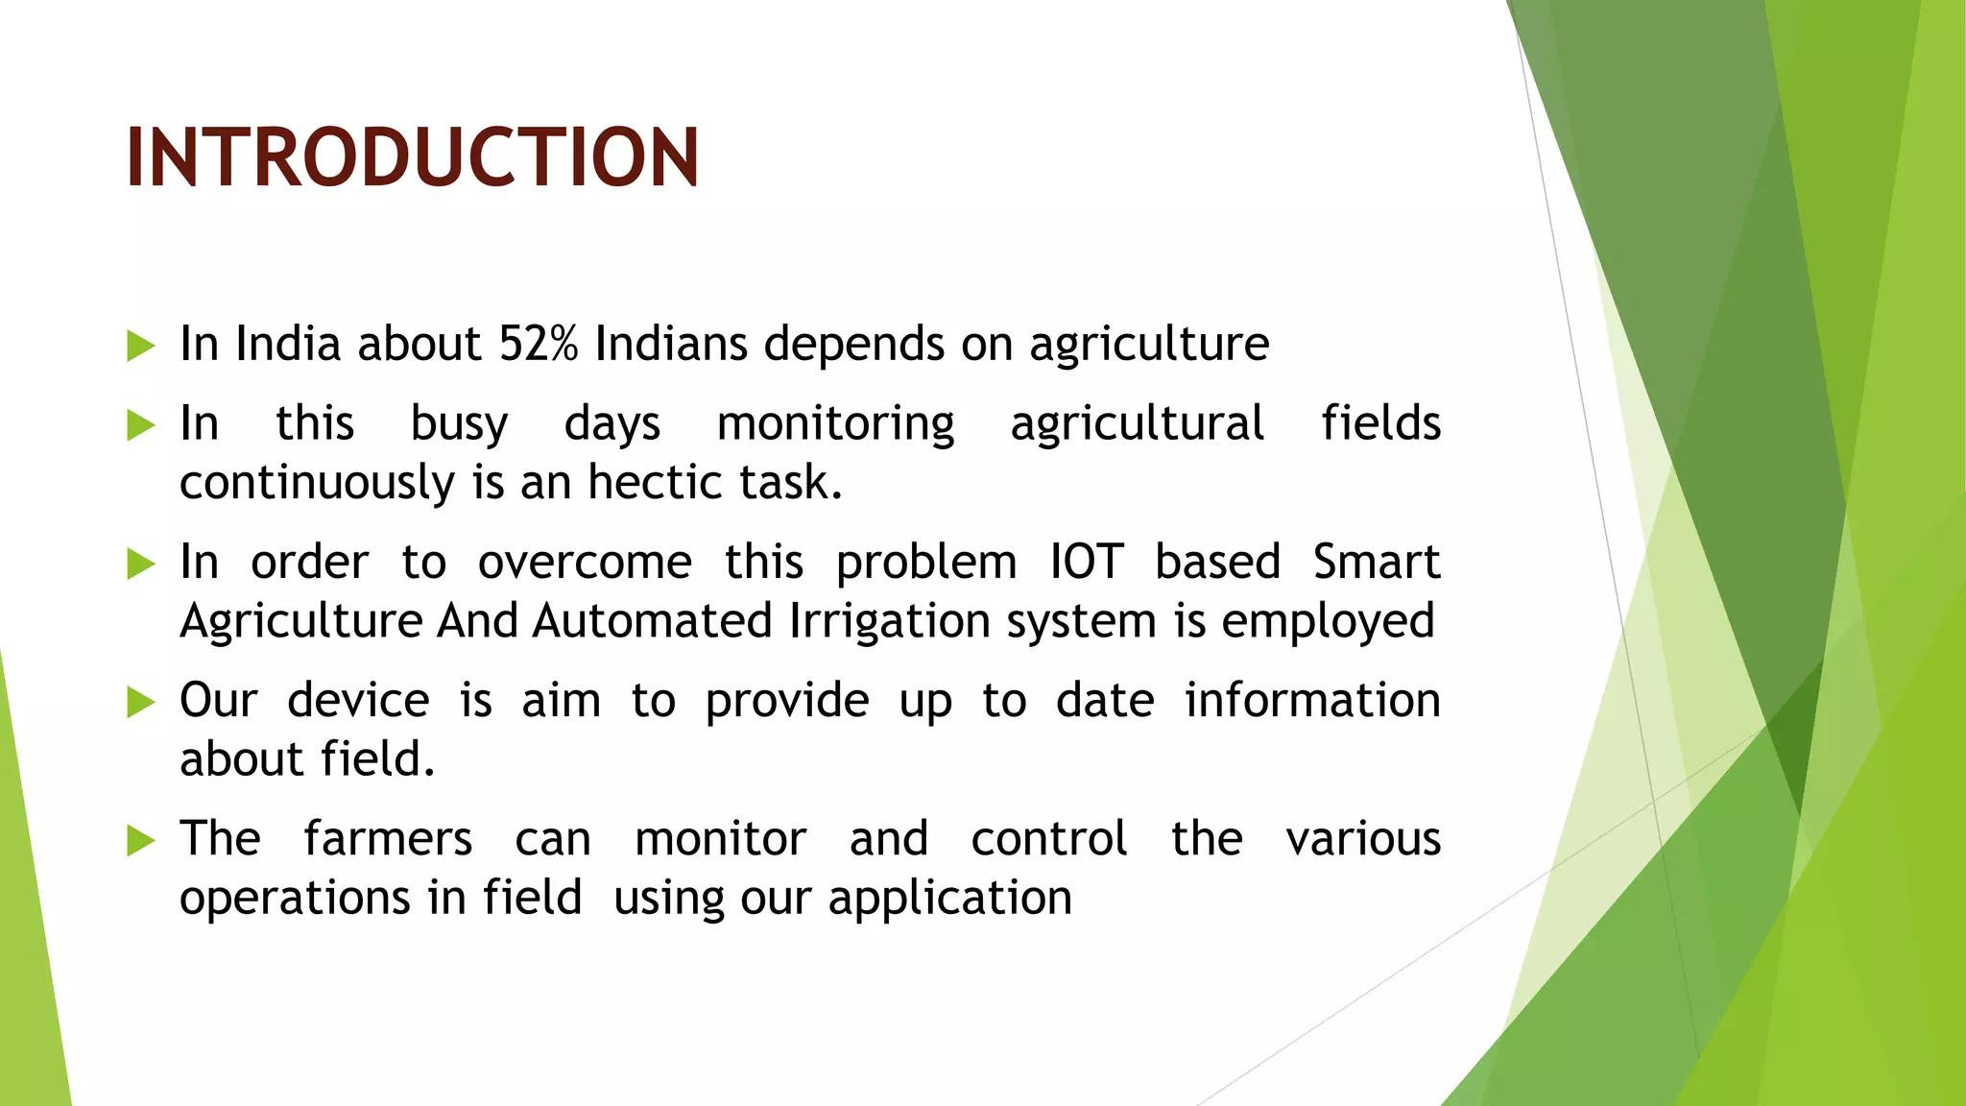

Slide 3
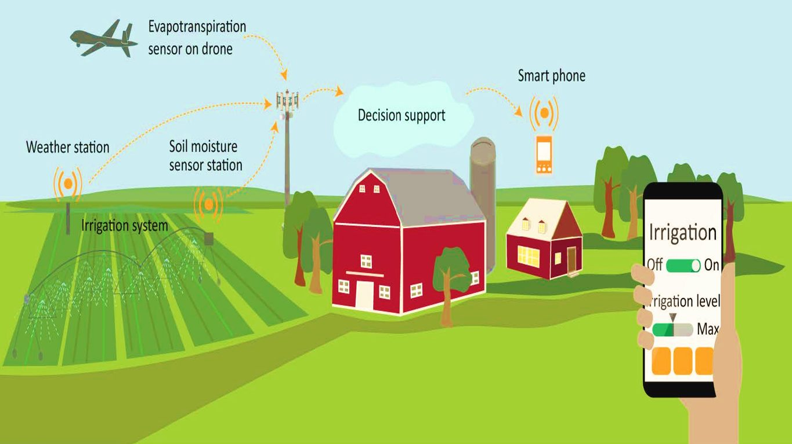

Slide 4
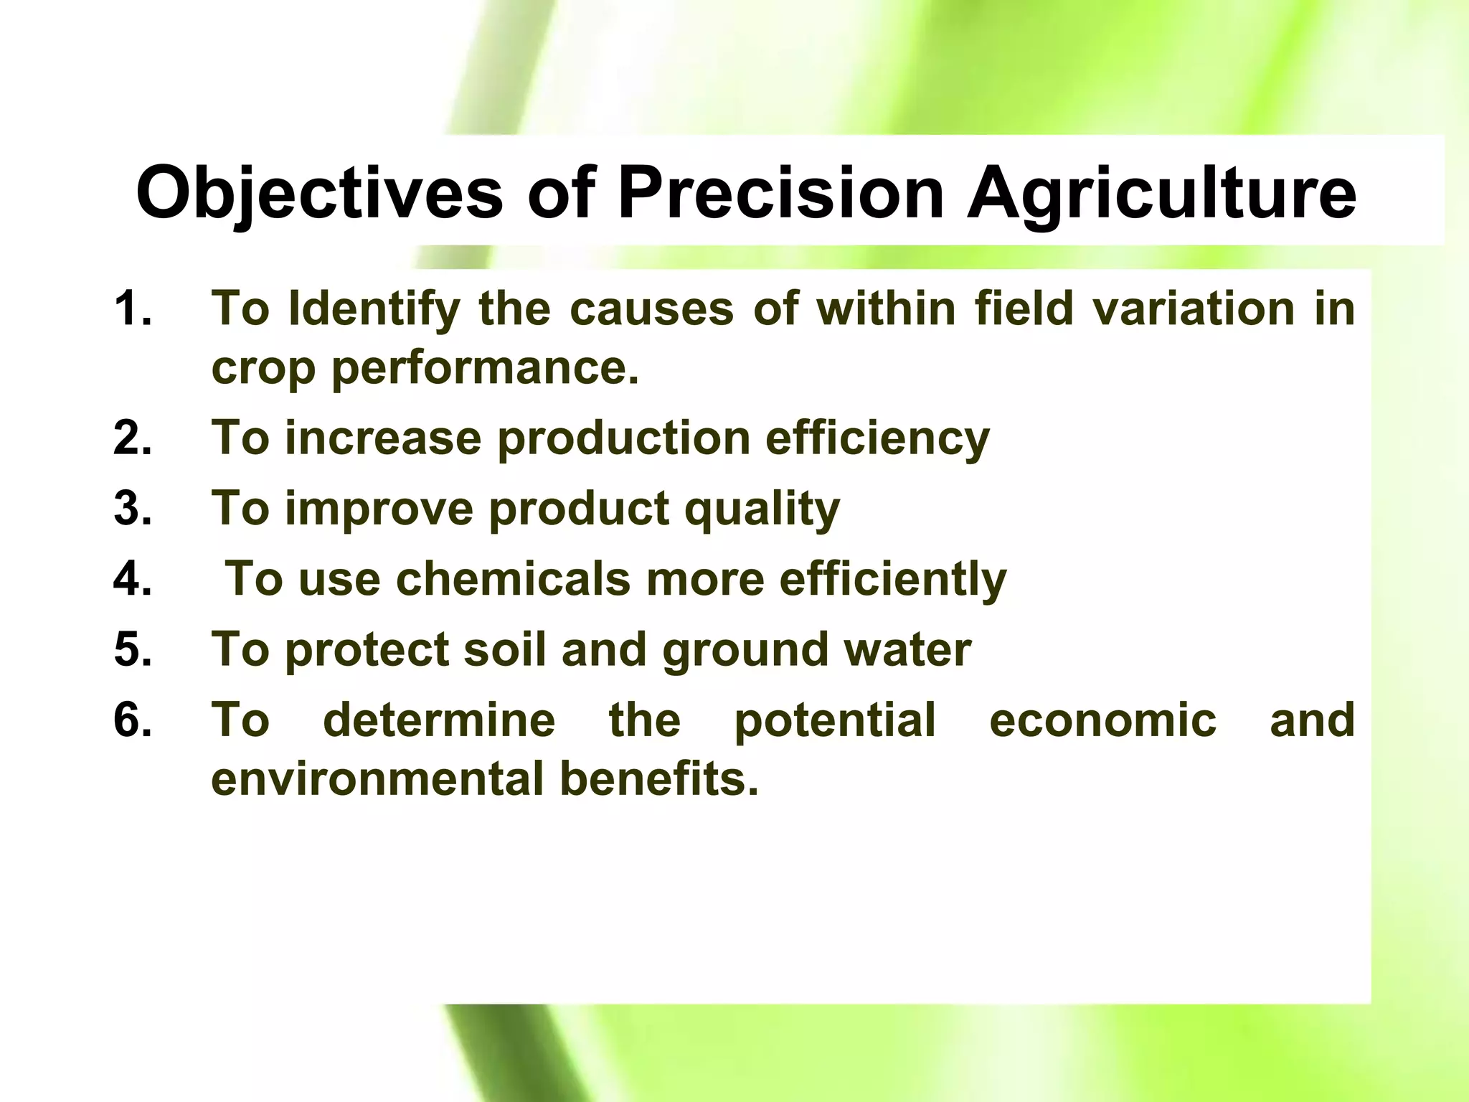

Slide 5
What is a Modular Approach? Definition: A design strategy that divides the smart agriculture system into distinct, interchangeable components (modules), each responsible for a specific function.
Benefits of a Modular Approach in Smart Agriculture:
Flexibility:
Easily add or upgrade individual modules (e.g., sensors, irrigation systems) without overhauling the entire system.
Scalability:
Scale up by adding more modules (e.g., additional sensors for larger fields) based on specific needs.
Easier Maintenance:
Isolate and troubleshoot issues in one module without disrupting other parts of the system.
Improved Collaboration:
Different teams can work on separate modules (e.g., one team on data analytics, another on user interface) concurrently.
Cost Efficiency:
Invest in and optimize specific modules, allowing for phased upgrades and reducing upfront costs.

Slide 6
Module:-1 SENSORS Overview of Sensors in Smart Agriculture Purpose: Collect real-time data on environmental and soil conditions to optimize farming practices.
Types of Sensors:
Soil Moisture Sensors:
Measure moisture levels in the soil to determine irrigation needs.
Prevent over- or under-watering.
Temperature and Humidity Sensors:
Monitor ambient conditions affecting plant growth.
Help in managing greenhouse environments.
Nutrient Sensors:
Assess soil nutrient levels (N, P, K).
Enable targeted fertilization.

Slide 7
Module 2: Data Processing Overview of Data Processing in Smart Agriculture Purpose: Transform raw data collected from sensors into actionable insights for decision-making.
Key Components of Data Processing:
Data Collection:
Aggregate data from various sensors (soil moisture, temperature, humidity, etc.).
Use IoT protocols (e.g., MQTT, HTTP) for efficient data transmission.
Data Storage:
Utilize cloud storage or local databases for secure data management.
Ensure scalability to handle large volumes of data.
Real-Time Processing:
Implement edge computing to process data closer to the source.
Enable immediate responses to critical conditions (e.g., triggering irrigation).
Data Visualization:
Create dashboards to present data in user-friendly formats.
Use charts and graphs for easy interpretation of trends and insights.

Slide 8
Module 3: User Interface Overview of the User Interface (UI)Purpose: Provide farmers with an intuitive platform to monitor, control, and analyze their agricultural operations.
Key Features of the User Interface:
Dashboard:
Centralized view of all sensor data (soil moisture, temperature, humidity).
Visual representation of key metrics (graphs, gauges).
Alerts and Notifications:
Real-time alerts for critical conditions (e.g., low moisture levels, pest detection).
Customizable notification settings (SMS, email, app notifications).
Control Systems:
Remote control of irrigation systems and other automated processes.
Scheduling options for irrigation and fertilization based on data insights.
User-Friendly Design:
Simple navigation and layout for ease of use, even for non-tech-savvy users.
Mobile app compatibility for access on-the-go.

Slide 9
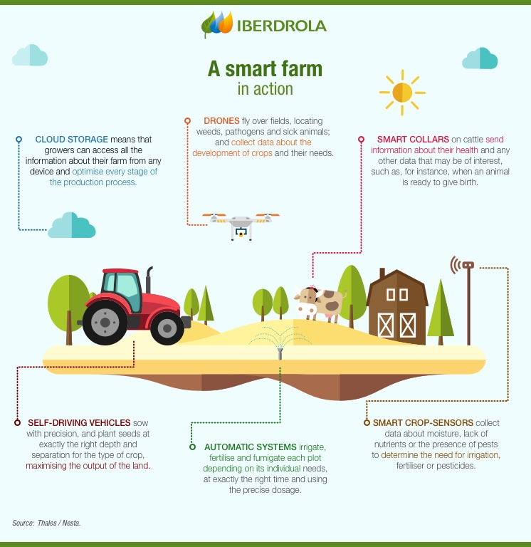

Slide 10
METHODOLOGY Overview of Methodology A structured approach to developing the smart agriculture system, ensuring all components work cohesively.
Key Steps in the Methodology:
Research and Requirement Analysis:
Gather information on farming needs and existing technologies.
Identify specific challenges faced by farmers.
System Design:
Define system architecture and select appropriate technologies (sensors, IoT platforms, etc.).
Design individual modules (sensors, data processing, user interface).
Testing and Validation:
Conduct field tests to evaluate system performance.
Collect feedback from farmers for improvements.
Deployment:
Roll out the system to selected farms.
Provide training for end-users on system operation.
Monitoring and Maintenance:
Continuously monitor system performance.
Regularly update software and hardware as needed.

Slide 11
Project Planning Overview of Project Planning A detailed plan to ensure timely and successful implementation of the smart agriculture system.
Key Components of the Project Plan:
Timeline:
Define phases of the project with estimated completion dates (e.g., research, design, testing, deployment).
Resource Allocation:
Identify team members and their roles (e.g., developers, agronomists).
Allocate budget for hardware, software, and training.
Milestones:
Set key milestones to track progress (e.g., completion of prototype, successful field tests).
Risk Management:
Identify potential risks (e.g., technical failures, budget overruns) and develop mitigation strategies.
Feedback Loop:
Establish a system for continuous feedback from farmers to improve the system post-deployment.

Slide 12
Challenges and Solutions
Common Challenges in Smart Agriculture Systems
Data Privacy and Security:
Challenge: Concerns over unauthorized access to sensitive data collected from farms.
Solution: Implement strong encryption protocols and access controls to protect data.
System Integration:
Challenge: Difficulty in integrating various modules (sensors, data processing, user interface).
Solution: Use standardized communication protocols and APIs to ensure compatibility between components.
Technical Literacy:
Challenge: Farmers may lack the technical skills to use advanced technology.
Solution: Provide comprehensive training and support to users, including user manuals and tutorials.
Reliability of Technology:
Challenge: Dependence on technology can lead to issues during system failures or outages.
Solution: Develop backup systems and fail-safes, and ensure regular maintenance and updates.
Cost of Implementation:
Challenge: High initial costs can deter farmers from adopting smart agriculture technologies.
Solution: Explore partnerships with agricultural organizations or government grants to subsidize costs.

Slide 13
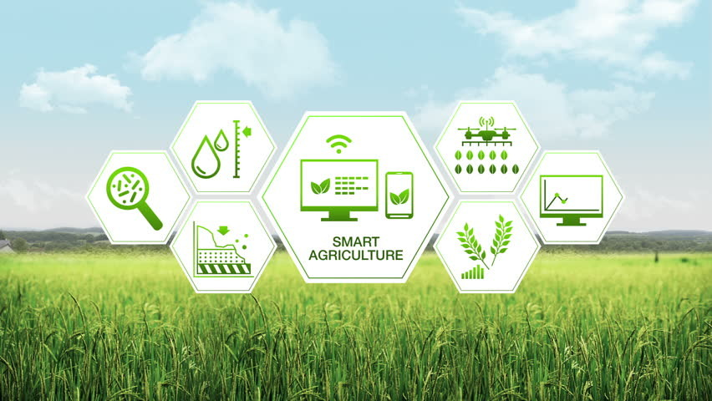

Slide 14
Future Work
Potential Enhancements for the Smart Agriculture System
AI and Machine Learning Integration:
Goal: Improve predictive analytics for crop yield, pest control, and disease prevention.
Approach: Develop models that learn from historical data to make real-time recommendations.
Advanced Sensor Technology:
Goal: Implement next-gen sensors for more precise data collection (e.g., nutrient sensors, drone technology).
Approach: Research and integrate emerging sensor technologies for enhanced monitoring capabilities.
Automated Decision-Making:
Goal: Enable autonomous systems for irrigation and fertilization based on data analysis.
Approach: Develop algorithms that automatically adjust systems without manual intervention.
Integration with Supply Chain:
Goal: Connect smart agriculture systems with supply chain management tools for better resource allocation.
Approach: Use data to optimize logistics, inventory, and distribution based on real-time farm conditions.
User Feedback and Iterative Development:
Goal: Continuously improve the system based on user feedback.
Approach: Establish regular feedback loops with farmers to refine features and usability.
Sustainability Practices:
Goal: Focus on eco-friendly practices to promote sustainable agriculture.
Approach: Integrate features that monitor and reduce carbon footprints and promote biodiversity.

Slide 15
CONCLUSION
Key Takeaways
Enhanced Agricultural Efficiency:
The smart agriculture system leverages technology to optimize resource use, increase crop yields, and reduce waste.
Modular Design:
A modular approach allows for flexibility, scalability, and easier maintenance, making it adaptable to various farming conditions.
Real-Time Insights:
Data processing and visualization provide farmers with actionable insights, enabling informed decision-making and timely interventions.
User-Centric Interface:
A well-designed user interface ensures that technology is accessible, even for those with limited technical skills.
Future Growth Potential:
Ongoing advancements in AI, sensor technology, and sustainability practices promise to further enhance the system’s capabilities and impact.

Slide 16
