Slide 1

Project

Slide 2

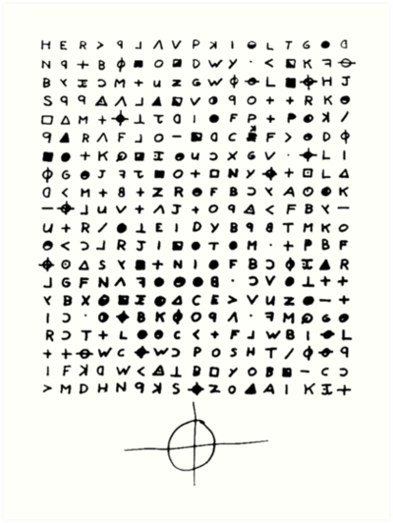
Project
In your final project for this part of the course, you will create a decoding algorithm.
Imagine that you received a secret text file from Israeli intelligence forces. The text in the text file is encrypted. Every letter in the text replaced by a different letter in the English alphabet.
Example:
Original text: AB DMF GR YGI
Decrypted text: MY CAT IS BIG.
Letters:
M=A, Y=B, C=D, A=M, T=F, I=G,
S=R, B=Y and G=I

Slide 3
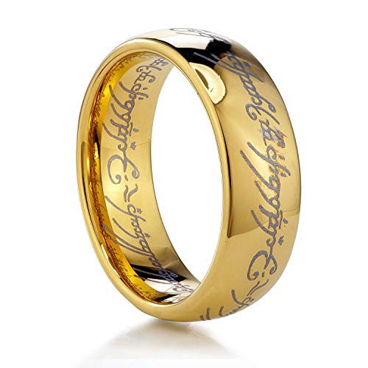
Your text file
'Puackich, hvhnkrally oaths phufhck. All ymr nhhd is Pykemn.'
J.U.U.U Kmltin.
mmps iks nmk eio; ---> hkmu

Slide 4
Part1
You can notice that some letters are more common and some letters are less common in the text.
In order to read the encrypted text suddenly a brilliant idea appears in your head. You want to replace 4 most common letters in the text with 4 most common letters in the English language ‘e’,’t’,’o’,’r’.
Assume that if for example, ‘a’ is the most common then it will be replaced by the letter ‘e’ and the letter ‘e’ will be replaced by the ‘a’.
After these changes will receive 8 changed characters.

Slide 5
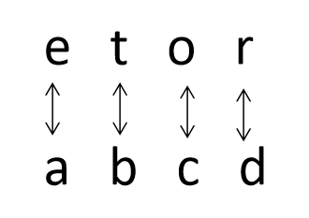
Part1 continue
For example: If the most common letters are ‘abcd’, than the replacement will be:
In the first part please create a function that will include the most common letters and their replacers. The function will receive a text as a string and will return the relevant dictionary.
For example:
{'a': 'e', 'c': 'o', 'b': 't', 'e': 'a', 'd': 'r', 'o': 'c', 'r': 'd', 't': 'b'}

Slide 6
Part 1 notes
The dictionary will not include letters that weren’t changed.
Some characters may be not letters, numbers, spaces, etc. Please specify your code just on letters search.
Your code must be case insensitive but in your dictionary please present just the lower case of the letters.
Please consider:
There are at least four different letters in your text.
For every popular letter, there is no letter that appears the same number of times.
The most popular letters are different from ‘e’,’t’,’o’,’r’

Slide 7
Part 2
Write a function that will receive a text as a string and the dictionary that you built in the previous part.
The function will go over every character in your string. If a character will be found as a key in your dictionary, then you will replace the character in the string with the key value.
In case that a character doesn’t appear in your dictionary then the character will stay the same.
The function will return the changed text file.
For example:
Original text: ('///bha Taa3add, bha Tdaer, enr b7ha Fdcccccbbb...')
The dictionary that we created in the first part is:
{'a': 'e', 'c': 'o', 'b': 't', 'e': 'a', 'd': 'r', 'o': 'c', 'r': 'd', 't': 'b'}
The returned string will be:
('///the bee3err, the bread, and t7he frooooottt...‘)

Slide 8
Part 3
Create a function that will receive as an input a path to the text file that includes the encrypted text.
The function will use functions from part 1 and part 2 and will add the decrypted text to the original text file.
First of all please add the following line to the end of your original text file: ‘The encryption for the above text is’:
Make the function create another txt file called results.txt that will contain just the decrypted text results.
Example:
Original text file:
///bha Taa3add, bha Tdaer, enr b7ha Fdcccccbbb…
Translated text file:
///bha Taa3add, bha Tdaer, enr b7ha Fdcccccbbb…
The encryption for the above text is:
///the bee3err, the bread, and t7he frooooottt...

Slide 9
Part 3 notes
The function will not return anything it will just update the text file.
The common character search must be done on all text file and not line by line.
Please ignore the \n characters.
The text message file will be added to the project description as well.

Slide 10
Part 4
Now after you finished to decrypt the message you like to use the information that was written to your new text file.
Create a function that will find the longest word in the results.txt file, please count in each word just alphabetical characters.
Put all words that have the maximum size of into a list. Please return the list of the longest words.
Hint: In order to remove all non alphabetical characters use the following command:
Import re
regex = re.compile('[^a-zA-Z]')
list[i] = regex.sub('', <Your string>)

Slide 11
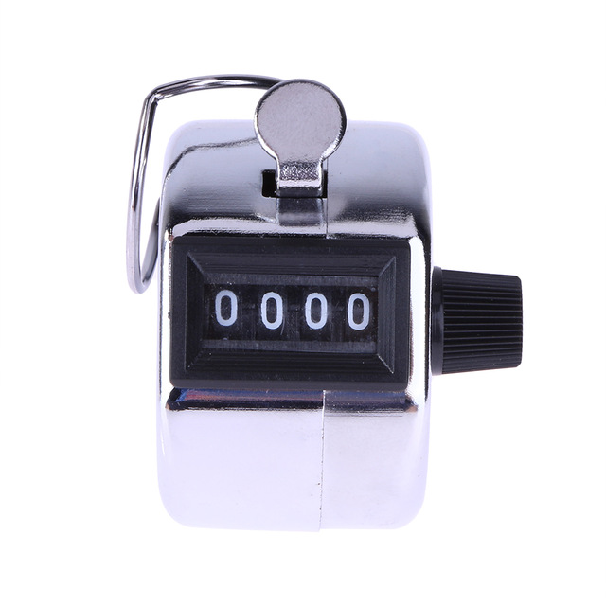
Part 4 continue
Create a function that will count the number of lines in the results.txt file. The function will return the number of lines in the text file.

Slide 12

Conclusion
Finally, our “Mossad” agent needs to receive your decrypted message with several agreed marks in the message, in order to do so we will declare our main function.
Your main function will decrypt your encrypted message as was mentioned in parts 1,2 and 3. After it, the function will write to the original message file the first value of the longest words list that you are created in the first function of part 4 by a number of times that you received from the function that counted the number of lines in the results file.
For example:
Your longest word is “BOOBOBA”
The number of lines is 2.
Then the text that will be added to the file will be:
BOOBOBA BOOBOBA

Slide 13
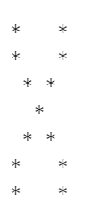

Conclusion continue
The final mark is:
Please write this mark to your original text file in your main function.
Reminder: In order to execute your main function please run the following command line:

Slide 14
Thank you for your time

