Slide 1
SENSORS AND ACTUATORS
INTRODUCTION:
Presented by: Mohammad Mohid & Muhammad Asad
Subject: ICT
Program: Bs Data Science
Semester: I

Slide 2
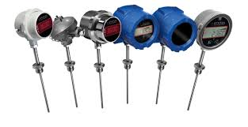
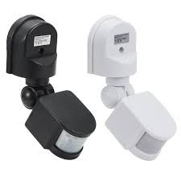
SENSORS:
DEFINITION:
Devices that detect and measures physical changes or environmental changes.
PURPOSE:
Sensors allow machines and systems to interact with the physical changes.
EXAMPLE:
Temperature sensors, motion detectors, etc.

Slide 3
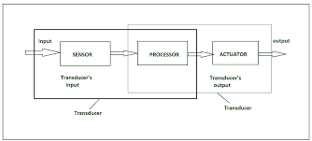
WORKING OF SENSORS:
BASIC PRINCIPLE:
Detect changes in the environment (e.g., light, heat, motion, pressure).
Changes are converted into an electrical signal or data.
Data is then processed or transmitted.

Slide 4
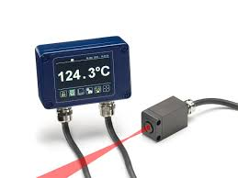
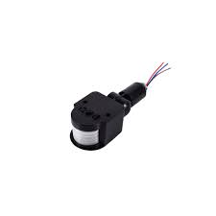
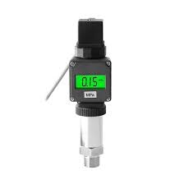
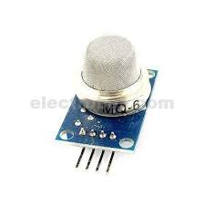
TYPES OF SENSORS:
Temperature Sensors:
Measure temperature; e.g., thermocouples, thermistors.
Motion Sensors:
Detect movement; e.g., PIR (Passive Infrared), radar.
Pressure Sensors:
Measure the force exerted by a fluid or gas; e.g., piezoelectric sensors.
Gas Sensors:
Detect specific gases; e.g., carbon dioxide (CO₂), methane (CH₄), or oxygen (O₂) sensors.
Etc.

Slide 5
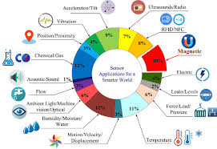
APPLICATION OF SENSORS:
Automotive:
Sensors in cars for ABS, parking assistance
Healthcare:
Wearable sensors for heart rate, blood pressure monitoring
Home Automation:
Smart homes use sensors for lighting, climate control, and security systems.
Environmental Monitoring:
Sensors for detecting pollution levels, weather, and natural disasters.

