Slide 1
Fog hits one airport.
Three airports still react alone.
THE PROBLEM
19
flights diverted from Dubai International by fog in one morning
Each other's backup airports
but each plans its own recovery. Nobody plans the network.
SHJ
Gulf News, 20 Nov 2025
18.2%
of UAE GDP comes from aviation and the tourism it brings
DXB
IATA, Apr 2025
$200
a minute: what extra flying can cost when a wide-body diverts
AUH
fog
R.W. Mann, via The Points Guy, 2017
Notes:
About 30 seconds, then go to the next slide: the demo video starts on its own.
Last November, fog diverted 19 flights from Dubai International in a single morning. Aviation and the tourism it brings are about 18 percent of the UAE's economy, and every diversion burns money: up to 200 dollars a minute for a wide-body.
Abu Dhabi, Dubai and Sharjah are each other's backup airports, but each one plans its own recovery. Nobody plans the network. That is the gap SKYPACT closes.

Slide 2
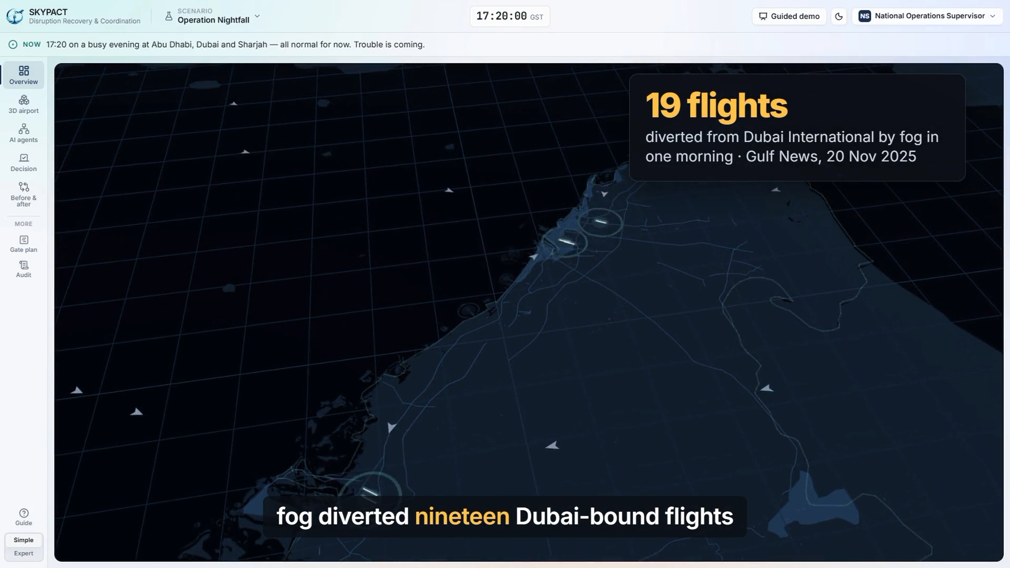
Notes:
The two-minute demo plays by itself when this slide opens (2:00, narrated). If it does not start, click it once. Advance when it ends.

Slide 3



One plan for all three airports,
approved by people in minutes
THE VALUE
Simulated fog evening at Abu Dhabi, 18:00 to 22:00
Who it pays off for
29 → 5
−60%
GCAA
One live picture of all three airports, every decision logged and replayable
low-fuel emergency diversions
time planes spend circling
Airports
Diverted flights arrive planned, gates already reserved
7 → 0
< 6 min
Airlines
Fewer diversions; each one avoided saves tens of thousands of dollars
gate clashes on arrival
from fog to an approved plan
Model annual licence per airport, deployed on-premises Next a 90-day shadow pilot on one airport pair
Results from SKYPACT's simulation of one fog evening on real airport layouts, with synthetic flights. Diversion cost: industry estimates.
Notes:
About 30 seconds, after the video.
In our simulated fog evening, coordinating all three airports cut low-fuel diversions from 29 to 5 and time spent circling by 60 percent, and every stakeholder approved the plan in under six minutes.
GCAA gets one live picture and a full audit trail. Airports get diverted flights that arrive planned. Airlines avoid diversions that cost tens of thousands of dollars each.
We license it per airport and it runs on-premises. Our ask: a 90-day shadow pilot on one airport pair, where SKYPACT advises and people decide.

