Slide 1
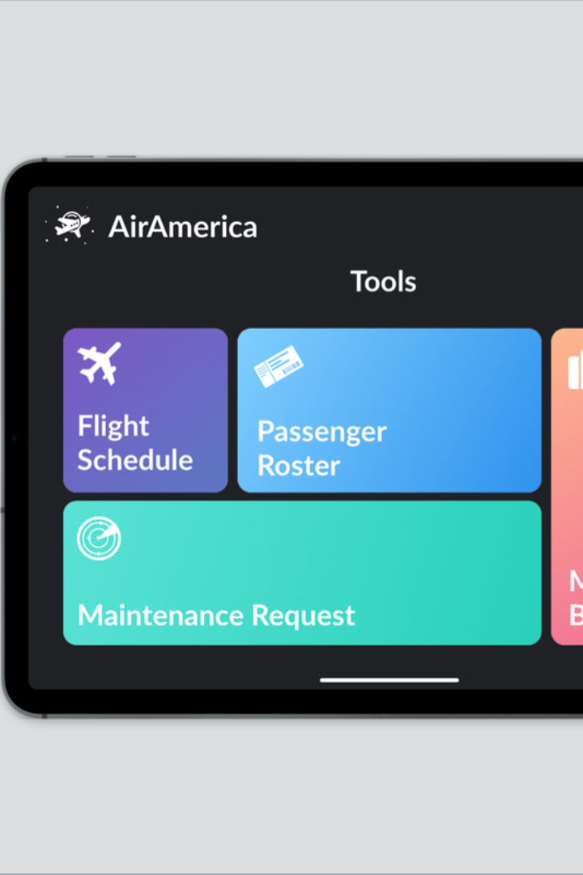
Mini-Project Airlines Database Management
Welcome to the world of Mini-Project Airlines Database Management! In this presentation, we will explore the purpose, design, management, and development of an airline database system.
M
Mohammad Zaafir
M
MANOHARA M
N
NITHIN

Slide 2
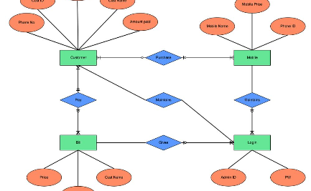
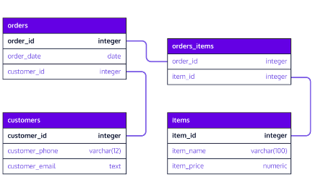
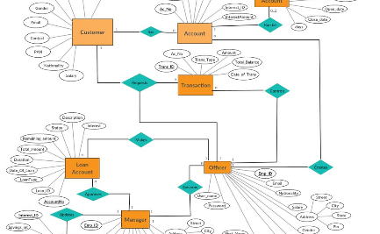
Database Design
Entity-Relationship Diagram
Schema and Tables
Attributes and Relationships
Explore the structure of the database, including the different tables and their attributes.
Discover the visual representation of the database's entities and relationships.
Dive deeper into the details of the attributes and relationships between the entities.

Slide 3

Database Management
Data Import and Export
Data Query and Manipulation
Learn how to efficiently import and export data into and out of the airline database.
Discover powerful techniques to query and manipulate data to extract valuable insights and optimize operations.
Security and Access Control
Explore the importance of maintaining data security and implementing access controls to protect sensitive information.

Slide 4

Objectives
Efficient Flight Management
Streamlined Reservation System
Passenger Information Management
Staff and Crew Management
Data Security and Compliance
User Authentication and Authorization
Integration with External Systems
Scalability
Reporting and Analysis
User Experience Enhancement
Testing and Quality Assurance
Feedback System

Slide 5
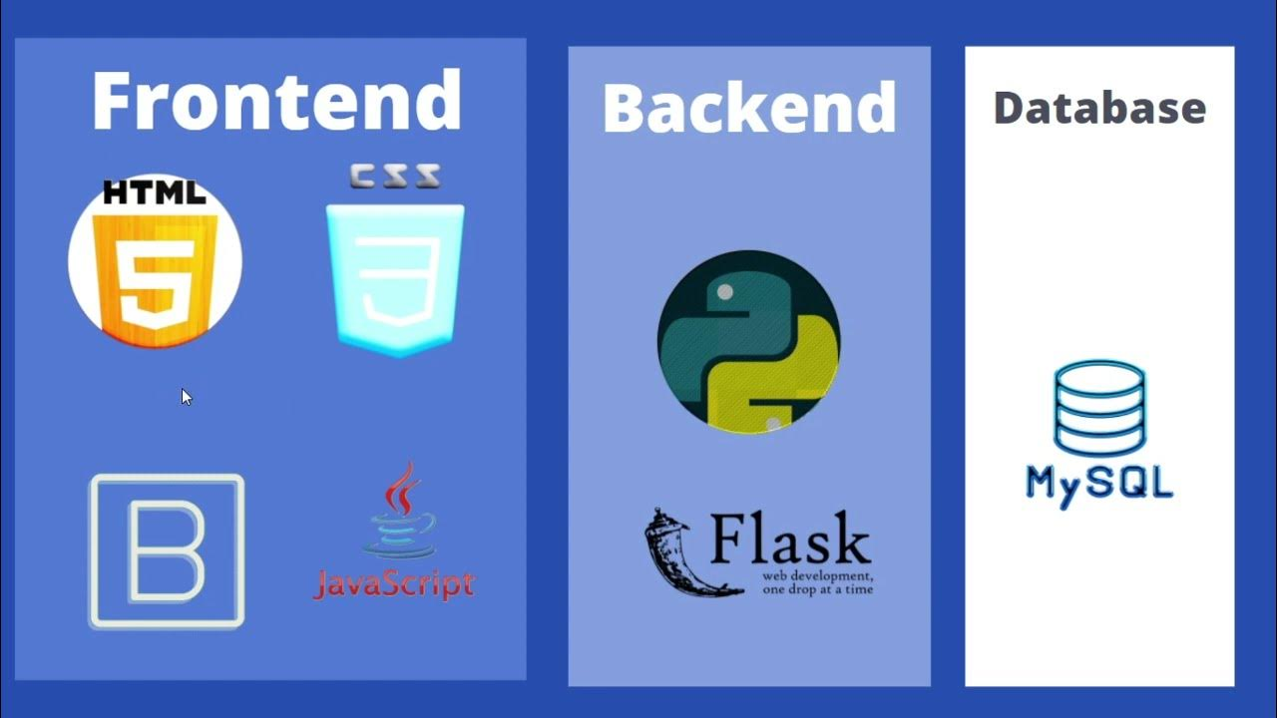

Slide 6


Slide 7

Conclusion
Providing a Web Application Which has More Compatibility and User Friendly Features.

Slide 8


